Slide 1

Marketing Analytics
Based on First Principles :
Chapter 15
Using Marketing Mix Models to Optimize the Marketing Mix

Slide 2
Agenda
Learning Objectives
Introduction
  Overview
Estimating a Marketing Mix Model
  Omitted Variable Bias
  Unit Root Problems
  Multicollinearity
  Elasticities
  Price Cutting and Price Elasticities
Summary
Takeaways

Slide 3
Learning Objectives
Know what an omitted variable bias in OLS regression is and what the underlying causes of an omitted variable bias are.
Understand how dummy variables (for example, brand-specific dummy variables) can be used to at least partially address an omitted variable bias. Be able to explain how dummy variables shift the intercept of an OLS regression model up or down.
Be able to explain what a unit root problem is and how it can be diagnosed.
Explain what to do when a unit root problem is present.
Understand what multicollinearity is and how it impacts the results in an OLS regression model. Also, be able to explain how multicollinearity can be detected and what can be done to address multicollinearity problems in an OLS regression model.
Know what elasticities are and how (for example) price and advertising elasticity can be calculated using OLS regression
Explain how to interpret elasticities based on OLS regression results.

Slide 4
Agenda
Learning Objectives
Introduction
  Overview
Estimating a Marketing Mix Model
  Omitted Variable Bias
  Unit Root Problems
  Multicollinearity
  Elasticities
  Price Cutting and Price Elasticities
Summary
Takeaways

Slide 5
Overview
The 4 Ps are the marketing mix
  Product
  Price
  Place
  Promotion
Price and most elements of the promotional mix (e.g., advertisements) can usually be changed fairly quickly.
Product and place changes often require more lead time.
Hence, marketing mix models often focus on the market’s response to changes in price and promotion while controlling for the impact of changes pertaining to product and place.

Slide 6
Agenda
Learning Objectives
Introduction
  Overview
Estimating a Marketing Mix Model
  Omitted Variable Bias
  Unit Root Problems
  Multicollinearity
  Elasticities
  Price Cutting and Price Elasticities
Summary
Takeaways

Slide 7
Estimating a Marketing Mix Model
Marketing mix models usually include several independent (i.e., predictor) variables. Including more than one independent variable often improves model fit. However, when building marketing mix models, there are several modeling challenges that need to be taken into consideration. We discuss some of these challenges next.
When building marketing mix models, there are several modeling challenges that need to be taken into consideration.
Common modeling challenges marketers encounter are:
  Omitted variable bias
  Multicollinearity
  Unit root problems

Slide 8
Estimating a Marketing Mix Model
Let’s assume you are the brand manager for a blender (a small kitchen appliance).
Your brand is Brand 2, and there are three other brands competing for your target customer segment.
Your market research specialist recently collected the data (see next slide). The data includes yearly brand sales data for all four brands (including yours) from 2014 to 2020 along with the average price at which the brands were sold, yearly dollars spent on three types of advertising (TV, online, and print), the previous year’s market share of each brand, and new products introduced by year and brand.
You decide to use this data to build a marketing mix model to better understand the impact of price and advertising on unit sales.

Slide 9
Estimating a Marketing Mix Model
Year | Brand | Sales (units; tsd) | Price ($) | Advertising ($; tsd) |  |  | Market Share (t - 1) | New Products
 |  |  |  | TV | Online | Print
2014 | 1 | 150 | 100 | 480 | 120 | 60 | 13.0% | 1
2015 | 1 | 155 | 95 | 589 | 147.25 | 73.625 | 11.3% | 1
2016 | 1 | 167 | 90 | 473.445 | 135.27 | 135.27 | 11.5% | 0
2017 | 1 | 168 | 89 | 523.32 | 149.52 | 112.14 | 11.4% | 1
2018 | 1 | 165 | 85 | 546.975 | 168.3 | 168.3 | 11.1% | 2
2019 | 1 | 170 | 77 | 431.97 | 143.99 | 143.99 | 11.0% | 1
2020 | 1 | 180 | 75 | 371.25 | 148.5 | 185.625 | 10.6% | 1
2014 | 2 | 270 | 165 | 1336.5 | 445.5 | 445.5 | 33.5% | 3
2015 | 2 | 302 | 148 | 1474.968 | 536.352 | 536.352 | 37.3% | 2
2016 | 2 | 320 | 150 | 1716 | 624 | 624 | 35.0% | 1
2017 | 2 | 350 | 145 | 1776.25 | 710.5 | 710.5 | 36.3% | 3
2018 | 2 | 350 | 140 | 588 | 294 | 294 | 37.7% | 2
2019 | 2 | 380 | 130 | 1185.6 | 592.8 | 444.6 | 38.6% | 2
2020 | 2 | 405 | 125 | 708.75 | 405 | 303.75 | 40.0% | 3
2014 | 3 | 400 | 150 | 2520 | 840 | 1050 | 43.6% | 2
2015 | 3 | 450 | 125 | 2700 | 900 | 900 | 50.2% | 2
2016 | 3 | 455 | 125 | 2047.5 | 682.5 | 511.875 | 44.1% | 1
2017 | 3 | 470 | 120 | 1240.8 | 451.2 | 338.4 | 43.0% | 2
2018 | 3 | 465 | 110 | 1406.625 | 511.5 | 255.75 | 41.9% | 2
2019 | 3 | 480 | 100 | 1584 | 576 | 144 | 40.3% | 2
2020 | 3 | 510 | 99 | 1943.865 | 706.86 | 176.715 | 38.8% | 1
2014 | 4 | 130 | 100 | 260 | 104 | 208 | 9.9% | 0
2015 | 4 | 140 | 85 | 160.65 | 71.4 | 107.1 | 10.9% | 1
2016 | 4 | 150 | 82 | 196.8 | 98.4 | 98.4 | 9.3% | 1
2017 | 4 | 155 | 80 | 248 | 124 | 124 | 9.3% | 1
2018 | 4 | 170 | 75 | 245.4375 | 140.25 | 140.25 | 9.2% | 0
2019 | 4 | 175 | 75 | 275.625 | 157.5 | 196.875 | 10.0% | 2
2020 | 4 | 190 | 70 | 266 | 133 | 66.5 | 10.6% | 1

Slide 10
Omitted Variable Bias
You estimate a linear OLS regression model in which unit sales is the dependent variable and price is the only independent variable. You include all four brands’ data in this model.
Price looks significant,
but it has a positive
relationship with sales.
You expect, though,
that it should be negative
as increases in price
should not lead to
increases in demand.

Slide 11
Omitted Variable Bias
After inspecting the data and your results, the marketing analytics manager tells you that you are dealing with an omitted variable bias, i.e., that your model lacks important variables.
You decide to include
a dummy variable for
each brand.
Turns out that this
helps explain why
price was positive in
the previous regression.
Each brand has a different
intercept.

Slide 12
Omitted Variable Bias
Here are your results with just brand dummy variables (with your brand as the baseline):
Now you want to start adding other variables like online advertising:
Coefficients:
 | Estimate | Std. Error | t value | Pr(>|t|)
(Intercept) | 645.88 | 31.8874 | 20.25 | <0.001 ***
price | -2.1377 | 0.21951 | -9.74 | <0.001 ***
Brand 1 Dummy | -294.28 | 14.3599 | -20.49 | <0.001 ***
Brand 3 Dummy | 68.7192 | 9.21275 | 7.46 | <0.001 ***
Brand 4 Dummy | -314.150 | 15.5574 | -20.19 | <0.001 ***
---
Signif. codes: 0 ‘***’ 0.001 ‘**’ 0.01 ‘*’ 0.05 ‘.’ 0.1 ‘ ’ 1
Coefficients:
 | Estimate | Std. Error | t value | Pr(>|t|)
(Intercept) | 541.67 | 54.803 | 9.88 | <0.001 ***
price | -1.6478 | .29705 | -5.55 | <0.001 ***
online advertising | .00004 | .000018 | 2.25 | <0.05 *
Brand Dummies | included
---
Signif. codes: 0 ‘***’ 0.001 ‘**’ 0.01 ‘*’ 0.05 ‘.’ 0.1 ‘ ’ 1

Slide 13
Omitted Variable Bias
Out of curiosity, you then estimate the model but drop price as an independent variable. Doing so yields the following results:
You examine the results and notice that the online advertising coefficient is almost three times as large when excluding price as an independent variable (.00011 vs. .00004).
This seems like an omitted variable bias problem again.
Coefficients:
 | Estimate | Std. Error | t value | Pr(>|t|)
(Intercept) | 244.28 | 17.208 | 14.20 | <0.001 ***
online advertising | .00011 | .000019 | 6.12 | <0.001 ***
Brand Dummies | included
---
Signif. codes: 0 ‘***’ 0.001 ‘**’ 0.01 ‘*’ 0.05 ‘.’ 0.1 ‘ ’ 1

Slide 14
Omitted Variable Bias
To see if that is the case, you look at the correlation between price and online advertising.
You notice that price and units sold are negatively correlated, as are price and online advertising. She says the bias (i.e., positive or negative) of the included variable’s coefficient is always the product of the (i) relationship between the omitted variable and the included x-variable and the (ii) relationship between the omitted variable and the y-variable.
.Since both are negative, the product of the two is positive, indicating a positivity bias. Thus, when excluding price as a predictor variable, the regression overestimates the true relationship between online advertising and units sold.
 | Unit sales | Price | Online advertising
Unit sales | 1.00
Price | -0.869 | 1.00
Online advertising | 0.769 | -0.738 | 1.00

Slide 15
Omitted Variable Bias
At this point, you realize that it is indeed not only important what you include in a regression but also what you do not include. Your marketing analytics manager concurs and adds that you need to bring industry and institutional knowledge to your model.
What are the factors that impact sales?
She also says there has been quite a bit of research over the years about what variables to include in marketing mix models.
In a nutshell, this research indicates that you need to include the 4 Ps – price, promotion, product, and place – when building a marketing mix model.

Slide 16
Unit Root Problems
Your marketing analytics manager also suggests you may want to consider controlling for the respective brands’ previous year’s unit sales in your marketing mix model.
Thus, you add lagged sales as a new variable to your existing model (that already includes price, online advertising, and brand dummies as independent variables).
You estimate the model and obtain the following output:
Coefficients:
 | Estimate | Std. Error | t value | Pr(>|t|)
(Intercept) | 176.75 | 69.522 | 2.54 | <0.05 *
price | -.4272 | .27400 | -1.56 | <0.14
online advertising | .00004 | .000011 | 3.34 | <0.01 **
Lagged sales | .60595 | .100706 | 6.02 | <0.001***
Brand Dummies | included
---
Signif. codes: 0 ‘***’ 0.001 ‘**’ 0.01 ‘*’ 0.05 ‘.’ 0.1 ‘ ’ 1

Slide 17
Unit Root Problems
You notice that lagged unit sales is a very good predictor of unit sales, and that price is no longer a significant predictor (i.e., p-value is >0.1).
Given these results, you are curious what would happen when you only include lagged sales as a predictor variable. You go ahead and estimate this model and obtain the following results:
You also look at the R-squared of the model. It is as follows:
Coefficients:
 | Estimate | Std. Error | t value | Pr(>|t|)
(Intercept) | 3.5559 | 5.2079 | 0.68 | <0.51
Lagged sales | 1.0373 | .01763 | 58.82 | <0.001***
---
Signif. codes: 0 ‘***’ 0.001 ‘**’ 0.01 ‘*’ 0.05 ‘.’ 0.1 ‘ ’ 1
R-squared: 0.9925, Adjusted R-squared: 0.9923
F-statistic: 3460.10 on 1 and 26 DF, p-value: < 0.0001

Slide 18
Unit Root Problems
Thus, lagged unit sales (i.e., unit sales in t – 1) is almost a perfect predictor of unit sales (i.e., unit sales in t).
In other words, year over year, you realize that an excellent prediction in terms of what unit sales next year will be is what you sold this year plus a little extra that is coming from the intercept.
As a marketer, you are also a bit disheartened by the model. Indeed, you realize the model may not be as useful to you because the excellent predictive power of lagged unit sales seems to mask the predictive power of the variables you have control over (such as price etc.).
You need to test for the presence of a unit root problem (i.e., the coefficient of lag sales is not statistically different from 1).

Slide 19
Unit Root Problems
You find that you do have a unit root problem. The solution to this problem is first differencing.
To do this, you subtract unit sales in time t-1 from unit sales in time t. Thus, you use change in unit sales (from time t-1 to time t) as your dependent variable.
Given the inertia in unit sales year-over-year in your data, predicting change in sales should yield interesting insights because there is a lot more variation in that variable.

Slide 20
Multicollinearity
Your data includes advertising data not only on online advertising but also on print and TV advertising. Hence, in a next step, you decide to add all three types of advertising to your model.
You obtain the following results:
Coefficients:
 | Estimate | Std. Error | t value | Pr(>|t|)
(Intercept) | 28.254 | 47.848 | 0.59 | <0.57
price | -.2900 | .2954 | -0.98 | <0.34
Online advertising | .00000 | .0000 | 0.59 | <0.56
TV advertising | .00002 | .00001 | 1.55 | <0.14
Print advertising | .00001 | .00002 | 0.66 | <0.52
Brand Dummies | included
---
Signif. codes: 0 ‘***’ 0.001 ‘**’ 0.01 ‘*’ 0.05 ‘.’ 0.1 ‘ ’ 1
R-squared: 0.628, Adjusted R-squared: 0.498
F-statistic: 4.83 on 7 and 20 DF, p-value: < 0.01

Slide 21
Multicollinearity
You look across the model results and are not particularly pleased with what you see. Although the R-squared is fairly high, none of the coefficients appear to be significant.
You likely have a problem with multicollinearity.
You check the correlations and find that indeed to be the case, as shown below:
 | Online advertising | TV advertising | Print advertising
Online advertising | 1.00
TV advertising | 0.73 | 1.00
Print advertising | 0.48 | 0.83 | 1.00

Slide 22
Multicollinearity
Multicollinearity refers to the situation where two or more independent variables in a regression are highly correlated.
Multicollinearity is problematic because it undermines the statistical significance of the correlated variables.
Moreover, it also changes the coefficients and sometimes even the signs of the coefficients.
Multicollinearity should be addressed when the correlation between variables is above .4 or .5.
The question, of course, is: How do you do that?

Slide 23
Multicollinearity
Indeed, if the correlation between two variables is (e.g.) >.9, the variables are essentially capturing the same information.
Generally, there are 3 options to consider:
  Remove one of the variables
  Combine the variables by, for example, taking the average of the variables or adding the variables up, thus creating a new variable that is then used in the regression. Importantly, if variables are on different scales, it is important to first standardize the variables before combining them.
  Use factor analysis (see Chapter 11 for an overview of factor analysis) and include a factor score as the variable in the regression model.

Slide 24
Multicollinearity
You consider these options and decide to take the average of the three advertising variables and then include the average advertising variable in your regression, yielding the following results:
These results make more sense to you. The price coefficient is now close to being significant, and the combined advertising variable is positive and significant.
At this point, you remember that you also have the lag of market share and number of new product introductions as two additional variables available in your dataset.
Coefficients:
 | Estimate | Std. Error | t value | Pr(>|t|)
(Intercept) | 16.869 | 19.466 | 0.87 | <0.40
price | -.2232 | .1375 | -1.62 | <0.12
Advertising (combined) | .00004 | .0000 | 4.41 | <0.001***
Brand Dummies | included
---
Signif. codes: 0 ‘***’ 0.001 ‘**’ 0.01 ‘*’ 0.05 ‘.’ 0.1 ‘ ’ 1

Slide 25
Multicollinearity
You decide to add these two variables to your model, yielding the following results:
You are a bit surprised that the number of new products launched does not have a significant impact on the change in unit sales. However, other than that, you think the coefficients seem appropriate.
Coefficients:
 | Estimate | Std. Error | t value | Pr(>|t|)
(Intercept) | -26.285 | 32.445 | -0.81 | <0.43
price | -.2403 | .1338 | -1.79 | <0.10 .
Advertising (combined) | .00004 | .0000 | 3.94 | <0.001***
Lagged market share | 144.729 | 80.10 | 1.81 | <0.10 .
New products launched | -1.7439 | 2.650 | -0.66 | <0.52
Brand Dummies | included
---
Signif. codes: 0 ‘***’ 0.001 ‘**’ 0.01 ‘*’ 0.05 ‘.’ 0.1 ‘ ’ 1
R-squared: 0.681, Adjusted R-squared: 0.569
F-statistic: 6.10 on 7 and 20 DF, p-value: < 0.001

Slide 26
Elasticities
Marketing mix models are used to make inferences about how much the marketing mix elements – product, price, place, and promotion – impact sales.
The focus is often on price and promotion as those can be fairly easily adjusted, and marketing managers want to know whether (and how) changes in price and advertising result in changes in sales.

Slide 27
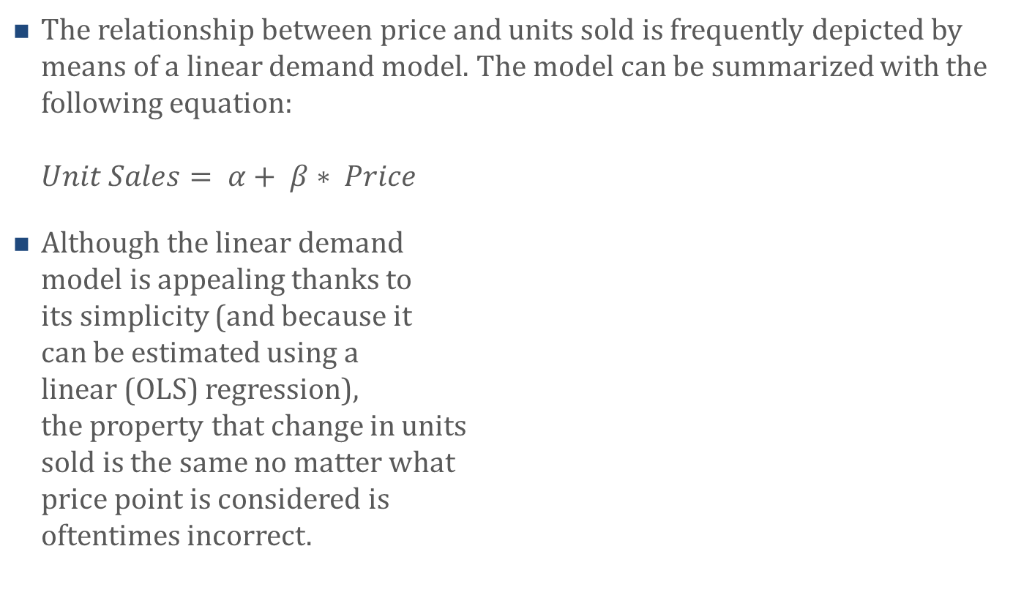
Elasticities
The relationship between price and units sold is frequently depicted by means of a linear demand model. The model can be summarized with the following equation:
$Unit Sales= α+ β∗ Price$
Although the linear demand
model is appealing thanks to
its simplicity (and because it
can be estimated using a
linear (OLS) regression),
the property that change in units
sold is the same no matter what
price point is considered is
oftentimes incorrect.

Slide 28
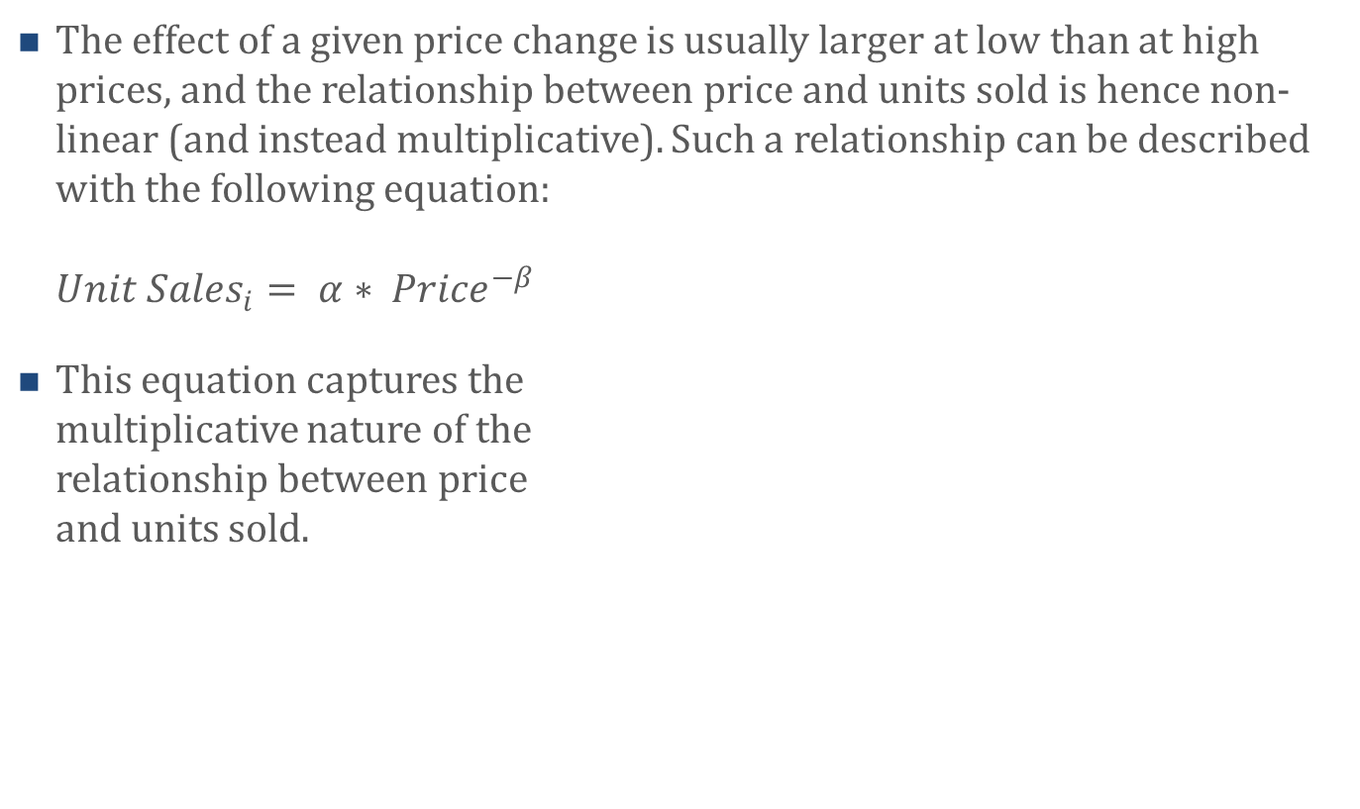
Elasticities
The effect of a given price change is usually larger at low than at high prices, and the relationship between price and units sold is hence non-linear (and instead multiplicative). Such a relationship can be described with the following equation:
${Unit Sales}_{i}= α∗ {Price}^{−β}$
This equation captures the
multiplicative nature of the
relationship between price
and units sold.

Slide 29
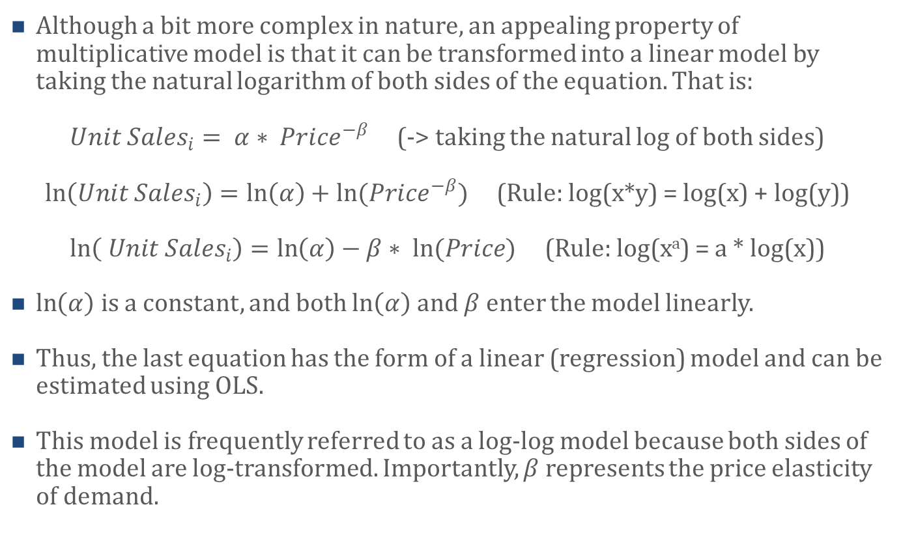
Elasticities
Although a bit more complex in nature, an appealing property of multiplicative model is that it can be transformed into a linear model by taking the natural logarithm of both sides of the equation. That is:
${Unit Sales}_{i}= α∗ {Price}^{−β}$ (-> taking the natural log of both sides)
$\ln\left({Unit Sales}_{i}\right)=\ln\left(α\right)+ln({Price}^{−β})$ (Rule: log(x*y) = log(x) + log(y))
$\ln\left( {Unit Sales}_{i}\right)=\ln\left(α\right)−β∗ ln(Price)$ (Rule: log(xª) = a * log(x))
$\ln\left(α\right)$ is a constant, and both $\ln\left(α\right)$ and $β$ enter the model linearly.
Thus, the last equation has the form of a linear (regression) model and can be estimated using OLS.
This model is frequently referred to as a log-log model because both sides of the model are log-transformed. Importantly, $β$ represents the price elasticity of demand.

Slide 30
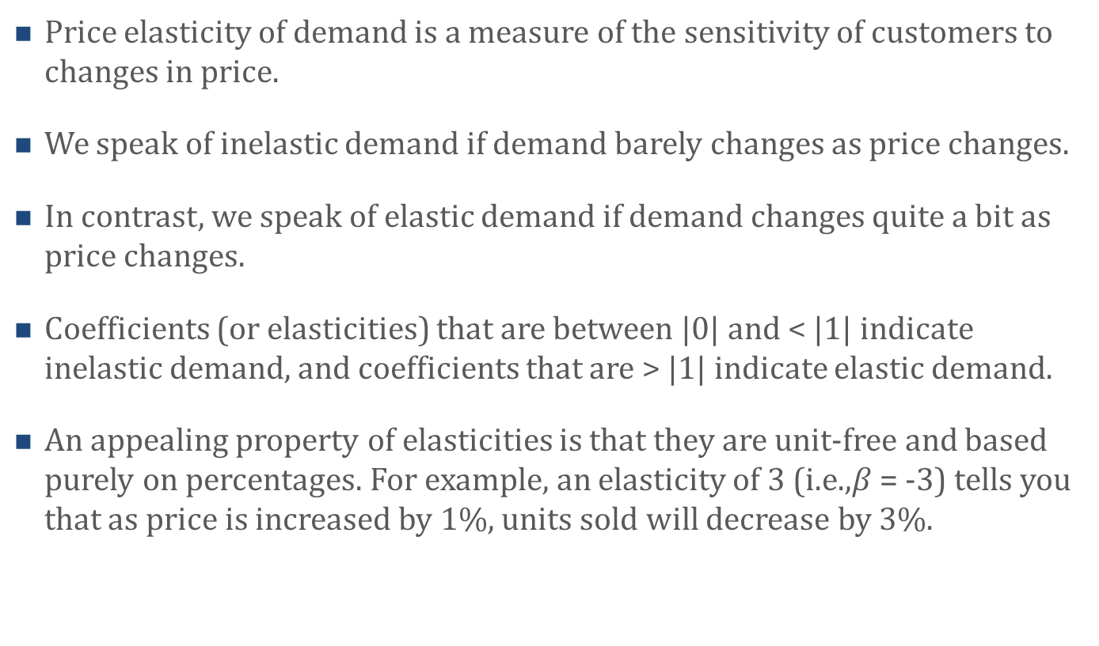
Elasticities
Price elasticity of demand is a measure of the sensitivity of customers to changes in price.
We speak of inelastic demand if demand barely changes as price changes.
In contrast, we speak of elastic demand if demand changes quite a bit as price changes.
Coefficients (or elasticities) that are between |0| and < |1| indicate inelastic demand, and coefficients that are > |1| indicate elastic demand.
An appealing property of elasticities is that they are unit-free and based purely on percentages. For example, an elasticity of 3 (i.e.,$β$ = -3) tells you that as price is increased by 1%, units sold will decrease by 3%.

Slide 31
Price Cutting and Price Elasticities
Many managers cut product prices as a way to stimulate units sold.
Consider a company that sells one product. Also, let’s assume that company decides to cut its product’s price by 5%.
By how much would the company’s units sold have to increase to keep its profits unchanged?
The answer depends on the product’s contribution margin.
Contribution margin | Sales Increase Required | Price Elasticity Required
10% | 100% | |20|
25% | 25% | |5|
50% | 11% | |2.2|

Slide 32
Estimating a Marketing Mix Model
Having learned about elasticities, you decide to estimate your marketing mix model as a log-log model.
To do that, you first log-transform your dependent variable as well as your price and the advertising variables.
You also decide to add year dummies – also referred to as year fixed effects – to your regression to control for year-specific effects (e.g., boom and bust cycles), another common source of omitted variables.
Thus, you include a dummy variable for all but one of the 7 included years (2014 – 2020) in your model. The dropped year becomes your baseline year variable.

Slide 33
Estimating a Marketing Mix Model
You then estimate the regression, which yields the following results:
You look at your regression result and notice that both ln_price and ln_advertising are significant.
Coefficients:
 | Estimate | Std. Error | t value | Pr(>|t|)
(Intercept) | 1.402 | .8986 | 1.56 | <0.15
Ln_price | -.4449 | .1911 | -2.33 | <0.05*
Ln_advertising | .0539 | .0211 | 2.56 | <0.05*
Lagged market share | .4692 | .2671 | 1.76 | <0.11
New products launched | -.0153 | .0091 | -1.69 | <0.12
Brand Dummies | included
Year Dummies | included
---
Signif. codes: 0 ‘***’ 0.001 ‘**’ 0.01 ‘*’ 0.05 ‘.’ 0.1 ‘ ’ 1
R-squared: 0.7626, Adjusted R-squared: 0.5421
F-statistic: 3.46 on 13 and 14 DF, p-value: < 0.05

Slide 34
Estimating a Marketing Mix Model
Ln_price’s coefficient is -0.44. Hence, this tells you that in your industry, as price is increased by 1%, the growth rate in units sold will decrease by 0.44%. Thus, demand is fairly inelastic as price changes.
Note that had you included unit sales as the dependent variable (instead of the first difference of sales), then you would interpret the price coefficient as follows:
  As price increases by 1%, units sold decrease by 0.44%.
  Moreover, Ln_advertising’s coefficient is 0.05, indicating that as advertising increases by 1%, the growth rate in units sold will increase by 0.05%.

Slide 35
Agenda
Learning Objectives
Introduction
  Overview
Estimating a Marketing Mix Model
  Omitted Variable Bias
  Unit Root Problems
  Multicollinearity
  Elasticities
  Price Cutting and Price Elasticities
Summary
Takeaways

Slide 36
Summary
Marketers use the marketing mix – also known as the 4 Ps or product, price, place, and promotion – to execute their firms’ positioning strategy. Marketers use marketing mix models to determine the degree to which the 4 Ps influence firm performance and to derive insights on how and where they can improve their marketing mix.
Marketing mix models are typically based on ordinary least squares (OLS) regression models which allow marketers to analyze the relationship between a dependent variable (e.g., unit sales) and one or more independent variables (e.g., price, online advertising etc.).
Although standard OLS regression models are fairly straightforward to estimate, they often bring with them a number of modeling challenges that marketers must take into consideration. Common modeling challenges marketers encounter when building marketing mix models are:
  Omitted variable bias
  Multicollinearity
  Unit root problems

Slide 37
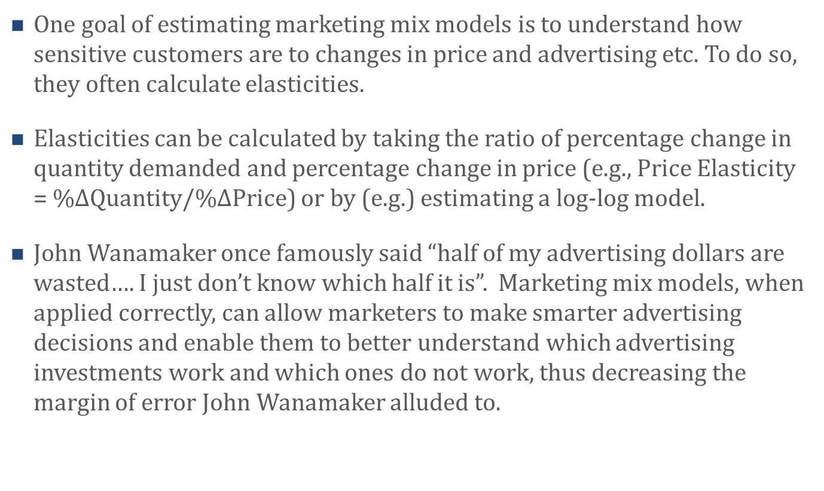
Summary
One goal of estimating marketing mix models is to understand how sensitive customers are to changes in price and advertising etc. To do so, they often calculate elasticities.
Elasticities can be calculated by taking the ratio of percentage change in quantity demanded and percentage change in price (e.g., Price Elasticity = %$∆$Quantity/%$∆$Price) or by (e.g.) estimating a log-log model.
John Wanamaker once famously said “half of my advertising dollars are wasted…. I just don’t know which half it is”. Marketing mix models, when applied correctly, can allow marketers to make smarter advertising decisions and enable them to better understand which advertising investments work and which ones do not work, thus decreasing the margin of error John Wanamaker alluded to.

Slide 38
Agenda
Learning Objectives
Introduction
  Overview
Estimating a Marketing Mix Model
  Omitted Variable Bias
  Unit Root Problems
  Multicollinearity
  Elasticities
  Price Cutting and Price Elasticities
Summary
Takeaways

Slide 39
Takeaways
The purpose of the marketing mix – product, price, place, and promotion – is to execute the company’s intended positioning. When the marketing mix is executed correctly, the company’s customers should be happier, and, in turn, the company’s profits should increase.
Executing the marketing mix correctly is a non-trivial task. Is the advertising grabbing customers’ attention? Should the price be decreased? Or increased? What about product and placement decisions? Marketing mix models, when done correctly, can help managers answer these and other questions.
Marketing mix models often rely on ordinary least squares (OLS) regression models which, at first glance, seem seemingly easy to estimate. However, executing OLS regression models correctly requires researchers to pay attention to aspects such as omitted variable bias, unit root problems, and multicollinearity issues.
Omitted variable bias means that the regression model lacks key independent variables. Not including these key independent variables – or controlling for them using (e.g.) dummy variables – means that the coefficients of the focal independent variables are likely biased (i.e., wrong).

Slide 40
Takeaways
Unit root problems can arise when including the lagged value of the dependent variable as an independent variable in the model.
Multicollinearity issues arise when independent variables are highly correlated with each other. It is problematic in regression because it undermines the statistical significance of the correlated variables. If multicollinearity issues arise, it is often advisable to combine independent variables.
When marketing mix models are estimated as log-log models (i.e., both the dependent variable and the focal independent variables are log-transformed), the focal variables’ coefficients are elasticities (e.g., price elasticity, advertising elasticity etc.).
Price elasticity of demand is a measure of the sensitivity of customers to changes in price. Likewise, advertising elasticity of demand is a measure of the sensitivity of customers to changes in advertising etc.
An appealing property of elasticities is that they are unit-free and based purely on percentages. For example, a price elasticity of |2| means that as price (anywhere along the price continuum) is increased by 1%, units sold will decrease by 2%.

