Slide 1

Marketing Analytics
Based on First Principles :
Chapter 13
Forecasting Sales for
New Products

Slide 2
Agenda
Learning Objectives
Introduction
  What is the Purpose of Forecasting Sales for New Products?
  Qualitative vs. Quantitative Forecasting Methods
The Bass Diffusion Model
  Background
  Model Details
  Model Assumptions
  Examples of p and q
  Electric Skateboards: An Example
Accuracy of the Bass Diffusion Model
Analog method
Summary
Takeaways

Slide 3
Learning Objectives
Be able to describe why forecasting sales serves an important purpose for firms.
Understand and explain the different types of forecasting methods.
Know the difference between qualitative and quantitative forecasting methods and what their respective strengths and weaknesses are.
Be able to explain how the Bass diffusion model works.
Understand the difference between innovators and imitators in the Bass diffusion model.
Know how to estimate the coefficient of innovation and imitation as well as the market potential using OLS regression.
Understand the assumptions that go into the Bass diffusion model.
Be able to explain how the analog method works.

Slide 4
Agenda
Learning Objectives
Introduction
  What is the Purpose of Forecasting Sales for New Products?
  Qualitative vs. Quantitative Forecasting Methods
The Bass Diffusion Model
  Background
  Model Details
  Model Assumptions
  Examples of p and q
  Electric Skateboards: An Example
Accuracy of the Bass Diffusion Model
Analog method
Summary
Takeaways

Slide 5
What is the Purpose of Forecasting Sales for New Products?
Forecasting sales for a new product is important for two main reasons.
  It reduces uncertainty when making tactical decisions. For example, companies need to decide how much of a new product they should manufacture. These and other decisions are typically made under much uncertainty, which good forecasts can significantly reduce, thus resulting in better decisions.
  Sales forecasts provide important inputs when making strategic decisions. For example, should a company go after a specific market segment? These decisions often depend on how much a market is predicted to grow in the future, for which sales forecasts can provide important inputs.
Bottom line: In much of business, good sales forecasts are essential to being well prepared.

Slide 6
Qualitative vs. Quantitative Forecasting Methods
Sales forecasts can be made using qualitative or quantitative forecasting methods.
Qualitative forecasting methods include:
  The jury of executive opinion method
  The Delphi method
  The sales force composite method
Quantitative forecasting methods include:
  Time series regression models
  Conjoint analysis
  Bass diffusion model.

Slide 7
Qualitative vs. Quantitative Forecasting Methods
Qualitative and Quantitative forecasting methods have their strengths and weaknesses. These include:
 | Qualitative | Quantitative
Characteristic | Based on people's opinions | Based on numeric data and equations
Strength | Can incorporate expertise that is hard to codify | Can consider large amounts of data
Weakness | Opinions can dominate and/or bias the forecast | Must have data

Slide 8
Agenda
Learning Objectives
Introduction
  What is the Purpose of Forecasting Sales for New Products?
  Qualitative vs. Quantitative Forecasting Methods
The Bass Diffusion Model
  Background
  Model Details
  Model Assumptions
  Examples of p and q
  Electric Skateboards: An Example
Accuracy of the Bass Diffusion Model
Analog method
Summary
Takeaways

Slide 9
Background
The Bass diffusion model, named after Frank Bass who was an American academic in the field of marketing science, is about understanding when customers will adopt a new product.
In particular, the intuition behind the Bass diffusion model is that there is heterogeneity in terms of when people adopt new products.
  Some people are innovators. These are people who adopt new products because of their own knowledge of the product features or benefits. Importantly, innovators do not need anyone else to influence them to adopt the product. That is, they adopt new products due to external influences only (i.e., external to the social system in which they live).
  On the other hand, many people are imitators, meaning they adopt a new product largely because of the social influence provided by others. That is, they largely adopt due to internal influences (i.e., internal to the social system in which they live).

Slide 10
Background
(PANEL A) illustrates how these two types of people adopt a new product over time. If we overlay the two curves shown in PANEL A, we get a curve similar to the one shown in PANEL B.
PANEL A | PANEL B

Slide 11
Background
The initial adoptions can all be attributed to the innovators, whereas subsequent adoptions are mostly from imitators. Importantly, the Bass diffusion model decomposes adopters into the innovators and imitators.
Correspondingly, the Bass diffusion model includes an innovator coefficient (p) that captures how fast people adopt without any influence from others and an imitator coefficient (q) that captures how fast people adopt due to imitation.

Slide 12
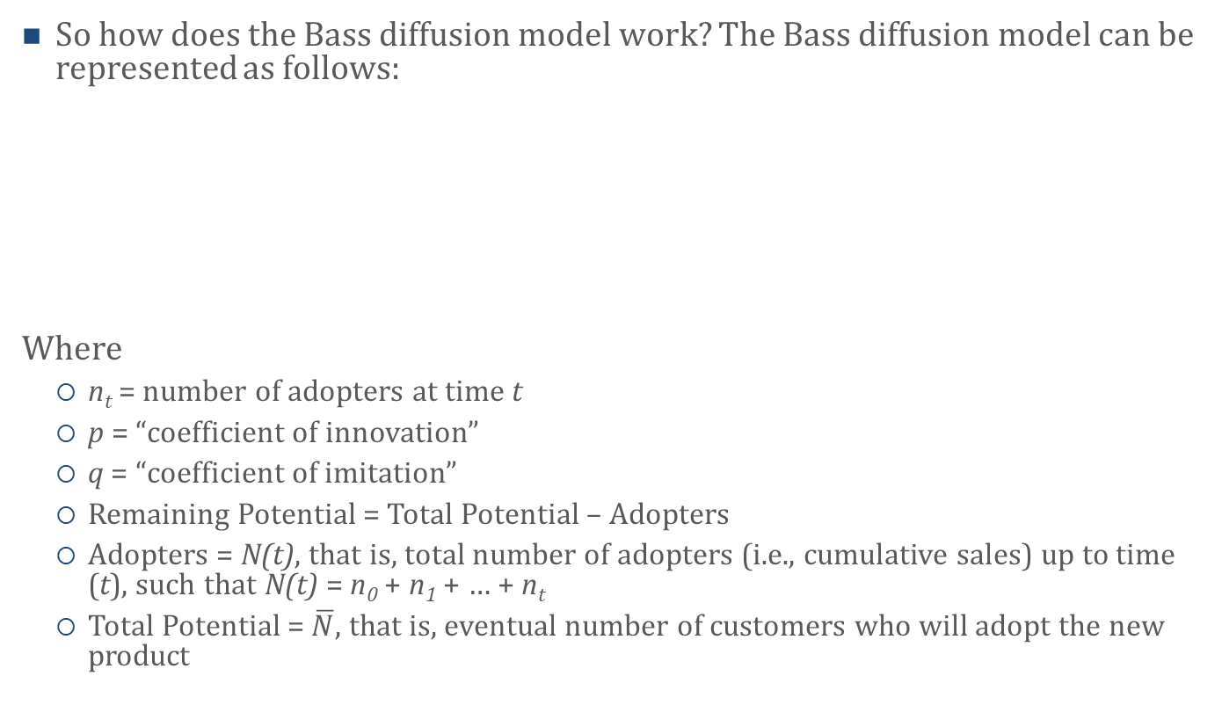
Model Details
So how does the Bass diffusion model work? The Bass diffusion model can be represented as follows:
Where
  n_{t} = number of adopters at time t
  p = “coefficient of innovation”
  q = “coefficient of imitation”
  Remaining Potential = Total Potential – Adopters
  Adopters = N(t), that is, total number of adopters (i.e., cumulative sales) up to time (t), such that N(t) = n₀ + n₁ + … + n_{t}
  Total Potential =$\overline{N}$, that is, eventual number of customers who will adopt the new product

Slide 13
Model Details
Thus, we can express the equation as follows:
Or, alternatively:
We can further re-write the equation as follows:

Slide 14
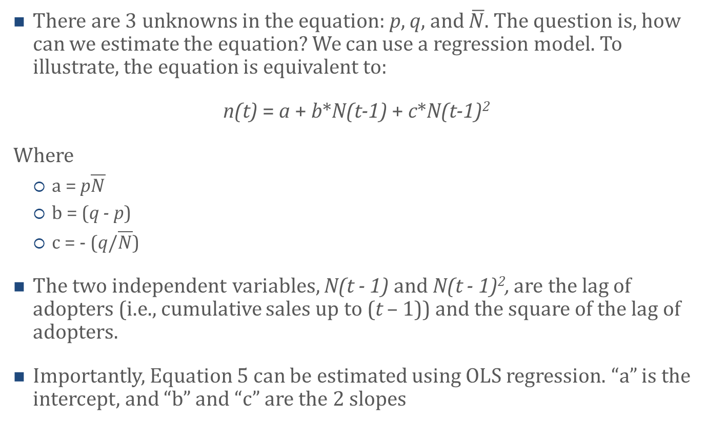
Model Details
There are 3 unknowns in the equation: p, q, and $\overline{N}$. The question is, how can we estimate the equation? We can use a regression model. To illustrate, the equation is equivalent to:
n(t) = a + b*N(t-1) + c*N(t-1)²
Where
  a = p$\overline{N}$
  b = (q - p)
  c = - (q/$\overline{N}$)
The two independent variables, N(t - 1) and N(t - 1)², are the lag of adopters (i.e., cumulative sales up to (t – 1)) and the square of the lag of adopters.
Importantly, Equation 5 can be estimated using OLS regression. “a” is the intercept, and “b” and “c” are the 2 slopes

Slide 15
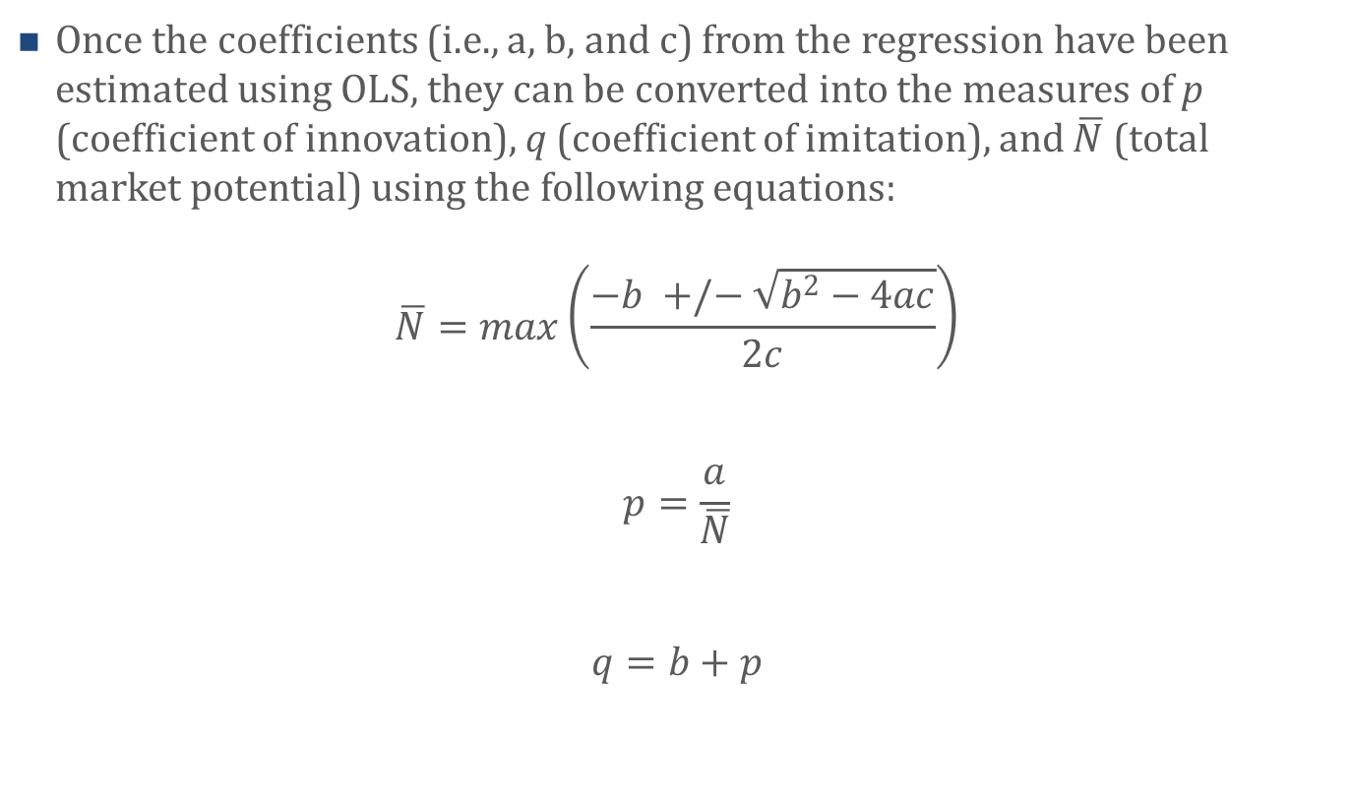
Model Details
Once the coefficients (i.e., a, b, and c) from the regression have been estimated using OLS, they can be converted into the measures of p (coefficient of innovation), q (coefficient of imitation), and $\overline{N}$ (total market potential) using the following equations:
$$\overline{N}=max\left(\frac{−b +/− \sqrt{b^{2}−4ac}}{2c}\right)$$
$$p=\frac{a}{\overline{N}}$$
$$q=b+p$$

Slide 16
Model Assumptions
The traditional Bass diffusion model makes several assumptions, including:
  All expected customers will eventually adopt
  The market potential stays the same over time
  No repeat purchases occur
  Marketing tactics (e.g., the impact of advertising or pricing decisions) are not included in the model
It is important to note, though, that all of these assumptions can be relaxed using different extensions of the Bass diffusion model.

Slide 17
Examples of p and q
p, the coefficient of innovation, and q, the coefficient of imitation, differ across products.
Larger p’s indicate that the product has sufficient features and benefits such that more and more consumers do not want to or need to wait for others to adopt the product, that is, they do not require the internal influence to adopt.
For example, here are some p and q values for different product categories:
Product / Technology | Coefficient of Innovation | Coefficient of Imitation
Black & White TV | 0.108 | 0.231
Color TV | 0.059 | 0.146
Cellular telephones | 0.008 | 0.421
Hybrid corn | 0.000 | 0.797
Home PC | 0.121 | 0.281

Slide 18
Electric Skateboards: An Example
You are a product manager at a leading skateboard manufacturer. You and your team are considering introducing an electric skateboard, an offering you currently do not have. You have noticed that more and more College students (one of your target customer segments) are purchasing electric skateboards.
Before moving ahead though, you want to get a better understanding of the electric skateboard market size and potential. Your market research specialist provided you with the sales data.

Slide 19
Electric Skateboards: An Example
Sales data:
Time period | Sales n(t) | Cumulative Sales N(t) | Lag of cumulative sales N(t - 1) | Cumulative Sales² N(t)² | Lag of Cumulative Sales² N(t - 1)²
1 | 0.8 | 0.8 | 0 | 0.64 | 0
2 | 1.5 | 2.3 | 0.8 | 5.29 | 0.64
3 | 2.9 | 5.2 | 2.3 | 27.04 | 5.29
4 | 4.9 | 10.1 | 5.2 | 102.01 | 27.04
5 | 6.2 | 16.3 | 10.1 | 265.69 | 102.01
6 | 7.8 | 24.1 | 16.3 | 580.81 | 265.69
7 | 3.8 | 27.9 | 24.1 | 778.41 | 580.81
8 | 7.5 | 35.4 | 27.9 | 1253.16 | 778.41
9 | 9.1 | 44.5 | 35.4 | 1980.25 | 1253.16
10 | 10.4 | 54.9 | 44.5 | 3014.01 | 1980.25

Slide 20
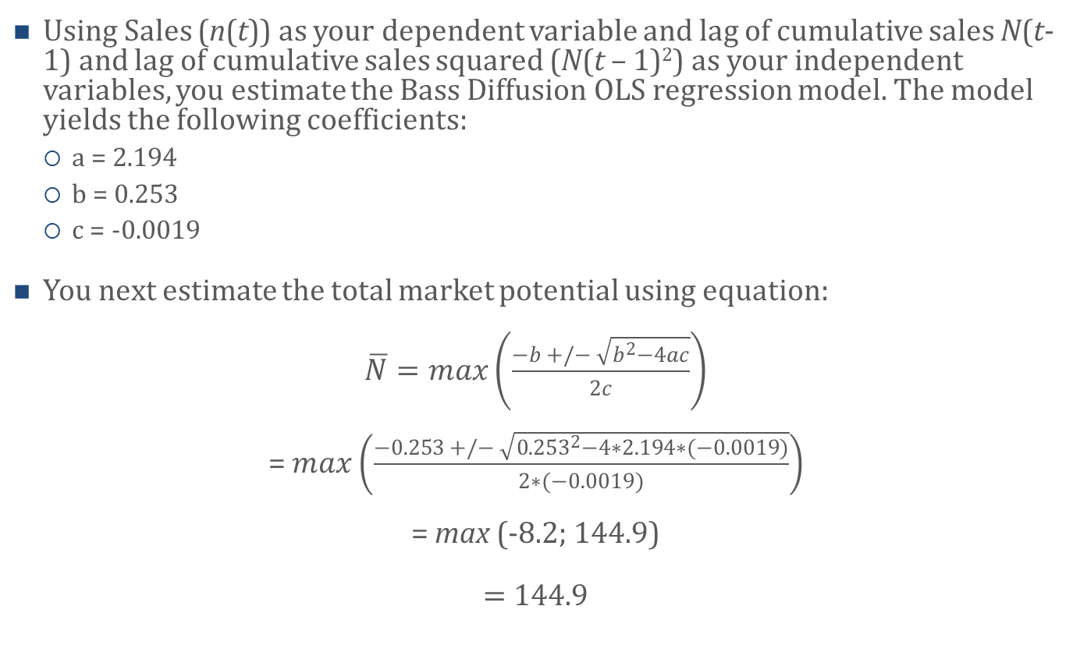
Electric Skateboards: An Example
Using Sales (n(t)) as your dependent variable and lag of cumulative sales N(t-1) and lag of cumulative sales squared (N(t – 1)²) as your independent variables, you estimate the Bass Diffusion OLS regression model. The model yields the following coefficients:
  a = 2.194
  b = 0.253
  c = -0.0019
You next estimate the total market potential using equation:
$\overline{N}=max\left(\frac{−b +/− \sqrt{b^{2}−4ac}}{2c}\right)$
= $max\left(\frac{−0.253 +/− \sqrt{{0.253}^{2}−4∗2.194∗(−0.0019)}}{2∗(−0.0019)}\right)$
= max (-8.2; 144.9)
$=$ 144.9

Slide 21
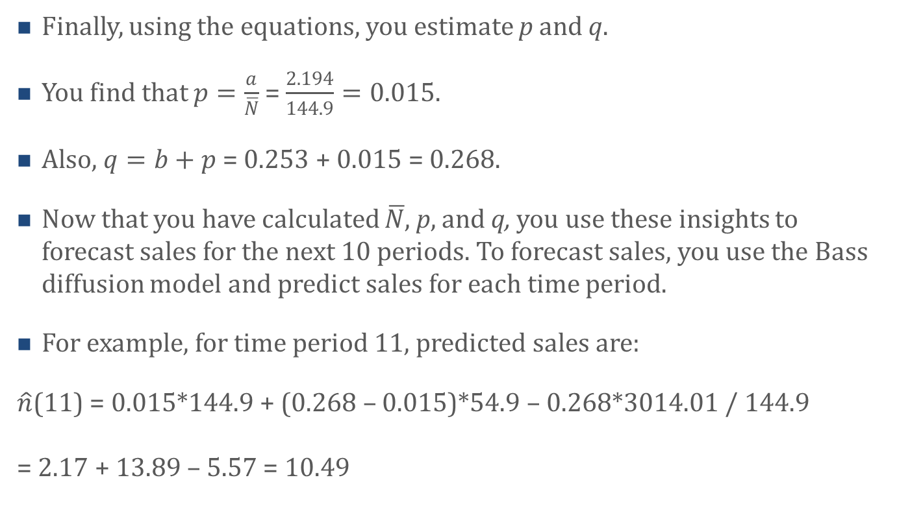
Electric Skateboards: An Example
Finally, using the equations, you estimate p and q.
You find that $p=\frac{a}{\overline{N}}$ = $\frac{2.194}{144.9}=0.015$.
Also, $q=b+p$ = 0.253 + 0.015 = 0.268.
Now that you have calculated $\overline{N}$, p, and q, you use these insights to forecast sales for the next 10 periods. To forecast sales, you use the Bass diffusion model and predict sales for each time period.
For example, for time period 11, predicted sales are:
$\hat{n}$(11) = 0.015*144.9 + (0.268 – 0.015)*54.9 – 0.268*3014.01 / 144.9
= 2.17 + 13.89 – 5.57 = 10.49

Slide 22
Agenda
Learning Objectives
Introduction
  What is the Purpose of Forecasting Sales for New Products?
  Qualitative vs. Quantitative Forecasting Methods
The Bass Diffusion Model
  Background
  Model Details
  Model Assumptions
  Examples of p and q
  Electric Skateboards: An Example
Accuracy of the Bass Diffusion Model
Analog method
Summary
Takeaways

Slide 23
Accuracy of the Bass Diffusion Model
The Bass diffusion model has been used extensively despite – or perhaps because – its simplicity. Although it is important to recognize the model’s limitations, it has proven to predict sales of some products and technologies quite well.
For example, the sales of color TVs as predicted by the Bass model:

Slide 24
Agenda
Learning Objectives
Introduction
  What is the Purpose of Forecasting Sales for New Products?
  Qualitative vs. Quantitative Forecasting Methods
The Bass Diffusion Model
  Background
  Model Details
  Model Assumptions
  Examples of p and q
  Electric Skateboards: An Example
Accuracy of the Bass Diffusion Model
Analog method
Summary
Takeaways

Slide 25
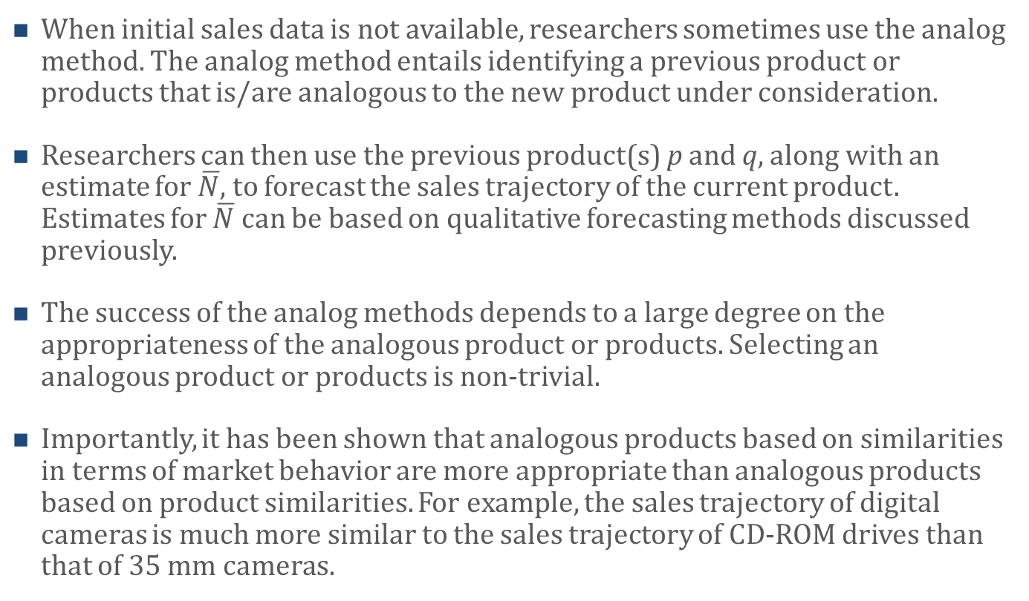
Analog Method
When initial sales data is not available, researchers sometimes use the analog method. The analog method entails identifying a previous product or products that is/are analogous to the new product under consideration.
Researchers can then use the previous product(s) p and q, along with an estimate for $\overline{N}$, to forecast the sales trajectory of the current product. Estimates for $\overline{N}$ can be based on qualitative forecasting methods discussed previously.
The success of the analog methods depends to a large degree on the appropriateness of the analogous product or products. Selecting an analogous product or products is non-trivial.
Importantly, it has been shown that analogous products based on similarities in terms of market behavior are more appropriate than analogous products based on product similarities. For example, the sales trajectory of digital cameras is much more similar to the sales trajectory of CD-ROM drives than that of 35 mm cameras.

Slide 26
Agenda
Learning Objectives
Introduction
  What is the Purpose of Forecasting Sales for New Products?
  Qualitative vs. Quantitative Forecasting Methods
The Bass Diffusion Model
  Background
  Model Details
  Model Assumptions
  Examples of p and q
  Electric Skateboards: An Example
Accuracy of the Bass Diffusion Model
Analog method
Summary
Takeaways

Slide 27
Summary
Good sales forecasts are essential for firms. They help reduce uncertainty with regards to many different decisions firms have to make, including operations, inventory, and hiring decisions. Moreover, good sales forecasts provide critical inputs when firms make strategic decisions, including what types of products to manufacture, which markets to enter, and which customer segments to target. Indeed, these decisions are frequently made with market potential in mind, and sales forecasts can provide important inputs with regards to market potential.
Firms make sales forecasts using qualitative and/or quantitative forecasting methods. Both methods have their strengths and weaknesses, so many researchers consider sales forecasts that are based on a combination of both qualitative and quantitative methods to be optimal.
In terms of the quantitative forecasting methods, conjoint analysis has been shown to work reasonably well when forecasting short-term sales. Moreover, researchers frequently use the Bass diffusion model to forecast sales in the mid- to long-term.

Slide 28
Summary
The Bass diffusion model assumes there is heterogeneity in terms of who adopts new products. In particular, it distinguishes between innovators and imitators. Whereas innovators adopt new products merely because of the product features and without considering other peoples’ influence (i.e., Word-of-Mouth), imitators adopt new product primarily due to other adopters’ influence (i.e., Word-of-Mouth).
The Bass diffusion model can be estimated using OLS regression, and includes three parameters: The coefficient of innovation (p), which captures the effect of innovators, the coefficient of imitation (q), which captures the effect of imitators, and the market potential, which captures the eventual number of customers who will adopt the new product.
The Bass diffusion model makes several assumptions, including that all expected customers will eventually adopt and that there are no repeat purchases, among others. Despite these assumptions, the Bass diffusion model has been found to represent many different sales patterns quite well.
When there is no initial sales data for a new product or technology, researchers sometimes use the analog method, which entails using the p and q of an existing product or products that are similar (i.e., analogous) to the new product under consideration. Sometimes researchers also combine the analog method with the approach based on early sales data.

Slide 29
Agenda
Learning Objectives
Introduction
  What is the Purpose of Forecasting Sales for New Products?
  Qualitative vs. Quantitative Forecasting Methods
The Bass Diffusion Model
  Background
  Model Details
  Model Assumptions
  Examples of p and q
  Electric Skateboards: An Example
Accuracy of the Bass Diffusion Model
Analog method
Summary
Takeaways

Slide 30
Takeaways
Good sales forecasts are essential for firms as they help reduce uncertainty.
Firms make sales forecasts using qualitative and/or quantitative forecasting methods.
Qualitative forecasting methods include the jury of executive opinion method, the Delphi method, and the sales force composite method, among others.
The Bass diffusion model is a popular quantitative forecasting method.
The Bass diffusion model distinguishes between innovators (who adopt new products because of the products’ features and not because of other peoples’ influence, i.e., Word-of-Mouth) and imitators (who adopt new products because of other peoples’ influence).

Slide 31
Takeaways
The Bass diffusion model includes three model parameters: The coefficient of innovation (p), which captures the effect of innovators, the coefficient of imitation (q), which captures the effect of imitators, and the market potential, which captures the eventual number of customers who will adopt the new product.
The Bass diffusion model makes several assumptions, but these assumptions can be relaxed in model extensions.
When initial sales data are not available, researchers sometimes use the analog method, which involves using the p(s) and q(s) of an existing product or products. Some researchers use the ps and qs from analogous products and then also estimate the p and q for the product under consideration using actual sales data. They then combine the estimates to arrive at their sales forecast.
The average p across products is approximately 0.03, and the average q is approximately 0.38.
The Bass diffusion model has been shown to predict sales of many products and technologies quite well, so many researchers believe that the model is a good starting point when forecasting sales.

