Slide 1

Marketing Analytics
Based on First Principles :
Chapter 12
Conjoint Analysis for Product
and Pricing Decisions

Slide 2
Agenda
Learning Objectives
Introduction
  What is Conjoint Analysis?
  Conjoint Analysis Examples
  Steps in Conjoint analysis
Ratings-based conjoint analysis
  Determining the $-value of Product Attributes
  Multiple Respondents
  Testing the Appropriateness of Product Profiles
  Market Share Forecasts
Using Conjoint Analysis Results for Segmentation
Choice-based Conjoint Analysis
Summary
Takeaways

Slide 3
Learning Objectives
Be able to describe what conjoint analysis is and for what purposes researchers may use it.
Understand and explain the six steps of conjoint analysis.
Know how to select product attributes and product attribute levels used as part of a conjoint analysis.
Know the difference between ratings-based, rankings-based, and choice-based conjoint analysis.
Be able to explain how to create product profiles (i.e., fractional factorial design).
Be able to create a survey to collect data to be used as part of a conjoint analysis.

Slide 4
Learning Objectives
Know how to estimate customers’ utilities using regression analysis. Be able to explain which variable is used as the dependent variable and which variables are used as the independent variables in the regression analysis.
Be able to explain how the levels of each product attribute are captured using dummy variables. Understand what a baseline category is.
Be able to explain what the regression coefficients capture. Also, based on the regression analysis results, know how to calculate each customer’s util units, and be able to explain what util units are.
Know how to calculate attribute importance based on the regression results.
Be able to explain when a customer’s willingness-to-pay for a specific product attribute can be estimated. Also, if applicable, be able to calculate the $-value of each product attribute level included in a conjoint analysis.
Know how to use conjoint analysis results to make market share forecasts.
Be able to explain how conjoint analysis results can be used for segmentation purposes.

Slide 5
Agenda
Learning Objectives
Introduction
  What is Conjoint Analysis?
  Conjoint Analysis Examples
  Steps in Conjoint analysis
Ratings-based conjoint analysis
  Determining the $-value of Product Attributes
  Multiple Respondents
  Testing the Appropriateness of Product Profiles
  Market Share Forecasts
Using Conjoint Analysis Results for Segmentation
Choice-based Conjoint Analysis
Summary
Takeaways

Slide 6
What is Conjoint Analysis?
Conjoint analysis is a multivariate method for assessing customers’ reactions to and preferences for predetermined product attribute combinations that represent potential products (i.e., goods or services).
Conjoint analysis provides researchers with insights into customers’ product preferences, and allows them to identify product attributes as well as attribute combinations most appealing to customers.
Conjoint analysis is based on customer feedback data on a select number of products that are each designed around different levels of the same product attribute(s) (also referred to as product bundles).
Using regression analysis, conjoint analysis decomposes these product bundles such that the utility (also referred to as value or part-worth) customers assign to the various levels of each of the product attributes can be derived.

Slide 7
What is Conjoint Analysis?
Rather than asking customers direct questions about their product preferences (e.g., how much would you like to pay to purchase a mutual fund?), conjoint analysis presents customers with different product attribute combinations (e.g., different mutual fund options including different price levels, etc.) and then asks the customers to evaluate these combinations.
Thus, conjoint analysis can help researchers design and price products most appealing to their target customers and evaluate a wide range of product design options.

Slide 8
Conjoint Analysis Examples
Conjoint analysis is one of the most commonly used marketing research and analytics techniques. It has been successfully applied in business-to-consumer and business-to-business settings as well as to gain insights about goods and services – real or hypothetical.
Some Examples:
  Courtyard by Marriott
  Match.com
  Apple vs. Samsung

Slide 9
Conjoint Analysis Examples
Courtyard by Marriott
In the 1980s, Marriott was losing some of its business traveler segment customers to competitors. They were also running out of good sites for typical full-service Marriott hotels.
Thus, Marriott’s management decided to conduct a conjoint analysis to create a new chain of hotels for the dissatisfied travelers.
Their analysis included several attributes and several attribute levels. For example, they considered external factors (building shape, landscape design, pool type and location), rooms (room size, room décor, type of heating and cooling, location and type of bathroom), food related services (type and location of restaurant, room service, vending), lounge facilities (location, atmosphere), and price (different price points).
Based on the conjoint analysis insights, Marriott created “Courtyard by Marriott” which turned out to be a huge success.

Slide 10
Conjoint Analysis Examples
Match.com
The algorithms used by online dating websites such as Match.com are frequently based on conjoint analysis.
In a nutshell, users of dating websites are shown profiles of people. These profiles are made up of and based on a set of attributes (i.e., height, weight, age, education, hair color, etc.).
Based on the profiles viewed, users make choices, and, based on these choices, dating websites try to find the perfect match for a respective user.
The resulting match scores are often the result of a conjoint analysis of how you (the person seeking a match) and the potential match share similar values for similar personal attributes.

Slide 11
Conjoint Analysis Examples
Apple vs. Samsung
Conjoint analysis has also been used in patent infringement suits. For example, a few years ago, Apple sued Samsung in the U.S. arguing that Samsung had stolen a feature of Apple’s touchscreen technology – the ability to recognize a second finger on the touchscreen.
Apple’s lawyers, with the help of a marketing professor, used conjoint analysis to calculate the intellectual property damage incurred. It turns out that this feature is worth on average $39.
Once Apple had an estimate of the worth of its touchscreen technology as part of a product, it multiplied this value by the number of products Samsung had sold that included the technology and thus arrived at an estimate of the property damage it sustained.

Slide 12
Steps in Conjoint analysis
Conjoint analysis requires six steps:
  Select product attributes to be included
  Select the product attribute levels to be included
  Create the product profiles
  Collect data from target customers
  Estimate the utility (also referred to as part-worths) of the product attributes and levels using regression analysis
  Analyze the results
The six steps are covered in detail in the following slides using a sandwich example.

Slide 13
Steps in Conjoint analysis
Select product attributes
Attributes included should be those most important to the target customers. To identify these attributes, it is often prudent to conduct focus groups with a sample of target customers. Considering the sandwich example, let us assume that, based on customer feedback, you decided to include the following product attributes in the conjoint analysis:
  Type of bread
  Type of meat
  Type of cheese
  Type of vegetables
  Price
Researchers should be careful to not include too many product attributes. Typically, it is advisable to keep the number of product attributes at 6 or less.
Some product attributes are expected by customers. For example, virtually all laptops nowadays have a built-in camera. Such attributes should not be included in a conjoint analysis, unless there is a potential opportunity to differentiate the product on that attribute.

Slide 14
Steps in Conjoint analysis
Select product attribute levels
Returning to the sandwich example, let us assume you decided to include the following product attributes levels (per attribute) in the conjoint analysis:
  Type of bread: White, Whole Wheat
  Type of meat: Ham, Turkey, No Meat
  Type of cheese: Provolone, American, Swiss
  Type of vegetables: Lettuce, Tomatoes, Lettuce & Tomatoes
  Price: $3.99, $4.99, $5.99
It is recommended to include 2 to 5 levels for each attribute to not overburden those providing feedback about the attribute combinations.
It is advisable to keep the number of attribute levels similar across the attributes included.
The meaning of the attribute levels should not be ambiguous.
The included attribute levels should be mutually exclusive, and the range of attribute levels should be consistent with what customers can expect to encounter in real life.

Slide 15
Steps in Conjoint analysis
Create the product profiles
In the sandwich example, we have 5 attributes with 2 to 3 levels each. Thus, even considering this relatively small set of attributes and levels, there are 2 (bread) x 3 (meat) x 3 (cheese) x 3 (vegetables) x 3 (price) = 162 possible sandwich combinations. No customer would want to provide feedback on that many different kinds of sandwiches. Thankfully, in conjoint analysis, this is also not needed.
There are different approaches to conjoint analysis. Among those, two are particularly popular:
  Ratings-based or Rankings-based conjoint analysis
  Choice-based conjoint analysis
In ratings-based conjoint analysis, customers independently rate a subset of the product profiles on, for example, a scale of 0 – 100, where 1 represents least preferred product and 100 represents most preferred product. Similarly, one can use a scale from 1 – 7 etc. Instead of asking customers to rate product profiles on a scale, it is also possible to ask customers to rank the product profiles. This would result in rankings-based conjoint analysis. In that case, each product’s rank is used as its rating.

Slide 16
Steps in Conjoint analysis
Returning to the sandwich example, a customer may be asked to rate the product profiles shown below on a scale from 1 – 7 (where 1 represents the least preferred product and 7 the most preferred product).
The sample of profiles was created as a fractional factorial design.
Product Profile | Bread | Meat | Cheese | Veggie | Price | Rating (1 - 7)
1 | Wheat | No Meat | Provolone | Tomatoes | $5.99 | 2
2 | White | Ham | American | Lettuce | $4.99 | 5
3 | White | Ham | Provolone | Lettuce & Tomatoes | $5.99 | 4
4 | Wheat | Turkey | American | Lettuce & Tomatoes | $5.99 | 1
5 | Wheat | Ham | Provolone | Lettuce | $4.99 | 4
6 | Wheat | No Meat | Swiss | Lettuce & Tomatoes | $4.99 | 6
7 | White | No Meat | Provolone | Tomatoes | $3.99 | 7
8 | Wheat | No Meat | Swiss | Lettuce | $3.99 | 6
9 | White | No Meat | American | Lettuce | $5.99 | 5
10 | Wheat | Turkey | Provolone | Lettuce | $3.99 | 4
11 | White | Ham | Swiss | Lettuce & Tomatoes | $3.99 | 7
12 | White | Turkey | Swiss | Tomatoes | $4.99 | 4
13 | White | Turkey | Swiss | Lettuce | $5.99 | 2
14 | Wheat | Ham | American | Tomatoes | $3.99 | 6
15 | Wheat | Ham | Swiss | Tomatoes | $5.99 | 3

Slide 17
Steps in Conjoint analysis
We could also create a survey using choice-based conjoint profiles. In choice-based conjoint analysis, customers are asked to make a series of choices among two or more product profiles presented in order, such as:

Slide 18
Steps in Conjoint analysis
Collect data from target customers
Once the product-profiles are created and the type of conjoint analysis (e.g., ratings-based vs. choice-based conjoint analysis) has been decided upon, researchers create a survey and invite randomly selected and representative (typically target) customers to complete the survey.
Conjoint-analysis surveys can be conducted using paper and pencil surveys, but it is quite common nowadays to use an online survey when collecting data for a conjoint analysis.

Slide 19
Steps in Conjoint analysis
Estimate customers’ utility using regression analysis
Once the data is collected, the next step entails estimating the customers’ utility – or part-worths.
Conjoint analysis provides (1) the relative importance each customer attaches to each included product attribute and (2) each customer’s utility (or part-worth) for each included level of each attribute.

Slide 20
Steps in Conjoint analysis
Text

Slide 21
Agenda
Learning Objectives
Introduction
  What is Conjoint Analysis?
  Conjoint Analysis Examples
  Steps in Conjoint analysis
Ratings-based conjoint analysis
  Determining the $-value of Product Attributes
  Multiple Respondents
  Testing the Appropriateness of Product Profiles
  Market Share Forecasts
Using Conjoint Analysis Results for Segmentation
Choice-based Conjoint Analysis
Summary
Takeaways

Slide 22
Ratings-based conjoint analysis
In ratings-based conjoint analysis, standard OLS regression analysis is used for the estimation.
The customers’ ratings of the various choices (i.e., ratings of sandwiches on a scale from 1 – 7 in the above example) form the dependent variable in the OLS regression.
Moreover, the respective level of each attribute associated with each rating is captured using dummy variables (i.e., a binary variable that takes on the form of 1 or 0).
These dummy variable(s) make up the independent variable(s) of the OLS regression.
Importantly, for each attribute included in the conjoint analysis, there will be x – 1 dummy variables, where x captures the respective number of attribute levels.

Slide 23
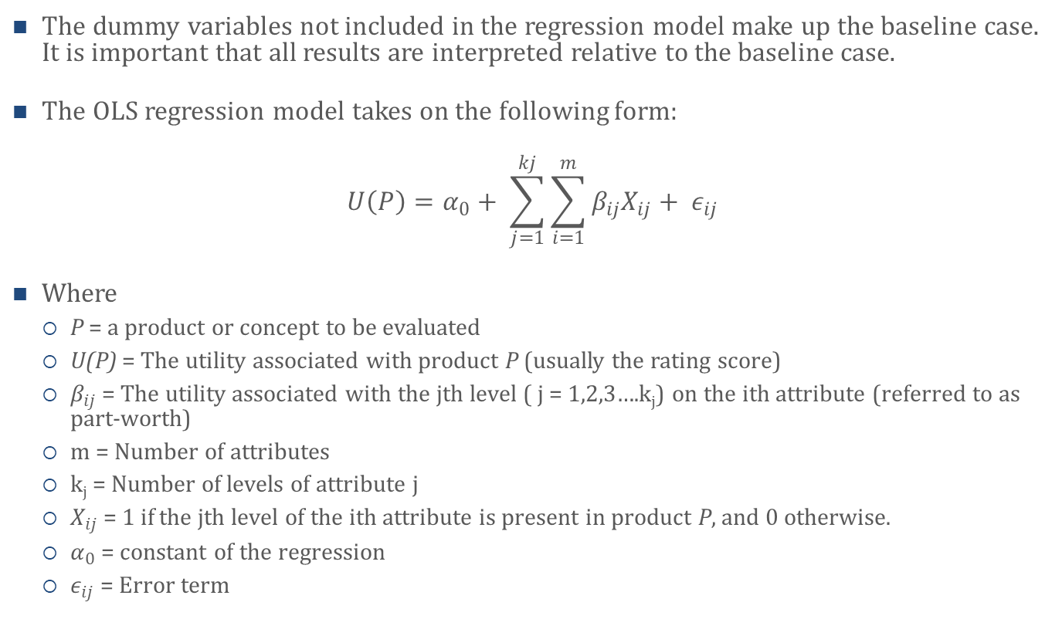
Ratings-based conjoint analysis
The dummy variables not included in the regression model make up the baseline case. It is important that all results are interpreted relative to the baseline case.
The OLS regression model takes on the following form:
$$U\left(P\right)=α_{0}+ \sum_{j=1}^{kj}{\sum_{i=1}^{m}{β_{ij}X_{ij}+ ε_{ij}}}$$
Where
  P = a product or concept to be evaluated
  U(P) = The utility associated with product P (usually the rating score)
  $β_{ij}$ = The utility associated with the jth level ( j = 1,2,3….k_{j}) on the ith attribute (referred to as part-worth)
  m = Number of attributes
  k_{j} = Number of levels of attribute j
  $X_{ij}$ = 1 if the jth level of the ith attribute is present in product P, and 0 otherwise.
  $α_{0}$ = constant of the regression
  $ε_{ij}$ = Error term

Slide 24
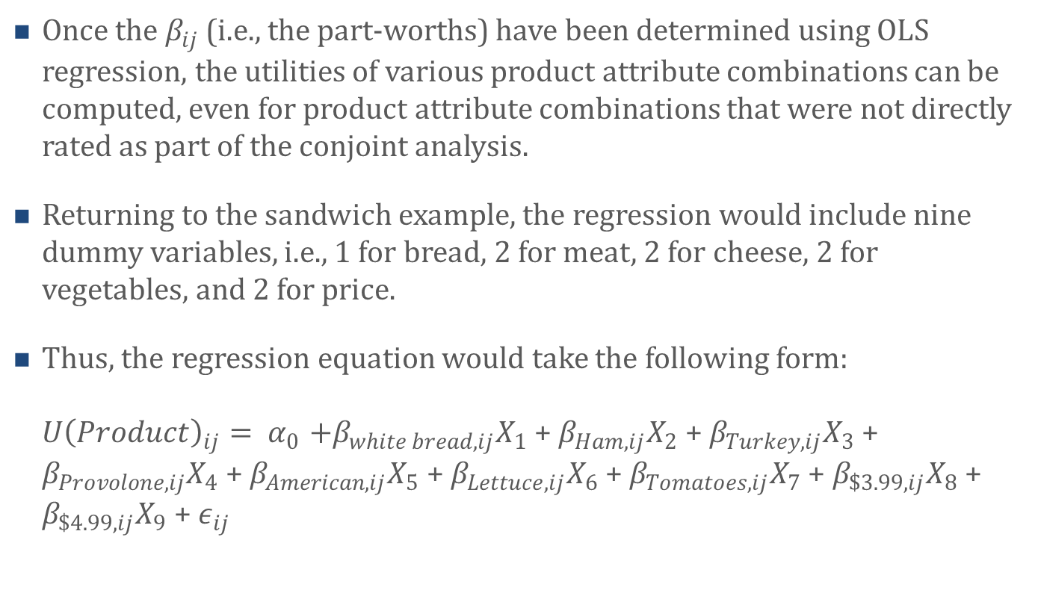
Ratings-based conjoint analysis
Once the $β_{ij}$ (i.e., the part-worths) have been determined using OLS regression, the utilities of various product attribute combinations can be computed, even for product attribute combinations that were not directly rated as part of the conjoint analysis.
Returning to the sandwich example, the regression would include nine dummy variables, i.e., 1 for bread, 2 for meat, 2 for cheese, 2 for vegetables, and 2 for price.
Thus, the regression equation would take the following form:
${U\left(Product\right)}_{ij}{= α}_{0}+β_{white bread, ij}X_{1}$ + $β_{Ham, ij}X_{2}$ + $β_{Turkey,ij}X_{3}$ + $β_{Provolone,ij}X_{4}$ + $β_{American,ij}X_{5}$ + $β_{Lettuce,ij}X_{6}$ + $β_{Tomatoes,ij}X_{7}$ + $β_{\$3.99,ij}X_{8}$ + $β_{\$4.99,ij}X_{9}$ + $ε_{ij}$

Slide 25
Ratings-based conjoint analysis
The regression analysis provides the coefficients (or part-worths)
Attribute | Part-worth (i.e., coefficient)
White bread | 0.198
Ham | -0.146
Turkey | -2.153
Provolone | -0.854
American | -0.007
Lettuce | -0.368
Tomatoes | -0.097
$3.99 | 2.896
$4.99 | 1.243
Constant (Intercept) | 3.443

Slide 26
Ratings-based conjoint analysis
The part-worths also offer insight in terms of which attribute is more – or less – important to the customer. To understand attribute importance, consider the range of the respective attribute part-worths.
  Bread: Range of part-worths from 0 to 0.198 = 0.198
  Meat: Range of part-worths from -2.153 to 0 = 2.153
  Cheese: Range of part-worths from -0.854 to 0 = 0.854
  Vegetables: Range of part-worths from -0.368 to 0 = 0.368
  Price: Range of part-worths from 0 to 2.896 = 2.896
Considering these ranges, price is the most important attribute to this customer, followed by meat type (s/he prefers no meat), cheese type, vegetables, and bread.

Slide 27
Determining the $-value of Product Attributes
If different price-levels are included in a conjoint analysis – as is the case in the sandwich example – then conjoint analysis can also be used to determine a customer’s perceived value of the different attributes (and levels thereof) included.
For example, we can see that the customer from the sandwich example values a price of $4.99 1.243 util units more than a price of $5.99 (the baseline).
This tells us that, considering sandwiches that fall into the $4.99 - $5.99 price range, 1.243 util units are worth $1.00. Thus, the customer is willing to pay about 16 cents more for white bread than wheat bread (i.e., $1.00/1.243 * 0.198 = $0.159) when s/he considers sandwiches that fall into the $4.99 - $5.99 price range.
In other words, the sandwich maker can charge about 16 cents more for white than whole wheat bread to this customer and s/he would still value the sandwich the same.

Slide 28
Multiple Respondents
Although conjoint analysis can be conducted with only one customer’s ratings, researchers will usually conduct a conjoint analysis using ratings from more than one customer.
If multiple customers participate in a conjoint analysis, each customer completes the same survey (such as the one presented earlier).
Then, using each customer’s respective data, researchers first estimate each customer’s individual part-worths following the steps above.
Subsequently, researchers will calculate the average of each part-worth across all customers.

Slide 29
Testing the Appropriateness of Product Profiles
If you use a fractional factorial design, you need to test whether the conjoint survey design is appropriate.
To test the design, create a correlation matrix for the dummy variables included in the analysis and analyze how they correlate with each other.
Correlations should be close to zero (or zero) across product attributes and about -0.5 (if there are 3 levels), -0.33 (if there are 4 levels), and -0.25 (if there are 5 levels) etc. within attributes.
Correlations should be close to zero (or zero) across product attributes to reduce the chance of multicollinearity affecting the results of the regression.

Slide 30
Market Share Forecasts
Conjoint analysis results can also be used to forecast market shares of various product profiles assuming the analysis is conducted with a representative sample of customers.
There are different market share forecast rules researchers use. We briefly summarize three of these rules here:
  Maximum utility rule (sometimes referred to as first choice rule)
  Share of preference rule
  Logit share of preference rule

Slide 31
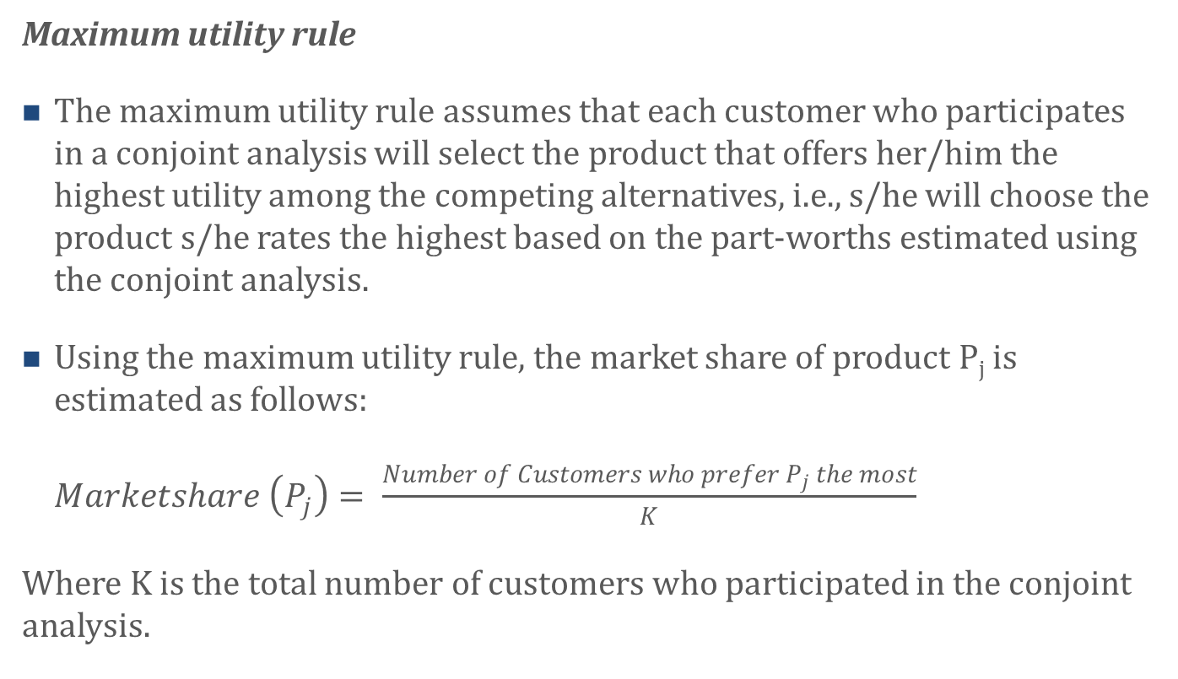
Market Share Forecasts
Maximum utility rule
The maximum utility rule assumes that each customer who participates in a conjoint analysis will select the product that offers her/him the highest utility among the competing alternatives, i.e., s/he will choose the product s/he rates the highest based on the part-worths estimated using the conjoint analysis.
Using the maximum utility rule, the market share of product P_{j} is estimated as follows:
$Marketshare \left(P_{j}\right)= \frac{Number of Customers who prefer P_{j} the most}{K}$
Where K is the total number of customers who participated in the conjoint analysis.

Slide 32
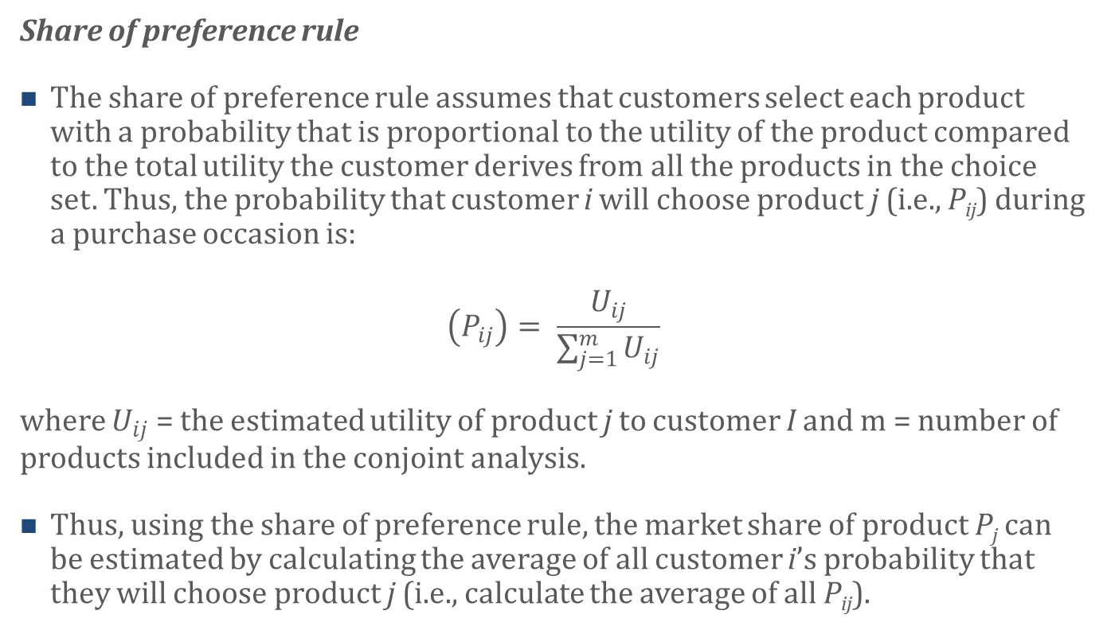
Market Share Forecasts
Share of preference rule
The share of preference rule assumes that customers select each product with a probability that is proportional to the utility of the product compared to the total utility the customer derives from all the products in the choice set. Thus, the probability that customer i will choose product j (i.e., P_{ij}) during a purchase occasion is:
$$\left(P_{ij}\right)= \frac{U_{ij}}{\sum_{j=1}^{m}{U_{ij}}}$$
where $U_{ij}$ = the estimated utility of product j to customer I and m = number of products included in the conjoint analysis.
Thus, using the share of preference rule, the market share of product P_{j} can be estimated by calculating the average of all customer i’s probability that they will choose product j (i.e., calculate the average of all P_{ij}).

Slide 33
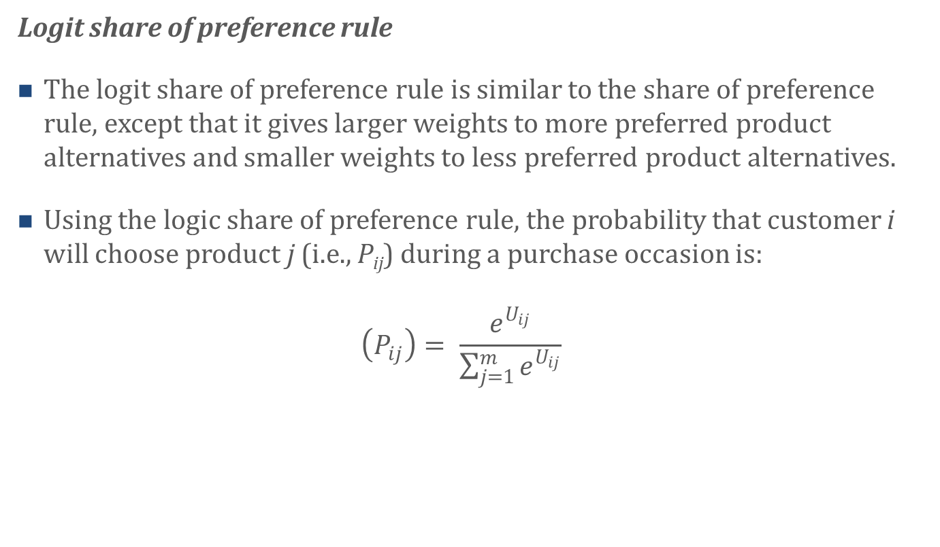
Market Share Forecasts
Logit share of preference rule
The logit share of preference rule is similar to the share of preference rule, except that it gives larger weights to more preferred product alternatives and smaller weights to less preferred product alternatives.
Using the logic share of preference rule, the probability that customer i will choose product j (i.e., P_{ij}) during a purchase occasion is:
$\left(P_{ij}\right)= \frac{e^{U_{ij}}}{\sum_{j=1}^{m}{e^{U_{ij}}}}$

Slide 34
Agenda
Learning Objectives
Introduction
  What is Conjoint Analysis?
  Conjoint Analysis Examples
  Steps in Conjoint analysis
Ratings-based conjoint analysis
  Determining the $-value of Product Attributes
  Multiple Respondents
  Testing the Appropriateness of Product Profiles
  Market Share Forecasts
Using Conjoint Analysis Results for Segmentation
Choice-based Conjoint Analysis
Summary
Takeaways

Slide 35
Using Conjoint Analysis Results for Segmentation
Insights gained from conjoint analysis can also be used for the purpose of segmentation (i.e., segmenting the customers, see Chapter 3).
In particular, customers can be segmented on the basis of their respective part-worths.
For example, there might be a significant number of customers (i.e., large segment) who really like sandwiches made using wheat bread, no meat, with Swiss cheese and lettuce.
If you believe that there are several segments of customers in the data, it may be worth first running a customer segmentation on the preference data.
Then, you can run a conjoint analysis for each of the segments of customers to determine the right product to develop for each customer segment.

Slide 36
Agenda
Learning Objectives
Introduction
  What is Conjoint Analysis?
  Conjoint Analysis Examples
  Steps in Conjoint analysis
Ratings-based conjoint analysis
  Determining the $-value of Product Attributes
  Multiple Respondents
  Testing the Appropriateness of Product Profiles
  Market Share Forecasts
Using Conjoint Analysis Results for Segmentation
Choice-based Conjoint Analysis
Summary
Takeaways

Slide 37
Choice-based Conjoint Analysis
As mentioned above, in choice-based conjoint analysis, customers are asked to make a series of choices among two or more product profiles.
Once customer feedback is collected based on the choice tasks, researchers will go through very similar steps as in the ratings-based analysis. One important difference, however, is that researchers use logistic regression or multinomial logistic regression instead of OLS regression to estimate the part-worths in choice-based conjoint analysis.
Logistic regression (see Chapter 7) is used when customers make choices between 2 options. Multinomial logistic regression is very similar to logistic regression but allows for the inclusion of more than 2 outcome variable options.

Slide 38
Agenda
Learning Objectives
Introduction
  What is Conjoint Analysis?
  Conjoint Analysis Examples
  Steps in Conjoint analysis
Ratings-based conjoint analysis
  Determining the $-value of Product Attributes
  Multiple Respondents
  Testing the Appropriateness of Product Profiles
  Market Share Forecasts
Using Conjoint Analysis Results for Segmentation
Choice-based Conjoint Analysis
Summary
Takeaways

Slide 39
Summary
Asking customers direct questions about their product preferences often leads to uninspiring answers. Indeed, customers typically want everything and they want it for free.
Conjoint analysis avoids this problem. Rather than asking customers direct questions about their product preferences (e.g., how much are you willing to pay for your cable subscription), conjoint analysis presents customers with different product attribute combinations (e.g., different cable subscription options including different price levels, etc.) and then asks the customers to evaluate these combinations.
The resulting customer feedback allows researchers to derive the utility customers assign to the various product attributes as well as levels of attributes, even those not directly evaluated by the customers.
Moreover, if different price levels are included as a product attribute, conjoint analysis can also be used to assess a target customer’s willingness to pay (WTP) for different product attributes and different product attribute levels.

Slide 40
Summary
Conjoint analysis can also be used to make sales and market share forecasts of different products and help with segmentation.
Conjoint analysis is one of the most commonly used marketing research and analytics techniques. It has been successfully applied in business-to-consumer and business-to-business settings as well as to gain insights about goods and services – real or hypothetical.
Conjoint analysis requires six steps: (1) Select product attributes to be included; (2) Select the product attribute levels to be included; (3) Create the product profiles. Note that it is best to use software packages such as R to create profiles; (4) Collect data from target customers; (5) Estimate the utility (also referred to as part-worths) of the product attributes and levels using regression analysis. This can be easily done in R; (6) Analyze the results.

Slide 41
Agenda
Learning Objectives
Introduction
  What is Conjoint Analysis?
  Conjoint Analysis Examples
  Steps in Conjoint analysis
Ratings-based conjoint analysis
  Determining the $-value of Product Attributes
  Multiple Respondents
  Testing the Appropriateness of Product Profiles
  Market Share Forecasts
Using Conjoint Analysis Results for Segmentation
Choice-based Conjoint Analysis
Summary
Takeaways

Slide 42
Takeaways
Conjoint analysis is a multivariate method for assessing customers’ reactions to predetermined product attribute combinations that represent potential goods or services.
Conjoint analysis can help marketers in designing and pricing their goods and services. It is equally useful for goods and services in business-to-consumer and business-to-business settings.
Even when considering a relatively small set of product attributes and levels when (for example) designing a new product, there are typically many different possible new product combinations. However, in conjoint analysis, customers need to evaluate only a fraction of the possible new product combinations. That said, researchers are still able to make inferences about all new product combinations, including those not directly evaluated by the customers.
There are different approaches to conjoint analysis. Among those, ratings-based and choice-based conjoint analysis are particularly popular. In ratings-based conjoint analysis, customers independently rate a subset of the product profiles on, for example, a scale of 0 – 100. In contrast, in choice-based conjoint analysis, customers are asked to make a series of choices among two or more product profiles presented to them.

Slide 43
Takeaways
Regression analysis is used in conjoint analysis to estimate customers’ preferences – or part-worths of the various product attributes and product attribute levels. Specifically, in ratings-based conjoint analysis, standard OLS regression analysis is used for the estimation. In contrast, in choice-based conjoint analysis, logistic regression or multinomial logistic regression is used to estimate the part-worths.
In the regression analyses, the respective level of each attribute associated with each rating is captured and included using dummy variables. These dummy variable(s) form the independent variable(s) in the OLS and logistic/multinomial regression analyses. Also, in ratings-based conjoint analysis, the customers’ ratings of the respective product profile are used as the dependent variable (DV), whereas in choice-based conjoint analysis, the customers’ product choices are used as the DV.
It is best to use software packages such as R to create the product profiles customers evaluate. That said, researchers can examine the correlation matrix of the included dummy variables (the independent variables) to test the appropriateness of the product profiles.
Conjoint analysis results can be used to forecast market shares of various product profiles assuming the analysis is conducted with a representative sample of customers.
Insights gained from conjoint analysis can be used to identify customer segments.

