Slide 1

Marketing Analytics
Based on First Principles :
Chapter 11
Survey Design and Testing to
Derive Customer Insights

Slide 2
Agenda
Learning Objectives
Introduction
  Principles of Questionnaire Design
  Types of Questions
  The Art of Asking Questions
  Questionnaire Layout
Principles of Sampling
  Probability versus Quota Sampling
  Sample Size for Estimating the Population Mean
  Sample Size for Estimating Proportions
  Sample Size Heuristics
Scales and Factor analysis
  Scale Development Process
  What is Factor analysis?
  Model Underlying Factor Analysis
  Number of Factors to Retain
  Interpretation of Factors
Summary
Takeaways

Slide 3
Learning Objectives
Be able to describe the most common methods used to administer questionnaires. Explain the advantages and disadvantages of these methods.
Understand the different types of scales that exist.
Be able to successfully design a questionnaire.
Understand the difference between probability and quota sampling, and know when to use which type of sampling.
Be able to calculate the sample size needed to estimate the population mean and proportion.
Understand what a latent construct is.
Know what factor analysis is and how it differs from principal component analysis (PCA) and cluster analysis.
Understand how factors can be rotated and know the difference between orthogonal and oblique factor rotation.

Slide 4
Agenda
Learning Objectives
Introduction
  Principles of Questionnaire Design
  Types of Questions
  The Art of Asking Questions
  Questionnaire Layout
Principles of Sampling
  Probability versus Quota Sampling
  Sample Size for Estimating the Population Mean
  Sample Size for Estimating Proportions
  Sample Size Heuristics
Scales and Factor analysis
  Scale Development Process
  What is Factor analysis?
  Model Underlying Factor Analysis
  Number of Factors to Retain
  Interpretation of Factors
Summary
Takeaways

Slide 5
Principles of Questionnaire Design
Conducting marketing analytics requires data. Sometimes, the data needed is already available to the researcher and does not need to be collected. In that case, researchers use what is referred to as secondary data, that is, data that was initially collected for a different purpose (e.g., data from the Census Bureau).
At other times, new data needs to be collected. This type of data is referred to as primary data. There are various ways to obtain primary data.
However, an oft-used method entails collecting data by means of questionnaires.

Slide 6
Principles of Questionnaire Design
A questionnaire is a formalized set of questions for obtaining information from respondents to generate the data necessary to accomplish the objectives of the research project.
Based on this definition, we can see that questionnaires should:
  Include a set of specific questions that the respondents can and will answer
  Should facilitate data processing. Specifically, it should be easy to record questionnaire answers, and code and analyze the responses
  Provide the information and data needed to answer the question(s) the researcher seeks to answer with the questionnaire

Slide 7
Principles of Questionnaire Design
Questionnaires can be administered in various ways. The four most common methods are:
  Personal (i.e., face-to-face) interviews
  Telephone interviews
  Mail questionnaires
  Online questionnaires
Each one of these methods has advantages and disadvantages.

Slide 8
Principles of Questionnaire Design
Advantages | Disadvantages
Personal Interviews
Flexibility in obtaining data | Bias of interviewer
Face-to-face encounter | Response bias
Ability to clear doubt in person | Time requirements
Can arouse and keep interest | Cost per completed interview is high
Can build rapport
Assistance of visual aid
Can clarify misunderstandings
Can probe for more complete answers
Telephone Interviews
Can be performed in a short period of time | Calls must be kept as short as possible
Low non-response rate | Bias of interviewer
Lower cost than personal interview | Difficult to use visual aids
Ability to clear doubt in person | Viewed as disrespectful by some
Can clarify misunderstandings | Difficulty obtaining accurate sample
Can probe for more complete answers

Slide 9
Principles of Questionnaire Design
Advantages | Disadvantages
Mail Questionnaires
Can cover broad respondent base | High non-response rate (many people do not mail the questionnaires back)
Lower cost compared to personal and telephone interviews | Cost-per survey could be high
Often more thought given to responses (compared to online) | Questions can be misinterpreted
Can be more effective when dealing with sensitive topics if anonymous | Cannot control for the identity of the respondent
 | Can be difficult to compile accurate mailing list
Online Questionnaires
Fast turnaround in administering questionnaire | High non-response rate
Relatively inexpensive | Questions can be misinterpreted
Immediate return upon completion | Respondents do not give answers much thought
Flexible design options (e.g., different questions appear based on previous answers) | Cannot control for the identity of the respondent
Inexpensive online questionnaire solutions exist

Slide 10
Types of Questions
There are two types of questions that are typically included in questionnaires:
Open-ended questions. An example of an open-ended question is: “What comes to your mind when you think of brand XYZ? Please list all your thoughts.” Some advantages of open-ended questions are that they (i) can provide very rich information and (ii) are good for exploratory research (for example, when the researchers are unsure about the questions to ask). Some of the disadvantages of open-ended questions are that they (i) are sometimes difficult to analyze and (ii) can be burdensome for the respondent.
Closed-ended questions. Examples of commonly used closed-ended question types in questionnaires are:
  Multiple choice questions (e.g., which of the following running shoe brands have you owned in the last 10 years: Nike, Adidas, Under Armour, Asics, New Balance, None of the above);
  Dichotomous (or binary) questions (e.g., have you heard of brand XYZ? Yes, No);
  Scaled response questions (e.g., On a scale from 1 – 7, how likely are you to purchase Nike shoes next time you purchase running shoes, where 1 means not at all likely and 7 means extremely likely).

Slide 11
Types of Questions
The scales of closed-ended questions depend of the question being asked. Importantly, there are four types of scales:
  Nominal scales are used in questions where the answer choices are named but they do not have an order or direction.
  Ordinal scales have an order, and the order is important. However, the difference between the answer choices is not known.
  Interval scales have an order, and the difference between each answer choice is known. Marketing researchers commonly use Likert scales. Likert scales are commonly constructed with five, seven, or nine points (see scaled response question example above) and are typically treated as an interval scale.
  Ratio scales are the same as interval scales but they also have a true zero. Examples are questions such as “how much do you spend on running shoes every year?”

Slide 12
The Art of Asking Questions
When designing a questionnaire, it is critical to make sure (i) the “right” kind of questions are included and (ii) the questions are worded appropriately.
The wording of the questions should be clear, the questions should not bias the respondent, and the respondent should be able and willing to answer the questions.
For example:
  “Do you own any stock? Yes, No.”
  Surprising to the researchers, a high degree of stock ownership turned up in rural areas. However, after investigating the responses some more, the researchers realized many respondents thought the question was about livestock (whereas the survey question was about financial products, i.e., stocks).

Slide 13
The Art of Asking Questions
When composing a questionnaire, it is important for the researcher to be clear on why she is asking a question.
In summary, some of the keys to writing useful questions on a questionnaire are as follows:
  Avoid complexity – use simple, conversational language
  Avoid leading and loaded questions
  Avoid ambiguity – be as specific as possible
  Avoid double-barreled questions
  Avoid making assumptions
  Avoid burdensome questions
  Avoid badly designed response categories

Slide 14
Questionnaire Layout
Questionnaires should be designed to appear as short as possible. One common practice is to use multiple-grid layout where similar questions and response alternatives are arranged in a grid format.

Slide 15
Questionnaire Layout
Questionnaires should start with easy to answer questions to build rapport with the respondent and to indicate that the questionnaire is not burdensome.
Tough and important questions should be placed in the middle of the questionnaire. At that stage, the respondent has likely committed to completing the questionnaire and is expected to answer these questions accurately.
Sensitive and/or demographic questions, in turn, should be asked at the end of the questionnaire to avoid making the respondent feel uneasy earlier on.

Slide 16
Questionnaire Layout
An Example:

Slide 17
Agenda
Learning Objectives
Introduction
  Principles of Questionnaire Design
  Types of Questions
  The Art of Asking Questions
  Questionnaire Layout
Principles of Sampling
  Probability versus Quota Sampling
  Sample Size for Estimating the Population Mean
  Sample Size for Estimating Proportions
  Sample Size Heuristics
Scales and Factor analysis
  Scale Development Process
  What is Factor analysis?
  Model Underlying Factor Analysis
  Number of Factors to Retain
  Interpretation of Factors
Summary
Takeaways

Slide 18
Probability versus Quota Sampling
When administering questionnaires, researchers usually want to obtain a big enough sample to make valid inferences about the population they are studying and interested in.
The question, however, is how many respondents do researchers have to get feedback from to make valid inferences about the population of interest. And how should the respondents be selected?

Slide 19
Probability versus Quota Sampling
There are two broad ways to select respondents
Probability sampling entails random selection of respondents (i.e., the sample). For example, a company might have a database that includes contact details of all its 10,000 customers. The company could randomly select 300 customers for the survey.
Quota sampling, as the name suggests, is based on quotas. For example, a company may have decided it wants to collect data from 300 respondents. Rather than randomly selecting the 300 respondents from the population of interest, the company’s researcher contacts every person in his contact list until he has responses from 300 respondents. Because the selection of the respondents is left to the subjective judgment of the researcher – or in the example here, his non-random contact list.

Slide 20
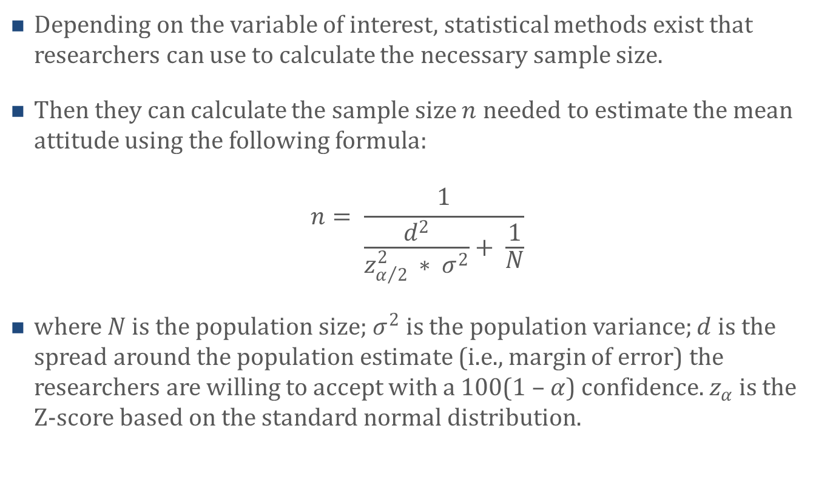
Sample Size for Estimating the Population Mean
Depending on the variable of interest, statistical methods exist that researchers can use to calculate the necessary sample size.
Then they can calculate the sample size $n$ needed to estimate the mean attitude using the following formula:
$$n= \frac{1}{\frac{d^{2}}{z_{α/2 }^{2}∗ σ^{2}}+ \frac{1}{N}}$$
where $N$ is the population size; $σ^{2}$ is the population variance; $d$ is the spread around the population estimate (i.e., margin of error) the researchers are willing to accept with a 100(1 – $α$) confidence. $z_{α}$is the Z-score based on the standard normal distribution.

Slide 21
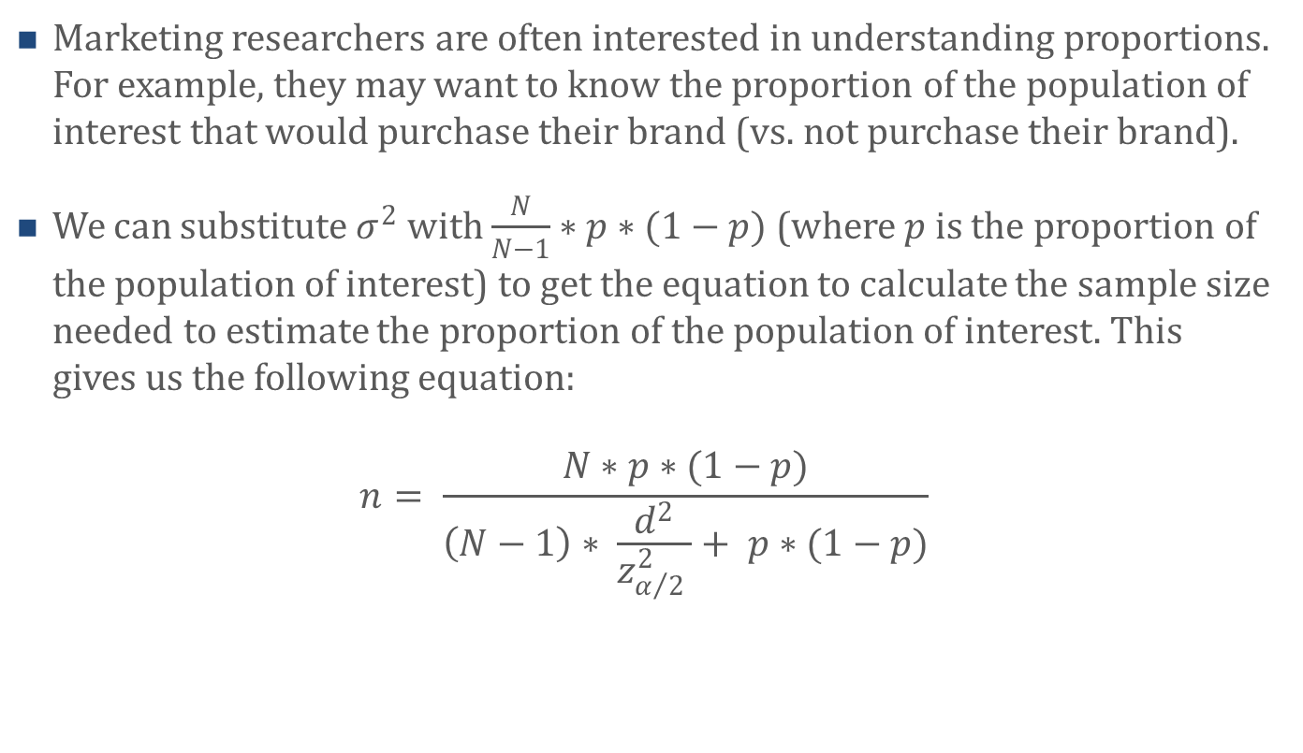
Sample Size for Estimating Proportions
Marketing researchers are often interested in understanding proportions. For example, they may want to know the proportion of the population of interest that would purchase their brand (vs. not purchase their brand).
We can substitute $σ^{2}$ with $\frac{N}{N−1}∗p∗(1−p)$ (where $p$ is the proportion of the population of interest) to get the equation to calculate the sample size needed to estimate the proportion of the population of interest. This gives us the following equation:
$$n= \frac{N∗p∗(1−p)}{\left(N−1\right)∗ \frac{d^{2}}{z_{α/2 }^{2}}+ p∗(1−p)}$$

Slide 22
Sample Size Heuristics
Although it is generally a good idea to use the above formulas to calculate the required sample size, some researchers rely on simple sample size heuristics.
A common heuristic is to have at least 5 times as many responses as there are survey questions, and a minimum of 50 responses. Thus, if the survey includes 20 questions, the sample size should be 100 (i.e., 20 x 5).

Slide 23
Agenda
Learning Objectives
Introduction
  Principles of Questionnaire Design
  Types of Questions
  The Art of Asking Questions
  Questionnaire Layout
Principles of Sampling
  Probability versus Quota Sampling
  Sample Size for Estimating the Population Mean
  Sample Size for Estimating Proportions
  Sample Size Heuristics
Scales and Factor analysis
  Scale Development Process
  What is Factor analysis?
  Model Underlying Factor Analysis
  Number of Factors to Retain
  Interpretation of Factors
Summary
Takeaways

Slide 24
Scale Development Process
Survey constructs of interest are often latent and hence cannot be directly observed.
Researchers typically use scales to measure latent constructs.
Scales usually include multiple questions where each question captures a different (yet related) aspect of the latent construct.
Marketers have developed hundreds of scales over the years, and researchers use these existing scales on a regular basis.
Sometimes, however, there are no existing scales, or the ones that exist do not fully meet the needs of the researchers. In those cases, researchers have to develop their own scale(s).

Slide 25
Scale Development Process
The scale development process typically follows a four-phase iterative procedure.
  Generating survey questions (also referred to as items) that capture the essence of the construct of interest.
  Researchers usually engage other researchers to evaluate the clarity and appropriateness of each of the survey questions they developed and to perhaps expand the list of questions.
  Researchers usually administer the resulting questions to a small sample of target respondents to assess any ambiguity or difficulty that they experienced when responding.
  Researchers will administer the survey questions (i.e., the scale) along with other survey questions to target respondents.

Slide 26
Scale Development Process
Researchers will typically use the responses to this survey to assess the reliability and validity of the newly developed scale.
There are a number of analyses researchers can use to assess scale (or construct) reliability and validity. In what follows, we focus on one of the key techniques: Factor analysis.

Slide 27
What is Factor analysis?
Factor analysis is a statistical technique used to analyze interrelationships (i.e., correlations) among a large number of variables and to explain these variables in terms of their common underlying dimensions (referred to as factors).
The main objective of factor analysis is condensing the information contained in the original variables into a small set of factors with a minimum loss of information.
Considering scale development, factor analysis is used to determine if all scale items (i.e., questions) load onto the same factor.

Slide 28
What is Factor analysis?
Factor analysis is very similar to principal components analysis (PCA) discussed in Chapter 5.
Indeed, both analyses are used to simplify the structure of a set of variables.
However, the two analyses also differ in important ways.
  In PCA, the components are calculated as linear combinations of the underlying variables whereas in factor analysis, the underlying variables are defined as linear combinations of the factors.
  Moreover, in PCA, the goal is to explain as much of the total variance in the variables as possible.
  In contrast, the goal of factor analysis is to explain the correlations among the variables.
  Furthermore, PCA is typically used to reduce the data into a smaller number of components whereas factor analysis is used to understand the constructs that underlie the variables.

Slide 29
What is Factor analysis?
Factor analysis is also very similar to cluster analysis discussed in Chapter 3.
Both are used to analyze the structure of relationships.
  However, whereas factor analysis is used to understand the structure of the relationship among variables, cluster analysis is used to identify meaningful subgroups (or clusters) of individuals (e.g., customers) or objects (e.g. companies).
  That is, the objective of cluster analysis is to classify a sample of individuals or objects into a small number of mutually exclusive clusters.

Slide 30
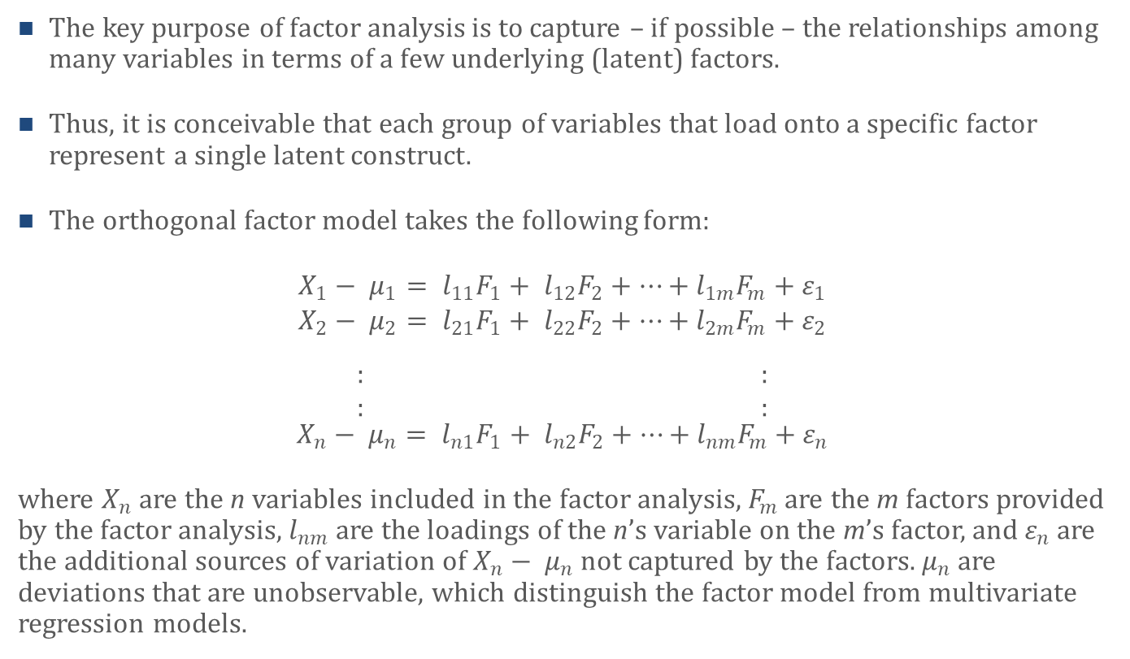
Model Underlying Factor Analysis
The key purpose of factor analysis is to capture – if possible – the relationships among many variables in terms of a few underlying (latent) factors.
Thus, it is conceivable that each group of variables that load onto a specific factor represent a single latent construct.
The orthogonal factor model takes the following form:
$$X_{1}− μ_{1}= l_{11}F_{1}+ l_{12}F_{2}+…+l_{1m}F_{m}+ε_{1}$$
$$X_{2}− μ_{2}= l_{21}F_{1}+ l_{22}F_{2}+…+l_{2m}F_{m}+ε_{2}$$
$\begin{matrix}: \\ :\end{matrix}$ $\begin{matrix}: \\ :\end{matrix}$
$$X_{n}− μ_{n}= l_{n1}F_{1}+ l_{n2}F_{2}+…+l_{nm}F_{m}+ε_{n}$$
where $X_{n}$ are the n variables included in the factor analysis, $F_{m}$ are the m factors provided by the factor analysis, $l_{nm}$ are the loadings of the n’s variable on the m’s factor, and $ε_{n}$ are the additional sources of variation of $X_{n}− μ_{n}$not captured by the factors. $μ_{n}$ are deviations that are unobservable, which distinguish the factor model from multivariate regression models.

Slide 31
Model Underlying Factor Analysis
In unrotated factor analysis, factors are extracted in the order of their importance.
The first factor is usually a general factor onto which almost every variables loads.
Thus, the first factor usually captures the largest amount of variance of the variables.
The second and subsequent factors then capture the residual amount of variance, with each factor accounting for smaller portions of the variance.
That said, factors can also be rotated to redistribute the variance from earlier factors to later factors, thus facilitating the interpretation of the various factors.

Slide 32
Number of Factors to Retain
There are a number of criteria researchers use when deciding on how many factors to retain in a factor analysis.
The most commonly used technique is the “Latent Root (or Eigenvalue) Criterion.” The rationale behind this technique is that any factor should account for the majority of variance of at least one variable. Only factors with an eigenvalue of at least 1 are retained.
Another criterion researchers use to decide on the number of factors to retain is the “Percentage of Variance Criterion.” This criterion is based on attaining at least a specified amount of variance of the variables with the factors.
Some researchers use the “A Priori Criterion.” As the name suggests, in this case, researchers decide before running the factor analysis how many factors they want to retain. Thus, they tell the software to keep a certain number of factors (for example, 4).

Slide 33
Interpretation of Factors
Once the number of factors to retain has been decided upon, the factors need to be interpreted.
Researchers interpret factors based on the variables that load onto the factors.
Importantly, variables are typically associated with (i.e., load onto) most if not all factors. However, they do so with varying degrees.
For example, a variable may have a factor loading of 0.12 with Factor 1 and a factor loading of 0.75 with Factor 2. Thus, this variable would be used to interpret Factor 2 (and not Factor 1).

Slide 34
Interpretation of Factors
An important feature of Factor analysis is that factors can be rotated. Sometimes rotations help with interpreting factors.
In orthogonal factor
rotation, the axes are
maintained at 90 degrees
as the factors are rotated
about the origin.
Thus, the factors remain
uncorrelated with each
other.

Slide 35
Agenda
Learning Objectives
Introduction
  Principles of Questionnaire Design
  Types of Questions
  The Art of Asking Questions
  Questionnaire Layout
Principles of Sampling
  Probability versus Quota Sampling
  Sample Size for Estimating the Population Mean
  Sample Size for Estimating Proportions
  Sample Size Heuristics
Scales and Factor analysis
  Scale Development Process
  What is Factor analysis?
  Model Underlying Factor Analysis
  Number of Factors to Retain
  Interpretation of Factors
Summary
Takeaways

Slide 36
Summary
A good questionnaire is often as easy to create as a good poem – it is difficult to do and takes many iterations. When designing a questionnaire, researchers need to ensure that the “right” kind of questions are included and that those questions are worded appropriately. In particular, the wording of the questions should be clear, the questions should not bias the respondent, and the respondent should be able and willing to answer the questions. Questionnaire designs should make use of a funnel approach and move from broader to narrower questions.
To gain meaningful insights from questionnaires, researchers seek to obtain a big enough sample to make valid inferences about the population they are studying and interested in. Researchers are well advised to use probability sampling, that is, randomly select their questionnaire respondents. Using probability sampling allows researchers to assess estimates resulting from the sampling probabilistically. There are several methods researchers can use to calculate the necessary sample size. Although it is generally a good idea to use these methods, some researchers rely on simple sample size heuristics instead.

Slide 37
Summary
Questionnaires often include latent constructs, i.e., constructs that cannot be directly observed. Questionnaire scales (or simply scales) are frequently used to measure these latent constructs. Scales typically include multiple questions where each question captures a different (yet related) aspect of the latent construct. Marketers have developed many different scales and researchers frequently use these scales. However, sometimes researchers have to develop their own scales. To do so, they are well advised to follow a four-phase iterative scale development process. This process includes assessing the reliability and validity of the newly developed scales. There are a number of methods researchers can use to assess scale reliability and validity. A key method is factor analysis.
Factor analysis is a statistical technique used to analyze interrelationships among variables. It is used to explain variables in terms of their common underlying dimensions, referred to as factors. Considering the scale development process, factor analysis is used to determine if all scale items (i.e., questions) load onto the same factor.

Slide 38
Agenda
Learning Objectives
Introduction
  Principles of Questionnaire Design
  Types of Questions
  The Art of Asking Questions
  Questionnaire Layout
Principles of Sampling
  Probability versus Quota Sampling
  Sample Size for Estimating the Population Mean
  Sample Size for Estimating Proportions
  Sample Size Heuristics
Scales and Factor analysis
  Scale Development Process
  What is Factor analysis?
  Model Underlying Factor Analysis
  Number of Factors to Retain
  Interpretation of Factors
Summary
Takeaways

Slide 39
Takeaways
Much thought needs to go into designing a good questionnaire.
How questions are asked in a questionnaire matters.
Questionnaires are most commonly administered online using online survey tools such as Qualtrics or SurveyMonkey, although other methods are still used. The researcher needs to decide which method is most advantageous given the research question at hand.
There are four types of scales: Nominal, ordinal, interval, and ratio. Key differences among these scales are whether (1) the values have a meaningful order, (2) the order can be quantified, and (3) the values have a “true” zero.

Slide 40
Takeaways
Marketing researchers commonly use Likert scales that are typically treated as interval scales (although some argue Likert scales should be treated as ordinal scales).
Researchers frequently use heuristics to decide how big of a sample to use. However, the necessary sample size to estimate population means and proportions can be easily calculated with simple formulas.
Researchers should use probability sampling whenever possible.
Factor analysis is a statistical technique used to analyze interrelationships (i.e., correlations) among a large number of variables and to explain these variables in terms of their common underlying dimensions (referred to as factors).
Factors that emerge from factor analysis are interpreted using the variables that load onto the factors. Factors can be rotated about the origin to facilitate factor interpretation.

