Slide 1

Marketing Analytics
Based on First Principles :
Chapter 8
Using Logistic Regression for
Customer Selection

Slide 2
Agenda
Learning Objectives
Introduction
  Objectives of Logistic Regression Models
  Common Uses of Logistic Regression Models
  Logistic Regression Example
Logistic Regression
  Logistic Regression Model
  Odds of an Event
  Model Fit and Testing for Significance of the Coefficients
  Odds Ratio in Logistic Regression
  Example
    Logistic regression with one predictor variable
    Logistic regression with multiple predictor variables
Summary
Takeaways

Slide 3
Learning Objectives
Know when to use logistic regression as opposed to (for example) OLS regression
Understand what type of variables are used in logistic regression
Know what form a logistic regression model takes
Be able to estimate probabilities using logistic regression output
Understand the difference between probabilities and odds
Know how to convert probabilities into odds, and vice versa

Slide 4
Learning Objectives
Know what the odds ratio is, how it is calculated and used
Understand what type of model fit measures are used in logistic regression models
Know how the significance of logistic regression coefficients is determined
Know how to calculate Pseudo R²
Understand and know how to create and understand a confusion matrix based on logistic regression results
Know how to use logistic regression to compute the profitability and return on marketing investment (ROMI) of a marketing campaign

Slide 5
Agenda
Learning Objectives
Introduction
  Objectives of Logistic Regression Models
  Common Uses of Logistic Regression Models
  Logistic Regression Example
Logistic Regression
  Logistic Regression Model
  Odds of an Event
  Model Fit and Testing for Significance of the Coefficients
  Odds Ratio in Logistic Regression
  Example
    Logistic regression with one predictor variable
    Logistic regression with multiple predictor variables
Summary
Takeaways

Slide 6
Objectives of Logistic Regression Models
Logistic regression is similar to linear regression such as ordinary least squares (OLS). It is used to estimate the effect of one or more independent variables x on a dependent variable y.
However, in contrast to (e.g.) OLS, where the dependent variable is continuous in nature, logistic regression is used when the dependent variable has only two possible categories, i.e., is binary.
As such, the objective of logistic regression is to determine how one or more independent variables x impact the probability that an observation falls into one of the two categories captured by the y variable.

Slide 7
Common Uses of Logistic Regression Models
Logistic regression is commonly used by Marketing researchers.
  It is a popular method used in customer acquisition. Will a certain customer buy the company’s product (yes/no)? Note that the outcome (or dependent) variable is binary, and hence logistic regression can be used to identify and use x variables that predict whether or not a customer buys a product etc.
  It can be used to predict retention of current customers (yes/no). Which customers are most likely to defect considering certain predictor (x) variables? Once customers at risk of defecting have been identified, marketers can employ interventions targeted at those customers they do not want to lose (but are likely to defect otherwise).
  It can be used to estimate the likelihood that a person will respond favorably to a mailing campaign (yes/no).

Slide 8
Logistic Regression Example
MyFriend is a relatively new insurance company specializing in car insurance policies.
It prides itself in its effective use of marketing analytics. Using customer data from the last 5 years, Max, MyFriend’s up and coming Analytics Manager, recently developed a model that helps the company identify current customers who are at risk of churning, that is, leaving the company for a competitor.
As part of his modeling approach, Max first pulled data from the local company server on all of MyFriend’s current and former insurance policy holders, including whether they had churned sometime during the last 5 years (captured by a binary variable: 1 = yes, 0 = no), the customer’s complaint behavior, gender, age, higher education, annual income, geographic information etc.

Slide 9
Logistic Regression Example
Max estimated a logistic regression model where he used the respective customer’s churn information as the dependent variable (i.e., customer churned: yes, no) and the other customer variables as the independent variables.
The model indicated that churn probabilities of MyFriend’s current customers ranged from as low as 9% to as high as 99%. He showed these results to his manager, MyFriend’s Director of Marketing, who was intrigued by the models’ strong fit.
Together, they appended a variable they had previously calculated that captured each customer’s worth to MyFriend. That variable was based on how much MyFriend earned from each customer – the average annual premium received per customer – minus the average yearly customer costs due to insured events etc.

Slide 10
Logistic Regression Example
They then sorted the customers by (1) customer worth and (2) probability of churning. Many of MyFriend’s most valuable customers had a high probability of churning.
Armed with these insights, Max’s Manager assembled a team and tasked it with identifying interventions they could target at MyFriend’s most valuable customers with high probability of churning.
She hoped these interventions would keep these customers happy and thus not cancel their insurance policy.

Slide 11
Agenda
Learning Objectives
Introduction
  Objectives of Logistic Regression Models
  Common Uses of Logistic Regression Models
  Logistic Regression Example
Logistic Regression
  Logistic Regression Model
  Odds of an Event
  Model Fit and Testing for Significance of the Coefficients
  Odds Ratio in Logistic Regression
  Example
    Logistic regression with one predictor variable
    Logistic regression with multiple predictor variables
Summary
Takeaways

Slide 12
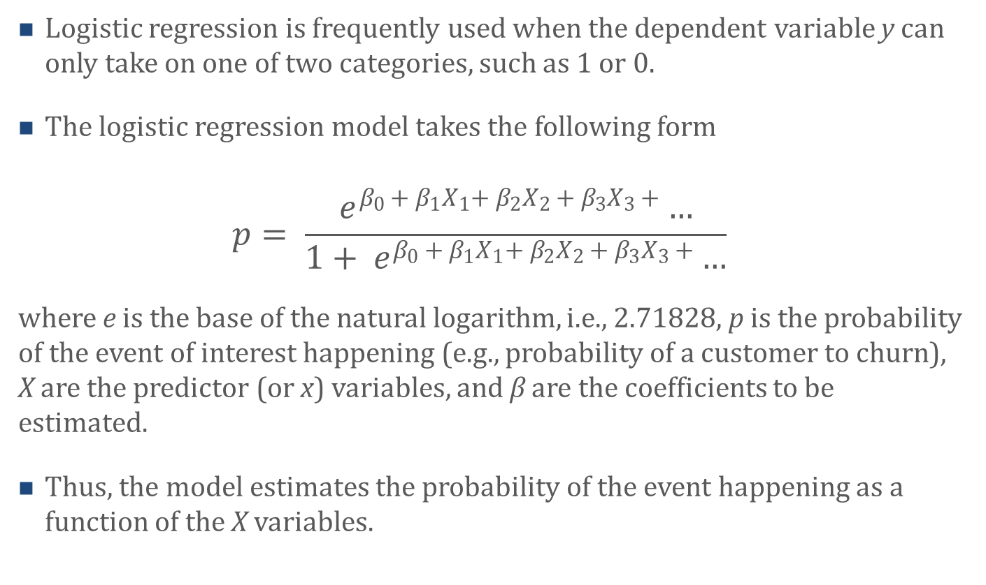
Logistic Regression Model
Logistic regression is frequently used when the dependent variable y can only take on one of two categories, such as 1 or 0.
The logistic regression model takes the following form
  $$p= \frac{e^{β_{0 }+ β_{1}X_{1}{+ β}_{2}X_{2 }{+ β}_{3}X_{3 }+}…}{1+ e^{β_{0 }+ β_{1}X_{1}{+ β}_{2}X_{2 }{+ β}_{3}X_{3 }+}…}$$
where e is the base of the natural logarithm, i.e., 2.71828, p is the probability of the event of interest happening (e.g., probability of a customer to churn), X are the predictor (or x) variables, and β are the coefficients to be estimated.
Thus, the model estimates the probability of the event happening as a function of the X variables.

Slide 13
Logistic Regression Model
Since they are probabilities, estimates of p will always be between 0 and 1.
Logistic regression can be performed with one or more x variables that can be either continuous of binary.
With only one x variable,
the probability p of a focal
event happening follows
an s-shape with
asymptotes at 0 and 1.
For example, see the figure
to the right.

Slide 14
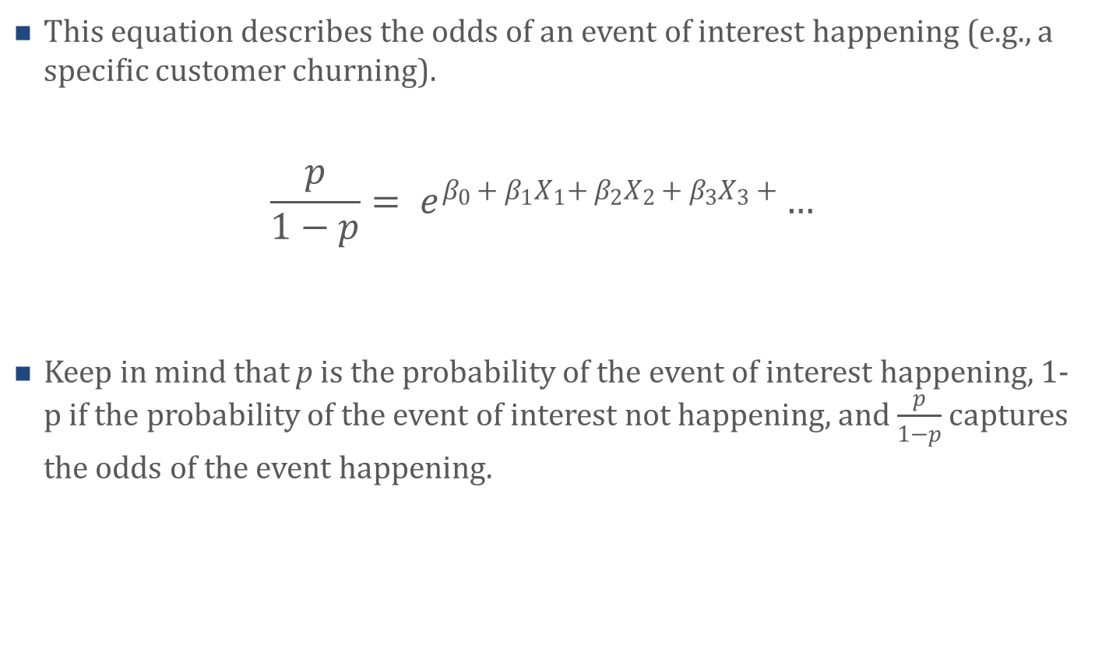
Odds of an Event
This equation describes the odds of an event of interest happening (e.g., a specific customer churning).
$$\frac{p}{1−p}= e^{β_{0 }+ β_{1}X_{1}{+ β}_{2}X_{2 }{+ β}_{3}X_{3 }+}…$$
Keep in mind that p is the probability of the event of interest happening, 1-p if the probability of the event of interest not happening, and $\frac{p}{1−p}$ captures the odds of the event happening.

Slide 15
Odds of an Event
Probability and odds are often used interchangeably. However, they are not equivalent mathematically.
  Probability ranges between 0 and 1, where 0 is an impossible event and 1 an inevitable event.
  Probability is usually reported as a percentage ranging from 0% to 100% (which is equivalent to ranging from 0 and 1).
  Probability captures the ratio of how often an event of interest occurred (e.g., customers who churned) over all possible events (e.g., customers who did and did not churn).
  Odds on the other hand can range from 0 to infinity. Odds capture the ratio of how often an event of interest occurred (e.g., customers who churned) over how often it did not occur (e.g., customer who did not churn).

Slide 16
Model Fit and Testing for Significance of the Coefficients
Instead of minimizing the squared deviations (i.e., least squares) like OLS regression does, logistic regression uses maximum likelihood to estimate the regression coefficients. That is, it maximizes the likelihood that an event occurs using iterative computing methods. Thus, logistic regression model fit is also assessed differently.
A likelihood value (i.e., - 2 times the log of the likelihood value, or -2LL) is used to determine how well a logistic regression model fits overall. Models that fit well have a small -2LL value, and a -2LL value of 0 indicates perfect model fit.

Slide 17
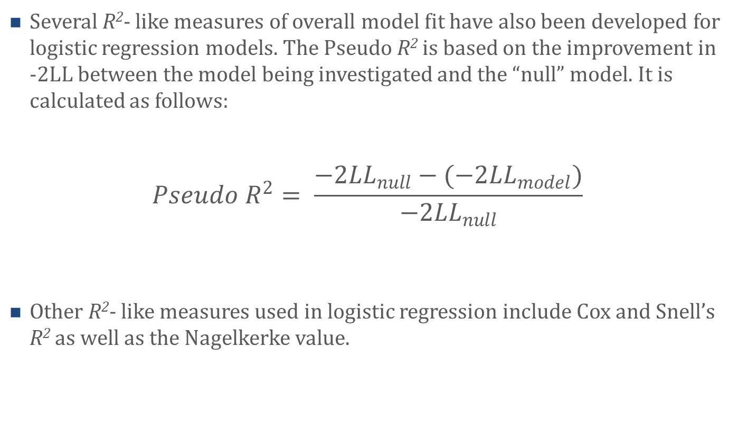
Model Fit and Testing for Significance of the Coefficients
Several R²- like measures of overall model fit have also been developed for logistic regression models. The Pseudo R² is based on the improvement in -2LL between the model being investigated and the “null” model. It is calculated as follows:
$$Pseudo R^{2}= \frac{{−2LL}_{null}−(−{2LL}_{model})}{{−2LL}_{null}}$$
Other R²- like measures used in logistic regression include Cox and Snell’s R² as well as the Nagelkerke value.

Slide 18
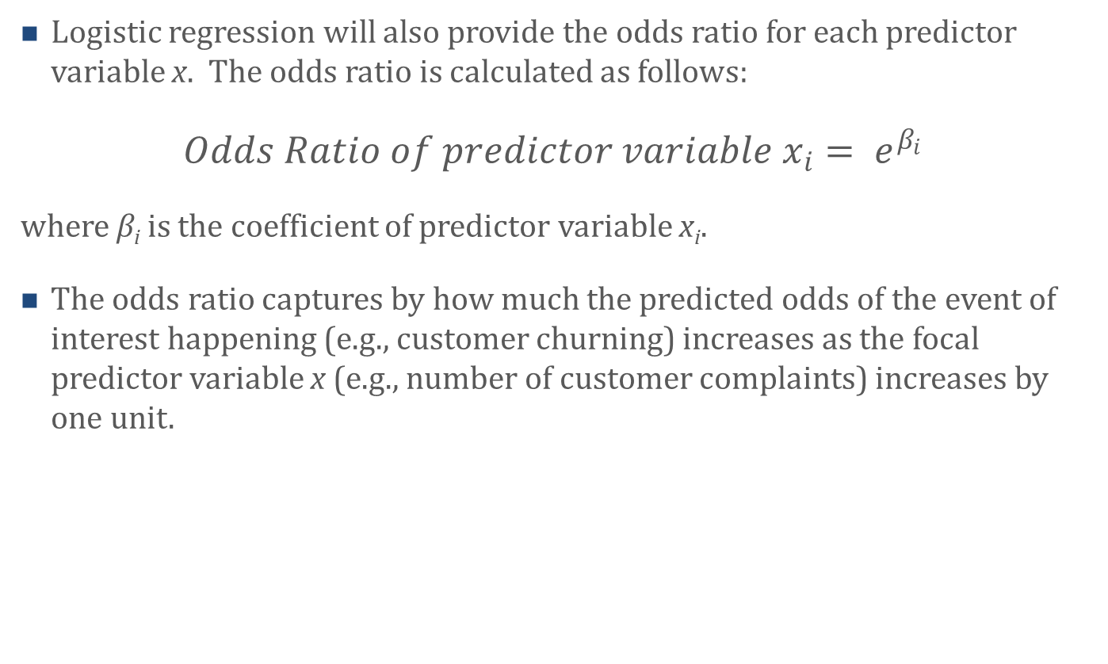
Odds Ratio in Logistic Regression
Logistic regression will also provide the odds ratio for each predictor variable x. The odds ratio is calculated as follows:
$Odds Ratio of predictor variable x_{i}= e^{β_{i}}$
where β_{i} is the coefficient of predictor variable x_{i}.
The odds ratio captures by how much the predicted odds of the event of interest happening (e.g., customer churning) increases as the focal predictor variable x (e.g., number of customer complaints) increases by one unit.

Slide 19
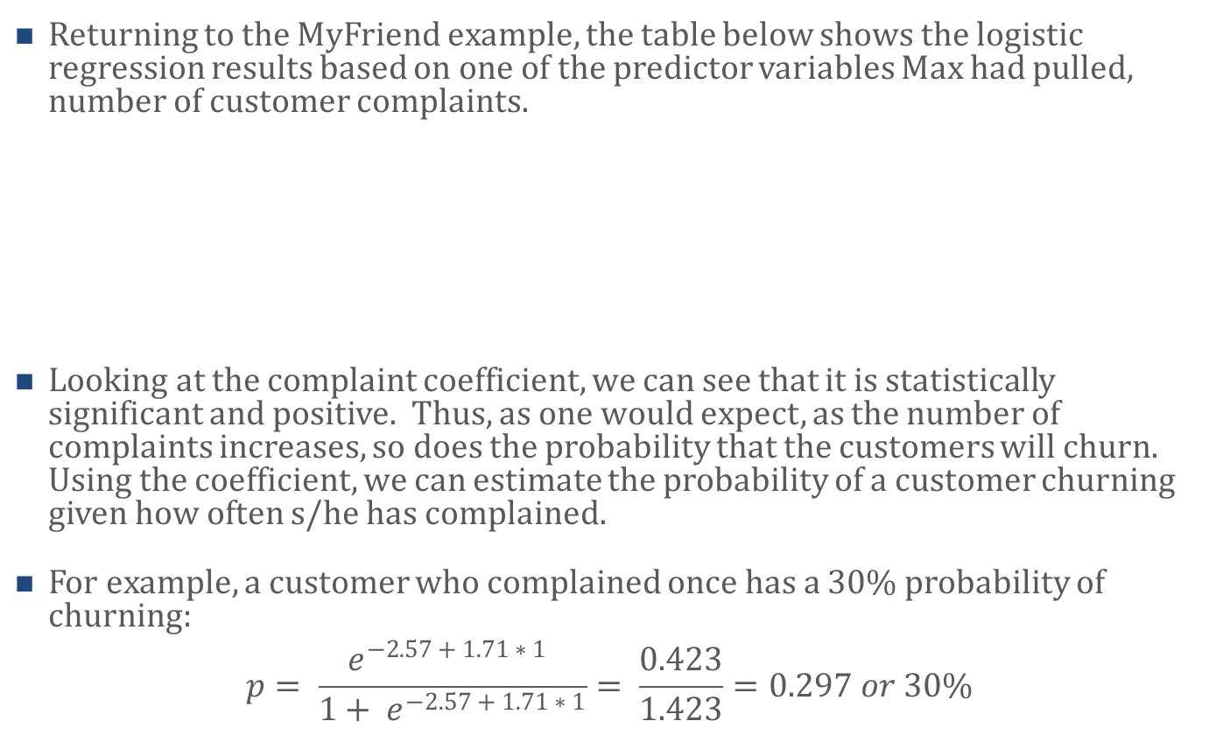
Logistic regression with one predictor variable
Returning to the MyFriend example, the table below shows the logistic regression results based on one of the predictor variables Max had pulled, number of customer complaints.
Looking at the complaint coefficient, we can see that it is statistically significant and positive. Thus, as one would expect, as the number of complaints increases, so does the probability that the customers will churn. Using the coefficient, we can estimate the probability of a customer churning given how often s/he has complained.
For example, a customer who complained once has a 30% probability of churning:
$$p= \frac{e^{−2.57 + 1.71 ∗ 1 }}{1+ e^{−2.57 + 1.71 ∗ 1}}= \frac{0.423}{1.423}=0.297 or 30\%$$
Predictor variable | Coefficient | Standard Error | z-value | p-value | Odds Ratio
Constant | -2.57 | .296 | -8.66 | .000 | .07
Complaints | 1.71 | .181 | 9.43 | .000 | 5.52

Slide 20
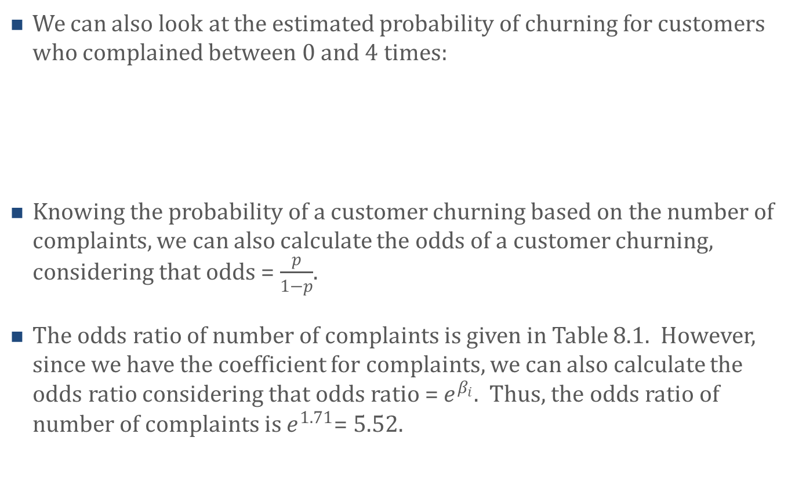
Logistic regression with one predictor variable
We can also look at the estimated probability of churning for customers who complained between 0 and 4 times:
Knowing the probability of a customer churning based on the number of complaints, we can also calculate the odds of a customer churning, considering that odds = $\frac{p}{1−p}$.
The odds ratio of number of complaints is given in Table 8.1. However, since we have the coefficient for complaints, we can also calculate the odds ratio considering that odds ratio = $e^{β_{i}}$. Thus, the odds ratio of number of complaints is $e^{1.71}$= 5.52.
# of times complained | 0 | 1 | 2 | 3 | 4
Estimated probability of churning | 7% | 30% | 70% | 93% | 98%
Estimated odds of churning | .076 | .42 | 2.3 | 12.9 | 71.5

Slide 21
Logistic regression with multiple predictor variables
Let us add two additional predictor variables to the logistic regression model. That is, besides number of complaints, let us also include age and gender as predictor variables. Gender is a binary variable coded as 0 = female, 1 = male.
Looking across the coefficients, we can see that two predictor variables are statistically significant: The number of complaints and age. In contrast, gender is not significant.
Predictor variable | Coefficient | Standard Error | z-value | p-value | Odds Ratio
Constant | 1.24 | .69 | 1.85 | .064 | 3.45
Complaints | 1.74 | .23 | 7.73 | .000 | 5.69
Age | -.103 | .02 | -5.72 | .000 | .902
Gender | -.00 | .45 | -.000 | 1.000 | .999

Slide 22
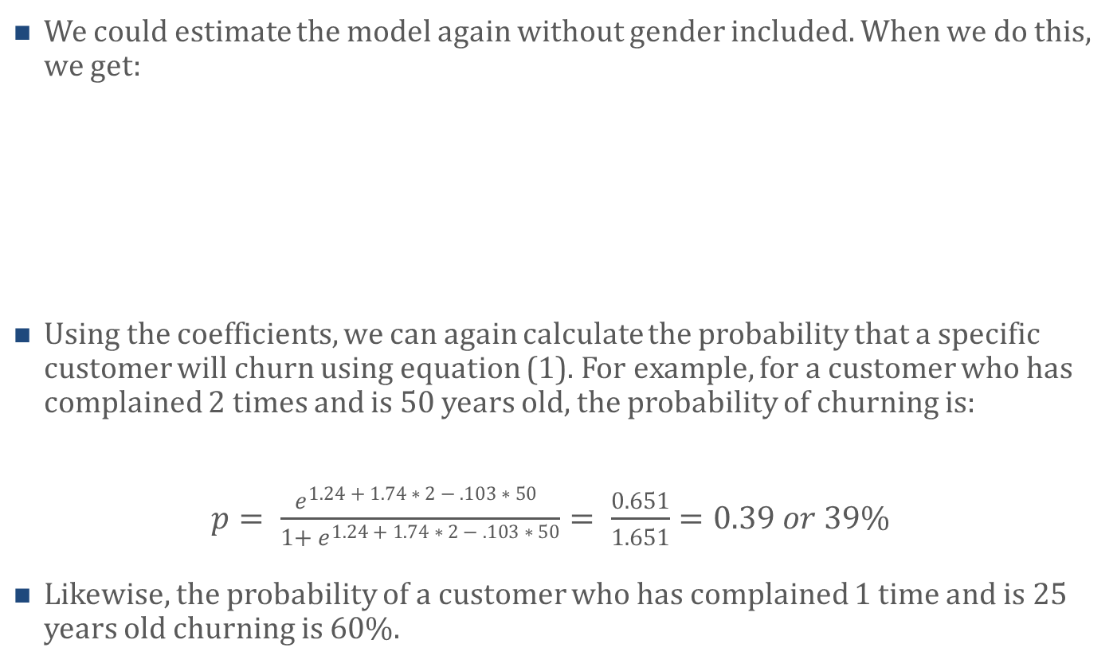
Logistic regression with multiple predictor variables
We could estimate the model again without gender included. When we do this, we get:
Using the coefficients, we can again calculate the probability that a specific customer will churn using equation (1). For example, for a customer who has complained 2 times and is 50 years old, the probability of churning is:
$p= \frac{e^{1.24 + 1.74 ∗ 2 − .103 ∗ 50 }}{1+ e^{1.24 + 1.74 ∗ 2 − .103 ∗ 50}}= \frac{0.651}{1.651}=0.39 or 39\%$
Likewise, the probability of a customer who has complained 1 time and is 25 years old churning is 60%.
Predictor variable | Coefficient | Standard Error | z-value | p-value | Odds Ratio
Constant | 1.24 | .65 | 1.90 | .057 | 3.45
Complaints | 1.74 | .22 | 8.03 | .000 | 5.70
Age | -.103 | .02 | -5.77 | .000 | .902

Slide 23
Agenda
Learning Objectives
Introduction
  Objectives of Logistic Regression Models
  Common Uses of Logistic Regression Models
  Logistic Regression Example
Logistic Regression
  Logistic Regression Model
  Odds of an Event
  Model Fit and Testing for Significance of the Coefficients
  Odds Ratio in Logistic Regression
  Example
    Logistic regression with one predictor variable
    Logistic regression with multiple predictor variables
Summary
Takeaways

Slide 24
Summary
Logistic regression is used to estimate the effect of one or more predictor variables on an outcome variable that is binary, that is, an outcome variable that has only two possible outcomes such as, for example, 1 and 0 or yes and no.
Marketers use logistic regression for a variety of purposes. For example, akin to RFM analysis, researchers can use logistic regression to decide which customers to target with a marketing campaign.
Importantly, logistic regression tends to outperform RFM analysis in identifying customers most likely to respond favorably to a marketing campaign thus resulting in a higher ROMI than RFM analysis.
Logistic regression is based on maximum likelihood methods, that is, iterative computing methods, and can be easily estimated using programs such as R or other statistical software programs.
24

Slide 25
Agenda
Learning Objectives
Introduction
  Objectives of Logistic Regression Models
  Common Uses of Logistic Regression Models
  Logistic Regression Example
Logistic Regression
  Logistic Regression Model
  Odds of an Event
  Model Fit and Testing for Significance of the Coefficients
  Odds Ratio in Logistic Regression
  Example
    Logistic regression with one predictor variable
    Logistic regression with multiple predictor variables
Summary
Takeaways

Slide 26
Takeaways
Logistic regression is akin to other regression models (e.g. OLS regression) but is used when the dependent (i.e., outcome) variable is binary instead of, for example, continuous.
Logistic regression allows researchers to estimate the probability that a binary outcome of interest occurs based on one or more predictor variables.
Logistic regression allows researchers to identify variables that significantly predict the binary outcome variable.
The probability with which a binary event of interest occurs based on predictor variables can also be expressed in odds.

Slide 27
Takeaways
Probability and odds are often used interchangeably, but they are not equivalent mathematically. Probability captures the ratio of how often a binary event of interest occurs (e.g., customers who churn) over all possible events (e.g., customers who do and do not churn).
In contrast, odds capture the ratio of how often an event of interest occurs (e.g., customers who churn) over how often it does not occur (e.g., customer who do not churn).
Logistic regression provides model fit measures that tell the researcher how good the predictor variables predict the outcome variable.

