Slide 1

Marketing Analytics
Based on First Principles:
Chapter 5
Perceptual and Preference Mapping
for Competitive Positioning

Slide 2
Agenda
Learning Objectives
Introduction
  Objectives of Perceptual and Preference Mapping
  Uses of Perceptual and Preference Mapping in Marketing
Perceptual and Preference Mapping
  Overview of Methods used in Perceptual and Preference Mapping
  Underlying Mathematical Models of Perceptual and Preference Mapping
Other Approaches for Mapping Similarity, Perceptions, and Preferences
Summary
Takeaways

Slide 3
Learning Objectives
Describe the objectives of perceptual and preference maps.
Know the different types of data that can be used to create perceptual and preference maps.
Understand the difference between similarity data and preference data and how the latter can be used to infer similarity.
Describe (broadly) how multidimensional scaling (MDS) works.
Describe (broadly) how principal component analysis (PCA) works.
Know when to use MDS and when to use PCA (or both) to create maps.
Appreciate how perceptual and preference maps can clarify underlying relationships.
Know how to create, read and interpret similarity-based maps, perceptual maps, preference maps, and joint-space maps using R and Tableau.

Slide 4
Agenda
Learning Objectives
Introduction
  Objectives of Perceptual and Preference Mapping
  Uses of Perceptual and Preference Mapping in Marketing
Perceptual and Preference Mapping
  Overview of Methods used in Perceptual and Preference Mapping
  Underlying Mathematical Models of Perceptual and Preference Mapping
Other Approaches for Mapping Similarity, Perceptions, and Preferences
Summary
Takeaways

Slide 5
Objectives of Perceptual and Preference Mapping
Today’s markets are crowded with options. Consumers face increasing number of choices
  Over 8,200 mutual funds
  Over 500 make-models of cars
  Over 30,000 products in a grocery store
  Over 40 flat screen TV brands
If companies can find a way to stand out from the crowd, then they are likely to outperform their competitors.
Perceptual and preference mapping can do that. These maps help companies understand how consumers’ perceptions and preferences compare across products and brands of different competitors on key dimensions that are relevant to those consumers.

Slide 6
Objectives of Perceptual and Preference Mapping
Differentiation
  This entails distinguishing a product or brand from others that exist in the marketplace with the goal of making your product or brand more attractive to the target customer segment.
  The key question: What dimension(s) do consumers consider as key as they compare and evaluate products and brands.
Positioning
  Tis is about deciding how a company wants its products and brand to be perceived in the minds of the target customer segment.
  The key questions: What is it that is unique about the products and brands? How are they different? What makes them stand out? Why should target customers purchase the focal company’s products and brands and not those of competitors?

Slide 7
Objectives of Perceptual and Preference Mapping
Positioning usually centers around a value proposition. Companies can pursue one or more value proposition depending on their competitive advantage. Value propositions usually fall into the following areas:

Slide 8
Objectives of Perceptual and Preference Mapping
Mapping
  Companies can visualize the positioning of their products and brands compared to competing products and brands using perceptual and preference maps.
  In these maps, each product or brand occupies a specific point. The maps can be multi-dimensional (although more than 2 or 3 dimensions is difficult to visualize).
  Products and brands that are more similar should show up on the map closer to each other relative to products and brands that are more dissimilar in the minds of consumers.
  These maps allow marketing managers to develop positioning strategies and understand the competitive structure of their markets.

Slide 9
Uses of Perceptual and Preference Mapping in Marketing
Perceptual maps are visual representations of competing products and brands based on several product and brand attribute dimensions.
Preference maps are visual representations of competing products and brands based on consumers stated or revealed (i.e., actual) choices.
Perceptual and preference maps are generated using multi-dimensional scaling (MDA) and principal components analysis (PCA).

Slide 10
Uses of Perceptual and Preference Mapping in Marketing
Example: The 4-door Sedan Market in the USA
  4-door sedans had been traditionally popular in the US market. In recent years, though, sedans have lost some of their popularity.
  Market researchers decided to conduct a survey to determine customer perceptions and preferences for 4-door sedans.
  They asked a sample of consumers how similar they thought various 4-door sedans were to one another.
  How similar are these cars to one another?

Slide 11
Uses of Perceptual and Preference Mapping in Marketing
Example: The 4-door Sedan Market in the USA
  The average similarity ratings of the survey are in the following table.
  Considering these responses, the Ford Taurus and the Chevrolet Impala are the most similar, and the Buick LaCrosse and the Dodge Charger are the most different in the eyes of the consumers that took the survey.

Slide 12
Uses of Perceptual and Preference Mapping in Marketing
Example: The 4-door Sedan Market in the USA
  Multi-dimensional scaling allows us to visualize these similarities on a 2-dimensional axis.

Slide 13
Agenda
Learning Objectives
Introduction
  Objectives of Perceptual and Preference Mapping
  Uses of Perceptual and Preference Mapping in Marketing
Perceptual and Preference Mapping
  Overview of Methods used in Perceptual and Preference Mapping
  Underlying Mathematical Models of Perceptual and Preference Mapping
Other Approaches for Mapping Similarity, Perceptions, and Preferences
Summary
Takeaways

Slide 14
Overview of Methods used in Perceptual and Preference Mapping
Depending on what you want to map, you would choose a different method. Here is an overview of the data types and mapping methods.
Type of Data Available | Perceptual Mapping | Preference Mapping | Joint Mapping
Similarity Ratings Only | Similarity Map using MDS
Preference Ratings Only |  | Ideal Point Map using MDS
Perception Ratings Only | Perceptual Map using PCA
Perception AND Preference Ratings |  |  | Vector-based Map Using PCA & MDS

Slide 15
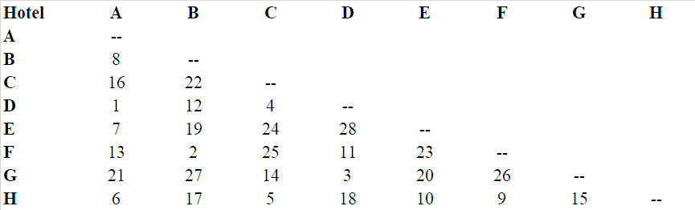
Underlying Mathematical Models of Perceptual and Preference Mapping
Similarity Maps
Based on multi-dimensional scaling (MDS) and can be used to infer the underlying dimensions from similarity or preference judgments.
Example
  Suppose we want to create a similarity map for 8 hotels, labeled A through H.
  We ask the consumers to report their perceptions of the similarities of the 8 hotels by asking them to rate all the pairs of hotels (i.e., 8 x 7/2 = 28 pairs).
  Here is a set of similarity judgements by a given individual where 1 is most similar and 28 is least similar.

Slide 16
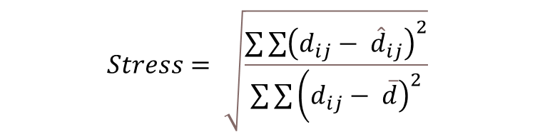
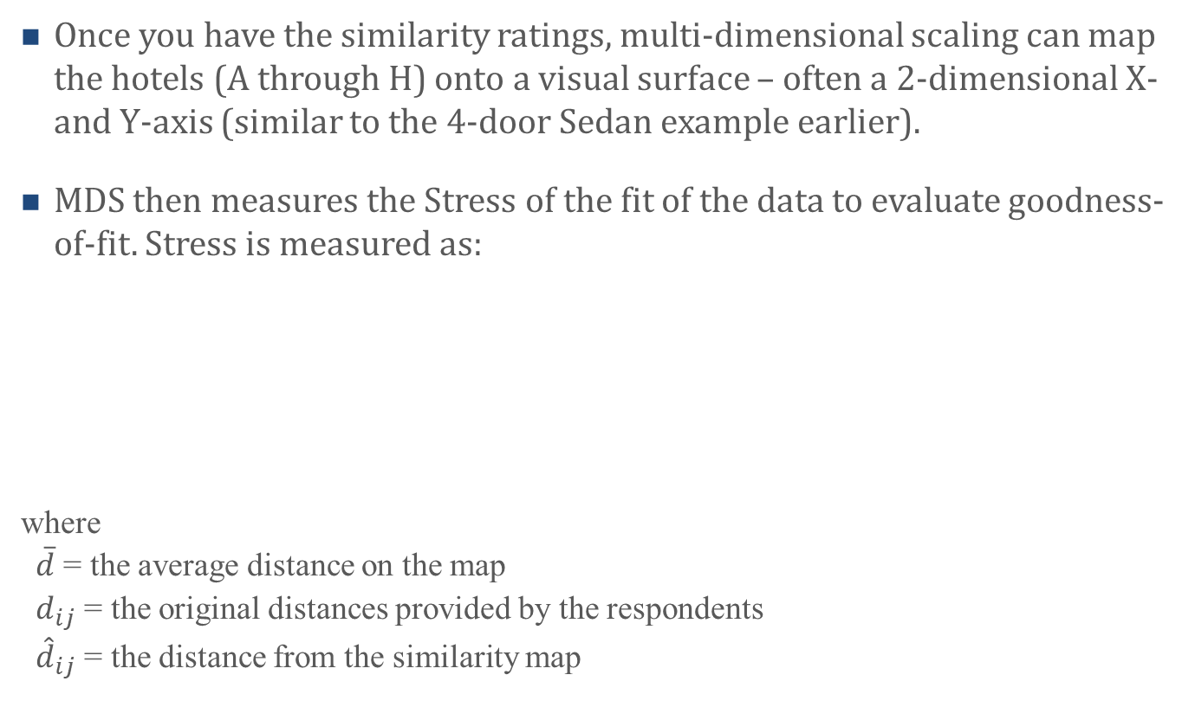
Underlying Mathematical Models of Perceptual and Preference Mapping
Similarity Maps
Once you have the similarity ratings, multi-dimensional scaling can map the hotels (A through H) onto a visual surface – often a 2-dimensional X- and Y-axis (similar to the 4-door Sedan example earlier).
MDS then measures the Stress of the fit of the data to evaluate goodness-of-fit. Stress is measured as:
where
$\overline{d}$ = the average distance on the map
$d_{ij}$ = the original distances provided by the respondents
${\hat{d}}_{ij}$ = the distance from the similarity map
$$Stress= \sqrt{\frac{{\sum{\sum{\left(d_{ij}− {\hat{d}}_{ij}\right)}}}^{2}}{\sum{\sum{\left({\left.d_{ij}− \overline{d}\right)}^{2}\right.}}}}$$

Slide 17
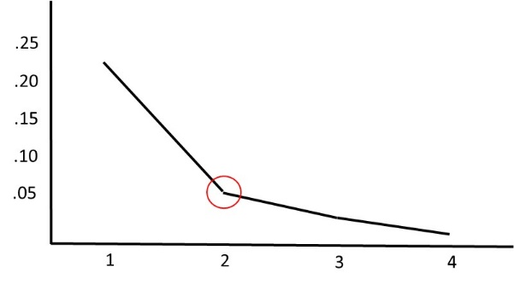
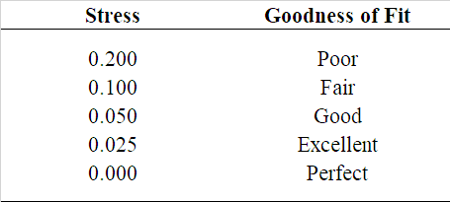
Underlying Mathematical Models of Perceptual and Preference Mapping
Similarity Maps
The Stress measure can help determine the optimal number of dimensions to plot using a Scree Plot similar to the one below:
Here we see that a 2-dimensional figure fits the data well as it has a Stress level at 0.05

Slide 18
Underlying Mathematical Models of Perceptual and Preference Mapping
Perceptual Maps
Based on Principal Components Analysis (PCA) and can be used to understand the relationship between attributes of products and brands with a set of products and brands.
Principal components summarize data across variables by transforming the original variables into a smaller set of variables that account for most of the variance in the data. The new variables are called principal components (sometimes they are also referred to as factors).
Perceptual maps have several advantages over similarity maps.
  Can visualize the similarity of products and brands (same as similarity maps)
  Allow researchers to understand a product or brand’s strength and weaknesses on the attributes measure (cannot be done by similarity maps)

Slide 19
Underlying Mathematical Models of Perceptual and Preference Mapping
Perceptual Maps
Perceptual maps are drawn based on consumer ratings of attributes about each of the products or brands in the sample. This is done by through data dimension reduction (i.e., factoring the attributes into 2 or 3 dimensions).
In PCA, principal components are extracted sequentially (i.e., the first principal component accounts for the most variance in the data). For example, if we have data on p brand or product attributes, x1, x2,…, xp, the first principal component, PC(1) is given by a linear combination of the variables:
PC(1) = w(1)1x1 + w(1)2x2 + w(1)pxp,
The weights w(1)j are chosen such that the variance of PC(1) across all the variables in the data is maximized.
The second principal component, PC(2), is calculated similarly, but it must be orthogonal (that is, uncorrelated) to PC(1). In a perceptual map, PC(1) is (typically) captured by the x-axis and PC(2) by the y-axis. These axes are orthogonal to one another and hence uncorrelated.

Slide 20
Underlying Mathematical Models of Perceptual and Preference Mapping
Perceptual Maps
Example: Suppose we want to understand how different supermarket chains perform on four attributes: Level of Prices, Quality of Service, Store Ambiance, and Breadth of Assortment.
We ask a set of consumers about their perceptions of 5 stores (Aldi, Costco, Wamart, Wegmans, and Whole Foods). Using their responses, we draw the following 2-dimensional perceptual map.

Slide 21
Underlying Mathematical Models of Perceptual and Preference Mapping
Perceptual Maps
To understand each supermarket’s perceived performance along the attributes measured, we draw perpendicular lines from the respective attribute vectors.
Based on the data collected,
Wegmans is perceived to perform
quite well on Breath of Assortment
and reasonably well on Store
Ambiance and Quality of Service.
Only Whole Foods outperforms
Wegmans on Store Ambiance and
Quality of Service. However,
Wegmans is perceived to perform
rather poorly as far as Level of
Price is concerned.

Slide 22
Underlying Mathematical Models of Perceptual and Preference Mapping
Perceptual Maps
When comparing different attribute vectors, you can look at their relative positions to each other. The closer the two vectors, the more highly correlated. And, if the two vectors are pointing in the opposite direction, these vectors essentially mean the opposite (i.e., negatively correlated).

Slide 23
Underlying Mathematical Models of Perceptual and Preference Mapping
Preference Maps
Preference maps are drawn similar to similarity maps using multi-dimensional scaling with ideal point and can be used to understand the relationship between consumer preferences of products and brands.
Ideal point preference maps use a set of preference (not similarity) ratings, but the underlying mathematical process is the same as for similarity maps.
Preference maps have several advantages and disadvantages when compared to similarity maps and perceptual maps.
  Can visualize the similarity of products and brands (same as similarity maps and perceptual maps)
  Allow researchers to identify the space on the map where each consumer’s ideal product or brand is located (unlike similarity maps and perceptual maps)

Slide 24
Underlying Mathematical Models of Perceptual and Preference Mapping
Preference Maps
To collect preference ratings, researchers usually ask respondents to provide preferences for products or brands. For example, we can assume we asked the same shoppers to evaluate their preference of the same 5 supermarkets using the following scale:
Here is a sample of 5 respondents’ preference ratings:

Slide 25
Underlying Mathematical Models of Perceptual and Preference Mapping
Preference Maps
MDS then uses the preference ratings to generate a preference map with points on it that represent each respondent’s ideal preference point and each product or brand.
The distances between products or brands represents the similarities (near) or dissimilarities (far) between products or brands.
The relative distances between the ideal preference point of a respondent and the products or brands represents the respondents’ preferences where when an ideal point is closer to a product or brand, it means the respondent is more likely to purchase that product or brand.

Slide 26
Underlying Mathematical Models of Perceptual and Preference Mapping
Joint-space Perceptual and Preference Maps
Joint-space maps combine both perceptual (i.e., how well products or brands perform along certain attributes) and preference (i.e., which products or brands customer prefer).
These joint-space maps are usually created in two steps.
  Create the perceptual map using PCA
  Overlay the perceptual map with the ideal point preference map
These joint-space maps are useful in that they help managers understand respondents’ perceptions of attributes and preferences simultaneously.

Slide 27
Underlying Mathematical Models of Perceptual and Preference Mapping
Joint-space Perceptual and Preference Maps
Example: Suppose we use the supermarket data from the perceptual map and preference map examples and put them together into a joint space map. We would get something that looks like:
The red dots represent the
supermarkets; the green vectors
represent the attribute vectors;
the blue vectors represent each
respondents’ preferences.
This figure suggests two segments
of consumers: those who prefer
price and those who prefer store
ambiance.

Slide 28
Underlying Mathematical Models of Perceptual and Preference Mapping
Joint-space Perceptual and Preference Maps
With the help of the preference vectors (or ideal points), it is also possible to predict a product or brand’s market share. There are two rules one can apply
First-choice rule: Assumes that respondents will always choose the object closest to the ideal point. The first-choice rule is usually appropriate in high-involvement and/or infrequently purchased product categories that are publicly consumed.
Share of preference rule: Assumes that respondents will spread their purchases across several objects proportional to their preference. This choice rule is usually appropriate in low-involvement and/or frequently purchased product categories where customers are variety seeking.

Slide 29
Agenda
Learning Objectives
Introduction
  Objectives of Perceptual and Preference Mapping
  Uses of Perceptual and Preference Mapping in Marketing
Perceptual and Preference Mapping
  Overview of Methods used in Perceptual and Preference Mapping
  Underlying Mathematical Models of Perceptual and Preference Mapping
Other Approaches for Mapping Similarity, Perceptions, and Preferences
Summary
Takeaways

Slide 30
Other Approaches for Mapping Similarity, Perceptions, and Preferences
There are other analytical approaches that might be useful to further extend the usefulness of brand positioning maps. Here are two such approaches.
Multiple Brands and Consumer Segments
  If you believe that there exist multiple segments of consumers, it may be useful to first segment the customer base (see Chapter 3 – Cluster Analysis for Segmentation) and then draw a perceptual map for each customer segment.
Data Mining Perceptual Maps
  One common limitation of positioning maps is the data is often sourced using consumer surveys. However, given the vast availability of user generated content (e.g., social media posts and product reviews), it is possible to gather consumer sentiments and perceptions of brands without repeatedly running consumer surveys.

Slide 31
Agenda
Learning Objectives
Introduction
  Objectives of Perceptual and Preference Mapping
  Uses of Perceptual and Preference Mapping in Marketing
Perceptual and Preference Mapping
  Overview of Methods used in Perceptual and Preference Mapping
  Underlying Mathematical Models of Perceptual and Preference Mapping
Other Approaches for Mapping Similarity, Perceptions, and Preferences
Summary
Takeaways

Slide 32
Summary
Consumers can choose from among many different goods and services (i.e., products) in most markets. Thus, if companies can find a way to stand out in these markets by appealing to their target segment or segments, they stand much to gain. An attractive brand positioning can help companies accomplish just that.
perceptual and preference maps allow managers to measure and represent customers’ perceptions and preferences about the brands that exist in a market.
Once managers know customers’ perceptions and preferences, they can seek strategies to differentiate their brands vis-à-vis their competitors on key dimensions that are relevant to their target customers thus gaining favorable responses.

Slide 33
Agenda
Learning Objectives
Introduction
  Objectives of Perceptual and Preference Mapping
  Uses of Perceptual and Preference Mapping in Marketing
Perceptual and Preference Mapping
  Overview of Methods used in Perceptual and Preference Mapping
  Underlying Mathematical Models of Perceptual and Preference Mapping
Other Approaches for Mapping Similarity, Perceptions, and Preferences
Summary
Takeaways

Slide 34
Takeaways
Most of today’s markets are very crowded and (potential) customers hence face many choices.
If companies can find a way to stand out from the crowd in a good way then they are likely to outperform their competitors. Perceptual and preference mapping can help companies do just that.
Perceptual and preference mapping allows marketers to measure and represent (potential) customers’ perceptions and preferences about their brands as well as their competitors’ brands on maps. Once marketers know (potential) customers’ perceptions and preferences about brands that compete in a market, they can seek strategies to differentiate their brands vis-à-vis their competitors on key attributes that are relevant to their target customers.

Slide 35
Takeaways (Cont.)
Differentiation entails distinguishing a brand from other brands that exist in the marketplace (i.e., the competition) with the goal to make the brand more attractive to the target audience. Differentiation should occur on key attributes that are relevant to the target audience.
Perceptual and preference maps are typically based on customer data that captures the customers’ perceptions of (1) brand attributes, (2) brand similarities, (3) brand preferences or (4) a combination of (1) – (3).
Marketers don’t usually collect data on only one brand or product attribute, but often 7 or 8 or even more. Yet, presenting information in a map about so many different brands and/or attributes in a managerially meaningful way is difficult. Hence, perceptual and preference maps are created using data reduction techniques such as multidimensional scaling (MDS) and principal component analysis (PCA).

