Slide 1

Marketing Analytics
Based on First Principles:
Chapter 4
Discriminant Analysis for
Targeting and Classification

Slide 2
Agenda
Learning Objectives
Introduction
  Objectives of Discriminant Analysis and Classification
  Uses of Discriminant Analysis and Classification
Discriminant Analysis and Classification
  Two-segment Discriminant Analysis
  Three- (or More) Segment Discriminant Analysis
  Linear versus Quadratic Discriminant Analysis
Summary
Takeaways

Slide 3
Learning Objectives
Describe the objectives of discriminant analysis and classification.
Understand how discriminant analysis and classification works.
Know what type of variables (i.e., data) are typically used in discriminant analysis.
Be able to describe how cluster analysis and discriminant analysis are used together.
Understand how discriminant analysis and classification are used as part of targeting.
Know how many discriminant functions will be used based on the number of segments and descriptor variables included in the analysis.
Know when to use linear and when to use quadratic discriminant analysis.
Understand how to create and read a confusion table.
Recognize how and why discriminant analysis might have to be repeated using different variables.
Know how to conduct discriminant analysis and classification using R and Tableau.

Slide 4
Agenda
Learning Objectives
Introduction
  Objectives of Discriminant Analysis and Classification
  Uses of Discriminant Analysis and Classification
Discriminant Analysis and Classification
  Two-segment Discriminant Analysis
  Three- (or More) Segment Discriminant Analysis
  Linear versus Quadratic Discriminant Analysis
Summary
Takeaways

Slide 5
Objectives of Discriminant Analysis and Classification
In marketing, we are often faced with the task of classifying objects (e.g., consumers, firms) into different group.
Discriminant analysis involves deriving the linear (or nonlinear) combination of two or more variables that best distinguish – or discriminate – between the (a priori defined) groups.
Classification entails assigning objects into the defined groups based on the score each object receives from the linear (or nonlinear) combination of the variables used as part of the discriminant analysis.
Discriminant analysis provides insights on (1) how good (or bad) specific variables are at capturing group membership and (2) how the defined groups differ with respect to the variables used to derive the linear (or nonlinear) combination.

Slide 6
Uses of Discriminant Analysis and Classification
Discriminant analysis and classification are often used as part of the STP (segmentation, targeting, and positioning) process – specifically targeting. Usually, discriminant analysis and classification follow immediately after cluster analysis for segmentation.
Once the clusters are identified and described using the bases variables, the next step involves profiling the objects (e.g., customers) using the descriptor variables.
Descriptor variables are usually based on demographic and/or geographic data that is readily available or can be purchased for the entire population (i.e., not just a firm’s customers).
Thus, discriminant analysis and classification provide an empirical approach for identifying target customers using data that is readily available (e.g., descriptors).

Slide 7
Agenda
Learning Objectives
Introduction
  Objectives of Discriminant Analysis and Classification
  Uses of Discriminant Analysis and Classification
Discriminant Analysis and Classification
  Two-segment Discriminant Analysis
  Three- (or More) Segment Discriminant Analysis
  Linear versus Quadratic Discriminant Analysis
Summary
Takeaways

Slide 8
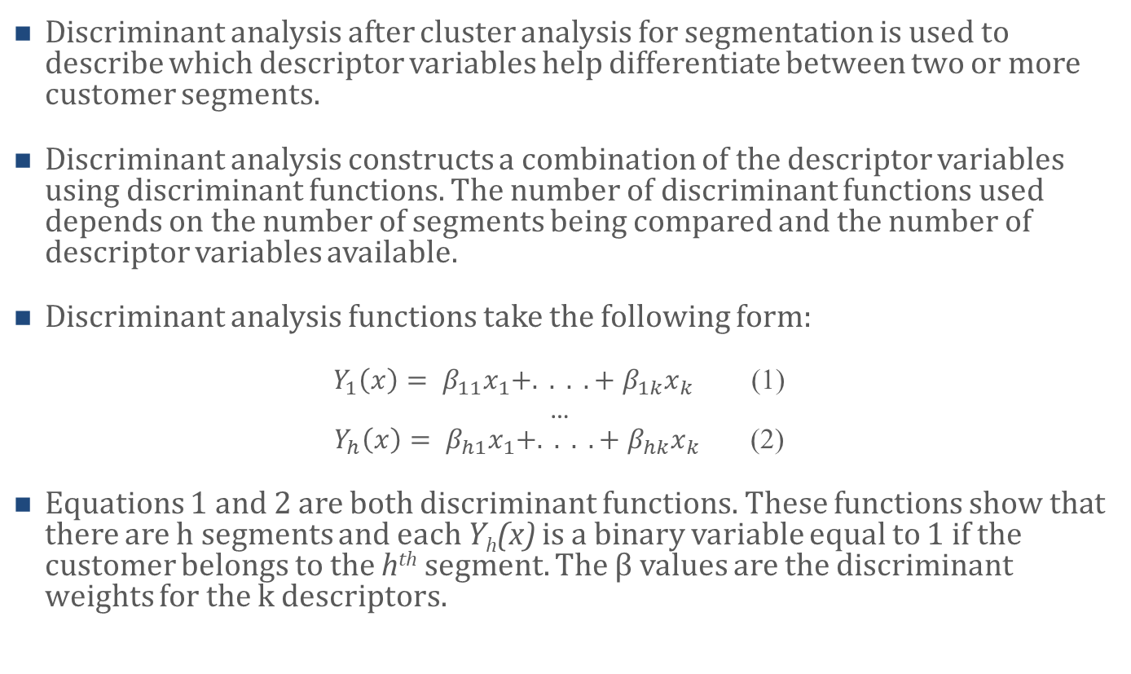
Discriminant Analysis and Classification
Discriminant analysis after cluster analysis for segmentation is used to describe which descriptor variables help differentiate between two or more customer segments.
Discriminant analysis constructs a combination of the descriptor variables using discriminant functions. The number of discriminant functions used depends on the number of segments being compared and the number of descriptor variables available.
Discriminant analysis functions take the following form:
$Y_{1}\left(x\right)= β_{11}x_{1}+. . . .{+ β}_{1k}x_{k}$ (1)
…
$Y_{h}\left(x\right)= β_{h1}x_{1}+. . . .{+ β}_{hk}x_{k}$ (2)
Equations 1 and 2 are both discriminant functions. These functions show that there are h segments and each Y_{h}(x) is a binary variable equal to 1 if the customer belongs to the h^{th} segment. The β values are the discriminant weights for the k descriptors.

Slide 9
Two-segment Discriminant Analysis
Consider the following example. A VP of a regional supermarket chain conducted cluster analysis using a sample of 1,000 shoppers.
She administered a survey to these shoppers asking questions regarding their preference as far as prices and quality at supermarkets is concerned. The cluster analysis revealed two dominant clusters (or segments): (1) Shoppers with a high preference for quality who do not mind paying a higher price for the higher quality (the quality segment) and (2) shoppers with a high preference for (low) price who are OK with average product quality (the value segment).
To profile these two segments, the VP of Marketing next conducted a discriminant analysis using two descriptor (i.e., demographic) variables she could easily gather about the 1,000 shoppers included in the cluster analysis: (1) income, (2) years of formal education.

Slide 10
Two-segment Discriminant Analysis (cont.)
The following shows a plot of the two variables describing the 1,000 shoppers as well as the segments they belong to.
As can be seen, both variables are positively correlated with a shopper belonging to the quality segment (i.e., being a quality shopper). Although there are a few exceptions, the quality shoppers have higher income and more years of formal education than the value shoppers (i.e., those belonging to the value segment).

Slide 11
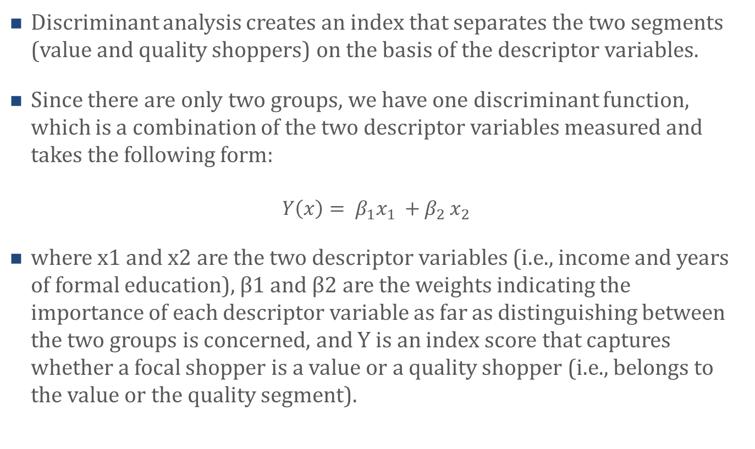
Two-segment Discriminant Analysis (cont.)
Discriminant analysis creates an index that separates the two segments (value and quality shoppers) on the basis of the descriptor variables.
Since there are only two groups, we have one discriminant function, which is a combination of the two descriptor variables measured and takes the following form:
$$Y\left(x\right)= β_{1}x_{1} {+ β}_{2}x_{2}$$
where x1 and x2 are the two descriptor variables (i.e., income and years of formal education), β1 and β2 are the weights indicating the importance of each descriptor variable as far as distinguishing between the two groups is concerned, and Y is an index score that captures whether a focal shopper is a value or a quality shopper (i.e., belongs to the value or the quality segment).

Slide 12
Two-segment Discriminant Analysis (cont.)
Is the discriminant function statistically significant?
  It is important to verify that the discriminant function is statistically significant and hence provides meaningful separation between the two groups – value and quality shoppers. To do that, researchers frequently rely on Mahalanobis’s distance (or D2) statistic (alternatively, one can also use the two-sample Hotelling’s T2 statistic or perform an ANOVA).
Calculate Index Scores
  If the discriminant function is significant,
  we can now calculate each shopper’s
  index score. This can be done by plugging
  each shopper’s descriptors into the
  discriminant function. We can also plot
  the discriminant function as in the
  figure to the right.

Slide 13
Two-segment Discriminant Analysis (cont.)
Finally, it is important to test if the discriminant function provides accurate differentiation between the two groups. To do that, one can compare the prediction of group membership with the shoppers’ group membership based on the cluster analysis to see if the discriminant function accurately places a shopper in the respective group.
An example confusion matrix:
Hit rate: (489+425)/1,000 = 91.4%
Takeaways: Income and Years of Formal Education seem to be good discriminate variables that help classify Value and Quality Shoppers.
Classification based on Cluster Analysis | Predicted Classification
 | Value Shopper | Quality Shopper
Value Shopper | 489 | 35
Quality Shopper | 61 | 415

Slide 14
Three- (or More) Segment Discriminant Analysis
When conducting discriminant analysis for more than two groups, there can be more discriminant functions. In fact, there can be h – 1 discriminant functions (where h is the number of segments), assuming there are more descriptor variables than segments.
Usually, the number of statistically significant discriminant functions is less than the potential number of discriminant functions. In this case you would use only the statistically significant discriminant functions to classify customers.
The first significant discriminant function will always provide the most discrimination. Each additional statistically significant discriminant function will provide less power of discrimination.

Slide 15
Linear versus Quadratic Discriminant Analysis
There are instances when the variance-covariance matrices of groups (i.e., segments) are homogenous. In this case, use the linear discriminant analysis functions as described previously.
When the variance-covariance matrices of the discriminant functions are heterogenous, you use a quadratic discriminant analysis approach.
You can use Bartlett’s test to determine whether you need to use linear or quadratic discriminant functions.

Slide 16
Agenda
Learning Objectives
Introduction
  Objectives of Discriminant Analysis and Classification
  Uses of Discriminant Analysis and Classification
Discriminant Analysis and Classification
  Two-segment Discriminant Analysis
  Three- (or More) Segment Discriminant Analysis
  Linear versus Quadratic Discriminant Analysis
Summary
Takeaways

Slide 17
Summary
Discriminant analysis and classification aims to assign – or classify – objects (e.g., customers) to clusters (e.g., segments) previously identified using cluster analysis.
Discriminant analysis usually uses relatively easily to acquire descriptor variables (e.g., demographics) on the objects.
In marketing, discriminant analysis and classification are used primarily for targeting purposes, and in particular to find easily accessible variables commonly shared by the customer segment (or segments) that is (are) of most interest to the company.
Once these variables are identified using discriminant analysis, researchers can use them on the entire population and hence identify the customers that likely belong to their target segment(s).

Slide 18
Agenda
Learning Objectives
Introduction
  Objectives of Discriminant Analysis and Classification
  Uses of Discriminant Analysis and Classification
Discriminant Analysis and Classification
  Two-segment Discriminant Analysis
  Three- (or More) Segment Discriminant Analysis
  Linear versus Quadratic Discriminant Analysis
Summary
Takeaways

Slide 19
Takeaways
Many marketing problems have to do with understanding how certain customer segments differ from one another. For example, how are the heavy and light users of a product different? What distinguishes customers interested in quality vs. price? Relying on easy to gather data, discriminant analysis allows marketers to understand how customers differ.
Discriminant analysis often follows cluster analysis. Whereas cluster analysis typically relies on primary data that allows companies to identify customer segments with similar needs and desires, discriminant analysis helps companies identify demographic or other easily observable variables (i.e., descriptor variables) that help the companies detect the customers that belong to the various segments found during cluster analysis.
Finding useful descriptor variables often requires that discriminant analysis is repeated a number of times using various descriptor variables until variables that discriminate well among the segments identified are found.

Slide 20
Takeaways (Cont.)
Confusion tables provide valuable information on the usefulness of the descriptor variables used in a discriminant analysis. In particular, confusion tables show how well the discriminant function classifies each object (e.g., customer) in the data set and hence how useful the used descriptor variables are.
If there are more descriptor variables than segments h, which is typically the case, then there will be at most h – 1 discriminant functions. Also, if the number of descriptor variables is less than the number of segments, then there will be no more discriminant functions than there are descriptor variables.
Depending on whether the variance-covariance matrices of the groups (i.e., segments) considered as part of the discriminant analysis are homogeneous, either linear or quadratic discriminant analysis is used. Linear discriminant analysis is used when the variance-covariance matrices of the respective groups included are homogeneous, and quadratic discriminant analysis is used when the variance-covariance matrices of the groups are heterogeneous.

