Slide 1
Marketing Analytics
Based on First Principles:
Chapter 3
Cluster Analysis for Segmentation

Slide 2
Agenda
Learning Objectives
Introduction
Objectives of Cluster Analysis
Common Uses of Cluster Analysis in Marketing
Three Examples of Cluster Analysis for Segmentation
Cluster Analysis
Naïve Cluster Analysis
Hierarchical Cluster Analysis
K-Means Cluster Analysis
Other Approaches for Cluster Analysis
Summary
Takeaways

Slide 3
Learning Objectives
Describe the objectives of cluster analysis and its importance to marketing research.
Discuss the difference between naïve and analytic cluster analysis approaches.
Understand and describe the difference between agglomerative and divisive clustering.
Understand the concept and know how to calculate Euclidean distance.
Explain why the identification of segments in hierarchical cluster analysis should be based on customer attitudes and behaviors (i.e., bases variables) instead of demographic and geographic (i.e., descriptor) variables.
Know how to conduct a hierarchical cluster analysis in Tableau and R and understand how to select number of segments to retain based on elbow plots.
Execute k-means clustering in Tableau and R and know how to use k-means clustering to describe segments.
Discuss and describe how marketers should select segment(s) to target.

Slide 4
Agenda
Learning Objectives
Introduction
Objectives of Cluster Analysis
Common Uses of Cluster Analysis in Marketing
Three Examples of Cluster Analysis for Segmentation
Cluster Analysis
Naïve Cluster Analysis
Hierarchical Cluster Analysis
K-Means Cluster Analysis
Other Approaches for Cluster Analysis
Summary
Takeaways

Slide 5
Objectives of Cluster Analysis
Cluster analysis aims to classify objects (for example, customers) into relatively homogenous groups called clusters (also referred to as segments) based upon the characteristics the objects possess.
Objects within each cluster should be similar to one another, but different from objects in other clusters.
Cluster analysis helps the researcher understand patterns of similarities and differences that exist among objects.

Slide 6
Common Uses of Cluster Analysis in Marketing
Marketers typically use cluster analysis to segment the market, that is, to determine the similarities and differences of a given set of customer in terms of attributes (i.e., preferences, needs and wants with regards to a product) and behaviors and assign similar customers into clusters or segments.
Customers or consumers within a segment should be similar in terms of attitudes and/or behaviors, whereas customers and consumers across segments should be different.
Marketers can also use cluster analysis for other (related) purposes.
Cluster analysis can be used to identify new product opportunities. Marketers can cluster-analyze brands and products and identify competitive sets that exist within a market. Some clusters might only have few and perhaps weak actors (i.e., firms), thus potentially offering opportunities.
Cluster analysis can be used to identify new markets to enter by, for example, cluster-analyzing various international markets thereby identifying those that are relatively similar to the existing markets.
To be useful, a segmentation analysis should yield a manageable number of segments (between three and eight segments is frequently recommended). Remember that firms have limited resources (MP#4) and hence typically have to choose a or a few customer segments to serve.

Slide 7
Common Uses of Cluster Analysis in Marketing
How Segmenting, Targeting and Positioning (STP) Creates Value
Segmentation
Identify segments
Targeting
Select segments
Positioning
Create competitive advantage
Marketing resources are focused to better meet customers needs and deliver more value to them
Brand/supplier loyalty leads to increased market share and creates a barrier to competition
Customers develop preference for brands that better meet their needs and deliver more value
Fewer marketing resources needed over time to maintain share due to brand or supplier loyalty
Customers become brand/supplier loyal, repeat purchase, communicate favorable experiences
Profitability (value to the firm) increases

Slide 8
Three Examples of Cluster Analysis for Segmentation
The Campaign for Real Beauty
Dove effectively segmented the beauty industry market, targeting “real women” by “providing a refreshingly real alternative for women who recognize that beauty comes in all shapes and sizes.”
Source: https://www.dove.com/my/stories/campaigns/dove-real-beauty-pledge.html

Slide 9
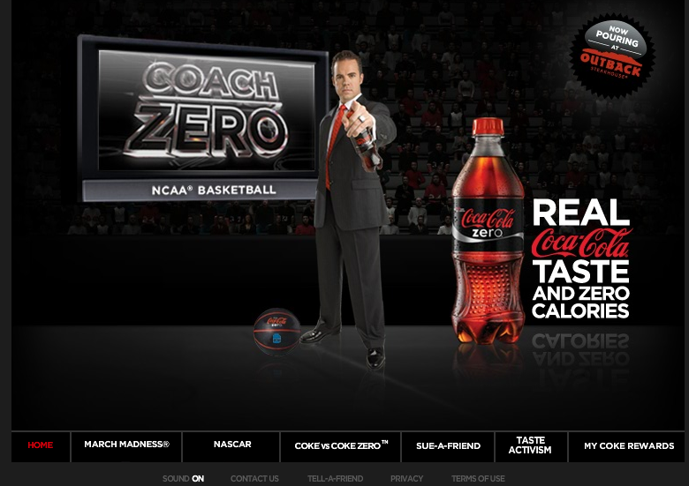
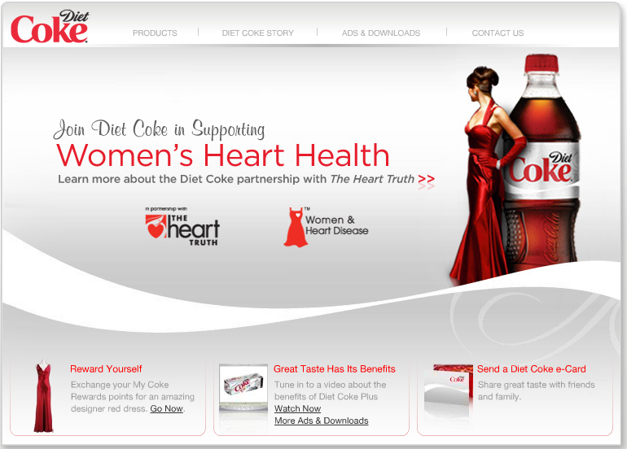
Three Examples of Cluster Analysis for Segmentation
Diet Coke vs. Coke Zero
Coca-Cola realized many men were reluctant to purchase and drink Diet Coke as they perceived it as a feminine product. Men also were purchasing less regular Coca-Cola. Coca-Cola decided to develop a new zero calorie Cola product (Coke Zero) and target it toward men.
Sources: https://us.coca-cola.com and https://www.dietcoke.com

Slide 10
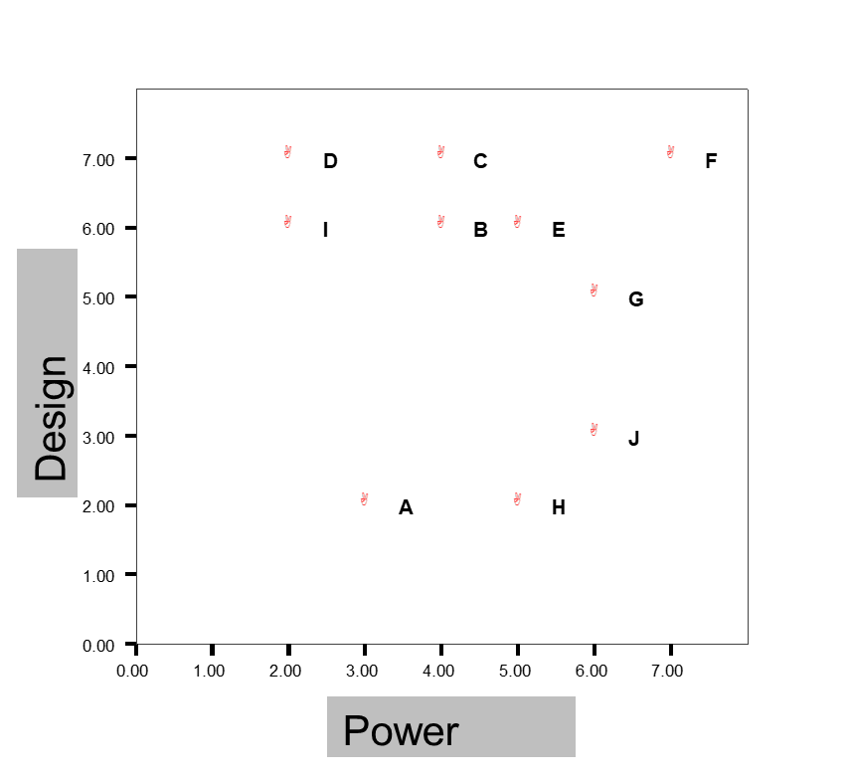
Three Examples of Cluster Analysis for Segmentation
The Laptop Market
You conduct a survey of 10 students and ask them about purchasing a new laptop.
You ask two attribute perception questions with 1 meaning it does not matter and 7 meaning it matters a lot.
How much do you desire a laptop with a quality design?
How much do you desire a laptop with strong computing power?
You plot the results of the survey
How many segments do you see?

Slide 11
Agenda
Learning Objectives
Introduction
Objectives of Cluster Analysis
Common Uses of Cluster Analysis in Marketing
Three Examples of Cluster Analysis for Segmentation
Cluster Analysis
Naïve Cluster Analysis
Hierarchical Cluster Analysis
K-Means Cluster Analysis
Other Approaches for Cluster Analysis
Summary
Takeaways

Slide 12
Naïve Cluster Analysis
Naïve approaches typically do not use analytical techniques, instead relying on intuitive and easy-to-spot patterns that exist in data.
Pros: Easy to conduct and often requires little effort
Cons: Insights obtained are often subjective (rather than data-driven) which are potentially less accurate and meaningful

Slide 13
Hierarchical Cluster Analysis
Hierarchical cluster analysis is based on the development of a hierarchy.
Agglomerative clustering is the most common approach for hierarchical cluster analysis. This involves starting with each object (person) being in its own cluster. Objects (people) are then grouped into bigger and bigger clusters until all objects are part of a single cluster.
Similarity of two objects (people) is determined using Euclidean Distance
Hierarchical cluster analysis is often used in the selection of the number of segments in your data.
$$Dist \left(A,B\right)= \sqrt{{\left({Power}_{A }− {Power}_{B}\right)}^{2}+ {\left({Design}_{A }− {Design}_{B}\right)}^{2}}$$

Slide 14
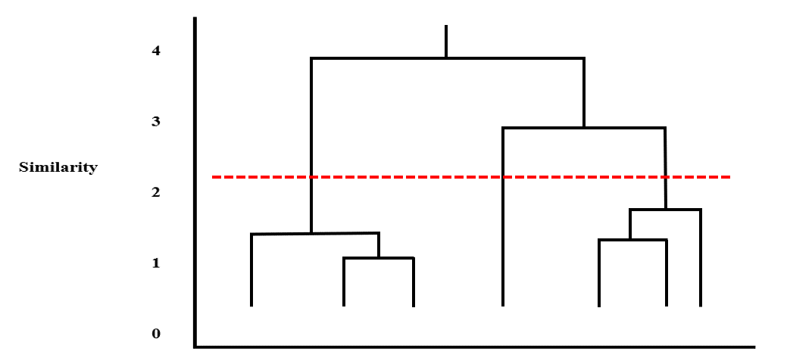
Hierarchical Cluster Analysis (cont.)
Input variables
Bases: characteristics that tell us why segments differ (e.g., needs, preferences, decision processes).
Descriptors: characteristics that help us find and reach segments.
Determining the number of segments
Elbow plots and dendrograms are frequently used to select the number of segments. Look for the kink in the line of the Elbow plot or the reduction in height from one cluster to the next of the Dendrogram. Here we would likely select a 3-segment solution.
Elbow Plot
Dendrogram

Slide 15
K-Means Cluster Analysis
K-means cluster analysis is useful once you have decided on the number of clusters in your data.
K-means cluster analysis will help you answer the following questions:
What is unique about the respective clusters?
How can the data points (e.g., consumers) that make up each cluster be described?
Describing the clusters: Use the bases from each cluster to describe what type of needs, preferences, decision processes are representative of the segment when compared to other segments.
Profiling the clusters: Use the descriptors from each cluster to identify what each cluster ‘looks’ like and where to find the consumers.

Slide 16
K-Means Cluster Analysis (cont.)
Evaluation and Selection: The final step in cluster analysis involves deciding on which cluster(s) or segment(s) to target. The decision should be based on two related aspects:
Attractiveness of the segment
Examples include size and growth of the segment as well as the structural characteristics of the segment (e.g., profitability and/or protectability of the segment)
Fit of the segment with the firm (i.e., competitive strength)
The fit usually depends on how the cluster(s) or segment(s) value the product and service offerings from your firm.
Typically, firms do not target all identified segments that exist in the market. Instead, a firm should target only segments with a high degree of attractiveness and fit.

Slide 17
Agenda
Learning Objectives
Introduction
Objectives of Cluster Analysis
Common Uses of Cluster Analysis in Marketing
Three Examples of Cluster Analysis for Segmentation
Cluster Analysis
Naïve Cluster Analysis
Hierarchical Cluster Analysis
K-Means Cluster Analysis
Other Approaches for Cluster Analysis
Summary
Takeaways

Slide 18
Other Approaches for Cluster Analysis
Although hierarchical and k-means clustering will be useful in most applications, there are new developments in cluster analysis worth identifying.
Supervised and Unsupervised Machine Learning
There may be circumstances where it is challenging to identify high quality bases and/or descriptors. When this is the case, it can be useful to rely on more data-driven rather than marketer-driven approaches to cluster analysis. However, it is always important to pay attention to potential over-fitting of the data (i.e., in-sample fit can be much larger than out-of-sample fit).
Big Data Cluster Analysis
Sometimes you have access to hundreds (if not thousands) of bases and descriptor variables. In such cases, you may need to explore other solutions to cluster analysis. This can include subsample clustering (running cluster analysis on samples of customers) or other cluster analysis packages (e.g., CLARA).

Slide 19
Agenda
Learning Objectives
Introduction
Objectives of Cluster Analysis
Common Uses of Cluster Analysis in Marketing
Three Examples of Cluster Analysis for Segmentation
Cluster Analysis
Naïve Cluster Analysis
Hierarchical Cluster Analysis
K-Means Cluster Analysis
Other Approaches for Cluster Analysis
Summary
Takeaways

Slide 20
Summary
Treating all customers as the same in terms of needs, preferences, and decision processes is a path to marketing failure as customers will migrate to competitors that target these customer segments with better offerings. This leaves the firm usually with customers from smaller segments other firms did not want to target or more price-sensitive customers.
The segmentation part of segmentation, targeting, and positioning (STP) uses cluster analysis to help marketing managers understand how to identify the number of customer segments in the market as well as how to describe and profile those customer segments.

Slide 21
Agenda
Learning Objectives
Introduction
Objectives of Cluster Analysis
Common Uses of Cluster Analysis in Marketing
Three Examples of Cluster Analysis for Segmentation
Cluster Analysis
Naïve Cluster Analysis
Hierarchical Cluster Analysis
K-Means Cluster Analysis
Other Approaches for Cluster Analysis
Summary
Takeaways

Slide 22
Takeaways
A foundational assumption in marketing strategy is that all customers differ in their attitudes and behaviors. A successful marketing strategy must manage and exploit customer heterogeneity, because if competitors identify niches of customers whose needs are poorly served and target them with a better offering, the incumbent firm risks losing its (often best) customers.
Sources of customer heterogeneity include customers’ individual differences, life experiences, functional needs, and self-identity or image, as well as persuasion through marketing. These factors work together to create divergent preferences.
The segmentation and targeting approach allow a firm to manage customer heterogeneity by segmenting potential customers into relatively homogenous groups, based on individual preferences and needs. Then the firm selects attractive segment(s) in which it can build a strong position.

Slide 23
Takeaways (Cont.)
Customer attitudes and behaviors (i.e., bases variables) are commonly used to identify customer segments. Data regarding bases variables is typically not easily available and must hence be collected via (e.g.) survey methods from a sample of the population of interest.
Customer demographic and geographic variables (i.e., descriptor variables) are commonly used to assign the population of interest to the segments identified (i.e., for profiling purposes). Secondary data regarding descriptor variables is typically available and hence must not be collected via (e.g.) survey methods.
Using hierarchical cluster analysis, bases variables are typically useful to identify the number of segments that exist.
Hierarchical cluster analysis and k-means clustering are two common methods used in segmentation analysis and can be easily implemented in R or Tableau.

