Slide 1
Introduction to Marketing Analytics
Based on First Principles:
Chapter 1
All Customers Differ
All Customers Change
All Competitors React
All Resources are Limited
First Principles: The foundational concepts or assumptions on which a theory, system, or method is based (Oxford Dictionaries )

Slide 2
Agenda
Learning objectives
What Are Marketing Analytics?
Definitions and Aliases
Evolution
Why Bother Learning Marketing Analytics?
Impact on Firm Performance
Marketing Analytics’ Examples
Marketing Analytics Jobs
Why Use a First Principles Approach for Marketing Analytics?
What Is the First Principles Framework for Marketing Analytics?
MP#1: All Customers Differ → Understanding Customer Heterogeneity
MP#2: All Customers Change → Understanding Customer Dynamics
MP#3: All Competitors React → Understanding Sustainable Competitive Advantage
MP#4: All Resources Are Limited → Understanding Resource Trade-offs
What Software Tools Are Used in This Book?
Takeaways

Slide 3
Learning Objectives
Define marketing analytics.
Identify in detail the importance of learning and utilizing marketing analytics.
Explain the benefits of understanding marketing analytics for firms and individuals.
Describe the First Principles framework for marketing analytics.
Outline the key marketing-based sources of a sustainable competitive advantage.
Apply software tools, R and Tableau, to perform marketing analytics analyses.
Detail the benefits of data visualization.

Slide 4
Agenda
Learning objectives
What Are Marketing Analytics?
Definitions and Aliases
Evolution
Why Bother Learning Marketing Analytics?
Impact on Firm Performance
Marketing Analytics’ Examples
Marketing Analytics Jobs
Why Use a First Principles Approach for Marketing Analytics?
What Is the First Principles Framework for Marketing Analytics?
MP#1: All Customers Differ → Understanding Customer Heterogeneity
MP#2: All Customers Change → Understanding Customer Dynamics
MP#3: All Competitors React → Understanding Sustainable Competitive Advantage
MP#4: All Resources Are Limited → Understanding Resource Trade-offs
What Software Tools Are Used in This Book?
Takeaways

Slide 5
What are Marketing Analytics?
Marketing analytics (also called customer analytics, data analytics, or big data) are changing the very world we live in and how we interface with businesses.
With marketing analytics, firms can quickly make optimized decisions; they can connect data in novel ways and thus earn incremental revenue.
This expansion of marketing analytics has been driven by many technological advances, such as the internet, GPS, smartphones, cheap data storage and processing, artificial intelligence (AI), and widespread digitization.
In many cases, the technology has advanced faster than managers’ ability to apply the advances effectively.
Marketing analytics can be defined as “a technology-enabled and model-supported approach to harness customer and market data to enhance marketing decision making.”

Slide 6
Definitions and Aliases of Marketing Analytics
Data analytics refers to a “multidimensional field that uses mathematics, statistics, predictive modeling and machine learning techniques to find meaningful patterns and knowledge in recorded data.”
Business analytics typically reduces the scope and focuses on data mining, predictive analytics, applied analytics, and statistics targeted at industry business processes.
Big data analytics is similar to data analytics but highlights the amount or breadth of data processed (i.e., very large amounts) and often the use of specific techniques (data mining, machine learning, AI) that are most relevant for this type of data structure.
Marketing analytics can be defined as “a technology-enabled and model-supported approach to harness customer and market data to enhance marketing decision making.”

Slide 7
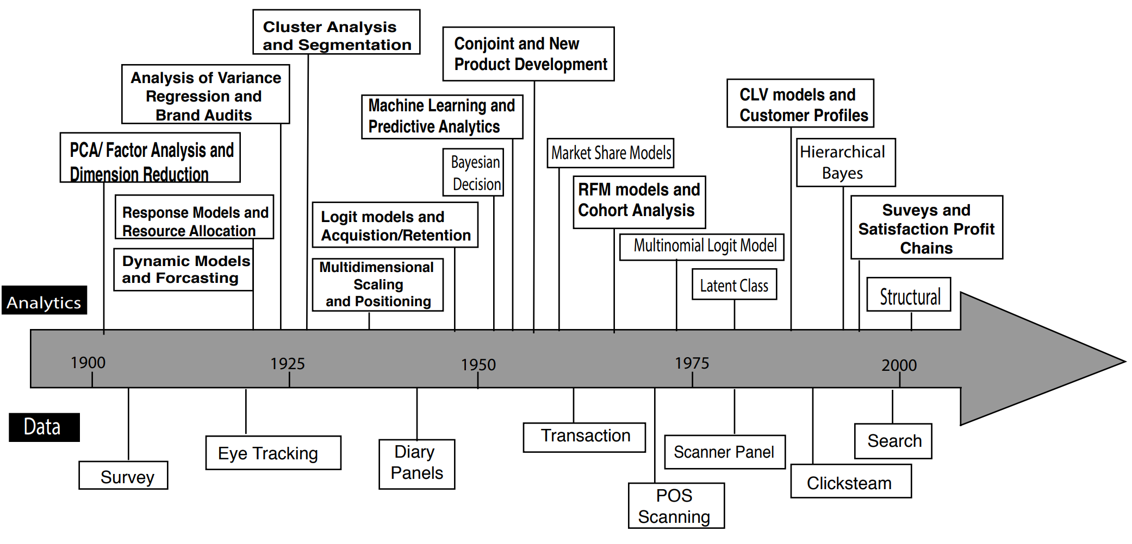
Evolution of Marketing Analytics
Marketing analytics have evolved dramatically due to the increasing amount and availability of data in the digital economy, as well as novel analysis techniques and uses of data analytics.
Marketing analytics in turn have evolved in two parallel, interrelated areas: the data and the analytics.

Slide 8
Agenda
Course Overview
What Are Marketing Analytics?
Definitions and Aliases
Evolution
Why Bother Learning Marketing Analytics?
Impact on Firm Performance
Marketing Analytics’ Examples
Marketing Analytics Jobs
Why Use a First Principles Approach for Marketing Analytics?
What Is the First Principles Framework for Marketing Analytics?
MP#1: All Customers Differ → Understanding Customer Heterogeneity
MP#2: All Customers Change → Understanding Customer Dynamics
MP#3: All Competitors React → Understanding Sustainable Competitive Advantage
MP#4: All Resources Are Limited → Understanding Resource Trade-offs
What Software Tools Are Used in This Book?
Takeaways

Slide 9
Benefits of Learning Marketing Analytics
Impact on Firm Performance
Improve financial performance
Increase new product success
For a one-unit increase (1 to 7 scale) in marketing analytics deployment, an average firm would gain an 8 percent increase in its return on assets (ROA), corresponding to an increase of $180 million in net income.

Slide 10
Firm Example: Grocery Store
Kroger’s direct mail coupon to customers prompted a redemption rate is over 70 percent within six weeks of the mailing, compared with an average coupon redemption rate of 7.93 percent.
What did the store do?
By marketing analysis, the store:
Creates a DNA on each customer to see what drives their behavior
Target each customer with the most effective coupons
These customized coupons are used much more often than they would have been without this deep customer knowledge
The coupons have generated $10 billion in revenue for Kroger

Slide 11
Firm Example: Hotel Industry
“Hotels can double their profitability by successfully marking up rooms just 10 percent.”
There are times when there are not enough hotel rooms to meet massive customers' demand and times with many unused rooms due to low demand
Hotels can vary prices to attempt to match supply and demand in a dynamic fashion
Using customer data analysis, hotels can drop room prices when demand on the website and call centers is low but rapidly increase prices when it senses an increase in demand

Slide 12
Marketing Analytics Jobs
Highest growth of job demand
Shortage in trained marketing analytical employee
“The U.S. Bureau of Labor Statistics sees strong growth in the data science field and predicts the number of jobs will increase by about 28% through 2026. To give that 28% a number, that is roughly 11.5 million new jobs in the field.”

Slide 13
Agenda
Course Overview
What Are Marketing Analytics?
Definitions and Aliases
Evolution
Why Bother Learning Marketing Analytics?
Impact on Firm Performance
Marketing Analytics’ Examples
Marketing Analytics Jobs
Why Use a First Principles Approach for Marketing Analytics?
What Is the First Principles Framework for Marketing Analytics?
MP#1: All Customers Differ → Understanding Customer Heterogeneity
MP#2: All Customers Change → Understanding Customer Dynamics
MP#3: All Competitors React → Understanding Sustainable Competitive Advantage
MP#4: All Resources Are Limited → Understanding Resource Trade-offs
What Software Tools Are Used in This Book?
Takeaways

Slide 14
Why Use a First Principles Approach for Marketing Analytics?
Managers are being overwhelmed with more and more analysis tools, processes, and research techniques, but hard to know when to apply each one
A key requirement for making good marketing decisions is to identify underlying factors on which the analytic tool depend
The First Principles Framework for marketing analytics provides a way to align each of the four First Principles with a set of approaches, processes, and analysis tools that can deal with the unique issues associated with each principle
First Principles approach present a structure relevant marketing context and clear purpose and defines a marketing analytics toolbox for analysts to select or develop right devices to address different marketing challenges.

Slide 15
Aligning Key Marketing Tools and Models According to First Principles
First Principle | Applicable Analysis Techniques
MP#1 All Customers Differ | Cluster analysis for segmentation
 | Discriminant analysis for targeting and classification
 | Perceptual and preference mapping for competitive positioning
MP#2 All Customers Change | Recency, frequency, and monetary (RFM) analyses for customer selection
 | Logistic regression models for customer selection
 | Customer lifetime value (CLV) analysis for customer selection
MP#3 All Competitors React | Survey design and design to derive customer insights
 | Conjoint analysis for product and pricing decisions
 | Forecasting sales for new products
MP#4 All Resources Are Limited | Using marketing mix models to optimize the marketing mix
 | Using marketing experiments to optimize the marketing mix
 | Using topic models to glean customer insights

Slide 16
Agenda
Course Overview
What Are Marketing Analytics?
Definitions and Aliases
Evolution
Why Bother Learning Marketing Analytics?
Impact on Firm Performance
Marketing Analytics’ Examples
Marketing Analytics Jobs
Why Use a First Principles Approach for Marketing Analytics?
What Is the First Principles Framework for Marketing Analytics?
MP#1: All Customers Differ → Understanding Customer Heterogeneity
MP#2: All Customers Change → Understanding Customer Dynamics
MP#3: All Competitors React → Understanding Sustainable Competitive Advantage
MP#4: All Resources Are Limited → Understanding Resource Trade-offs
What Software Tools Are Used in This Book?
Takeaways

Slide 17
First Principle #1: All Customers Differ
The most basic issue for marketing managers is that all customers differ.
As famously exemplified by the early days of the Ford Motor Company.
When few cars available, Ford could offer only a single color (black) for the Model T.
With various customers desire, Ford’s attempt to maintain a completely black color scheme must change.
Provide differentiated offerings to appeal various customers make firm perform well.
New product can be developed by seeking a clear understanding of customer heterogeneity with marketing analytics.
Marketers with current data who respond quickly and target smaller segments can gain more precise analysis insights and thus more informed marketing decisions.

Slide 18
First Principle # 2: All Customers Change
Customer’s desires/needs for most products and services change overtime or due to specific events
Consumer needs change: cars (Buick), clothes, food, financial services, and healthcare as consumers age
Trigger events: marriage, kids, job change, finances, move, graduation, acquisition, new managers, legal changes
Industries/markets change: technological innovations
Customer's needs vary not only due to inherent differences in people (heterogeneity) but also as people and markets change (dynamics)
Thus, segmentation and targeting needs to account for lifecycle changes/customer dynamics

Slide 19
First Principle #3: All Competitors React
Competitive reactions to a firm’s success can take various forms
Discover new technical innovations that disrupt the overall market and relegate the focal firm’s existing offerings
Pay close attention to environmental and cultural shifts that open new niches and make the focal firm’s offerings to seem out of touch
Not change the firm’s basic offering but provide it more effectively or efficiently
Companies need to build a “barrier” to being copied, giving them time to adapt to innovation by others
These barriers are termed sustainable competitive advantage (SCA) and are critical to long-term superior financial performance
Marketing analytics can help firms determine which marketing activities—involving brands, offerings, or relationships (BOR)—are going to provide the best reinforcements for these SCA.

Slide 20
First Principle #4: All Resources Are Limited
Most marketing decisions require tradeoffs across multiple objectives where resources are constrained and often interdependent
Advertising vs. salespeople vs. discounts vs. channel co-ops vs. R&D vs. online
Many “messages” are mutually exclusive (high status and low price) or (high performance and economical)
Short-term vs. long-term tradeoffs
Marketing analyses that can show managers how to manage their resource trade-offs to overcome or deal with their perennial resource limitations.

Slide 21
Agenda
Course Overview
What Are Marketing Analytics?
Definitions and Aliases
Evolution
Why Bother Learning Marketing Analytics?
Impact on Firm Performance
Marketing Analytics’ Examples
Marketing Analytics Jobs
Why Use a First Principles Approach for Marketing Analytics?
What Is the First Principles Framework for Marketing Analytics?
MP#1: All Customers Differ → Understanding Customer Heterogeneity
MP#2: All Customers Change → Understanding Customer Dynamics
MP#3: All Competitors React → Understanding Sustainable Competitive Advantage
MP#4: All Resources Are Limited → Understanding Resource Trade-offs
What Software Tools Are Used in This Book?
Takeaways

Slide 22
Software Tools Used in This Book
Many different software resources can be used to estimate the models we present in this book
R is well supported in business and business marketing
Tableau has superior ability for data visualization
Benefits of data visualization in certain situations
Supports teaching and learning, promotes understanding and generate interest and engagement
The cost of asking questions has decreased
The visualization, which is important for hierarchical data, helps the break-up of sales data into categories, subcategories etc.
with overwhelming velocity and volume relying on data, firm can’t comprehend without some layer of abstraction

Slide 23
Agenda
Course Overview
What Are Marketing Analytics?
Definitions and Aliases
Evolution
Why Bother Learning Marketing Analytics?
Impact on Firm Performance
Marketing Analytics’ Examples
Marketing Analytics Jobs
Why Use a First Principles Approach for Marketing Analytics?
What Is the First Principles Framework for Marketing Analytics?
MP#1: All Customers Differ → Understanding Customer Heterogeneity
MP#2: All Customers Change → Understanding Customer Dynamics
MP#3: All Competitors React → Understanding Sustainable Competitive Advantage
MP#4: All Resources Are Limited → Understanding Resource Trade-offs
What Software Tools Are Used in This Book?
Takeaways

Slide 24
Takeaways
Marketing analytics refers to the use of technology and models to improve marketing decision-making capabilities. Marketing analytics recently have advanced due to new analytics techniques and increased access to data.
Improved marketing analytics capabilities benefit both firms and employees.
The First Principles approach to marketing analytics involves grouping or aligning key marketing tools and their models according to the First Principles, to enable managers to understand their purpose and account for interdependencies and temporal ordering when formulating insights to aid in decision making.

Slide 25
Takeaways
All customers differ (MP#1), and customer heterogeneity must be considered when firms make decisions.
All customers change (MP#2), and managers need to account for variations in customers’ needs when developing marketing programs.
All competitors react (MP#3), such that other firms continuously attempt to copy and innovate, and managers must build and maintain barriers through sustainable competitive advantages (SCA) to competitive attacks.
All resources are limited (MP#4), which requires firms to make trade-offs when making marketing decisions.

