Slide 1

Marketing Strategy Chapter 7 (Relationships)
Marketing Principle #3
All Competitors React → Managing Relationship-based Sustainable Competitive Advantage

Slide 2
Agenda
Introduction
Relationship Marketing Strategy
  Building and Maintaining Relationships
  Targeting and Adapting Relationship Marketing Strategies
  Relationship Dynamics and Lifecycle Stages
Managing Relationship-Based Sustainable Competitive Advantage
  Building Relationship Equity
  Measuring Relationship Equity
  Multiple Regression
Takeaways

Slide 3
Relationship Marketing Basics
This relationship marketing (RM) process—namely, identifying, developing, maintaining, and terminating relational exchanges to improve performance—can produce relationship equity
This form of equity, in combination with brands and offerings, in turn can lead to a sustainable competitive advantage (SCA)
Relationship marketing and branding strategies that focus on building equity often overlap
Customer relationship management is the managerially relevant, organization-wide, customer-focused application of RM, using IT to achieve performance objectives
Notes:
Relationship Marketing Basics
From the earliest days of written history, interpersonal relationships have been critical to trade and business. Firms spend more than $36 billion every year to implement customer relationship management systems to help build and maintain strong customer relationships. This relationship marketing (RM) process—namely, identifying, developing, maintaining, and terminating relational exchanges to improve performance—can produce relationship equity. This form of equity, in combination with brands and offerings, in turn can lead to a sustainable competitive advantage (SCA). The American Marketing Association’s 2004 definition of marketing highlighted the key role of relationships, “an organizational function and a set of processes for creating, communicating, and delivering value to customers and for managing customer relationships in ways that benefit the organization and its stakeholders” (emphasis added). That is, managing relationships is a key focus for marketing, beyond traditional marketing-mix factors (e.g., promotion, product, price).
Relationship marketing and branding strategies that focus on building equity (see Chapter 5) often overlap. As you likely recall, brand equity is mainly a product-oriented notion, in the sense that it arises when customers respond differently (usually, more favorably) to a service or product because they are able to identify its brand. Rather than dealing with products, and describing how the brands of those products extend to the firm, RM addresses relationships. Still, both processes seek to build an intangible form of customer equity to increase loyalty, purchases, or financial outcomes among customers. Therefore, especially as customers’ attitudes about the firm expand and encompass everything associated with that firm—including its brands, products, and relationships—the distinction between branding and RM and the distinct impacts of brands or relationships are difficult to isolate. Furthermore, overall customer equity consists of the combination of relationship equity, as we discuss in this chapter, with brand equity (Chapter 5) and value equity (Chapter 6). That is, it’s important to distinguish brand equity from relationship equity, even though in practice, they often appear to overlap.
The relative importance of building relationships versus other strategies also depends on the specific exchange context. For example, strong relationships tend to be more effective for improving performance among services than among product offerings, in business-to-business (B2B) versus business-to consumer (B2C) markets, and for channel partners rather than direct customers. Recent research suggests that customer relationship value has exceeded brand value as a percentage of the total enterprise value, based on the prices that firms pay when acquiring firms.
Semantically, RM and customer relationship management (CRM) also often overlap, such that the terms are used interchangeably. But, more accurately, CRM combines relationship marketing with information technology in an attempt to integrate processes, people, operations, and marketing. Thus, customer relationship management (CRM) is the managerially relevant, organization-wide, customer-focused application of RM, using IT to achieve performance objectives. Many firms have implemented CRM systems to integrate and synthesize customer data based on the belief that enhanced customer insights will improve financial performance. Standard Bank, a leading South African banking group, deployed eFinance, a Siebel Systems’ CRM suite. Prior to this change, Standard Bank’s retail banking services were fragmented across product lines, but using its new integrated view of customers it saw a 78% increase in their conversion rate and a significant increase in cross-selling and upselling services.

Slide 4
Relationship Equity Represent an Important Source of SCA
Relational-based exchange was the norm since Homeric Greece
  Transactional (product) marketing emerged only with the increase in mass production and “middlemen”
  “a rebirth of marketing practices of the pre-industrial age”
  Early brands were all “family names”
Impact of “relationship” spending on sales twice as high as impact of advertising
Large part of our “cognitive and emotional function” evolved to handle relationship-based processing
$12 billion spent annually on relationship management
(Albers, Mantrala, and Sridhar 2010; Palmatier 2008)
Notes:
4
Marketing Principle #3 focuses on building and maintaining barriers, or sustainable competitive advantages (SCAs), to competitive attacks, based on the premise that competitors react continually to a firm’s success. Investments in building a firm’s relationship equity by developing B2B and B2C relationships can represent a strong barrier to competitors. Relationship equity refers to the aggregation of relational assets and liabilities, associated with the firm’s boundary-spanning employees and social networks linked to the offering or experience, that add to or subtract from the value provided by the firm’s offering. Efforts to build relationship equity often come after generating brand and value equities, because relational interactions are part of the product and service delivery or experience, which occurs after the product is designed and launched and brands have been promoted to the targeted customer segment. Yet, relationships powerfully affect behavior; relational-based decision making is ingrained in people’s psyches. For example, nearly one-third of human brain activity focuses on relational interactions, because they support cooperation and evolutionary advances. The varied
psychological processes and emotions associated with relational or seemingly relational interactions (e.g., gift–gratitude, anger–punishment, guilt–reciprocation, love–hate) help explain customers’ responses to marketers’ actions and thus the effectiveness of RM.

Slide 5
Relationship Marketing Builds Customer Relational Equity
Marketing Principle #3 focuses on building and maintaining barriers, or sustainable competitive advantages (SCA), to competitive attacks, based on the premise that competitors react continually to a firm’s success
Relationship equity refers to the aggregation of relational assets and liabilities, associated with the firm’s boundary-spanning employees and social networks linked to the offering or experience, that add to or subtract from the value provided by the firm’s offering
Relationships powerfully affect behavior; relational-based decision making is ingrained in people’s psyches
Strong affect on performance outcomes (meta-analysis of 20 years of data across 38,000 relationships)
  WOM (r = .61, p < .01)
  Loyalty (r = .52, p < .01)
  Objective performance (r = .35, p < .01)
(Palmatier et al. 2006)
Notes:
3 key aspects
Middleman had same products and sold on price, prior manufacturer and retailer were the same, Central location
Mass production and consumption during the industrial revolution changed the dynamics between producers and consumers. Producers took advantage of the economies of scale associated with mass production to produce a large volume of goods at low cost, but these voluminous goods also required transportation, storage, and sales across a larger geographic area and customer base to dispose of them. Many consumers relocated to manufacturing centers and cities, away from agricultural areas, which required the transportation and storage of goods to support these new population centers. Moreover, mass production generated the need for aggressive sales and promotions to create sufficient demand for the increased volume of goods. In aggregate, industrialization led to new industries, or “middlemen,” focused on transportation, storage, selling, and retailing (Bartels 1962). As these new channels competed for business, often with similar or indistinguishable products, exchanges became more transactional and pricing grew to represent a more, if not the most, salient component of the offering. Institutional and functional economists operating against this backdrop investigated the functions performed by wholesalers and retailers in an exchange to develop early marketing thought (Alderson 1965).

Slide 6
Many Trends are Increasing Effectiveness of RM Strategies
Shift to service economies
Increase in use of marketing channels
Aging population and shift of purchasing power
Increased global competition, “me too” offerings, and faster “product” commoditization
Firms look for additional sources of SCA and higher marketing ROI (advertising saturation)
(Fang, Palmatier, and Steenkamp 2007; Palmatier 2008)
Notes:
Such effects have prompted more researchers and managers to focus on RM, especially in light of the relatively recent transition toward service-based economies. Services now represent approximately 85% of the US economy. Compared with products, they are more intangible, less consistent, more perishable, and harder to evaluate, so customers and boundary-spanning personnel participate more closely in the production and consumption of services. The close resulting interactions also make the customer–seller relationships more critical; the intangibility of the service offering means trust is more important. As economies undergo this transition, customer–seller relationships expand (i.e., fewer middlemen, higher
interaction levels) and grow more important to customers (i.e., reduced risk and need for cooperation).
Other trends affecting this focus on RM include technology advances (e.g., communication, logistics, computing), global competition, and rapid product commoditization. For example, improvements to communications and logistics abilities allow producers and consumers separated by great distances to transact, such that traits and norms from local markets are duplicated at a global level. Consumers want trust and confidence in the global marketplace, and to find it, they often seek relational-based exchanges.

Slide 7
Benefits from Relationship Equity
Relationship marketing efforts seek to improve relationship characteristics with an exchange partner and build relationship equity, in the hope of ultimately improved financial performance
RM activities do not affect financial performance directly
Instead, they help build relationship equity, which influences customer behaviors, which improves the seller’s financial outcomes
This chain of effects operates through four mechanisms:
  Cooperative behaviors
  Relational loyalty
  Referrals or word of mouth (WOM)
  Empathetic behaviors
Notes:
Researchers from various disciplines study the impacts of relationships on human behavior, creating a rich theoretical foundation for understanding relationship marketing in particular. For example, social exchange theory has established that commitment and trust are central to strong business relationships, with commitment defined as an enduring desire to maintain a valued relationship and trust as confidence in a relationship partner’s reliability and integrity. Committed relationship partners thus devote extra effort and work to maintain and strengthen relational bonds, which enhances cooperation, financial performance, and other positive outcomes.
The influence of RM on decision making also is supported by gratitude, which prompts a need for reciprocation. This process generates feelings of pleasure, whereas failing to reciprocate generates feelings of guilt. According to evolutionary psychologists, reciprocity and gratitude are genetically and socially hardwired feelings, so they innately contribute to the effectiveness of RM strategies. Customers satisfy obligations to salespeople by purchasing. Gratitude also catalyzes prosocial behavior for as long as the emotion lasts. It can lead to longer-term effects when this feeling prompts norms of
reciprocity and solidifies a relationship. Noting the importance of gratitude in consumer decision making processes, Cadbury India launched a series of televised advertisements stressing the
Benefits from Relationship Equity. Relationship marketing efforts seek to improve relationship characteristics (e.g., quality, breadth) with an exchange partner and build relationship equity, in the hope of ultimately improved financial performance. That is, RM activities do not affect financial performance directly. Instead, they help build relationship equity, which influences customer behaviors, which improves the seller’s financial outcomes. This chain of effects operates through four mechanisms.
importance of happy moments worth being grateful for: graduating from school, victory by a favorite sports team, success of a loved one. Each moment then was associated with the consumption of Cadbury’s Dairy Milk chocolate. The well-received advertising campaign thus helped link consumption of the treats to a sense of gratitude in consumers’ minds, while also increasing Cadbury’s market share. Gratitude and reciprocity, together with trust and commitment, largely capture the effects of interpersonal relationship marketing and explain the strong empirical support for the impact of interpersonal relationships on customer decision making. In the conceptual model in Figure 7.1, interpersonal RM thus encompasses gratitude, reciprocity, trust, and commitment, which offer a combined indicator of relationship equity.
Gratitude and reciprocity, together with trust and commitment, largely capture the effects of interpersonal relationship marketing and explain the strong empirical support for the impact of interpersonal relationships on customer decision making.
Beyond these theoretical foundations, relationship theory also needs to encompass the elements of interfirm relationships, which involve groups of employees on both sides of the business exchange. For example, in firm-to-firm relationships, multiple interactions involve many people – in effect, networks of relationships. Sociology research offers network theory to describe the effects of the structure of an interaction among multiple entities (e.g., individuals, firms) in a network.15 Applied to interfirm relationships, this perspective suggests three determinants of exchange performance: relationship quality (composite of trust, commitment, gratitude, and reciprocity norms), relationship breadth (number of relationships), and relationship composition (diversity/attractiveness of contacts).16 The seller’s RM activities influence all three of these core and distinct dimensions of interfirm relationships that define the relationship equity of an interfirm exchange. In particular:
-Relationship quality: Similar to the notion of tie strength (i.e., relational bonds between actors) from network theory, the quality of relational bonds with an exchange partner refers to diverse interaction characteristics, such as commitment, trust, gratitude, reciprocity norms, and exchange efficiency. Each of these characteristics is interrelated but still captures unique aspects of relational bonds, such that they can affect specific exchange outcomes differently.
-Relationship breadth: As a measure of the number of relational bonds with an exchange partner, this dimension suggests that when relationships feature many interpersonal ties, they can provide information, profit opportunities, and protections against severed ties (e.g., due to reorganizations, turnover). With greater breadth, the departure of a particular contact person from one firm should have a less long-lasting impact on the interfirm relationship. Because of these benefits, a seller and customer that share broader interpersonal ties should achieve better exchange performance.
-Relationship composition: A diverse, authoritative contact portfolio increases a seller’s ability to effect change in its customers’ organizations. With diverse contacts, the seller can confirm information across different perspectives and gain access to critical decision makers. Imagine a new product approval process, which might include the customer’s engineering, manufacturing, quality, and purchasing departments. A strong relationship with a quality control manager has little impact on the purchasing department’s cost-based calculations. That is, even high-quality relationships with multiple contacts (breadth) are ineffective if they do not feature key decision makers or include only similar positions. Different areas within a customer firm make key decisions, not just the people with the most authority or “key” decision makers, so an effective seller must develop a relationship portfolio composed of diverse contacts. Figure 7.2 depicts the impacts of these three determinants on performance.

Slide 8

Example: Corning
Corning is a committed partner to Apple, manufacturing all the touchscreens for the iPhone
As new manufacturers step into the market with tougher, lighter, and glossy touchscreens, Corning is forced to innovate to maintain its relationship, as a top supplier, with Apple
In turn, Apple also devotes attention to Corning’s R&D effort by informing Corning about the desired properties of the new touchscreens (e.g., size, toughness, texture)
These efforts on the part of Apple and Corning support and strengthen the relationship bond between these partners.
Notes:
Corning is a committed partner to Apple, manufacturing all the touchscreens for the iPhone since the inception of the iPhone in 2007. As new manufacturers step into the market with tougher, lighter, and glossy touchscreens, Corning is forced to innovate to maintain its relationship, as a top supplier, with Apple. In turn, Apple also devotes attention to Corning’s R&D effort by informing Corning about the desired properties of the new touchscreens (e.g., size, toughness, texture). These efforts on the part of Apple and Corning support and strengthen the relationship bond between these partners.

Slide 9
Cooperative Behaviors
Cooperative behaviors are coordinated, complementary actions between partners to achieve a mutual goal
This creates value beyond what each individual firm could do on its own, cooperation increases customers’ flexibility and adaptiveness to sellers’ requests for changes, information, or reciprocation
If the customer obtains its portion of that created value before the seller (or vice versa), then the seller must wait for the reciprocal benefits
Commitment encourages the parties to remain in their valued relationships and bonds, even if the reciprocity is delayed or non-equivalent
Notes:
The first mechanism is cooperative behaviors, or coordinated, complementary actions between partners to achieve a mutual goal. As a means to create value beyond what each individual firm could do on its own, cooperation increases customers’ flexibility and adaptiveness to sellers’ requests for changes, information, or reciprocation. But if the customer obtains its portion of that created value before the seller (or vice versa), then the seller must wait for the reciprocal benefits. Such delayed responses, especially if waiting is difficult or uncomfortable, indicate the need for trusting relationships. In parallel, commitment encourages the parties to remain in their valued relationships and bonds, even if the reciprocity is delayed or non-equivalent. If relationships lack trust or commitment though, the parties generally cooperate only to the extent that the benefits they earn are both equivalent and simultaneous. On the crowdsourcing platform My Starbucks Idea, consumers of the coffee shop freely post their ideas related to how Starbucks could improve its value proposition, including new products, better service, or the removal of some existing ideas. The forum attracts thousands of committed visitors every day, even though consumers know full well that the chances that Starbucks might implement their ideas are very slim. But in this case, the extent of the relationship remains under the consumer’s control; each person can devote just as much effort to the cooperation as he or she finds appropriate, without being required to enter into a fully committed bond.

Slide 10
Relational Loyalty
Relational loyalty is the likelihood that the customer provides the seller benefits in the exchange process due to their relational attitudes and ties
Relationships positively influence this loyalty, because customers perceive less risk dealing with trusted partners, act on relationally generated belonging, and minimize costs by buying from valued sellers
Loyalty is very determinant of firm success in competitive marketplaces
Notes:
The second mechanism is relational loyalty, defined as the likelihood that the customer provides the seller benefits in the exchange process due to their relational attitudes and ties. For example, customers might engage in only limited searches for alternatives, rebuy without soliciting competitive bids, or disclose competitive quotes to give the favored seller a chance to win the business. Relationships positively influence this loyalty, because customers perceive less risk dealing with trusted partners, act on relationally generated belonging, and minimize costs by buying from valued sellers. Loyalty in turn becomes a crucial determinant of firm success in competitive marketplaces.

Slide 11
Referrals or Word of Mouth (WOM)
Referrals or word of mouth (WOM), reflects the likelihood that a customer comments positively about a seller to others
Relational bonds, feelings of gratitude, and positive attitudes drive the motivation and willingness to provide requested or unrequested referrals
Because it is not affected by switching costs or lack of time or motivation, WOM provides an effective indicator of customer loyalty; only customers with strong, trusting relationships are likely to risk their reputations by advocating a seller to another potential customer
Referrals and WOM differ from loyalty-favored behaviors, because they represent different performance-enhancing pathways
Notes:
The third mechanism is referrals or word of mouth (WOM), reflecting the likelihood that a customer comments positively about a seller to others. Relational bonds, feelings of gratitude, and positive attitudes drive the motivation and willingness to provide requested or unrequested referrals. Because it is not affected by switching costs or lack of time or motivation, WOM provides an effective indicator of customer loyalty; only customers with strong, trusting relationships are likely to risk their reputations by advocating a seller to another potential customer. However, referrals and WOM differ from loyalty-favored behaviors, because they represent different performance-enhancing pathways. Loyalty affects financial outcomes by altering the exchange process with the loyal customer; referrals affect them by generating business with new customers. Among these new customers, strong WOM can be extremely valuable, especially considering evidence that shows that consumers are willing to pay more for a product with an “excellent” rating (a form of WOM by other consumers) than for one with a “good” rating, promising premiums that range from 20 percent for real estate agents to 99 percent for legal services.

Slide 12
Empathetic Behaviors
Empathic behaviors are defined as having a greater likelihood to be influenced by perceptions of the seller’s position
Customers in a strong relationship may attribute service failures to external causes that the seller cannot control, which would reduce the impact of those failures on their purchase behaviors
Their sensitivity to and empathy for the seller’s difficult also may prevent them from imposing the price-reduction pressures that are common responses to service failures
Notes:
The fourth and last mechanism is empathic behaviors, or a greater likelihood to be influenced by perceptions of the seller’s position. Customers in a strong relationship may attribute service failures to external causes that the seller cannot control, which would reduce the impact of those failures on their purchase behaviors. Their sensitivity to and empathy for the seller’s difficult position (e.g., offshore competition, reduced sales and profits) also may prevent them from imposing the price-reduction pressures that are common responses to service failures.

Slide 13



Example: E-Commerce (China)
E-commerce is a fiercely competitive and growing market in China, with annual consumer spending of $540 billion and hundreds of notable players
Yet 61 percent of consumers are loyal mainly to just three firms: Taobao, JD, and Tmall
A recent report indicates that many of these loyal consumers remain open to receiving promotions from these e-commerce brands via e-mail or mobile messaging
They also are 19 percent more likely to visit their preferred brands’ websites, where they not only spend more but also are more forthcoming when it comes to sharing private information about their brand preferences
Notes:
For example, e-commerce is a fiercely competitive and growing market in China, with annual consumer spending of $540 billion and hundreds of notable players, and yet 61 percent of consumers are loyal mainly to just three firms: Taobao, JD, and Tmall. A recent report indicates that many of these loyal consumers remain open to receiving promotions from these e-commerce brands via e-mail or mobile messaging. They also are 19 percent more likely to visit their preferred brands’ websites, where they not only spend more but also are more forthcoming when it comes to sharing private information about their brand preferences

Slide 14
Agenda
Introduction
Relationship Marketing Strategy
  Building and Maintaining Relationships
  Targeting and Adapting Relationship Marketing Strategies
  Relationship Dynamics and Lifecycle Stages
Managing Relationship-Based Sustainable Competitive Advantage
  Building Relationship Equity
  Measuring Relationship Equity
  Multiple Regression
Takeaways

Slide 15
Power of Gratitude and Reciprocation
“The sentiment which most immediately and directly prompts us to reward, is gratitude.”
Evolutionary psychologists show gratitude and reciprocity have some heredity basis and argue that it provides individuals’ competitive advantage
  Enforced by positive (pleasure) and negative emotions (guilt)
  Punishment of moocher, ingrate, welsher
  Coke/raffle tickets, Krishna flower, 3-to-1 returns
Gratitude is a catalyst for starting relationships; leads to reciprocity norms (residual of gratitude)
Failure to feel gratitude sign of psychosis
(Emmons and McCullough 2004)
(Adam Smith 1790; Palmatier, Jarvis, Bechkoff, and Kardes 2009)
Notes:
Studies
Coke and raffle tickets (500% return) overcomes disliking
Krishna's gift of book or flower
Boy Scouts tickets (5$), followed by candy bar (1$), reciprocating concessions
Building and Maintaining Relationships
To use relationship equity as a competitive advantage, managers first must find ways to build and maintain strong relationships. Relationship marketing strategies comprise various activities, rewards, and loyalty programs that seek to encourage strong customer–seller relational bonds. Most firms focus their relational investments on dedicated RM programs, for good reason. Marketing departments tend to treat RM as another form of promotion and leverage the processes they have developed for traditional advertising or direct marketing campaigns. By implementing specific RM programs, the firm can budget for its efforts more clearly and better evaluate the programs’ effectiveness. Moving beyond this sort of implementation, such as by changing the firm’s culture, training boundary-spanning personnel, or developing new marketing channels, is harder and more risky to achieve.
Building Relationships
As Table 7.1 summarizes, several RM factors affect relationships and relational equity.25 Unfairness and conflict have the greatest impacts; they hurt all aspects of relationship quality. The recognition that the strongest effect is a negative one is insightful, in that people pay more attention to the bad than the good, and even strong relationships can suffer lasting damage. Partners must resolve problems and disagreements to prevent their potentially corrosive, relationship-damaging effects. Among the positive influences, when a customer perceives that a seller is knowledgeable or credible – such that it possesses seller expertise – information from this seller seems reliable, valuable, and persuasive. The more valuable information, provided by the competent seller, makes the exchange relationship more important to the customer, who in turn seeks to help strengthen and maintain it. Accordingly, firms must train their boundary-spanning employees well. Inexperienced or unskilled employees can have seriously detrimental impacts.
Another positive effect results from communication, or the amount, frequency, and quality of information shared by exchange partners.26 Bilateral communication builds relationships, helps resolve disputes, aligns goals and expectations, and uncovers new value opportunities. With clear, informative communication, both parties gain confidence in promises; the identification of new value-creating opportunities also increases commitment. Thus, communication indicates a significant positive effect on all relationship aspects.
Relationship investments represent the time, resource, and effort investments – such as preferential treatment, gifts, or loyalty programs – that improve relationships. The relationships then are marked by efficiency, convenience, companionship, and good decision making. When relationship investments are irrecoverable, they also create psychological bonds and reciprocity expectations. In turn, the benefits of these investments lead customers to perceive more relationship value, welcome relationship-building efforts, and invest their own resources in the strong relationship.
When the parties share common cultures, values, and goals, their similarity tends to indicate that they will work toward mutual goal achievement, which should strengthen the exchange relationship. Uncertainty also declines when similar partners share common perspectives. The resulting confidence, at both interpersonal and interorganizational levels, enhances relationship equity.
For example, in a sales context, domain knowledge similarity between the customer and sales reps helps improve sales outcomes by smoothing the relationship development process. Knowledge transfer and exchange is easier among similar individuals or organizations due to the common background language that they share.
Finally, three antecedents – dependence on seller, interaction frequency, and relationship duration –have smaller effects. Common strategies, such as those designed to lock in customers, increase switching costs, or increase customer dependence, appear less effective. In some cases, they even might disrupt customer relationships. Still, dependence has a positive effect on commitment, because customers work to maintain relationships with sellers on which they depend. Relationship duration, the length of the relationship between exchange partners, and interaction frequency, the number of
interactions per of unit of time between exchange partners, offer weaker strategies, in that they only work through familiarity, habit, and convenience.
The different RM strategies thus demonstrate widely varying effectiveness. Overall, however, the most effective strategies minimize conflict; improve seller expertise, bilateral communication, and relationship investments and benefits; and match the boundary spanner’s and organization’s characteristics to targeted customers. Although generating customer relationship benefits and investing in customer relationships strengthen most aspects, increasing customer dependence and interaction frequency or just maintaining the relationship over time are only minimally effective RM strategies.

Slide 16
Many Factors Leverage the Effects of RM on Gratitude: Enhancing Returns
See The Role of Customer Gratitude in RM to understand how it works (experiment and survey)
Freewill
Motive
Risk
Need
Feelings of gratitude
Gratitude-based reciprocal behaviors
Together determines effectiveness of RM
Relationship Marketing
Customer Trust
Performance Outcomes
Customer Commitment
(Palmatier, Jarvis, Bechkoff, and Kardes 2009)
Notes:
Use retail example
Catalyst for building and engaging norms, all societies

Slide 17
Higher Payoff when RM Program Operates in the “Social” vs. “Financial” Domain
Factors Leveraging RM Investments
Interaction Frequency
Customer loyalty
CRM use
Profit share by salesperson
RM Investments
Social RM
180% ROI
Incremental customer return (CLV)
Structural RM
100 to 120% ROI
Negative ROI
Financial RM
Controls
[313 customers across 34 different firms]
(Palmatier, Gopalakrishna, and Houston 2006)

Slide 18
Other Factors are Also Critical When Building Interfirm Relationships
Selling Firm
Customer Firm
Contact density- number of relational ties with an exchange partner
(network density)
Relationship quality- caliber of relational ties (tie strength)
Contact authority- decision making capability of relational contacts (attractiveness or social capital)
Social Network Perspective of RM
(Palmatier 2008)
Notes:
Groups on one or both sides
Not just the quality of the bonds, but breadth and composition also
Cables in bridge
Breadth more critical for customers with high turnover
Composition more important for customers that are hard to reach or deal with and for sellers launching new products

Slide 19
Density and Authority of “Relationship Portfolio” Impacts B2B Performance
Customer Factors Leveraging the Impact of Relational Drivers
Relational Drivers
Interface difficulty
Turnover in contacts
Service content
Contact density
Relationship quality
Customer value
Contact authority
Controls
[313 B2B relationships matched to objective performance data]
(Palmatier 2008)

Slide 20
Model of Interfirm Relationships
Key Relational Dimensions
Relationship Breadth:
Number of relational ties with an exchange partner
Seller performance outcomes
Relationship Quality:
Nature of relational bonds with an exchange partner
Relationship Composition:
Decision-making capability of the relational contacts at an exchange partner

Slide 21
Customer Relationship Develop at Multiple Levels Simultaneously
Measures of relationship and loyalty to “selling firm” often commingles firm and the salesperson effects leading to illusionary loyalty
Typical Measures Commingles Both Types of Loyalty
Selling firm-owned loyalty
Salesperson-owned loyalty
Relationship with individuals typically have a larger effect on behaviors than relationship with groups
  Individuals: online model (e.g., 26% shift)
  Firms: recall heuristics
(Palmatier, Scheer, and Steenkamp 2007)
Notes:
21
Buyers shift 26% of sales to another firm to follow salesperson
Online versus recall

Slide 22
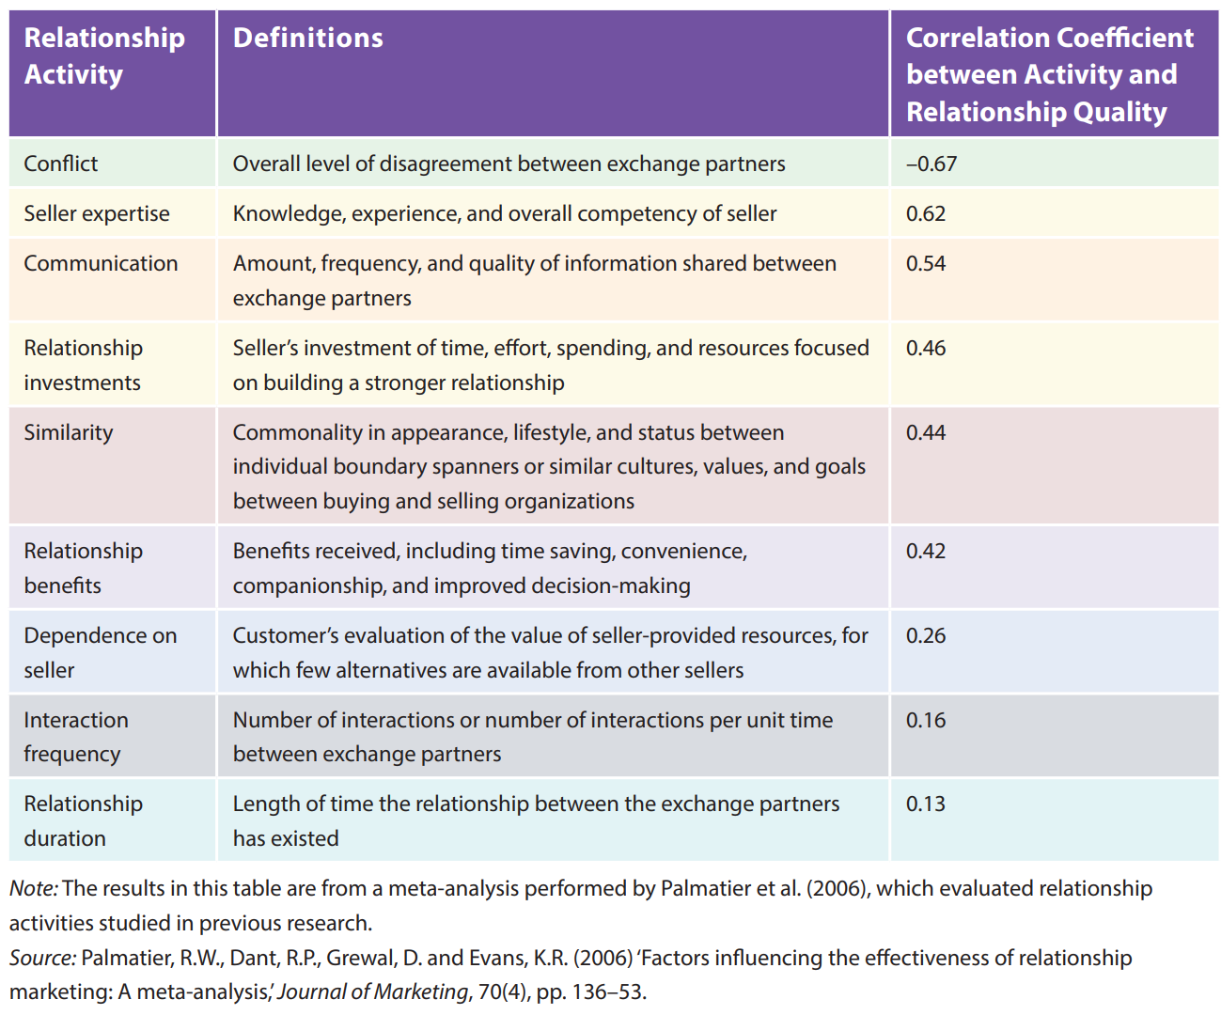
Highest Impact Relationship Marketing Activities
22

Slide 23
Example: Zappos (US)
The online retailer, renowned for its customer service, states that its purpose is “to live and deliver WOW.”
Zappos prioritizes customer service by training new Customer Loyalty Team members for six weeks before they ever work alone.
In that extensive training period, the Customer Loyalty Team members are taught to engage, connect, or bond with customers, even if this requires extended call time.
In addition to positive interfaces with customers, Zappos engages in relationship marketing and loyalty programs by offering VIP membership benefits, such as special discounts and free next-day shipping.
The strong relationship foundation and successful implantation of relationship marketing led to success; Amazon purchased Zappos for $807 million in 2009.
Notes:
The online retailer, renowned for its customer service, states that its purpose is “to live and deliver WOW.” Zappos prioritizes customer service by training new Customer Loyalty Team members for six weeks before they ever work alone.47 In that extensive training period, the Customer Loyalty Team members are taught to engage, connect, or bond with customers, even if this requires extended call time. In addition to positive interfaces with customers, Zappos engages in relationship marketing and loyalty programs by offering VIP membership benefits, such as special discounts and free next-day shipping. The strong relationship foundation and successful implantation of relationship marketing led to success; Amazon purchased Zappos for $807 million in 2009

Slide 24
Building Relationships: Takeaways
RM has a strong impact on performance especially WOM and may be getting more important
RM needs to build gratitude/reciprocity norms, trust, and commitment
  Gratitude helps start relationships
  Effect on gratitude can be leveraged by delivery (freewill, motive, timing/value)
Interfirm RM needs to build breadth and authority
  Relationship operate at many levels simultaneously
  Individual > firm, but susceptible to turnover
RM strategies
  Expertise and communication
  RM investments (social > structural > financial)
  Dependence, duration, and frequency not effective

Slide 25
Maintaining Relationships
A negative event can overwhelm an accumulation of positive activities
Long-term RM success often depends more on preventing the bad than on promoting the good
Negative activities generally have approximately twice as strong an effect as positive activities, but not all negative events are the same
Companies sometimes welcome toxic poisons, by engaging in actions that generate and even encourage perceptions of unfairness
When managers recognize unfairness as a relationship poison, they should find the antidote by revising their RM and loyalty programs to make the benefits for targeted customers invisible to bystanders
Preemptive approaches might be the best antidote
Notes:
Maintaining Relationships. A negative event can overwhelm an accumulation of positive activities. Long-term RM success thus often depends more on preventing the bad than on promoting the good. Negative activities generally have approximately twice as strong an effect as positive activities, but not all negative events are the same. Perceived unfairness or betrayal is probably the most potent relationship poison, with direct and powerful negative effects, such as undermining customer cooperation, flexibility, and performance. It also aggravates the negative effects of more conventional activities, such as daily conflict, disagreements, or opportunism. A party that invests heavily in the relationship, only to have the partner free-ride or cheat, seeks to punish this failure to reciprocate. Perceptions of unfairness thus lead directly to emotional, punitive, and retaliatory behaviors. For example, customers often leave only after some perceived unfairness pushes them to expend the substantial effort and cost required to switch to another brand.
Unfortunately, companies seemingly welcome the toxic poisons, by engaging in actions that generate and even encourage perceptions of unfairness. When customers believe that their ratio of benefits to costs is worse than others’, they feel compelled to restore the balance, often by punishing the company. Yet loyalty programs seek to create just such imbalanced ratios. Bystanders—the customers not targeted by the program—despise the unfair treatment they receive. In an airline study for example, bystanders’ perceptions of unfairness when they watched other customers receive priority boarding were so high that they harmed their loyalty and annual sales intentions ten times as much as these tactics improved customers targeted for these programs. Arguably, that outcome might be fine from a financial perspective, especially if loyalty programs truly target the firm’s most valuable customers, namely, the ones who account for the majority of its sales. Yet unfair treatment during initial interactions likely prevents any relationship from developing, even if the prospective customer might turn out to be highly valuable.
When managers recognize unfairness as a relationship poison, they should find the antidote by revising their RM and loyalty programs to make the benefits for targeted customers invisible to bystanders. If that is impossible, they need to issue clear, constant, and comprehensive explanations for why certain customers receive different treatment. They also need to seem legitimate to customers. For example, contracts between sellers and customers might be legally viable but still unfair, so firms that cite contracts likely suffer retaliation from customers who find any chance to “get even.” It is hard to build a strong customer relationship solely on the foundation of a contract, as many cell phone and cable providers have come to learn.
In addition, constant communications about preferable treatment could have the unfortunate effect of suppressing gratitude among target customers, by eliminating the pleasurable element of surprise. A study designed to evaluate airline rewards (e.g., priority boarding, priority check-in, reduced baggage fees) found that among targets, gratitude accounts for about 60 percent of the incremental lift in annual sales, but for bystanders, unfairness accounts for about 70 percent of the incremental sales drop. Bad is stronger than good, so firms need to think about building positive sentiment through RM programs but also mitigating any negative sentiment from RM programs that cause perceptions of unfair treatment.
Ultimately, preemptive approaches might be the best antidote. Through training initiatives, firms might help boundary spanners identify situations likely to generate unfairness perceptions and learn strategies to address the perceptions immediately. Overall, maintaining relationships requires preventing bad events (e.g., unfairness, unresolved conflict) while also persisting at least at a base level of positive RM efforts (e.g., communication, investing in the relationship).

Slide 26

Example: United Airlines
United Airlines cited its contractual policies when it refused to spend $1200 to repair a passenger’s guitar that its baggage handlers had carelessly broken
The passenger received word that he was ineligible for compensation because he failed to make the claim within United’s stipulated 24-hour timeframe
The passenger vented his frustration by creating a song entitled “United Breaks Guitars” and uploaded it on YouTube
As of 2014, it garnered almost 14 million views and may have cost United Airlines $180 million.
Notes:
United Airlines learned the lesson too: It cited its contractual policies when it refused to spend $1200 to repair a passenger’s guitar that its baggage handlers had carelessly broken. That is, the passenger received word that he was ineligible for compensation because he failed to make the claim within United’s stipulated 24-hour timeframe. The passenger vented his frustration by creating a song entitled “United Breaks Guitars” and uploaded it on YouTube. As of 2014, it garnered almost 14 million views and may have cost United Airlines $180 million.

Slide 27
Maintaining Relationships: Preventing the “Bad” is More Important than Adding More “Good”
Negative behaviors impact relationships more than positive behaviors
  Meta of 38,000 relationship shows negative activities have twice the effect of positive activities
  Conflict and opportunism also have strong negative effects
People seek explanation for negative more than positive events; unfairness judgments provide insight into motivation for bad events
Unfairness plays a large role in undermining relationships since individuals feel emotional need to punish unfair behaviors, even at a cost to themselves
  Hardwired psychological behavior to prevent cheating
  Starbucks/United Airlines
(Emmons and McCullough 2004)
(Palmatier et al. 2007; Samaha, Palmatier, and Dant 2011)
Notes:
Studies
Coke and raffle tickets (500% return) overcomes disliking
Krishna's gift of book or flower
Boy Scouts tickets (5$), followed by candy bar (1$), reciprocating concessions

Slide 28
Unfairness Aggravates the Negative Effect of Other Damaging Activities
Relationship Damaging Factors
Relationship Capabilities
Conflict
_
+
Interfirm cooperation
_
Interfirm performance
Perceived Unfairness
+
Interfirm flexibility
Opportunism
_
+
[493 customers over three years]
(Samaha, Palmatier, and Dant 2011)
Notes:
Use retail example
Catalyst for building and engaging norms, all societies

Slide 29
Strategies to Suppress Conflict and Opportunism can Worsen Unfairness
Contract utilization
Relationship Damaging Factors
Relationship Capabilities
Conflict
_
_
+
Interfirm cooperation
_
Interfirm performance
Perceived Unfairness
+
+
Interfirm flexibility
Opportunism
_
_
+
[493 customers over three years]
(Samaha, Palmatier, and Dant)
Notes:
Use retail example
Catalyst for building and engaging norms, all societies

Slide 30
High Conflict and Opportunism Have Minimal Effect in Absence of Unfairness
(Samaha, Palmatier, and Dant 2011)

Slide 31
However, Firms Often Expose Themselves to the Toxic Effects of Unfairness
Lost customer analysis shows that customers often leave due to the emotional push from unfairness (overcome exit barriers)
Loyalty, reward, and relationship programs are often the culprit
  Program participation tops 1.8 billion; average US household subscribes to 14 different programs
  But, often fail to meet financial expectations
Benefits to target customers can be overcome/offset by damage to bystanders
  Up in the Air Link
  Some programs are only available to new customers
(Henderson, Beck, and Palmatier 2011; Steinhoff and Palmatier 2014)

Slide 32
RM Can Simultaneous Help and Hurt Firm’s “Overall” Performance: 3 Key Elements
3) Customer Loyalty Portfolio
1) RM Reward Elements
Target 1
Reward 1: priority check in
Gratitude
+
+
Target 2
Firm portfolio performance
+
Target n
Reward 2: lounge access
Status
_
Bystander 1
Unfairness
_
+
Reward n:
Bystander 2
Bystander n
2) RM Delivery
Visibility of reward
Clarity of rules
(Steinhoff and Palmatier 2014)
Notes:
Use retail example
Catalyst for building and engaging norms, all societies

Slide 33
60% of Sales Lift Comes from Gratitude and 70% of Drop Comes from Unfairness
Customers Across Multiple US Airlines
See Understanding the Effectiveness of Loyalty Programs for overview
(Steinhoff and Palmatier 2014)

Slide 34
Maintaining Relationships: Takeaways
Preventing customer perceptions of unfairness; may be “highest impact” RM strategy
  Prevents large negative effect
  Suppresses negative effect of other negative activities
  Prevents punishing or retaliatory behaviors
Understanding ”true effectiveness” of loyalty programs needs a multidimensional view:
  Reward element perspective
  Reward delivery perspective
  Portfolio perspective (targets and bystanders)

Slide 35
However, RM Doesn’t Always Work
Some customers try to avoid relationships
  Hassle, cost, and time
  Prevent psychological debt as know they will feel pressure to reciprocate and/or guilt
RM more effective to customers that are “relationship oriented,” desire or need relationship to “solve” an exchange problem, and want governance benefits:
  Flexibility
  Minimize need for monitoring
  Cooperation
  Safeguard assets
  Manage risk
(Palmatier et al. 2008)

Slide 36
Targeting and Adapting Relationship Marketing Strategies
Various causal drivers are responsible for RM effectiveness and building relationship equity; their effects also depend on environmental or contextual factors though
When contextual factors increase a customer’s relationship orientation, or desire to engage in a strong relationship, they increase its receptivity to relationship building, prompting more effective RM
RM with customers without a strong relationship orientation imposes costs without parallel benefits
Notes:
Targeting and Adapting Relationship Marketing Strategies
Various causal drivers thus are responsible for RM effectiveness and building relationship equity; their effects also depend on environmental or contextual factors though. For example, seller expertise might be a strong positive antecedent to relational equity in general, but its influence also depends on whether customers are rebuying a commodity product (e.g., gasoline), in which case they have little interest in expertise, or investing in a highly technical, unfamiliar product (e.g., HDTV), in which case they likely find this RM activity very valuable. Understanding these contingencies can help managers target customers with specific, appropriate, adapted activities and strategies that optimize the returns on their RM investments.
Factors that Affect Customers’ Desire for Relationships. Relationship marketing is not effective for all customers. Some customers simply seek to avoid relationships. In line with MP#1, customers differ, so sellers must address this heterogeneity to determine how to allocate RM resources across customer portfolios. Relationship marketing should succeed best among customers that require a relational governance structure to address their uncertainty or dependence, that cannot predict or address their challenges in advance, or that lack other governance or institutional protections. When contextual factors increase a customer’s relationship orientation, or desire to engage in a strong relationship, they also increase its receptivity to relationship building, prompting more effective RM.
In contrast, RM with customers without a strong relationship orientation imposes costs without parallel benefits. The customer incurs costs, such as the opportunity costs associated with communicating with the seller and participating in the RM programs. Imagine a customer who contacts a seller’s call center to obtain a product sample but then must endure an extended follow-up visit from a salesperson full of queries, small talk, and relationship-building entreaties. Furthermore, RM demands some interpersonal reciprocity, which may make the customer feel personally indebted and uncomfortable.

Slide 37
Intensity of RM Should be Matched to the Relational Governance Needs of Customer
Customer’s Evaluation of Relational Governance
Exchange Inefficiency
(- mechanism)
_
+
_
Exchange Performance
Relationship Marketing Activities
+
_
+
Relationship quality
(+ mechanism)
+
Relationship proneness
Product dependence
Category involvement
Relationship stage
Salesperson competence
Industry Norms
Relationship Orientation
+
(Palmatier et al. 2008)
Notes:
Use retail example
Catalyst for building and engaging norms, all societies

Slide 38
Firms Are Becoming More Global, But Use US-based RM Insights
International trade accounts for 20% of global GDP
Among the S&P 500 firms that report foreign sales, 46% of their total revenues in 2010 came from foreign markets
Meta-analysis of 144 papers, across 29 countries, 43,000 relationships, which represents 82% of global GDP
US ranks only as 16 of 25 countries in terms of RM effectiveness on performance: RM is more effective outside the US
Especially in BRIC countries, RM is 55% more effective than in US at driving performance
(Samaha, Beck, and Palmatier 2014)

Slide 39
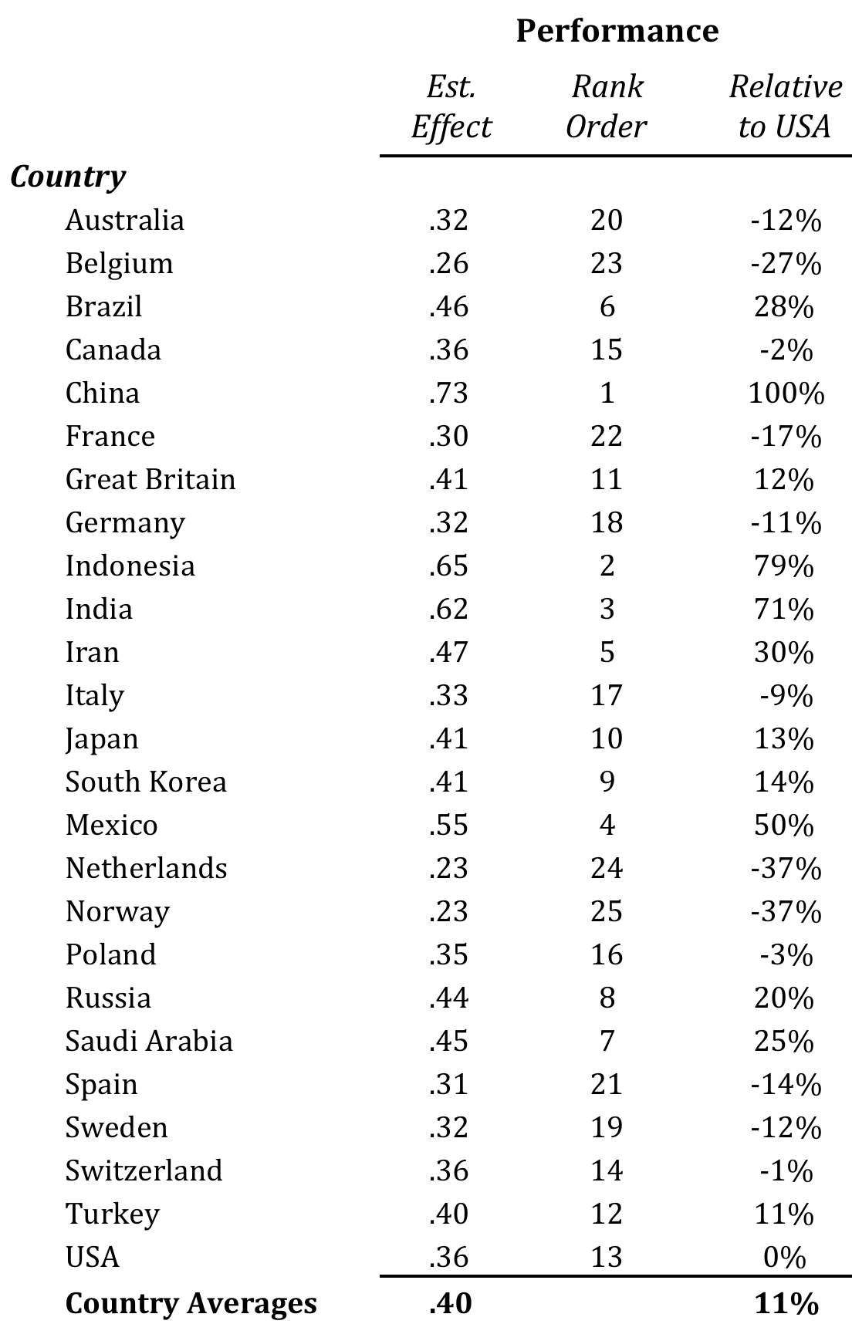
RM Payoff Varies Across Different Countries
On average, RM 11% more effective outside the US
Relationships have the largest payoff in China: 100% larger than in US
Relationships have the smallest payoff in Norway and Netherlands: 37% smaller than in US
(Samaha, Beck, and Palmatier 2014)

Slide 40
Targeting RM: Takeaways
RM strategies need to be adapted based on:
  Customer’s governance needs (i.e., customer’s desire or need for a relationship, or relationship orientation)
  Customer’s culture
In general, RM will be more effective when:
  Product dependence is high
  Category involvement is high
  Industry has high relational norms
  Salesperson is more competent
  Individualism is low
  Power distance is high (for status related constructs)
  Institutional trust is low (for remerging economies)
  In service and channel contexts
RM effectiveness will also depend on the relationship’s stage or state
Notes:
Optimal RM effectiveness means that the level of RM activities matches the customer’s relationship orientation. Some determinants of a customer’s relationship orientation include:
-Relationship proneness: the basic tendency of an individual to engage in relationships. This stable, individual difference variable implies that a relationally prone customer experiences a higher relationship orientation toward sellers.
-Exchange and product uncertainty: captures volatility, monitoring difficulty, and the speed of technological changes. Greater uncertainty increases the need for adaptability, as is likely for exchange partners with strong relationships.
-Product category involvement/dependence: reflects the importance of and customer need for a particular product category, due to personal-, firm-, or role-related needs, values, and interests, which increase an entity’s relationship orientation.
-Relational norms: vary across exchange contexts but broadly reflect the value placed on customer–seller relationships in an industry or shopping context. Each context has some “bandwidth of working relationships” that “reflects the explicit or implicit relationship strategies.” Strong relationship norms enhance an individual’s or firm’s relationship orientation.
-Relationship-centric reward systems: encourage strong customer–seller relationships through evaluation systems, compensation programs, and policies. If a business buyer’s rewards depend mostly on price reductions, multiple sourcing, or the number of transactions, the buyer embraces a transaction orientation. If a buyer receives relationship-focused incentives, it should exhibit a higher relational orientation.
-Services: are less tangible and consistent but more perishable than products, such that they demand more customer and boundary spanner involvement. Stronger relationships between customers and sellers appear more critical for services than for products. Because evaluations of service offerings tend to be ambiguous, service intangibility also may make the benefits of relational trust more critical.
-Business-to-business markets: feature greater complexity, such that they require adaption and strong relational governance structures. Thus, RM is more effective in B2B than in B2C markets. One sales force management text estimates that B2B firms spend close to $800 billion annually on sales forces, and yet: “Usually working alone and unsupervised, salespeople are entrusted with a company’s most important asset: its relationship with its customers. Often salespeople have considerable control over this relationship; to some customers, the salesperson is the company” (p. 521).
-Emerging markets: with their fewer institutional protections to business exchange make RM more effective than in developed markets. Customer relationships exert a 55% greater effect on performance in the BRIC countries (Brazil, Russia, India, and China) than in the US, for example.
Aligning Relationship Marketing Strategies with Customers’ Relationship Orientation
Costly RM efforts can undermine performance. However, aligning RM efforts with the customer’s relationship orientation helps balance the flexibility, monitoring, and safeguarding benefits against the added costs that the customer incurs to build and maintain those relationships. For customers with a higher relationship orientation, RM leads them to perceive the exchange as efficient, which improves relational equity and thus seller performance. But according to one study, customers with a low relationship orientation would shift 21% of their business to another supplier that offered completely automated transactions (i.e., no salesperson).38 Thus, understanding each customer’s relationship orientation is particularly critical in response to cost-reducing and productivity-enhancing efforts that minimize the time business customers have available to meet with sellers, even as sellers increase their relationship-building efforts.
According to one study, customers with a low relationship orientation would shift 21% of their business to another supplier that offered completely automated transactions (i.e., no salesperson). Organizational policies and procedures that promote relationship building, such as compensation systems that incentivize salespeople to engage indiscriminately in intensive relationship building, will likely alienate customers, especially those with a low relationship orientation. A portfolio of customers distributed across a relationship orientation spectrum demands targeted approaches. A unilateral emphasis on RM will create unnecessary expenses and misalignments with the relational governance preferences of many customers.
Factors that Leverage Relationship Marketing Delivery Effectiveness
The effects of RM programs also depend on their delivery, which largely determines the inferences that customers make about the seller. For example, if customers believe the seller has more or less free will in offering RM benefits, or does so sincerely or opportunistically, they likely develop different feelings of gratitude. These feelings, in turn, affect their short-term customer behavior in response to RM activities. For example, if the seller offers the RM benefit of its own accord, it is exhibiting free will rather than contractual or mandated behavior, such as by giving an unexpected gift or performing a random act of kindness. An RM investment likely takes on new meaning if it is not part of a formal RM program. Thus, higher levels of gratitude result from RM investments when the customer perceives the investments as acts of free will rather than contractual fulfillments or duties.39
People also consider other parties’ motives, defined as the desire or need that incites their action. Customer inferences about motives play key roles in their perceptions of sellers’ actions, such that they experience gratitude when the favor implies benevolent intentions rather than an ulterior, marketing motive. Because relationships often begin with some investment (e.g., time, effort), in a noncontractual context, the person who initiates the investment generally suffers some risk, due to the subjective possibility that the investment fails to prompt reciprocated behavior. Higher perceived risk generally induces higher levels of gratitude though. Most people appreciate a gift, especially if it has value; value and appreciation also increase if the gift is necessary. That is, need is a condition in which a person requires or desires something, so if a need exists, the relevant situation invokes higher value. When a recipient obtains a needed item, or one that creates more risk for the partner, the recipient’s gratitude should increase.

Slide 41
Relationship Dynamics and Lifecycle Stages
Most relationships begin with an exploratory or early stage, featuring limited confidence in the partner’s ability and trustworthiness but also a willingness to explore the relationship to determine if the potential benefits exceed those available from alternative options
If the initial experiences are positive and produce the desired outcomes, as well as evidence of trustworthiness, relationships move into the growth or developing stage
If the relationship continues, the partners continue to obtain benefits and greater interdependence, such that they reach the maturity or maintaining stage
Even successful relationships can enter a decline or recovery stage in response to specific events (conflict, unfairness, betrayal) or passive neglect (failure to communicate, ending investments)
Notes:
Relationship Dynamics and Lifecycle Stages
Relationships operate according to a lifecycle process, during which they develop, shift, and ultimately dissolve, according to the path-dependent stages in Figure 7.3. Most relationships begin with an exploratory or early stage, featuring limited confidence in the partner’s ability and trustworthiness but also a willingness to explore the relationship to determine if the potential benefits exceed those available from alternative options. During early communications, the parties realize synergistic norms and goals through reciprocated transactions. If the initial experiences are positive and produce the desired outcomes, as well as evidence of trustworthiness, relationships move into the growth or developing stage. The escalation of reciprocated transactions and increased affective attachment produce trust, commitment, and satisfaction.
If the relationship continues, the partners continue to obtain benefits and greater interdependence, such that they reach the maturity or maintaining stage. Their calculative trust gets replaced by knowledge- and affective-based trust, communication, and other relational norms that reinforce their common goals. Both firms view their partner’s behaviors as predictable, and mutual investments occur. In combination, these factors increase the partners’ willingness to make long-term commitments to and investments in the relationship. They expect continued interactions. Still, even successful relationships can enter a decline or recovery stage in response to specific events (conflict, unfairness, betrayal) or passive neglect (failure to communicate, ending investments)

Slide 42
Relationship Dynamics and Lifecycle Stages
Across the different relationship stages, RM strategies should be adapted as follows:
  Early – use gratitude-, communication-, and competency-based strategies to build reciprocity norms and explore potential
  Growth – use bilateral investments to exploit relationship potential, though the window for investments is small
  Maintain – don’t neglect (ongoing communication and investments) or betray (unfairness and conflict) customers
  Recovery – use communication together with compromise to rebuild relationships and avoid exchanges based solely on dependence
Notes:
Across the different relationship stages detailed in Figure 7.3, RM strategies should be adapted as follows:
-Early: Use gratitude-, communication-, and competency-based strategies to build reciprocity norms and explore potential.
-Growth: Use bilateral investments to exploit relationship potential, although the window for investments is small. For example, Cricket Australia and the Channel Nine broadcasting system regularly team up for mutual gains: Cricket Australia assigns Channel Nine exclusive TV rights to its national and international cricket tournaments, and Channel Nine agrees to invest in the latest digital technology to provide more engaging and incisive cricket telecasts for fans.
-Maintain: Don’t neglect (ongoing communication and investments) or betray (unfairness and conflict) customers. Flipkart, India’s fastest growing online retail startup, invests significantly in technology to ensure that every customer who returns a product is issued a full refund within 30 days, knowing the importance of being perceived as a fair retailer among consumers.
-Recovery: Use communication together with compromise to rebuild relationships and avoid exchanges based solely on dependence. As important venues for firms to receive feedback, review websites allow consumers to express their opinions and provide product ratings, but their reviews often highlight product failure experiences. This negative feedback can damage firms’ reputations and adversely affect their performance; therefore, many hotels (e.g., The Ritz London) respond publicly and immediately to consumers’ online complaints on Tripadvisor.com to avoid any damage to their image, especially among prospective consumers who use the websites to obtain prepurchase information.

Slide 43
Customer Relationship Lifecycle
Exploratory/Early Stage | Growth/Development Stage | Maturity/Maintain Stage | Decline/Recovery Stage
Use gratitude-, communication-, and competency-based strategies to build reciprocity norms and explore potential. | Use bilateral investments to exploit relationship potential by building strong relationship bonds. | Don’t neglect (ongoing communication and investments) or betray (unfairness and conflict) the partner. | Use communication together with compromise to recover the relationship and avoid an exchange that is based solely on dependence.
Relationship Quality High
Relationship Quality Low
Most Effective Relationship Marketing Strategies

Slide 44
Agenda
Introduction
Relationship Marketing Strategy
  Building and Maintaining Relationships
  Targeting and Adapting Relationship Marketing Strategies
  Relationship Dynamics and Lifecycle Stages
Managing Relationship-Based Sustainable Competitive Advantage
  Building Relationship Equity
  Measuring Relationship Equity
  Multiple Regression
Takeaways

Slide 45
Building Relationship Equity
The process of building relationship equity consists of two main steps:
  A firm needs to develop a strong foundation that supports relationship building and maintenance
  With this foundation, the firm can begin to implement relationship marketing and loyalty programs targeted at specific customer groups, designed to generate specific relational outcomes across the firm’s customer portfolio
Notes:
Building Relationship Equity
The process of building relationship equity consists of two main steps. First, a firm needs to develop a strong foundation that supports relationship building and maintenance. Primarily, it must organize, hire, train, and build systems for employees that support positive relational interfaces with customers. In addition, the firm needs to establish and institute fundamental processes conductive to positive relational exchanges. Second, with this foundation, the firm can begin to implement relationship marketing and loyalty programs targeted at specific customer groups, designed to generate specific relational outcomes across the firm’s customer portfolio. Some academic research detailing best practices in this effort is summarized in Table 7.2.

Slide 46
Step 1: Developing a Strong Relationship Foundation
Unfairness and unresolved conflict can undo years and fortunes spent on relationship building
Counterproductive to increase RM budgets without having a process that deals with customer problems, service failures, or trust violations
The individual, boundary-spanning personnel with whom customers interact usually are the most critical means to create and maintain strong customer relationships
Because so many drivers of customer relationships revolve around boundary spanners, sellers need to dedicate their RM investments to selecting, training, and motivating boundary-spanning employees
Increasing the amount, frequency, and quality of communication with customers also can be effective
Regardless of the extensiveness of such external communication though, a poor alignment of internal, organizational elements with RM can undermine any effort to build customer relationships
Notes:
Step 1: Developing a Strong Relationship Foundation. Unfairness and unresolved conflict can undo years and fortunes spent on relationship building. In many cases, it is counterproductive to increase RM budgets without a well-designed process for dealing with customer problems, service failures, or trust violations. Sellers must design customer conflict resolution within the framework of their overall RM activities, such as creating a culture that emphasizes the importance of resolving problems, supported by formal systems for correcting customer issues. That is, the culture of the selling firm is important, and all elements, from hiring and training salespeople to compensation and support systems, must encourage the seller’s representatives to pursue and maintain good relationships with customers.
These individual, boundary-spanning personnel with whom customers interact usually are the most critical means to create and maintain strong customer relationships, so firms also should empower boundary spanners to resolve issues immediately. At the Ritz-Carlton for example, employees may spend up to $1,000 solving customer issues on their own, without any approval. The interpersonal relationships of customers with boundary spanners affect customer behaviors more than do their relationships with the selling firm. To take advantage of this strong impact of interpersonal relationships, sellers should assign a dedicated contact person to customers, especially in B2C settings; if the customer calls and the dedicated contact person is not available, other employees can acknowledge that they are filling in and give the customer the option to wait until the contact person is available, leave a message, or agree to let the substitute handle a critical issue. Similar tactics even might be implemented in call centers. Inbound calls rarely get directed to a specific rep, but the Vanguard mutual fund company assigns all “Flagship customers” a dedicated representative and phone number. Outgoing calls, direct mail, and up- or cross-selling efforts always should come from the contact person. Even web-based interfaces can reference this dedicated staffer (e.g., with a picture) or offer an option to e-mail the contact person.
Because so many drivers of customer relationships revolve around boundary spanners, sellers need to dedicate their RM investments to selecting, training, and motivating boundary-spanning employees. Expensive advertising and rebate programs likely will be wasted—especially if the firms sell exclusive, luxury, technical, or complex products and services—if the customers’ interactions with contact employees are poor. Whether the seller is Flipkart or the Ritz, strong RM firms expend significant effort to ensure the effectiveness of their boundary-spanning personnel.
Increasing the amount, frequency, and quality of communication with customers also can be effective, especially when the communication comes through parallel channels. Early in the relationship lifecycle, communication drives relationship quality and growth, with multiple dividends. In addition to this immediate impact, communication can improve relationship quality over time, such as by unveiling new cooperative value creation ideas or preventing ugly conflict or service failures.
Regardless of the extensiveness of such external communication though, a poor alignment of internal, organizational elements (e.g., corporate leadership, strategy, culture, control) with RM can undermine any effort to build customer relationships. If internal control systems discourage salespeople or boundary spanners from developing relationships with customers for example, they can have far-reaching and detrimental effects. Sellers thus should conduct internal RM audits and design flexible RM policies and programs, such that their appropriately motivated boundary spanners recognize their ability to adapt their RM activities to their customers’ specific relationship orientations.

Slide 47
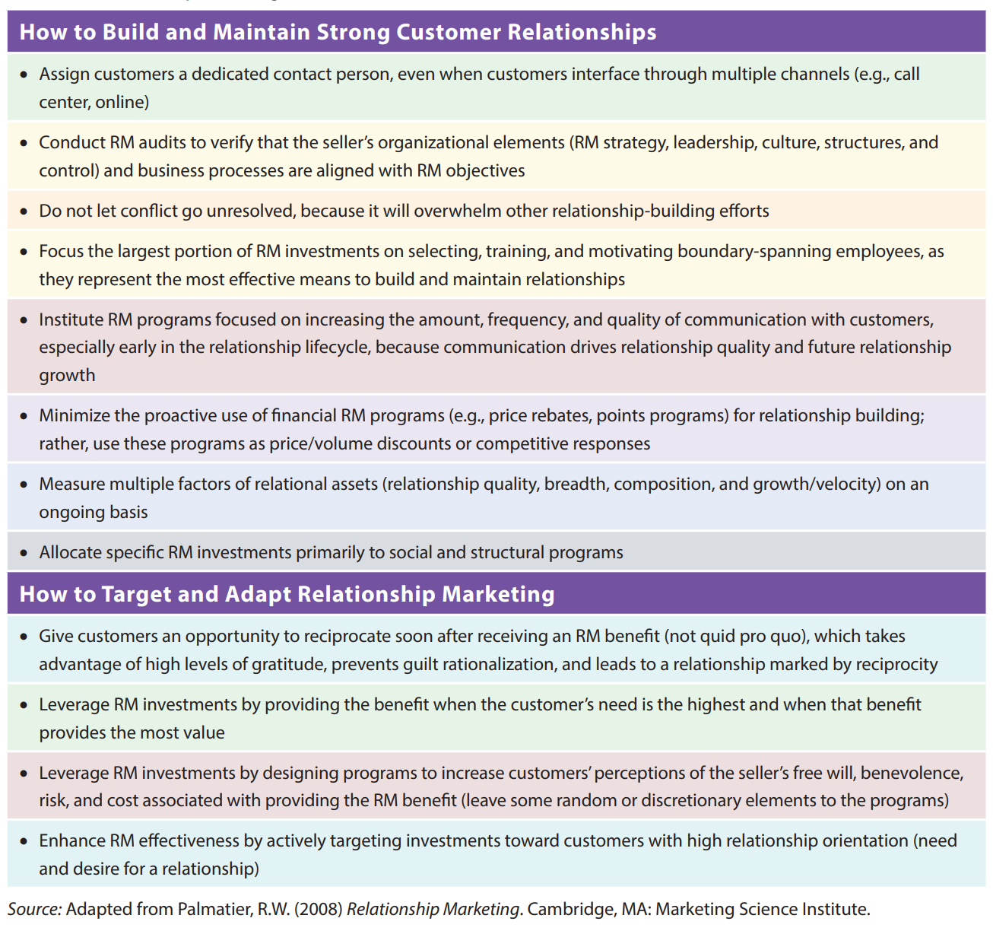
Relationship Marketing Best Practices
47

Slide 48
Step 2: Implementing Targeted RM and Loyalty Programs
Different RM programs build different forms of relational ties that generate varying returns from different types of customers
Social RM programs use social engagements like meals and sporting events to convey the customer’s special status
Structural RM programs provide investments that customers might not make themselves, such as in electronic order processing interfaces or customized packaging
Financial RM programs provide economic benefits, in the form of special discounts, giveaways, free shipping, or extended payment terms that ultimately tend to offer little relative advantage, because competitors can easily match them
Notes:
Step 2: Implementing Targeted RM and Loyalty Programs. Different RM programs build different forms of relational ties that generate varying returns from different types of customers. Relationship marketing investments in specific programs should be allocated primarily to social and structural, rather than financial, programs.
Social RM programs use social engagements like meals and sporting events to convey the customer’s special status.
The difficult-to-duplicate bonds that result from such special treatment often prompt customers to reciprocate, with repeat sales, recommendations, or ignoring competitive offers. The financial returns of social RM investments have direct, significant impacts on profit—greater than those of other RM investment types and reaching return-on-investment (ROI) values of approximately 180 percent. Yet social programs also lead customers to build relationships with the salesperson rather than the selling firm, so they could defect if the salesperson turns over or leaves the firm. This cautionary note suggests that multiple members of the firm should maintain at least some communications with customers. Still, perhaps because of the interpersonal nature of their delivery (i.e., salespeople allocate their available resources in real time at their own discretion), a social program’s effects appear largely immune to contextual factors.
Structural RM programs provide investments that customers might not make themselves, such as in electronic order processing interfaces or customized packaging. They generally increase the customer’s efficiency, convenience, or productivity, creating a hard-to-quantify but substantial customer benefit. With their considerable setup costs and benefits, the existence of these programs binds customers and sellers closely. The competitive advantages resulting from these structural bonds occur because customers increase their business with the seller to take full advantage of their value-enhancing offerings. With regard to profit, the influence of structural RM investments depends on interaction frequency. If customers show an average interaction frequency (a few times per week), short-term returns break even. If they engage in frequent interactions, the ROI for structural RM is about 120 percent. To leverage structural relationship investments, sellers thus should focus on customers who can get the most value from customized structural solutions and who participate in relatively more frequent interactions.
Financial RM programs provide economic benefits, in the form of special discounts, giveaways, free shipping, or extended payment terms that ultimately tend to offer little relative advantage, because competitors can easily match them. Customers attracted by incentives also tend to seek out deals and are less profitable to serve. This is not to discount the benefits and returns financial programs can provide in some situations. Rather, they cannot be the only type of program used to build relationships. Instead, tactics such as price reductions or rebates should represent price or volume discounts or responses to competitors’ moves. It is extremely easy to misallocate financial RM programs too; a customer service employee can simply hand out a financial incentive (e.g., free sample, special discount).

Slide 49

Example: Telstra (Australia)
Telstra, Australia’s telecoms giant, launched a loyalty program called “Thanks” that rewards its customers with movie tickets and access to live music and sporting events
Mark Buckman, the chief marketing officer of Telstra, indicated that: “We want our customers to turn into advocates for our business. They stay longer with you, they spend more money with you and they recommend you to friends and family”
The program was launched to recognize the relationship Telstra has with its customers, while enhancing the commitment to the brand.
Notes:
Telstra, Australia’s telecoms giant, launched a loyalty program called “Thanks” that rewards its customers with movie tickets and access to live music and sporting events. Mark Buckman, the chief marketing officer of Telstra, indicated that: “We want our customers to turn into advocates for our business. They stay longer with you, they spend more money with you and they recommend you to friends and family.” The program was launched to recognize the relationship Telstra has with its customers, while enhancing the commitment to the brand.

Slide 50

Example: Your World Rewards (UAE & US)
Emirates Airline and Starwood Hotels & Resorts Worldwide, Inc. formed a partnership, Your World Rewards, to provide reciprocal benefits to Emirates Skywards and Starwood Preferred Guest (SPG) customers
The combined program allows Skywards and SPG elite members to gain points and rewards when they fly with Emirates or stay with Starwood..
Thierry Antinori, executive vice president and chief commercial officer of Emirates Airline, reports that: “The combination of Emirates’ growing global network, Starwood’s innovative take on hospitality and our top-rated loyalty programs allow us to recognize our most valuable customers with a heightened level of service and greater rewards wherever they travel – be it to one of our more than 140 destinations or at any of Starwood’s 1,200 hotels.”
Notes:
Your World Rewards (UAE & US)
Emirates Airline and Starwood Hotels & Resorts Worldwide, Inc. formed a partnership, Your World Rewards, to provide reciprocal benefits to Emirates Skywards and Starwood Preferred Guest (SPG) customers. The combined program allows Skywards and SPG elite members to gain points and rewards when they fly with Emirates or stay with Starwood. Platinum members of both programs can receive the highest level of rewards or exclusive benefits such as elite check-in, complimentary in-room Internet access, and priority check-in. Thierry Antinori, executive vice president and chief commercial officer of Emirates Airline, reports that: “The combination of Emirates’ growing global network, Starwood’s innovative take on hospitality and our top-rated loyalty programs allow us to recognize our most valuable customers with a heightened level of service and greater rewards wherever they travel – be it to one of our more than 140 destinations or at any of Starwood’s 1,200 hotels.”

Slide 51
Step 2: Implementing Targeting RM and Loyalty Programs
Overall, targeting RM programs toward customers with high relationship orientations will make them more effective
Sellers need to leverage their RM investments by designing and delivering programs that increase their customers’ perceptions of the seller’s free will, benevolence, risk, and cost
The next step, beyond inducing gratitude, is getting customers to act on these feelings in ways that produce the most benefits
RM investments should be targeted and adapted according to the relationship stage
Notes:
Overall, targeting RM programs toward customers with high relationship orientations will make them more effective. For customers who do not desire strong relationships or who perceive RM activities as a waste of time, unwanted hassle, or extra cost, improper targeting could lead them to shift to transaction-oriented sellers. For example, many firms understandably allocate their RM resources to their biggest customers or those with the most potential, but this criterion ignores the customer’s viewpoint.
Instead, sellers need to leverage their RM investments by designing and delivering programs that increase their customers’ perceptions of the seller’s free will, benevolence, risk, and cost. Those perceptions should invoke gratitude for the RM benefit received. In contrast, RM benefits that everyone receives, that come in response to a request, that match a competitor’s offer, or that constitute part of the overall product or service offering generate less gratitude and thus little need to reciprocate. Ideally, all programs would retain some random or discretionary elements, rather than devolving into totally structured, quid pro quo programs that do little to promote relationships (e.g., airline loyalty points programs). Sellers instead can generate higher returns by carefully structuring and designing the delivery of their programs.
The next step, beyond inducing gratitude, is getting customers to act on these feelings in ways that produce the most benefits. For example, sellers should create opportunities for customers to reciprocate but avoid any sense of demanding quid pro quo. These opportunities not only allow the seller to leverage the customer’s gratitude but also prevent guilt rationalization and encourage more reciprocity norms. A feeling of gratefulness toward a seller can, in the worst case scenario, generate feelings of guilt, which customers try to relieve by rationalizing their failure to reciprocate (e.g., assigning a negative motive to the seller). Gratefulness also decays over time. Therefore, an airline might be better off if it contacts frequent fliers with offers for discounts on upgrades if they book a certain number of flights within the next six months, for example. This offer grants each flier a ready opportunity to act on feelings of gratitude and should create reciprocity norms in their relationship. This recommendation is especially notable in the context of research that shows that people often reciprocate far in excess of the value received and even then continue to feel grateful.
Finally, RM investments should be targeted and adapted according to the relationship stage. They can concentrate in early growth stages, when customers are more receptive to relationship building and competitive rivalry may be lower. Later on, as the relationship matures, existing structures, links, and communication processes should represent competitive barriers and support SCA. In the maintenance stage, RM investments can be reduced, to match customers’ needs. Sellers also might explore opportunities to expand the relationship, with new products or services, to shift the customer back onto a growth trajectory.

Slide 52
Measuring Relationship Equity
A central measure of the effectiveness of RM efforts is relational equity, which should be assessed on an ongoing basis to support learning and refinement over time
An effective measure of relational equity requires a clear definition of the target of that measure
If RM efforts inherently result in longer relationships, then it may seem that duration should be a good proxy for relationship strength or equity
Another approach links RM programs and relationship equity measures to customer lifetime value, to isolate what portion of the CLV results from relationship equity or specific RM programs
Although this CLV approach is very helpful, in that it integrates multiple financial outcomes into one measure and captures future financial benefits, it cannot capture some of the potential benefits of a strong relational bond, such as positive WOM that leads to new customer acquisition
Notes:
A central measure of the effectiveness of RM efforts is relational equity, which should be assessed on an ongoing basis to support learning and refinement over time (similar to brand equity). Relevant measures would acknowledge the multidimensional aspect of customer relationships. In interfirm relationships, sellers need to capture the breadth (number of contacts) and composition (authority and diversity) of their customer contact portfolio and focus on any weaknesses. If a customer satisfaction survey only includes one informant who reports on relationship quality, the results likely will be misleading, because this single measure cannot reveal the varied, different relational ties that might bind the two firms or whether existing contacts influence key decisions by the customer firm. Lifecycle stage measures, together with measures of the direction and rate of growth of the relationship (i.e., relational velocity), might provide a better leading indicator of the relationship’s future, because customers in stagnant or mature relationships probably require new RM tactics. If a customer no longer requires a relationship, the seller should move it to a more transactional interface or else find a way to reinvigorate the exchange with new offerings. Some fundamental characteristics of business relationships, which also reflect the measures required to capture relationship equity, are summarized in Table 7.3.
—Table 7.3 about here—
An effective measure of relational equity requires a clear definition of the target of that measure. A request that the customer report on the quality of his or her relationship with the seller must specify for example whether the relationship target is the selling firm, an aggregate entity, the primary sales contact, or a sales team. Leaving the target ambiguous will cause each measure to vary, depending on the degree to which it represents the individual- or firm-level relationship. Individual-level relationships are less stable over time (e.g., due to job changes) but typically have greater impacts on customer behavior and financial outcomes.
If RM efforts inherently result in longer relationships, then it may seem that duration should be a good proxy for relationship strength or equity. However, this measure is not very effective. In research into the impact of relationship duration on customer profitability, long-term customers reasonably constitute most of the firm’s profits, but short-term customers are important too: They capture nearly 30 percent of firm profits. A different study indicates that long-term customers (> 6 years) offer higher sales growth, inventory turnover, and returns on invested capital, but they also account for lower gross margins. In most cases, relationship duration, especially after the first year, fails to increase customer profits or prices, so it is a poor proxy for relationship equity.
Another approach links RM programs and relationship equity measures to customer lifetime value (recall the CLV Sidebar 3.2), to isolate what portion of the CLV results from relationship equity or specific RM programs. Sidebar 7.1 describes how multivariate regression can facilitate this approach, because it can link many different variables or drivers (i.e., independent variables) to an outcome variable of interest (i.e., dependent variables, or CLV in this example) and then discover which independent variables significantly affect the outcome and by how much.
Although this CLV approach is very helpful, in that it integrates multiple financial outcomes into one measure and captures future financial benefits, it cannot capture some of the potential benefits of a strong relational bond, such as positive WOM that leads to new customer acquisition. Strong customer relationships also accrue knowledge-based benefits and insights, helping sellers identify new product opportunities, test and refine new product concepts, and accelerate the adoption of new product launches. Therefore, strong relationships likely influence sellers’ financial performance in ways that financial metrics cannot reveal. Such effects are especially difficult to capture because they occur in a time and location that differs greatly from the site at which the customer’s relational behaviors take place. For example, the seller might use critical information that a relational customer provides it to develop a proprietary new product. The profitable sales that the seller generates with different customers in different markets due to this product likely would accrue only many years in the future.

Slide 53
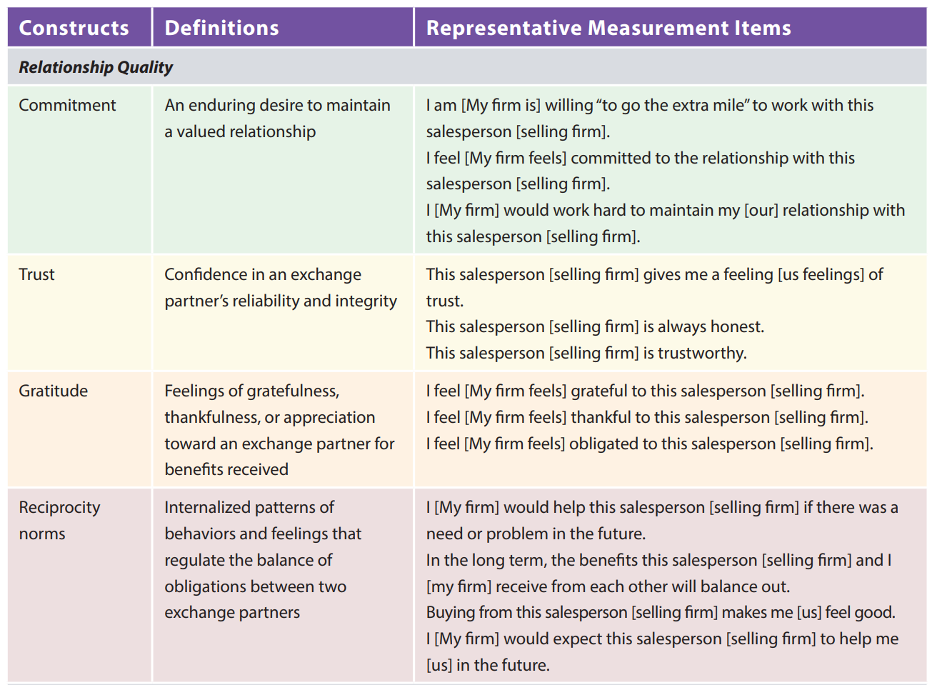
Key Relationship Dimensions and Example Measures
53

Slide 54
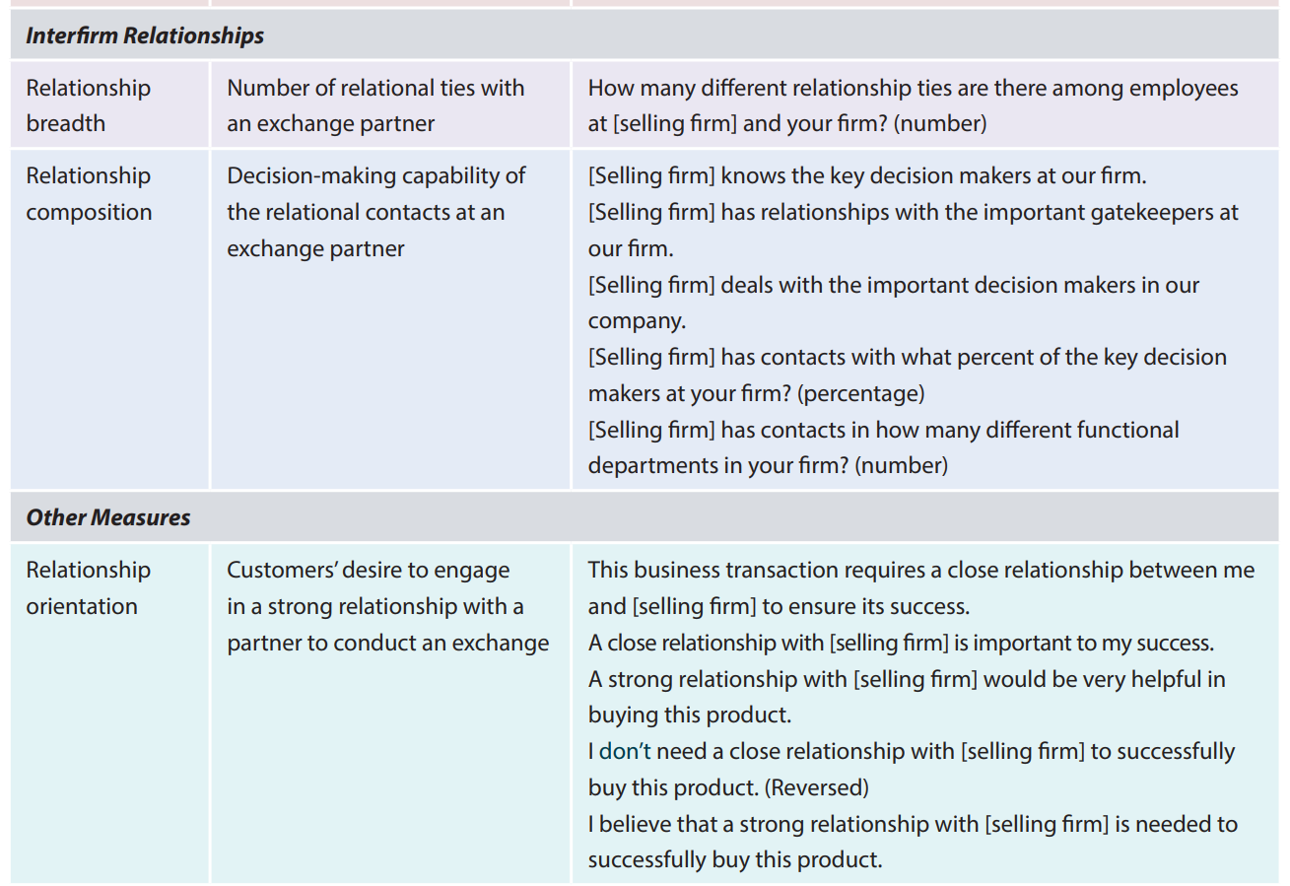
Key Relationship Dimensions and Example Measures
54

Slide 55
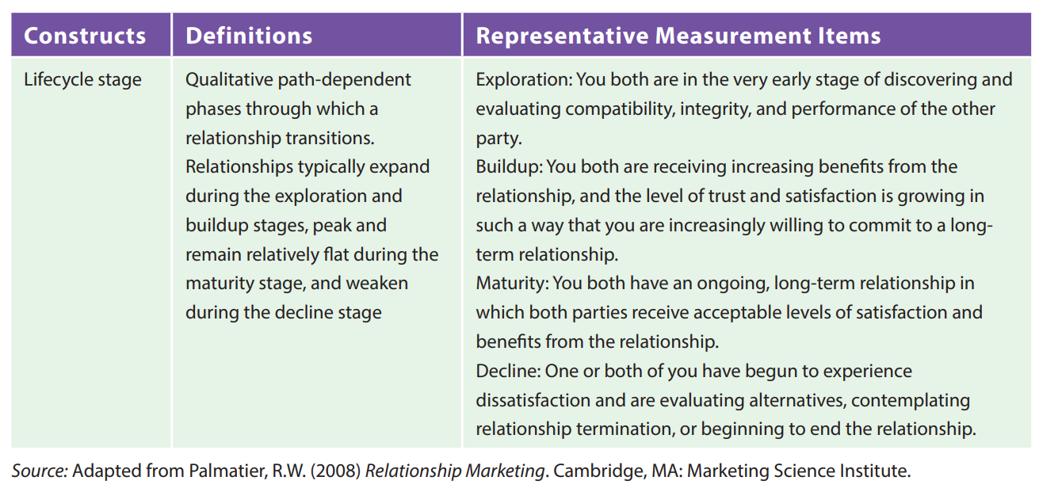
Key Relationship Dimensions and Example Measures
55

Slide 56

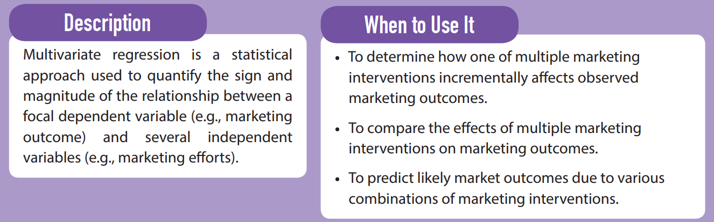
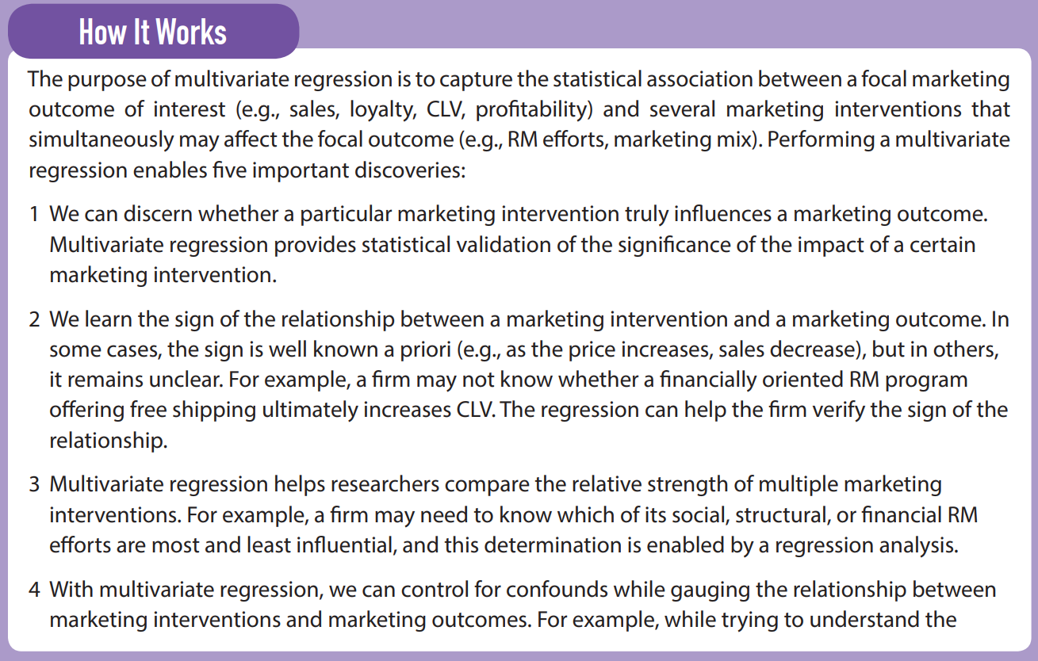

Slide 57
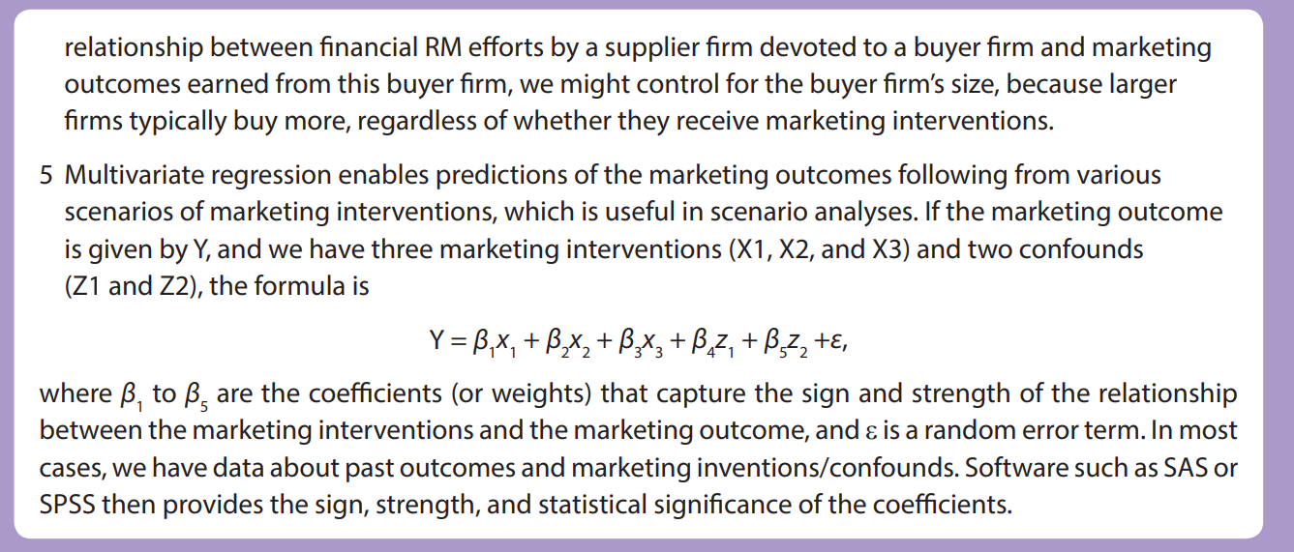

Slide 58
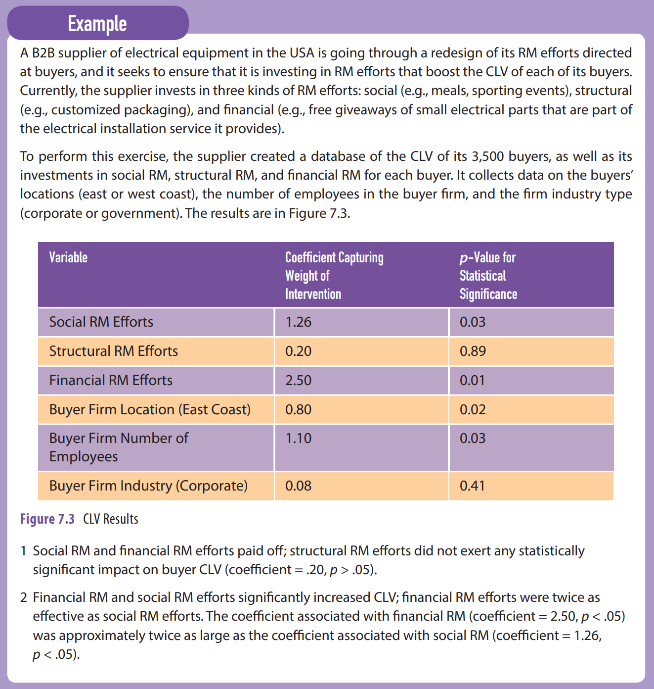

Slide 59
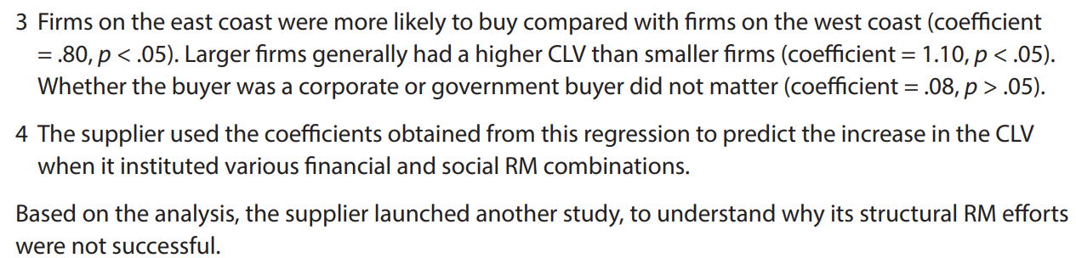

Slide 60
RM Program Audit/Design Process (same process for any BOR program)
Determine AER objective(s) for targeted persona(s) using CLV
Collect and analyze data to identify effective RM strategies
    Evaluate past programs using choice models, natural experiments, etc.
    Qualitative interviews and/or surveys personas
    Qualitative interviews within exemplar boundary spanners
    Benchmark competitors and/or best in class
Design RM/loyalty program
    Rank reward elements to build gratitude and status with targets and prevent unfairness with bystanders (gifts, interpersonal, specialness, communication, similarity, trust)
    Identify delivery options to magnify effects with targets (visibility, rules, surprise, randomness, timing, control attributions)
    Evaluate effect on portfolio (prevent unintended consequences)
    Estimate ROI of programs
Perform field experiment to test effectiveness of top few programs versus control group, analyze, and then launch

Slide 61
Agenda
Introduction
Relationship Marketing Strategy
  Building and Maintaining Relationships
  Targeting and Adapting Relationship Marketing Strategies
  Relationship Dynamics and Lifecycle Stages
Managing Relationship-Based Sustainable Competitive Advantage
  Building Relationship Equity
  Measuring Relationship Equity
  Multiple Regression
Takeaways

Slide 62
Takeaways
Relationship marketing’s (RM) influence on decision making is supported by the underlying psychological emotion of gratitude, which leads to a desire to repay
The linkages between relationships and financial performance operate through four mechanisms, including increased cooperation, loyalty, word-of-mouth, and empathetic behaviors
The most effective RM strategies emphasize positive factors such as seller expertise, communication, relationship investment, and similarity while minimizing negative factors such as unfairness and conflict
The effect of negative activities on relationships is twice as strong as positive activities; it is important to prevent negative events while continuing positive RM
Notes:
Relationship marketing’s (RM) influence on decision making is supported by the underlying psychological emotion of gratitude, which leads to a desire to repay.
The linkages between relationships and financial performance operate through four mechanisms, including increased cooperation, loyalty, word-of-mouth, and empathetic behaviors.
The most effective RM strategies emphasize positive factors such as seller expertise, communication, relationship investment, and similarity while minimizing negative factors such as unfairness and conflict.
The effect of negative activities on relationships is twice as strong as positive activities; it is important to prevent negative events while continuing positive RM.

Slide 63
Takeaways
Bystanders of loyalty programs often perceive their treatment as unfair; this is why loyalty program preferential treatment should be invisible to bystanders
To optimize RM effectiveness, sellers must match the level of RM activities to the customer’s relationship orientation. Some of the factors that determine a customer’s relationship orientation are relationship proneness, exchange and product uncertainty, product category involvement or dependence, relational norms, relation-centric reward systems, services, business-to-business markets, and emerging markets
Because RM is not effective for all customers, sellers must determine where to allocate RM resources across their customer portfolios
Notes:
Bystanders of loyalty programs often perceive their treatment as unfair; this is why loyalty program preferential treatment should be invisible to bystanders.
To optimize RM effectiveness, sellers must match the level of RM activities to the customer’s relationship orientation. Some of the factors that determine a customer’s relationship orientation are relationship proneness, exchange and product uncertainty, product category involvement or dependence, relational norms, relation-centric reward systems, services, business-to-business markets, and emerging markets.
Because RM is not effective for all customers, sellers must determine where to allocate RM resources across their customer portfolios.

Slide 64
Takeaways
Factors that help leverage the effectiveness of RM delivery include free will, motive, risk, and value
Relationships operate through a typical lifecycle with four phases: exploration, growth, maturity, and decline/recovery. Each phase requires different RM strategies
There are two steps to building relationship equity: developing a strong relationship foundation and implementing targeted RM and loyalty programs
To understand the effectiveness of RM efforts, firms should measure their relational equity on an ongoing basis and link it to customer lifetime value
Notes:
Factors that help leverage the effectiveness of RM delivery include free will, motive, risk, and value.
Relationships operate through a typical lifecycle with four phases: exploration, growth, maturity, and decline/recovery. Each phase requires different RM strategies.
There are two steps to building relationship equity: developing a strong relationship foundation and implementing targeted RM and loyalty programs.
To understand the effectiveness of RM efforts, firms should measure their relational equity on an ongoing basis and link it to customer lifetime value.

Slide 65
Readings
The Role of Customer Gratitude in Relationship Marketing (academic paper on how RM programs work, experiment and survey)
Understanding the Effectiveness of Loyalty Programs: Managing Target and Bystander Effects (framework for understanding loyalty programs)
Effect of Service Transition Strategies on Firm Value (academic paper using secondary data to understand when shifting to services payoffs)
Marketing Strategy Book: Chapter 7
  Relationship Marketing Book

