Slide 1
Class 15
SERVICES MARKETING and
SERVICES INNOVATION

Slide 2
Innovating Through Services

Slide 3
Agenda for Today & Next Few Classes
Today
  Services
Remaining class
  Consulting Project for Portland Trailblazers
    Reports
    Presentations
  Final Exam – On Canvas
    1 page of written notes
    Peer Evaluation included in Final Exam

Slide 4
Today’s Key Topics
Need to think of marketing as delivering services. (job to be done)
Key characteristics of services and service quality.
Innovate with services: product company adding services or services company adding products

Slide 5
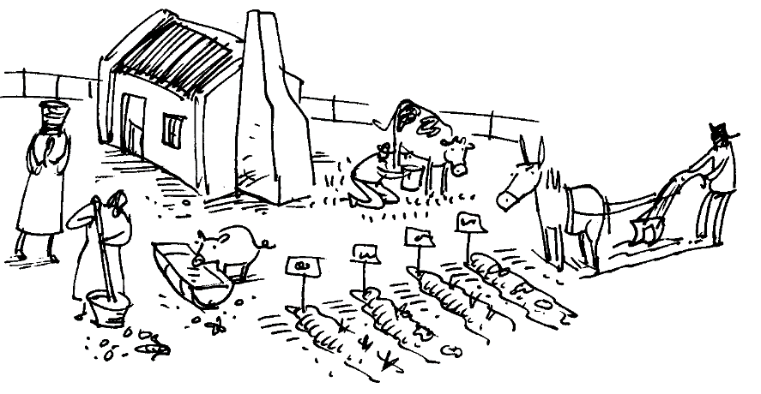

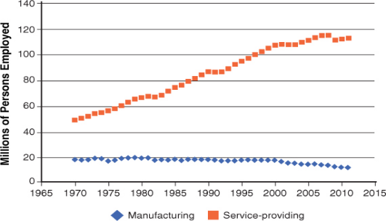
Why Services? History.
Bureau of Labor Statistics (2012)
Notes:
Parallel to to agriculture due to productivity growth- we no longer need hordes of manufacturer workers as we no longer need hordes of farmers
China shift from agri
Services-health, financial, retail, entertainment

Slide 6
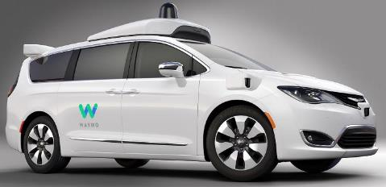

Why Services? Future
In the past, you buy and own the asset.
Now, you can just buy the moment?
Notes:
Parallel to to agriculture due to productivity growth- we no longer need hordes of manufacturer workers as we no longer need hordes of farmers
China shift from agri
Services-health, financial, retail, entertainment

Slide 7
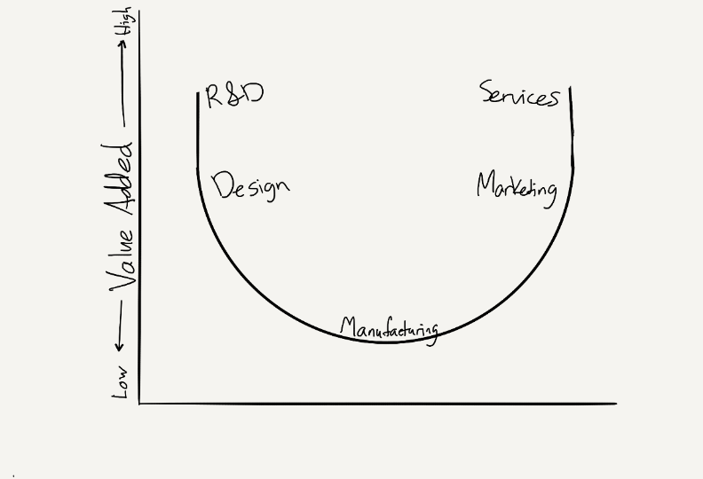
Smiling Curves
Phase
Comp Success
Upstream
Component production
World Tech
Middle
Product Assembly
World Cost Ops
Downstream
Distribution
Region Brand Relationship

Slide 8
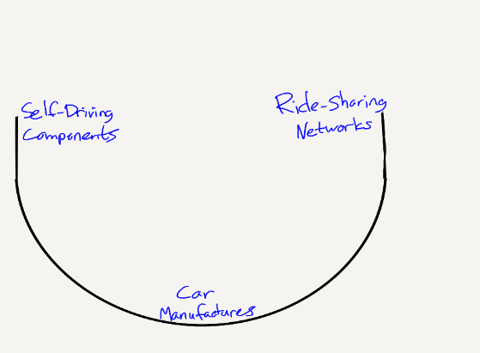
Smiling Curves
Phase
Comp Success
Upstream
Component production
World Tech
Middle
Product Assembly
World Cost Ops
Downstream
Distribution
Region Brand Relationship

Slide 9
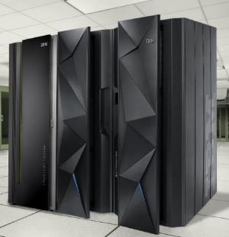
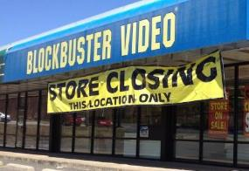
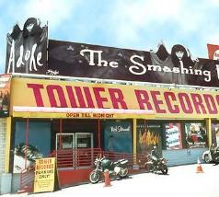



Services win… closer to customer experience
IBM

Slide 10
Today’s Key Topics
Need to think of marketing as delivering services.
Key characteristics of services and service quality.
Innovate with services: product company adding services or services company adding products

Slide 11
What are Services?
Economic activities whose output is not a physical product or construction
Generally consumed when produced
Provides intangible benefits:
  Convenience
  Amusement
  Timeliness
  Comfort
  Health
  Confidence
  Peace
Notes:
Jobs with services or products?

Slide 12
Key “Service” Characteristics
Intangibility
    No inventory
    Few patents, IP difficult to protect
    Difficult for customers to visualize
    Difficult for customers to verify an intangible benefit
    Pricing not based on cost, but based on “value”
Co-production and Use
    Customer involvement
    Hard to decentralize: can’t mass produce heart surgery
Perishable
    No returns
    Cyclical issues in matching supply & demand
Heterogeneity (customer & employee)
    Difficult to standardize & control experience
    Robot or empowered employee?
Notes:
Tangibility spectrum- fast food both product or services
Healthcare

Slide 13
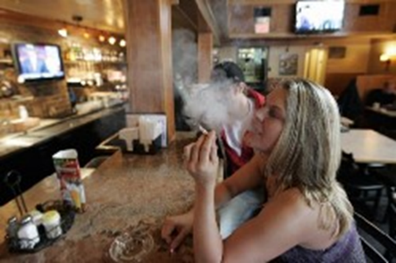
3 Additional P’s for Services
People- employees & customers
Physical environment - atmospherics, facilities, and materials
Process- procedures & flow of activities
Service Marketing Mix:
Product/service
Place
Promotion
Price
People
Physical environment
Process
Notes:
Do we care about a manufacturers employees? Location? Etc.

Slide 14

Service Quality (SQ)
5 drivers of SQ
  Reliability
  Responsiveness
  Assurance
  Empathy
  Tangibles
Expectations
vs
Experience
Range of Expectations = Zone of Tolerance (ZOT)
Experience Above or Below → Loyalty ☺ or ☹
& adjusts future ZOT
Notes:
Japanese retailer bow and are extremely helpful, gas station
Russian chess playing waiters
Expectations provide the reference point for service quality
Prospect theory

Slide 15
Gaps Model = SQ failures
CUSTOMER
Expected
Service
Customer
Gap
Customer gap= Gaps 1+2+3+4
Perceived
Service Experience
COMPANY
Service Delivery
Communications
to customers
Gap
4
Gap 3
Gap 1
Customer-driven service
designs and standards
Gap 2
Critical Incident:
Gap widens unexpectedly
Can convert failure to delight if handled well
Need single person/group responsible for whole SQ system
Company perceptions of
customer’s expectations
Notes:
McDonalds example

Slide 16
Today’s Key Topics
Need to think of marketing as delivering services.
Key characteristics of services and service quality.
Innovate with services: product company adding services or services company adding products

Slide 17
Questions for struggling companies
What business are you in?
What does your customer accomplish with your product?
Is your customer interested in a “product”, a “service”, or a “solution”?
Notes:
Parallel to to agriculture due to productivity growth- we no longer need hordes of manufacturer workers as we no longer need hordes of farmers
China shift from agri
Services-health, financial, retail, entertainment

Slide 18
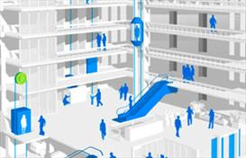

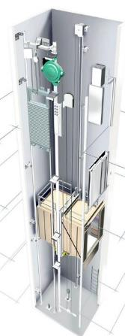
Example of SCA from services
Manufactured elevators & escalators
Founded in Finland, 1908
Notes:
Ideas and what they actually did

Slide 19
Example of SCA from services
Problems:
Quality increased
  Less replacement orders in existing markets
Globalization
  Price pressure from global manufacturers
  Growing markets were foreign
    Higher costs to sell
    Risks from geo-political, cultural, distance, currency, etc…
Notes:
Ideas and what they actually did

Slide 20
Example of SCA from services
Solution: Transition to Selling Services
Transactional sales
  “please buy my elevator”
  “I’ll throw in maintenance if there are issues”
Maintenance prioritization
  Negotiate maintenance visits upfront
  Change to relational contracts & norms
  Build ongoing connection & knowledge of customers (Knowledge SCA)
  Availability to many customers in dense area (Network SCA)
Notes:
Ideas and what they actually did

Slide 21
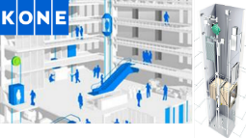

Example of SCA from services
Solution: Transition to Selling Services
Final “solution” selling
  “Sell” availability of resource
    “Pay per day of operation at high level of quality”
  Handle all install, replacement, maintenance , insurance, etc…
  Can buy other manufacturers products
  Efficiency goes up & costs go down
Notes:
Ideas and what they actually did

Slide 22

Integrated Solution
Bundle services around core product with new service capabilities into product (ipod + itunes)
Take over middleman distribution, install, replacement, (Kone)
Solve for risk and payment to sell total solution (Rover)
Leverage concentrated knowledge (WayUp/CampusJob: Consult & Educate)
(Davies, Brady, Hobday 2006; Wise and Baumgartner 1999)
Notes:
Value chain analysis can work well

Slide 23
Innovation “Processes” in Services
Problem: Service innovation is difficult to research before launch, success depends on execution
Solutions:
Bank of America’s Idea Generation & Test
  Stage-gate process
  Redesigned “experimental” branches
Wal-Mart’s let 1,000 flowers bloom
  All stores can develop and implement ideas
  Systematic duplication
  Emeralds Facebook Ads
Notes:
What are the advantages and disadvantages of each method?
What companies are good at this? Starbucks? What innovation, atmospherics, types of employees?
Drive through?
Greeters?
Perceived wait times reduced by monitors

Slide 24
Product + Service Innovations
Innovate across Customer-Activity-Chain (CAC)
CAC: total experience revolving around “product”
  Temporal: end-to-end sequence of related activities
    Leads to specific customer outcomes
  Expansion: total related activities across company & industry boundaries
Change boundaries between user & provider
Innovate to help with more of the CAC
(Sawhney, Balasubramanian, and Krishnan, 2004)
Notes:
Stage of life-education, career
Interest-golf, camping
Asset- car, home
HR
Segment level- IT productive improvement for lawyers
Same as first reading, new points of differentiation but adds in blue ocean, and discontinuous innovation
Think of this as product line extension, brand extensions, etc.

Slide 25
But, “Service Innovations” Take Time
Must reach a critical mass before positively impacting firm value (20 to 30%)
Faster & larger effects if:
  Related services
  Increase R&D spend
  Slow growth core market
  High level of competition
  New salesforce
(Fang, Palmatier, and Steenkamp 2008)

Slide 26
Products vs Services
Perfect before or after launch?
Perfect products before launch
  Launch is expensive
  Difficult to change once production ramps
  Test prototypes with conjoint
Launch services as MVP (lean startup book)
  Find which segment fits (product market fit)
  Refine with user feedback (iterate)
  Rate of change predicts winner (Tesla software updates)

Slide 27
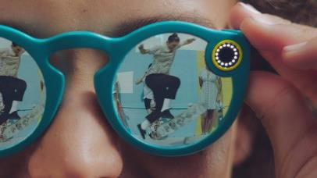

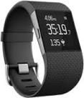
Product + Service = holy grail
Product companies should add services for knowledge accumulation, differentiation, and relationship development.
Service companies should consider adding product to reinforce service

Slide 28
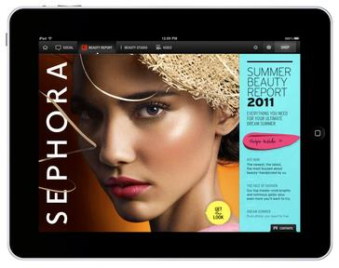
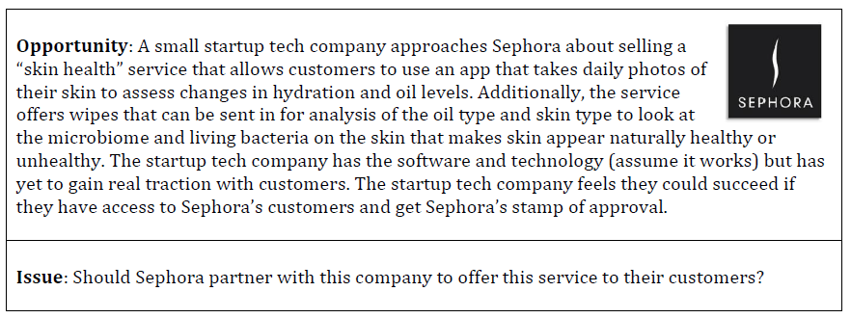

Slide 29
Course Review

Slide 30
4 Fundamental Complexities of Marketing
1)
2)
3)
4)
Customers are different (heterogeneity)
    STP & Customer centricity
Customers change (dynamics)
    CLV, AERC, Product Lifecycle and diffusion
Competition reacts (pressure & disruption)
    SCA
Resources are limited (interdependency)
    ROM, control loop, Portfolio management
Notes:
Solve specific marketing problems while understanding how decisions impact overall strategy
Must balance

Slide 31
Strategy, STP, SCA
What is strategy?
STP?
SCA?

Slide 32
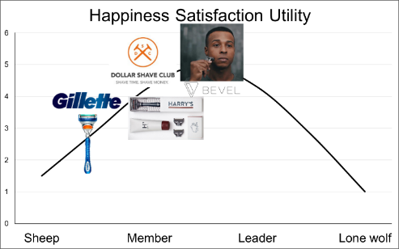
Theory of Optimal Distinctiveness
Tradeoff between desire for:
  Autonomy vs _________?
  Niche vs Mass Market

Slide 33
Foundation of Business Strategy
Background analysis (3Cs)
Customers
Company
Competitors
Fit to Market (STP)
Segmentation
Targeting
Positioning
Marketing mix
(4Ps & SCA)
Product
(Offering)
Place
(Distribution)
Promotion
Pricing
Sales and Profits
Customer management (AERC & CLV)
Acquisition
Expansion
Retention
Contagion

Slide 34
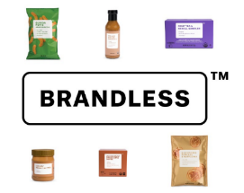
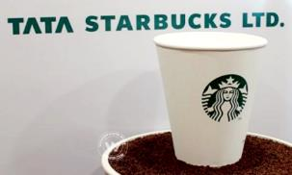

Answer these questions
  Who to sell to?
  What to sell (real and perceived)?
  How to win (sustain competitive advantage)?
  How to manage customer interactions (acquisition, expansion, retention)?
Notes:
DISCUSSION QUESTIONS: Make a grid elements/questions on left- who and process across top in 2 columns
Who to sell to? Marketing: Segmentation and targeting customers
What to sell? Marketing and engineering: Product & services (benefits/experience/status)
How to win? Marketing/Eng/Mgt: Positioning versus competition, SCA, 4Ps
How to manage customer interactions: Marketing: AER processes, CLV
Corporate vs marketing: finance, cash flow, taxes, reporting, allocation among SBUs, vision and mission, boundaries, financial dimensions (cash, taxes, reporting)
Draw circle and show portions
Thus, can’t leave marketing strategy to just the marketers

Slide 35
Markstrat
Strategy
  STP to create & hold valuable position
  Customer-centricity, Market-Orientation, and 3Cs
  Long term planning & short term execution
Competition, Dynamics & Heterogeneity
Interrelated Decisions
  Constraints (budget & time)
  Synergies (R&D, marketing mix, sales & budget)
Research & Analytics
  Conjoint & STP (semantic and/or MDS)
  Experiments

Slide 36
Market Orientation
What is it?
Three components?

Slide 37
Customer Equity & Brand Equity
Brand & Relationship building costs are Investments or Expenses?
4 Pillars of Brand Equity?
4 Stages of Brand Development?

Slide 38

CLV Analysis
Margin
Multiplier
Initial cost
CLV = lifetime value of a customer (or segment) in $
  m = margin $ (revenue – variable costs)
  i = discount rate as a %
  r = retention rate a %
  AC = acquisition cost for customer in $
Calculation assumes values do not change in the future
(Ofek 2002)
Slide 38

Slide 39


AERC:
Recently Acquired
Nearly Lost/ Lost
Long-term
Baby Amazonians
1a
Satisfied
$$
$$
$$$
$$$
5a
$$
$$
$$$
2a
Angry or “Cheater”
$$
1b
2b
3
$
One Timers
$
$
$$$$$
$
$$$$$
5b
$
$
$
4a
Loyalist
4b
6
$
$
STP for each Choice

Slide 40
Marketing Strategy Planning Process
Components?
Control Loop Metrics
Mission metrics?
Customer centric performance metrics?
ROM?

Slide 41
What is the outcome?
What is the cost?
Return
On
Marketing
=
What is the cost?
Most important recent contribution to marketing strategy

Slide 42
Innovation
Define?
Blue Ocean?
Disruptive Technology & Innovators Dilemma?

Slide 43
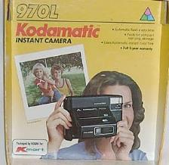
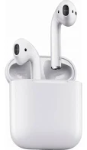
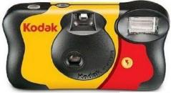
Marketing new offerings
Avoid making customer give something up
  Compatibility
Endow benefits… they give you up
  Trialability, Complexity, & Relative Advantage
“De-Risk” to ease concerns for “loss aversion”
  Observability & Trialability
Successful launch strategies
  Eliminate the old
  Targeting
    Seek new customers & uses
    Where do disruptions enter market?
Developers’ curse
  Product developers are familiar
  Inflate value compared to novice

