Slide 1
Class 14 DISRUPTION and LAUNCHING INNOVATIONS

Slide 2
Additional Topics
Product Life Cycle
Crossing the Chasm
How to reach mainstream customers?
Growth Hacking
First Mover Advantage?
Bass diffusion model
Consulting project
ME2 questions

Slide 3
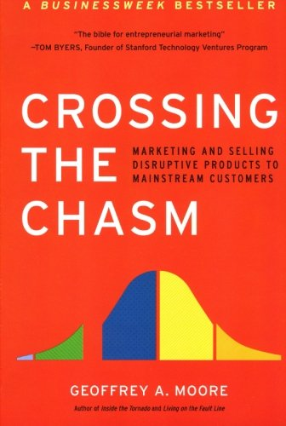
Targeting to go Mainstream?
Find your lane
Stay in your lane
The grass is not greener
Success can kill
Use success with early adopters to perfect product and build testimonials… needed for risk averse mainstream

Slide 4
Success Involves Moving the “Innovation” Across Different Types of Customers
% of
addressable market
The
Chasm
Time

Slide 5
Failing to “Cross The Chasm”
Taking on too many different visionaries
Leads to expensive customization projects
Revenue growth tapers off
Visionaries are small slice of the market in different vertical fields
Too scattered to build “proven” solution w/ enough similar references for any group of Early Majority Pragmatists
Momentum needed internally
Key personnel become disillusioned
Investments and new sources of capital run dry
Notes:
Customers on either side may look the same, but are buying for fundamentally different reasons.
Early adopters buys for a change agents (expecting radical discontinuity) while early majority buys for productivity improvement (want to minimize disruptions), early adopters don’t make good references for early majority but early majority want references.
Examples, optical switching, electronic books, artificial intelligence
First there is market, then market goes away while main stream waits to see what will happen, then it may start up again
Xerox-Document Mgt Software
Stuck in the chasm
Final focused just on Pharma
Won 30 to 40 customers

Slide 6
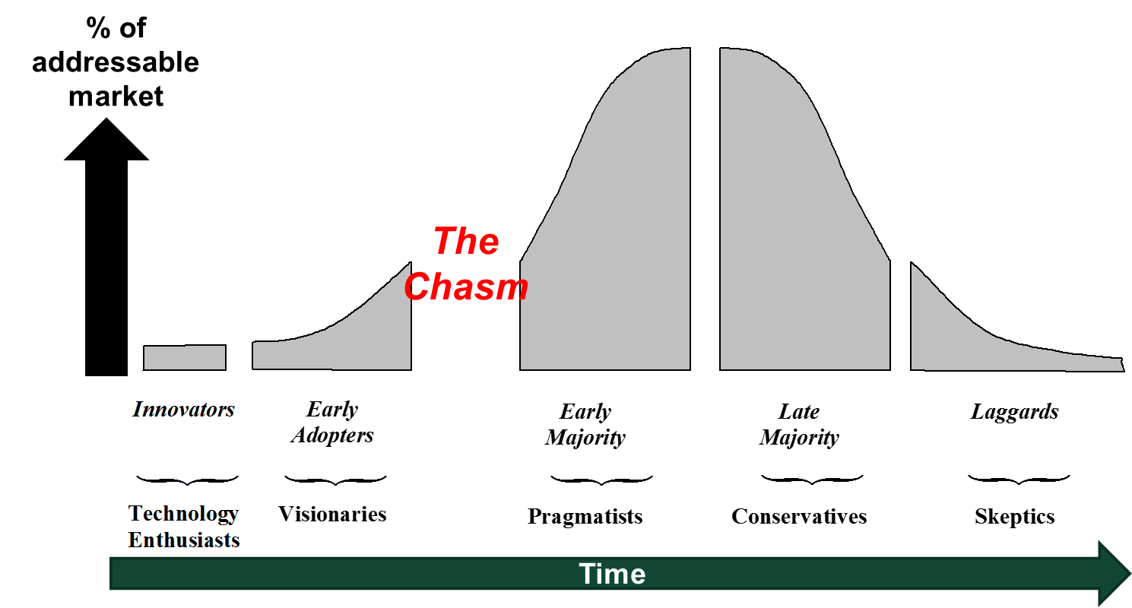
Innovators: Technology Enthusiasts
Will tolerate initial glitches & develop make-shift solutions
Willing to alpha/beta test and work with technical personnel
Provide early revenue but not a large group
Importance: They are the gatekeeper to the next group

Slide 7
Early Adopters: “Visionaries”
See early adoption as a means to beat competition
Not very price sensitive
Demand customized solutions and intensive support
Determines standards (dominant design) when product forms compete (USB drive, VHS vs Betamax)
Early adopters communicate horizontally (across industry boundaries)
Opinion leaders and change agents
Importance: Can make or break you
The right strategy here helps you cross the chasm to mainstream where scale → break even profits

Slide 8
Early Majority: “Pragmatists”
Interested in productivity enhancements (pure utilitarian)
Risk averse, fear disruptions in their operations
Want proven applications, reliable service
Seek the convenient “whole product” design (total solution)
Buys only with a reference/testimonial from similar other (same vertical / segment)
Sales to this group is the entry to the mainstream market:
They want to move together (herd mentality)
They want to pick the same technology solution (avoid risk)
Don’t want to integrate a new technology only to see the provider go out of business (loss of service)

Slide 9
STP for successful launch
Segmenting and targeting strategies
Focus on narrow groups with high intra-segment communication
Low end and/or new users for disruptive innovations
Target group that value your simple application, add features later (feature roadmap) and then new user groups (user roadmap).
Select segments where “Rogers’ 5 factors” are best, no takeaways compared to predecessor (endowment effect), large relative advantage (10x)
Positioning strategies
Make offering compatible with existing behavior
Education and simplicity are key to messaging
Free samples, reduce risk, use warranty and trial periods
Enhance visibility of users, testimonials
Migration strategies (visionaries to pragmatists)
How to persuade gate keepers, leaders, influencers?
Building references and testimonials

Slide 10
Address in any growth plan
Psychology & Prospect Theory
Scarcity & social proof
Endowment effect & loss aversion
Crossing the Chasm (customer and feature road map)
Rogers’ 5 Factors
Relative advantage
Compatibility
Complexity
Trialability
Observability

Slide 11
Additional Topics
Product Life Cycle
Crossing the Chasm
How to reach mainstream customers?
Growth Hacking
First Mover Advantage?
Bass diffusion model
Consulting project
ME2 questions

Slide 12
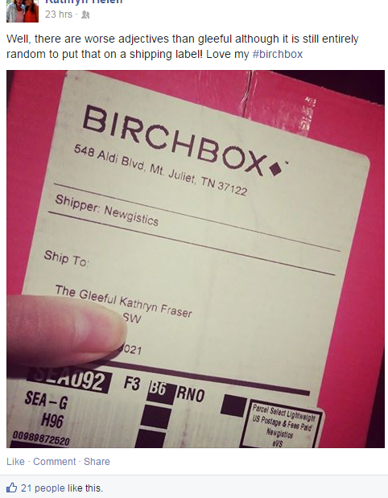
Growth hacker success?

Slide 14
Additional Topics
Product Life Cycle
Crossing the Chasm
How to reach mainstream customers?
Growth Hacking
First Mover Advantage?
Bass diffusion model
Consulting project
ME2 questions

Slide 15
First mover advantage?
65 year historical study on market entry order
Failure rate of pioneers is 47%
11% of pioneers are ultimate leaders (10 years later)
First mover advantage is trumped by followers who are better. Best beats first.
(Tellis and Golder 1996)

Slide 16
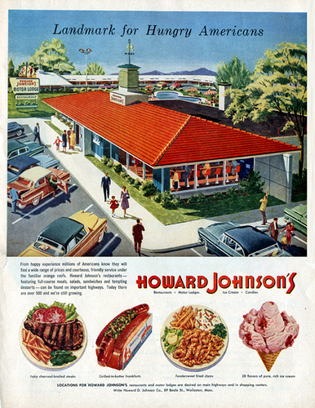
Which Company is…
“World’s biggest chain of highway restaurants.”
“Pioneer in restaurant franchising.”
“Most strongly entrenched factor in the industry.”
“Most fabulous success story in restaurant chains.”
quotes from Financial World, 1964-1967
McDonald’s?
X

Slide 17
Who’s the Pioneer of…?
Product | Survey Says! | Correct Answer
Personal computers | Apple | MITS
Video recorders | Sony | Ampex
Disposable diapers | Pampers | Chux
Light beer | Miller Lite | Trommer’s Red Letter
Safety razors | Gillette | Star
Soft drinks | Coca-Cola | Vernors
Copiers | Xerox | 3M
Word processing software | WordPerfect or WordStar | IBM
Web browser | Netscape or Mosaic | WorldWideWeb
Online bookseller | Amazon | Books.com
Microprocessor | Intel | Intel

Slide 18
Additional Topics
Product Life Cycle
Crossing the Chasm
How to reach mainstream customers?
Growth Hacking
First Mover Advantage?
Bass diffusion model
Consulting project
ME2 questions

Slide 19
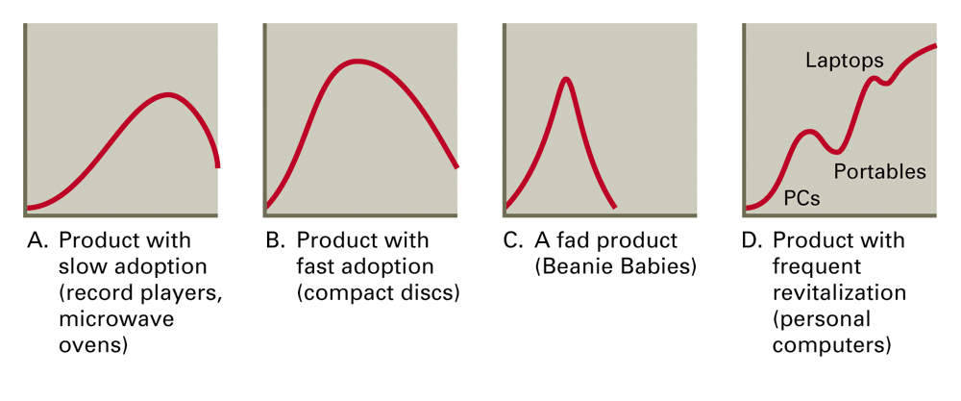
Which Diffusion Curve Will a New Product Follow?
Notes:
19

Slide 20
The Bass Diffusion Model
Mathematical model used to forecast if you will become a zombie
n_{t} = p × Remaining + q × Adopter Proportion × Remaining Potential Potential
Innovation Imitation Effect Effect
How easy is it to transmit/fight off?
How likely am I to encounter a Zombie?
n_{t} = number of adopters at time t (Sales)
p = “coefficient of innovation” (propensity to adopt independent of # of previous adopters)
q = “coefficient of imitation” (propensity to adopt as a function of number of adopters)
Remaining Potential = Total Potential (N) – # Adopters
Notes:
29
29
23
5
5

Slide 21
Innovation and Imitation Mechanisms in the Bass Model
Adoptions = n(t)
Due to Imitation Effect
Due to Innovation Effect
Time

Slide 22
Factors Affecting the Rate of Diffusion
Innovation Factors
Relative advantage over existing products
Degree of compatibility with existing approaches.
“Does it involve switching from familiar?”
Low complexity
Can it be tried?
Imitations Factors
Communication channels used
Nature of “links” among market participants
Nature and effect of promotional efforts
Benefits are observable
Notes:
41
41
33
13
13

Slide 23
Forecasting DirecTV
Used Bass Diffusion model
Market size estimated from customer survey
Diffusion parameters estimated from managerial judgments and similar products (cable TV)
Five year forecast before launch
Results:
Forecasts of demand only 16% below actual
Justified earlier launch of a satellite for expanded capability
Forecast accuracy worth $$$$

Slide 24
Multi-Year Forecast-Actual Graph
Notes:
The forecast turned out to be remarkably accurate.

