Slide 1
Class 9
A-E-R-C MAP
CUSTOMER EXPERIENCE
CUSTOMER ENGAGEMENT

Slide 2
Customer-Based Value
Customer Management
Professor Henderson

Slide 3

Course Timeline
Boot-camp: basics of marketing strategy & go-to-market
Apr
Customer-based value: manage customers as assets, grow over time
May
Innovation-based value: designing and launching innovations
June
2

Slide 4



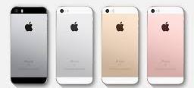


Core Mktg Strategy Cases
Optimal Distinctiveness & direct to consumer business models
STP & SCA: target where relative strength meets attractive opportunity. Build relationships with growing community. Different where it matters.
Put core customer 1st, brand 2nd, product 3rd
Competitive analysis & predicting market evolution
Marketing Strategy Planning Process

Slide 5
Agenda for the Week
Today
  CLV & A-E-R-C Map
  Customer experience & engagement
  Customer relationships
Wedneday
  CLV & A-E-R-C Continued
  ME 2 intro
Markstrat 8 and 9
ME1

Slide 6
Varying Customer Profits
Profits Vary Across Customers
  Firms earn 150% of profits from 30% of customers
But, Profits Also Vary Across Time
  Cross sell & up-sell increases revenue
  Customer acquisition costs already paid
  Cost to serve decreases

Slide 7
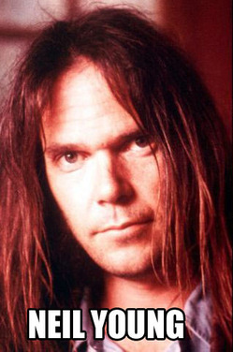
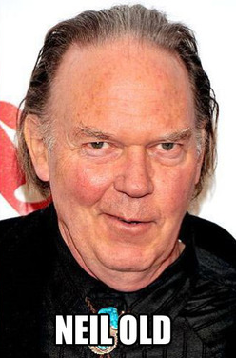
Customer’s needs change

Slide 8

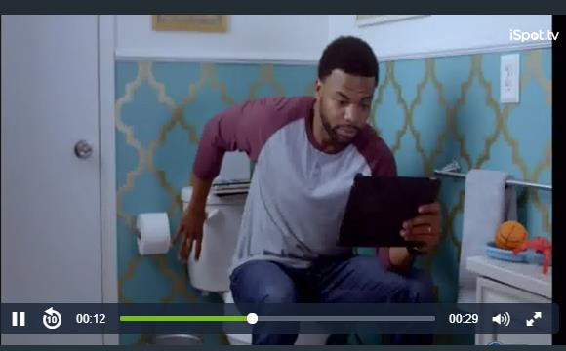
Customer Lifetime Value
All the nevers in life state farm https://www.ispot.tv/ad/7E8W/state-farm-never
King of the castle Allstate https://www.ispot.tv/ad/7F7E/allstate-king-of-the-castle

Slide 9

What is CLV
Model to help guide how to prioritize efforts?
  How much can we spend trying to acquire customers in Segment A
  How much can we spend trying to retain customers in Segment B
  Which customers remain after incentive ends?
  Are all customers worth acquiring/retaining?
CLV approach:
A form of customer-centric accounting where firm’s value is the sum of cash flows accrued over each customer’s “lifetime”
How much will Xfinity make from me over my lifetime?
Captures “true” contribution by accounting for:
  Customer heterogeneity and dynamic effects (varies by individual (segment) and discounts future profits)
  Tensions and tradeoffs among AER strategies (does acquisition tactic lead to retention failures?)

Slide 10
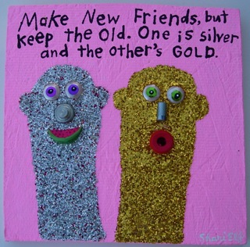
Emphasize Acquisition or Retention?

Slide 11
CLV formula
Margin
Multiplier
Initial cost
CLV = lifetime value of a customer (or segment) in $
  m = margin $ (revenue – costs to serve)
  i = discount rate as a % (time value of money)
  r = retention rate a %
  AC = acquisition cost for customer in $
Calculation assumes values do not change in the future and assumes stable across customer types.

Slide 12
CLV & AERC Bathtub Framework
Answer questions & generate AER Positioning Statements
Who to upsell/cross sell
What to offer / promote
Is this best ROM option
Expansion
C₃
C₃
Acquisition
C₁
C₂
C₄
C₆
Who to target
What to offer / promote
Is this best ROM option
Who do we lose (why)
How to prevent or recover
Is this best ROM option
C₅
C₇
C₈
Retention
Lost customer
C₉
Evaluate existing customer’s time dependent behaviors/needs
  Synchronize customers in time (cohort analysis)
  Create marketing action for each “customer time”
  Metrics to evaluate performance (diagnostic)

Slide 13
AERC Map: Strategy to Tactics
Segment customers by stage: recently acquired, long term, and lost/nearly lost
Understand migration paths
  Identify triggers and drivers to migration
Prioritize (CLV) customer types & tactics for each stage
  Margin $, migration rates, marketing tactic costs
  Past acquisition info (where did customers come from?)
Determine positioning (statements) for customers in each stage (who, what, why)
Develop AERC strategies (how) to execute positioning
  Choice models to evaluate different approaches (elasticity of marketing tactics) …test with experiments (refine)
Slide 13

Slide 14
CLV and control loop
Need to know Acquisition funnel stats
  How many prospects
  Cost per prospect
  Quality score of each prospect
  What percent convert to paying customers
  What is cost of conversion
  What efforts can help get us prospects
  What efforts can help convert prospects
  What is the cost & ROM on these efforts?

Slide 15
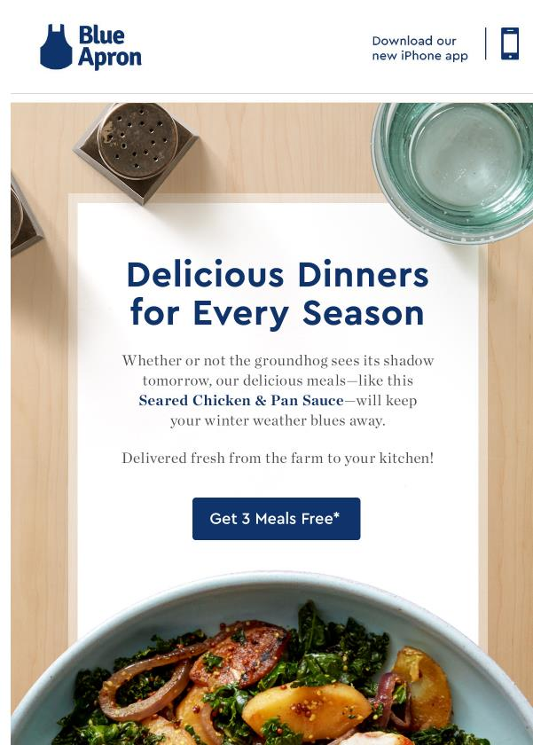


Slide 16
CLV and control loop
Need to know Margin stats
  What is average revenue per user
  What is average cost to serve
  How consistent is our margin across our entire customer portfolio
    Should we segment by:
      product lines
      how long they have been a customer
      cost to serve
      needs or demographics
  How can we expand average revenue?
  How can we decrease cost to serve?
    What is cost and ROM of efforts to change these?
    Does change hurt acquisition or retention efforts?

Slide 17
CLV and control loop
Need to know Retention stats
  What percent of cohort is retained each year
  Is this percent stable
    Does it change over time (year 1 vs year 3)
    Is it consistent across Customer types (should we track by segment)
    Are there any particular “triggers” that increase or decrease defection likelihood?
  How can we increase retention rate?
    What is cost and ROM of these efforts?
    Do these efforts add to cost to serve or impact acquisition success?

Slide 18
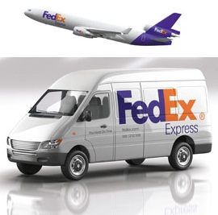
CLV FedExercises
Margin
Multiplier
Initial cost
CLV = lifetime value of a customer (or segment) in $
  m = margin $ (revenue – costs to serve)
  i = discount rate as a % (time value of money)
  r = retention rate a %
  AC = acquisition cost for customer in $
Calculation assumes values do not change in the future and assumes stable across customer types.

Slide 19
FedExercises
Margin per unit:
$12.50-$4.25 = $8.25
Units per account per year:
2,285 / 140 = 16.32 * 12 = 195.86
Contribution > Initial Costs

Slide 20
Customer Relationships
Similarities and differences to friends, families, dating?
  # of people involved
  Changes over time
  Emotions
  Norms and expectations
  Formality & structure
  Power

Slide 21
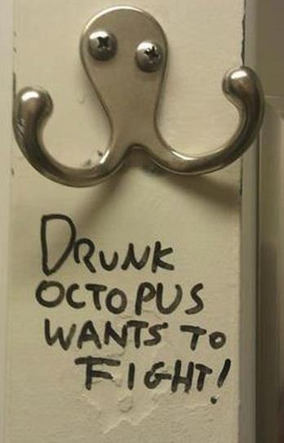
Careful of early positioning
Increase value. Don’t win a new customer with a discount.

Slide 22
Relationship Toolkit
CRM
  Personal & transactional data storage & access
  Knowledgeable interactions across customer touch points
  Data is source of predictive models (e.g., calculate which customers at greatest risk of defection)
Loyalty Programs
  Typically reactive: structured & rule based, reward past behavior, feeds CRM system.
  Dangerous: another area to compete, another area to screw up, can be burdensome for customers, can seem unfair & alienate.
Engagement Initiatives
  Typically proactive
  Risky: need to be targeted well, they can break habits and make company look desperate or manipulative… “coming on too strong”.
(Palmatier, Gopalakrishna, and Houston 2006)
Notes:
22

Slide 23
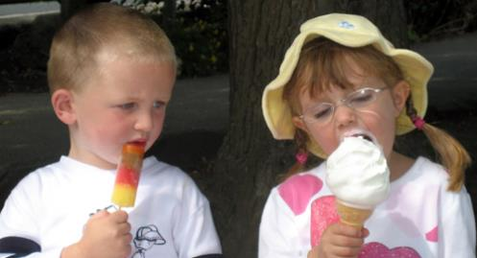
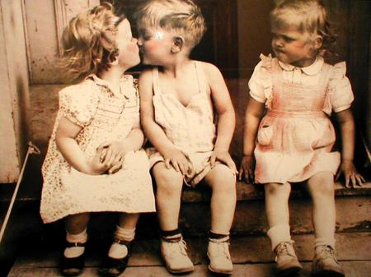

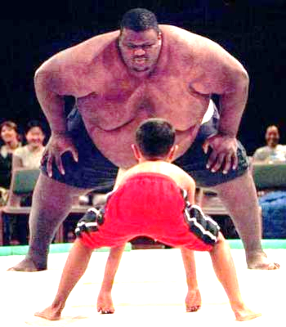


Jealousy
Envy
Unfairness
Aspiration
Attraction or Repulsion

Slide 24
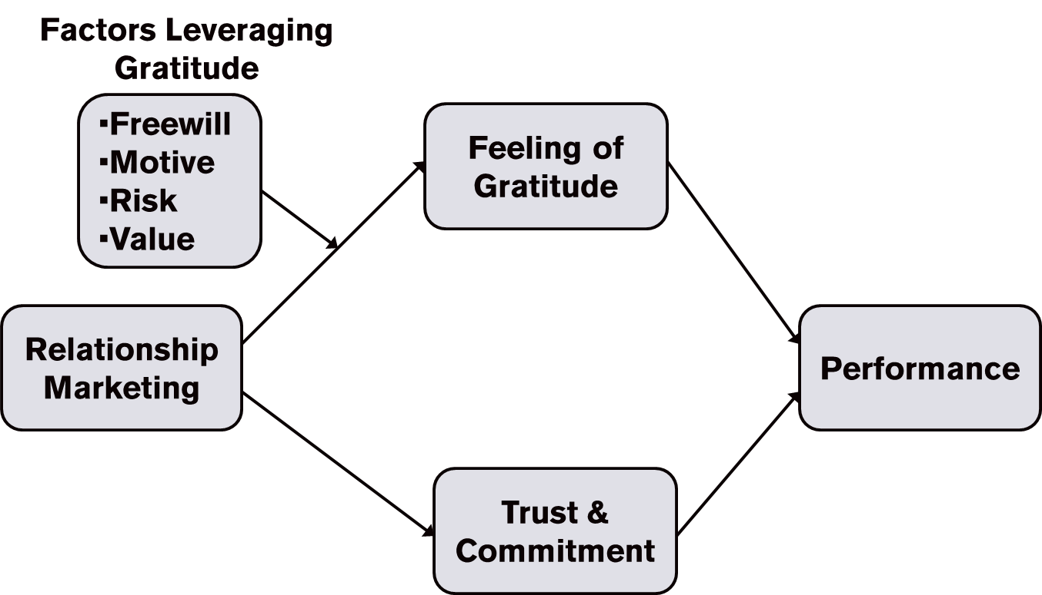
Evolutionary Driver: Gratitude
Heredity basis behind gratitude, trust, and reciprocity.
  Failure to feel gratitude sign of psychosis
  Enforced by positive (pleasure) and negative pressure (guilt)
  Coke/raffle tickets experiment
(Emmons and McCullough 2004; Palmatier, Jarvis, Bechkoff, and Kardes 2008)
Notes:
24
Studies
Coke and raffle tickets (500% return) overcomes disliking
Krishnas’s gift of book or flower
Boy Scouts tickets (5$), followed by candy bar (1$), reciprocating concessions

Slide 25

Cheaters gonna cheat…
Customers you can “steal” easily have lower retention rates.

Slide 26

Bigger The Prize…
Higher the cost to win
Longer it takes to acquire, the longer they stay

Slide 27
Types of Relationship Investments
Social
  Personalizing the relationship (e.g., status, perks, access)
  Highest short term return (1$ → $1.80)
Structural
  Customized linkage, increases efficiency for customers (FedEx + Nike)
  Netflix & Pandora recommendations
  Photo cloud storage, free with phone
  Breakeven if interactions are frequent (1$ → $1.20)
Financial
  Special discounts, free products, “traditional” loyalty rewards
  Does not generate positive ROI
  Acquires/Trains “deal-prone” customers
(Palmatier, Gopalakrishna, and Houston 2006)
Notes:
27

Slide 28
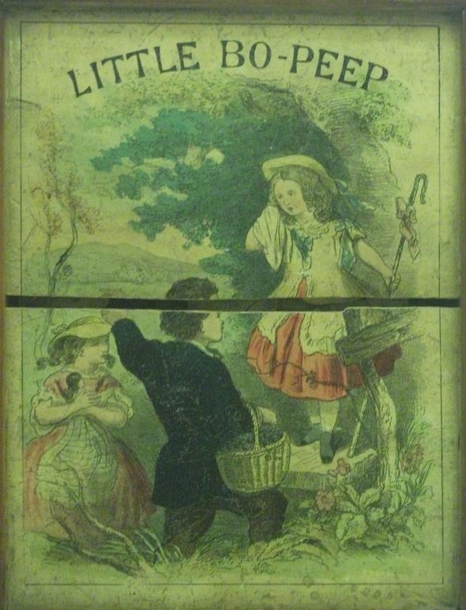


Don’t imprison customers

Slide 29
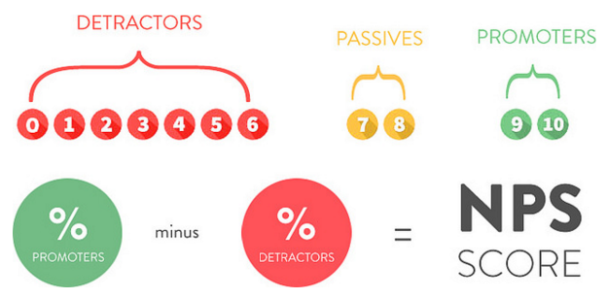
Net-Promoter Score (NPS)
Popular metric that correlates with loyalty
“How likely is it that you would recommend [firm] to a friend or colleague?”
Scores of 75% and above are “world class”
http://andrewchen.co/a-practitioners-guide-to-net-promoter-score/
Reichheld (2003)

Slide 30
Number of eBay Customers Without Advertising:
Contagion → Diffusion
million
What drives this?
R5Fs & Bass Modeling
Notes:
EBay is a good example because there is clear diffusion—the more people access the site, the more attractive it is.

Slide 31
Word-of-Mouth (WOM) Works Both Ways
AVG business only hears from 4% of dissatisfied customers
Complainers are more likely to stay than 96% non-complainers
60% of complainers would stay if their problem was resolved; 95% if problem resolved quickly
Dissatisfied customers tell 4x more people about their problem than a satisfied customer (dissatisfied then problem resolved)

Slide 32
“American business has developed an insane imbalance between obsessive customer acquisition and negligent customer expansion and retention”
(CEQUITY 2008)

Slide 33
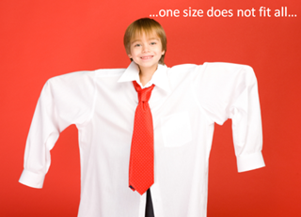
Customers Are Different
We want lots of customers…
But the more we acquire, the more they vary …
The more difficult to serve at a low cost & with high, reliable quality.

Slide 34
Class 10
CUSTOMER LIFETIME VALUE
CALCULATE, INVEST, GROW

Slide 35
Agenda for the Week
Today
  CLV & A-E-R-C Continued
  ME 2 intro
Deadlines approaching:
  Markstrat 8 and 9
  ME1

Slide 36


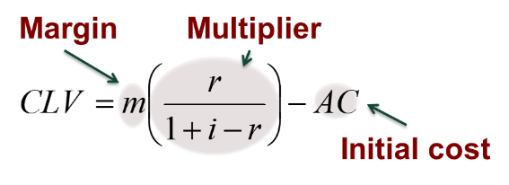
CLV & SNAP
What we knew at IPO:
  $8.60 revenue per user (North America)
  Lost $500M in 2016
    Spent $350M on Google Cloud
    About $2.50 to $2.20 per user (140-160M users)
  Sought $20B valuation at IPO and first day closed at $33B
    CLV per 158M DAU users? $126 (IPO offering) – $208 (closed)
What we know Jan 2019:
  DAU flat at 186M … Retention Rate?
  Cost to acquire increases as user growth slows
  $10.31 revenue per user (North America)
    FB revenue per user is $110 and growing (North America)
  Lost $576M in 2018
    $544M on Cloud … $3.10 per user
  Competition from FB & IG, TikTok?
  Current valuation $11B
    Implies CLV per 186M DAU of $60

Slide 37

AERC
Recently Acquired
Nearly Lost/ Lost
Long-term
Prospecting
&
First Date
1a
Satisfied
$$
$$
$$$
$$$
5a
$$
$$
$$$
2a
Angry or “Cheater”
$$
1b
2b
$
One Timers
3
$
$
$$$$$
$
4a
$$$$$
5b
$
$
$
Loyal
4b
$
$
Segment recently acquired, long-term, nearly/lost
  High potential (Prime member, multiple services, higher CLV)
  Triers (acquired from gift card or promotion, lower CLV, discount shopper)
Find migration paths, triggers, and CLVs
  1: Convert early visitors to satisfied customer (How?)
  2: Critical failure (e.g., bad experience, tries “Etsy”, prefers less “corporate”) (Fix?)
  3: Expands & commits (buys lots of services, will forgive, advocate)
  4: Migrates to lost (Win back? Recoverable?)
  5: Turnaround (from ☹ to ☺)
Create positioning statement and tactics to test

Slide 38
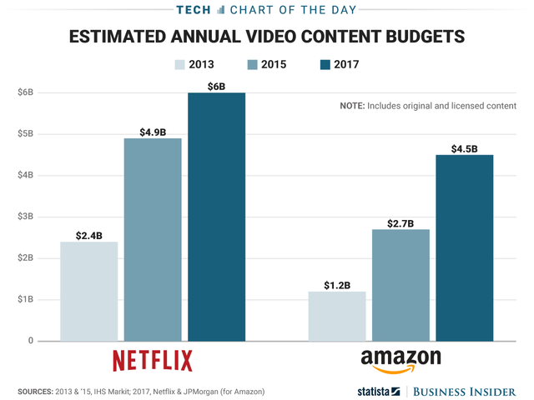
Amazing Amazon
https://youtu.be/NrmMk1Myrxc Go
https://youtu.be/9X_fP4pPWPw Look
https://youtu.be/EIQh0O3wOdM Wardrobe

Slide 39
AERC Example:
Recently Acquired
Nearly Lost/ Lost
Long-term
Prospecting
&
First Date
1a
Satisfied
$$
$$
$$$
$$$
5a
$$
$$
$$$
2a
Angry or “Cheater”
$$
1b
2b
3
$
One Timers
$
$
$$$$$
$
$$$$$
5b
$
$
$
4a
Loyalist
4b
6
$
$
Path 6: Contagion.
Create a plan for one AERC path
  Who ______________________________________________________
  What _____________________________________________________
  Why ______________________________________________________
  How ______________________________________________________
  How to evaluate success & improve? ___________________

Slide 40
Optimizing AERC Spending
Diminishing returns
Can lead to a negative CLV
(Blattberg and Deighton 1996)

Slide 41
ME2: Airbnb
Using choice modeling to inform:
What is best approach to acquire new travelers?
Who are the best hosts to recruit to join the platform?
Live demonstration of analytics and how it relates to management decisions

Slide 42
Class 11
MARKSTRAT QUIZ
(mini midterm) and
GUEST SPEAKERS ON MANAGING CAREERS IN MARKETING

Slide 43
Class 12
SCIENCE OF SALES and
GUEST SPEAKER FROM INTEL’s SALES TEAM

