Slide 1
Class 7 COMPETITION and BSC 2

Slide 2
Agenda for Today & Next Few Classes
Today
BSC2 – Coffee Wars
Wednesday
ME 2 prep – Cluster analysis for STP
Markstrat 6
Friday
Markstrat 7
Next week
Customer relationship level strategy
Markstrat 8 & 9

Slide 3
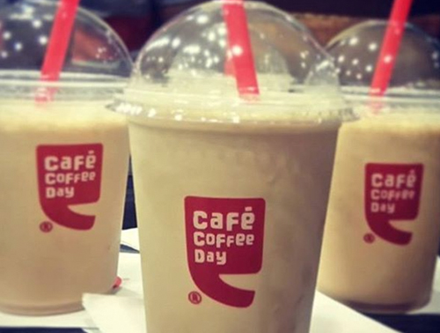
BSC2: Coffee Wars

Slide 4
Coffee Wars - India
Who is CCD’s core customer
What key benefits does CCD provide this customer?
What is unique to CCD that SBUX cant copy?
Who is Starbucks’ core customer
What key benefits does SBUX provide this customer?
What is unique to SBUX that CCD cant copy?
Relationship / Brand / Network SCA advantage?

Slide 5
Coffee Wars Cont.
Should CCD fight over SBUX customer?
If do:
risk of losing brand relationship to current customer by diluting image/position.
If don’t:
Risk of losing core customer if they “graduate” to a SBUX customer.
SBUX ability to redefine what is mainstream?
In USA & China, SBUX started luxury & “pulled up” mainstream.
Rather:
should CCD expand internationally with similar “youth” target segment (vs. expand domestically with “high end” segment)?
Financial considerations:
Long-term attractiveness of “high-end segment” VS short-term losses as costs rise in an effort to fight for the segment.
Will SBUX lower prices?
Benefits/Risks:
match the competition but risk losing “aspirational”, “premier”, “accessible luxury” image.

Slide 6
Café Coffee Day vs Starbucks India

Slide 7
Café Coffee Day
Growth continues
1722 locations in 245 cities as of March 2018
42 lounge outlets … down to 38
7 square outlets … down to 1
Expanded to Austria, Czech Republic, Dubai, Malaysia, Egypt
Went public IPO in 2015, $1billion valuation… now $34-56B
323rd biggest company in India’s Fortune 500
http://economictimes.indiatimes.com/et-now/corporate/cafe-coffee-day-to-launch-ipo/videoshow/49333170.cms

Slide 8
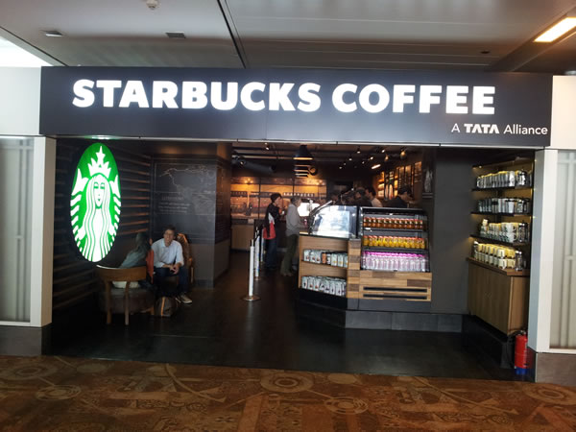

Slide 9
Starbucks, a Tata Alliance
Goal of 50 locations by end of 2013
Invested $59 million
1st store opened in 2012 - 50th opened July ‘14
2016: 84 stores in 7 cities
2019: 140 stores in 10 cities
Net profit margin declined over first few years
Replaced CEO in 2015 and 2019
Launched Teavana product line stores
Sales doubled in during 2017-2018
Broke even on EBITDA basis in 2018

Slide 10
Network Effects … Flywheel
Supply Side (inherent value):
Similar to economies of scale (e.g., pre internet newspaper) but for supply networks
The more exclusive suppliers to one host, fixed costs and production costs fall, suppliers cant leave, “host” benefits
Netflix and AirBnB
Demand Side (value from other users):
With each new user, all existing users benefit
Telegraph → Facebook.
Both:
UBER & wait time liquidity.
Amazon & marketplace

Slide 11
Class 8 SEGMENTATION TARGETING POSITIONING WITH CLUSTER ANALYSIS

Slide 12
Agenda for Today & Next Few Classes
Monday
BSC2 – Coffee Wars
Today
ME 2 prep – Cluster analysis for STP
Markstrat 6
Friday
Markstrat 7
Next week
Customer relationship level strategy
Markstrat 8 & 9

Slide 13
Top Issues Managers Face
The New Intelligent Enterprise (executives from 3000 leading firms, not marketers)
Top 5 issues:
Innovating
Growing revenue
Reducing costs
Profitably acquiring and retaining customers
Being faster and more adaptable
High performers 3x more likely to use data & analytics
Shortage in managers that use data & analysis to solve business problems
High performers distribute data (analysis & results) and best practices
“How would you measure?” “How would you test for that?”

Slide 14
Segmentation Analysis ME1
Segment heterogeneous customer needs.
Focus on a single homogenous customer group.
Cluster Analysis: consists of dividing the market into groups of customers where
Customers within group have very similar needs
Customers across groups have different needs.
Marketing Engineering ME1
Live software and analytics demonstration
Notes:
Most segmentation efforts fail due to segmenting on descriptors versus needs

