Slide 1
Class 4 CUSTOMER EQUITY and BRAND EQUITY

Slide 2
Agenda for Today & Next Few Classes
Today
Customer Equity & Brand Equity
Markstrat Decision 4
Wednesday
Marketing Strategy Planning Process & ROM
Markstrat Decision 5
Next week
BSC2 – Starbucks enters India.

Slide 3
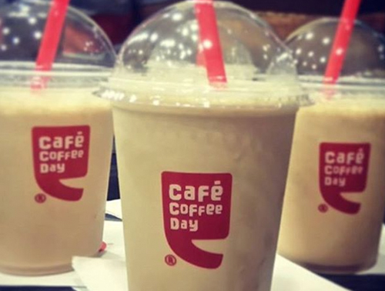
BSC2 Case Preview

Slide 4
Marketing Strategy Framework
Key Questions
Data research & analysis (3Cs)
Customers
Company
Competitors
Who to serve?
Segmentation, targeting, and positioning (STP)
Segment
Target
Position
What to provide?
Marketing mix (4Ps) is positioning in action
Product
(Offering)
Place
(Distribution)
Promotion
How to reach
& engage?
Pricing
Customer management decisions (AERC)
Sales and Profits
Acquisition
Expansion
Retention
Contagion
How to grow &
build SCA?

Slide 5
Marketing “Strategy” ???s
Who to serve?
What to provide (real and perceived)?
How to win/beat competition (sustainable competitive advantage)?
How to manage customer interactions (acquisition, expansion, retention)?
Positioning:
POP point of parity &
POD points of difference
Notes:
DISCUSSION QUESTIONS: Make a grid elements/questions on left- who and process across top in 2 columns
Who to sell to? Marketing: Segmentation and targeting customers
What to sell? Marketing and engineering: Product & services (benefits/experience/status)
How to win? Marketing/Eng/Mgt: Positioning versus competition, SCA, 4Ps
How to manage customer interactions: Marketing: AER processes, CLV
Corporate vs marketing: finance, cash flow, taxes, reporting, allocation among SBUs, vision and mission, boundaries, financial dimensions (cash, taxes, reporting)
Draw circle and show portions
Thus, can’t leave marketing strategy to just the marketers

Slide 6
Learn To Address 4 Fundamental Problems…
Customers are different (heterogeneity)
Customer change (dynamics)
Competitors react (pressure & disruption)
4. Resources are limited (opportunity costs… find your lead domino)

Slide 7
Agenda for Today & Next Few Classes
Today
Customer Equity & Brand Equity
Markstrat Decision 4
Wednesday
Marketing Strategy Planning Process & ROM
Markstrat Decision 5
Next week
BSC2 – Starbucks enters India.

Slide 8
Today’s Key Topics
What is Customer Equity?
What is the concept?
Decomposing into three components
What is Brand Equity?
Understanding the 4 pillars
Stages of investment
Marketing mix and brand equity

Slide 9
Great companies
My favorite company is:
This is my favorite company
because:
How much should the value of this company decline if you get hit by lightening?

Slide 10
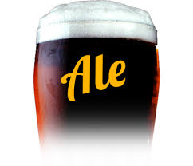
What is Customer Equity?
What is equity?
“In accounting and finance, equity is the residual value or interest of investors in assets”
Assets – Liabilities = Equity

Slide 11
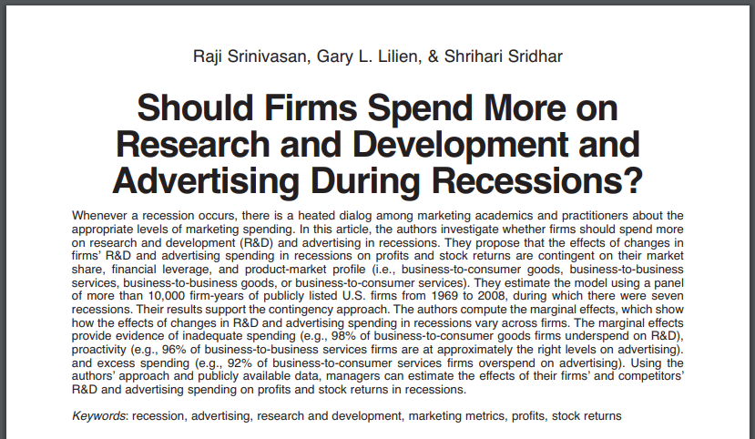
Why use accounting terminology?

Slide 12
Customer Equity as Market Power
The added value above and beyond the core offering
Overlaps when service is core to brand
Equity Stack
Service
Relationship
Incremental value (price premium) due to dealing with the “people” (e.g., branded beer served by your favorite bartender)
Overall value to customer
Brand
Incremental value (price premium) due to brand (e.g., branded beer)
Utility
Baseline offering satisfaction (e.g., blind beer taste test)

Slide 13
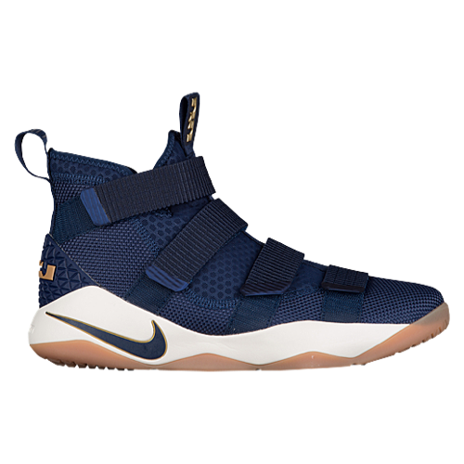
Brands = Symbolic Meaning
We buy products
not for what they do
but for what they mean

Slide 14
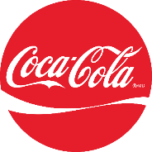
How much is a brand worth?
“Arguments rage about how much brands are worth”
–Economist 2014
Coca Cola’s brands are valued at $79.2 billion, but trademarks on balance sheet are only valued at $6.7 billion
UBER is valued at $70 billion, Owns almost no cars, few tangible assets

Slide 15
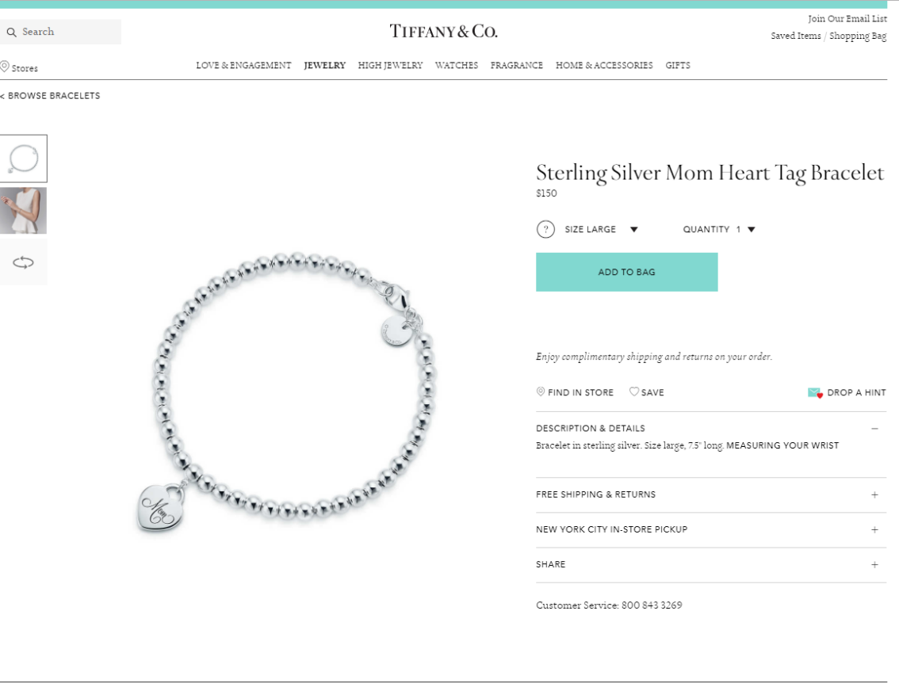
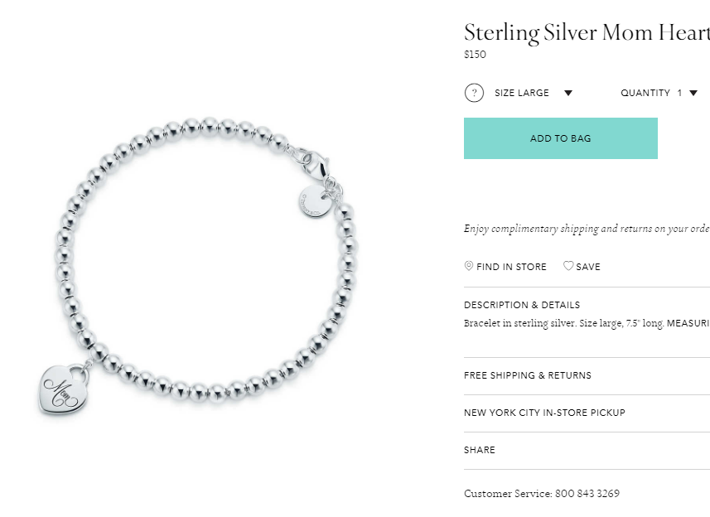
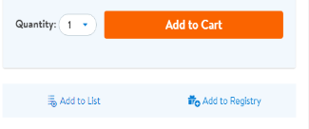
How much would you pay?

Slide 16
How much would you pay?

Slide 17
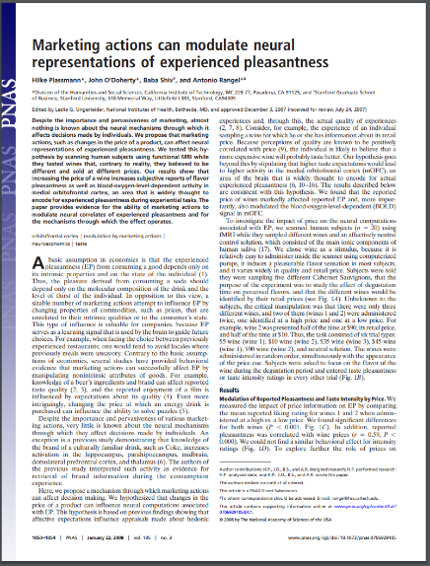
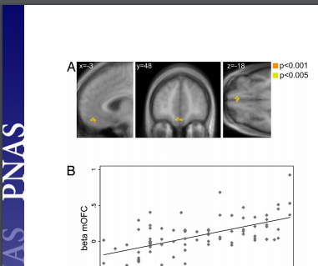
This is your brain on branding

Slide 18
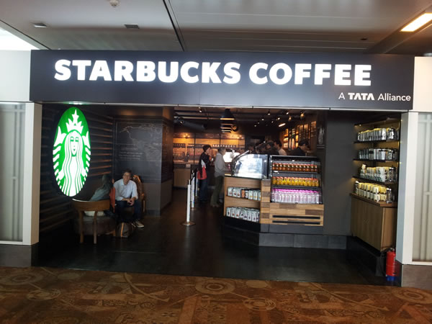
Customer Equity = Market Power
What advantages does Starbucks enjoy because of it’s built up customer equity?

Slide 19
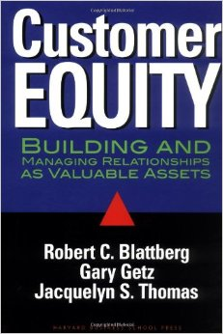
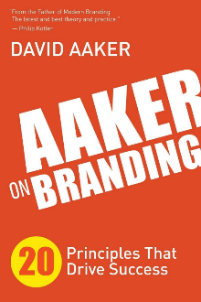
Maximize customer equity!
Measure customer equity & manage to enhance!
When facing trade-offs, prioritize:
Customers
Brands
Products
Example: product cannibalization

Slide 20
Marketing strategy – STP ?
https://youtu.be/6UblzmyXc_Y
$399 at 6:35

Slide 21
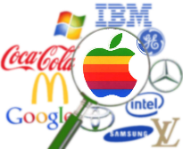
BE Valuation Methods
Price Premium: compares branded vs. unbranded products to determine increases (or decreases) in customer willingness to pay
Income Split: estimates the present value of firm’s income attributable to brand; but uses reported earnings, which can be manipulated
Royalty Relief: based on hypothetical cost of licensing the brand or revenue share from selling through another company’s salesforce (e.g., IBM & Box). Estimated from similar arrangements.

Slide 22
2 Models of Brand Equity
4 stages (cognitive development):
Identity
Meaning
Response
Relationship
4 pillars (component benchmarking)
Knowledge
Relevance
Esteem
Differentiation

Slide 23
4 Stages to Building Brand Equity
Stage of Brand
Development
Branding Objective
at Each Stage
4. Relationships
what about you and me?
intense, active loyalty
3. Response
what do I feel/think?
positive, accessible reactions
2. Meaning
what are you?
points of parity
and difference
1. Identity
who are you?
deep, broad
brand awareness
Notes:
Brand identity: captures awareness, easy of recall
Brand meaning
Performance: meets functional needs
Imagery: psych and social needs
Brand response
Judgments: quality, credibility, superiority
Feelings: emotional response (e.g., fun, safety)
Brand relationships (resonance): loyalty, attachment, community

Slide 24
4 Pillars of Brand Equity
Knowledge: The extent to which customers are familiar with the brand
Relevance: The extent to which customers find the brand to be relevant to their unique needs
Esteem: The regard customers have for the brand’s quality, leadership, and reliability
Differentiation: The extent to which the brand is seen as distinct

Slide 25
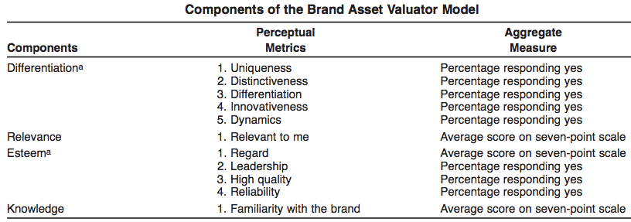
Brand Asset Value Scale
Stahl, Heitmann, Lehmann, and Neslin 2012

Slide 26
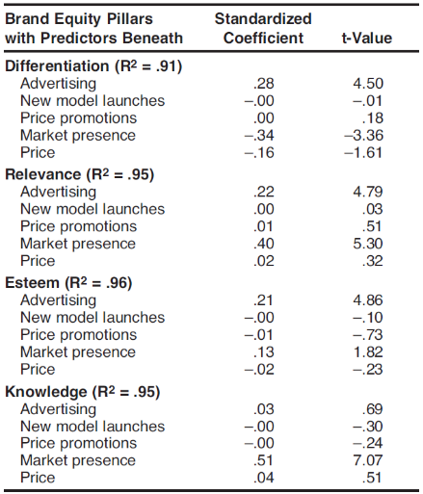
Marketing Mix for Building Brand Equity
Note:
Price promotions never build brand equity
Advertising best for differentiation & esteem
Large market presence homogenizes brands
Data: 39 major US auto brands over 10 years
Stahl, Heitmann, Lehmann, and Neslin 2012

