Slide 1
Class 1 MARKETING STRATEGY
Course Intro & Fundamental Concepts

Slide 2
Agenda for Today & Next Few Classes
Today
Course Details
Introduction to Marketing Strategy
Wednesday
Markstrat – Decision Round 1 is in class. Basics of segmentation and targeting
Next week
Markstrat – Brand portfolio management, R&D, and perceptual advertising. Basics of positioning
BSC1 – Brandless

Slide 3
Course Learning Objectives
Informed strategic decisions
Analytical tools & processes
Opportunities to practice

Slide 4
Course Timeline
Boot-camp: basics of marketing strategy & go-to-market
April
Customer-based value: manage customers as assets, grow over time
May
Innovation-based value: designing and launching innovations
June
2

Slide 5
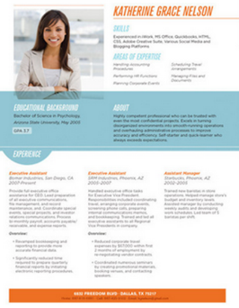
Learning Components
Markstrat (25% of grade) SIGN UP
9 decision rounds (1st is during next class)
Points for short & long term performance
Quiz & peer assessment
Business Strategy Cases (15%)
2 cases based on real companies’ challenges
TWIST Video & HBR case
Marketing Engineering (20%)
2 analysis based assignments
Can do in small teams of 2 to 3 students
Consulting project (15%)
Real world, digital marketing strategy
Segmentation analysis, professor will lead
In class learning & quizzes (25%)
Participation & in-class assignments
Quiz and final exam
Resume Magic:
Technical proficiencies
Consulting experience

Slide 6
Course Citizenship & Policies
In-class conduct
Teamwork
Academic honesty
Accommodating special needs
Title IX
Research requirement
Learning list

Slide 7
Agenda for Today & Next Few Classes
Today
Course Details
Introduction to Marketing Strategy
Wednesday
Markstrat – Decision Round 1 is in class. Basics of segmentation and targeting
Next week
Markstrat – Brand portfolio management, R&D, and perceptual advertising. Basics of positioning
BSC1 – Brandless

Slide 8
Today’s Key Topics
What is Marketing Strategy?
Formal definition
Simple idea
The Marketing Strategy Framework
Key concepts
Key questions
Business models and strategy
The case of razor blades (product vs service)
The case of computers (product vs platform)
Optimal Distinctiveness Theory
A theory to guide

Slide 9
What is Strategy?
Relative Advantage
Competition
Dynamics
Uncertainty
Notes:
List on board elements of strategy … discussion

Slide 10
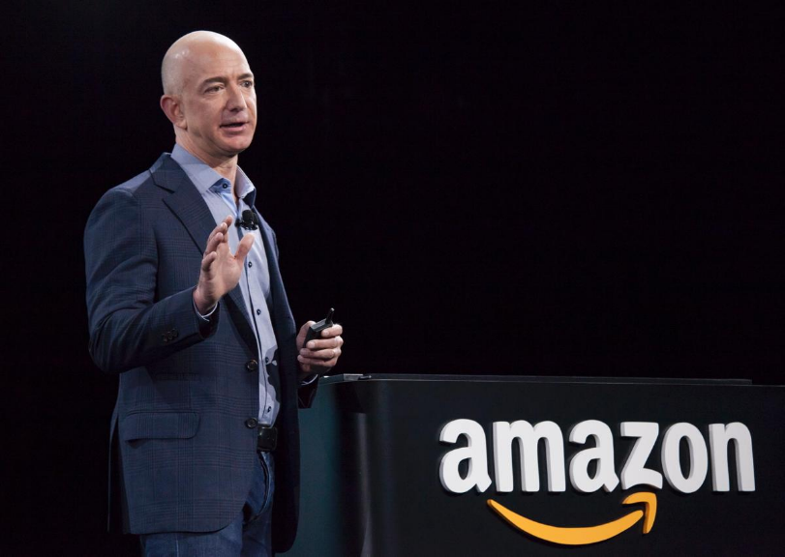
Strategy
“Complaining is not a strategy”

Slide 11
Marketing Strategy, defined…
“Marketing strategy describes the direction the business will pursue within its chosen environment and guides the the allocation of resources and effort.”
— American Marketing
Association, 2014
Simple idea:
Strategy is a theory of where to compete.
Focus where you can be better or at least different.
Define “location’” by differences in customers.

Slide 12
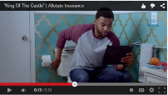
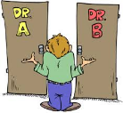
Learn To Address 4 Fundamental Problems…
Customers are different (heterogeneity)
Customer change (dynamics)
Competitors react (pressure & disruption)
4. Resources are limited (opportunity costs… find your lead domino)
1980
1989 CNBC & 1996 MSNBC
1996
http://youtu.be/y_pIPUEmSkA

Slide 13
Long term Mktg Strategy Goal
Occupy a position in the market that is:
Valuable
Differentiated
Defensible
Sustainable Competitive Advantage

Slide 14
Sustainable Competitive Advantage
Sources:
Shared history (relationship)
Knowledge (learned secrets)
Collective-distributed image (brand)

Slide 15
Marketing Strategy Framework
Key Questions
Data research & analysis (3Cs)
Customers
Company
Competitors
Who to serve?
Segmentation, targeting, and positioning (STP)
Segment
Target
Position
What to provide?
Marketing mix (4Ps) is positioning in action
Product
(Offering)
Place
(Distribution)
Promotion
How to reach
& engage?
Pricing
Customer management decisions (AERC)
Sales and Profits
Acquisition
Expansion
Retention
Contagion
How to grow &
build SCA?

Slide 16
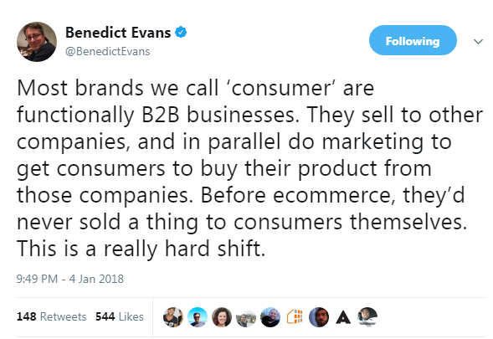
Business Models & Strategy
 | Product (Gillette) | Service (Dollar Shave Club)
Market (B2B or B2C)
Distribution Channel (Direct or Retail)
Promotional Channel (Mass media or Social media)
Segmentation Basis (Demographics, +)
Target Market Specificity (Mass market or niche)
SCA Basis (Brand, relationship, network effect)
P&G (Gillette) spent $2B on R&D in 2014 (double Unilever)
P&G spent $10B on advertising (37% more than Unilever).
P&G dominates retail shelf space because of scale and relationships

Slide 17
Optimal Distinctiveness

Slide 18
Optimal Distinctiveness
Dollar Shave Club launched in 2012
www.youtube.com/watch?v=ZUG9qYTJMsI
Unilever acquires Dollar Shave Club for over $1 billion
P&G acquires Bevel in 2018
Harry’s raised $112M in 2018
Winners: Facebook, Google, Snap
Losers: TV

Slide 19
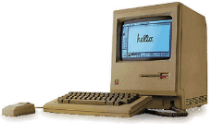
Business Models & Strategy
Consumer Market |  | Business Market
Product & Service | Service & Platform | Product & Service | Service & Platform
Apple | Windows | IBM | Amazon AWS
Design and manufacture hardware and software | Design software, others compete to host it on their hardware | Sell servers to company and service them | Rent server processing as needed and host add on services
Ecosystem: Suppliers and distributors | Ecosystem: Partners and developers | Ecosystem: Suppliers and distributors | Ecosystem: Partners and developers

Slide 20
Class 2 MARKSTRAT SIMULATION
Introduction

Slide 21
Agenda for Today & Next Few Classes
Today
Course Details
Introduction to Marketing Strategy
Wednesday
Markstrat – Decision Round 1 is in class. Basics of segmentation and targeting
Next week
Markstrat – Brand portfolio management, R&D, and perceptual advertising. Basics of positioning
BSC1 – Brandless

Slide 22
Why Markstrat?
Strategy
STP to create & hold valuable position
Long term planning & short term execution
Interrelated Decisions
Constraints (budget & time)
Synergies (R&D, marketing mix, sales & budget)
Research & Analytics
Conjoint & STP (semantic and/or MDS)
Experiments
Competition (Game Theory) & Change
Teamwork
☹ or ☺
Objective Performance ($ is blind)

Slide 23
Markstrat and the Marketing Strategy Framework
Data research & analysis (3Cs)
Customers
Company
Competitors
Segmentation, targeting, and positioning (STP)
Markstrat
Segment
Target
Position
Marketing mix (4Ps) is positioning in action
Product
(Offering)
Place
(Distribution)
Promotion
Pricing
Not
Markstrat
Customer management decisions (AERC)
Acquisition
Expansion
Retention
Contagion

Slide 24
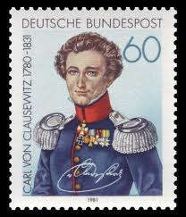
Karl von Clausewitz, On War, 1832
“Where absolute superiority is not attainable, you must produce a relative one at the decisive point by making skillful use of what you have.”

Slide 25
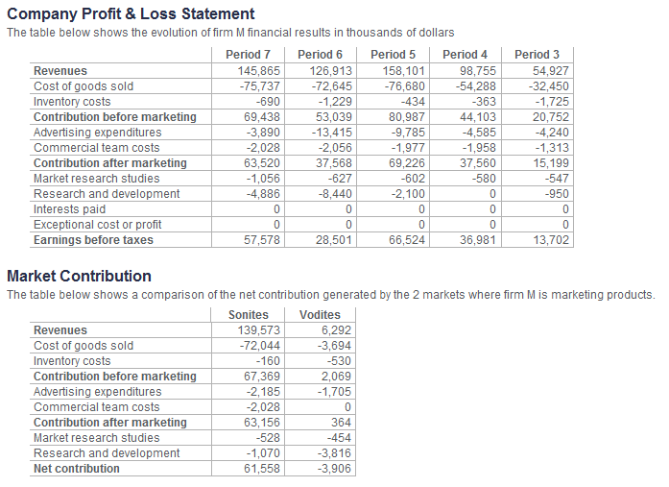
Understand P&L: CEO Level Strategy

Slide 26
Your Objective
Maximize your Stock Price Index
You will have to optimize:
Market share
Sales growth
Net contribution
Cumulative net contribution
R & D investments
Grades, learning, and prizes?!?!

Slide 27
Decisions are limited for now…
Your team can get familiar with Markstrat
Gather information
Do not make any major changes in your firm's operation
Can not introduce new brands, modify or withdraw existing ones
Can not start R&D projects
Can not give perceptual objectives for advertising

Slide 28
Make First Decisions
Price
By brand
Optimal point pricing (lower is not necessarily better)
Production
By brand (consider left over inventory)
Production team can adjust by + or – 20% of planned
Advertising
By brand
By target segment (advertising agency fits to appropriate advertising channel)
Media spend & advertising
Commercial Team
By brand
By channel (fit channel to target segment)
Media spend & advertising
Order Marketing Research
Semantic Scale or Multidimensional Scaling for STP and R&D
Experiments & competitive studies for optimizing budget allocation
Conjoint for STP and R&D
Perceptual Advertising Available Next Round and then R&D

Slide 29
Buy Market Research Studies
Hire marketing research consulting companies
Don’t necessarily need to buy all studies
Definitely buy Multidimensional Scaling &/or Semantic Scales
Only 2 Vodite studies (Market Forecast & Semantic) actually produce results before a Vodite product is launched.

Slide 30
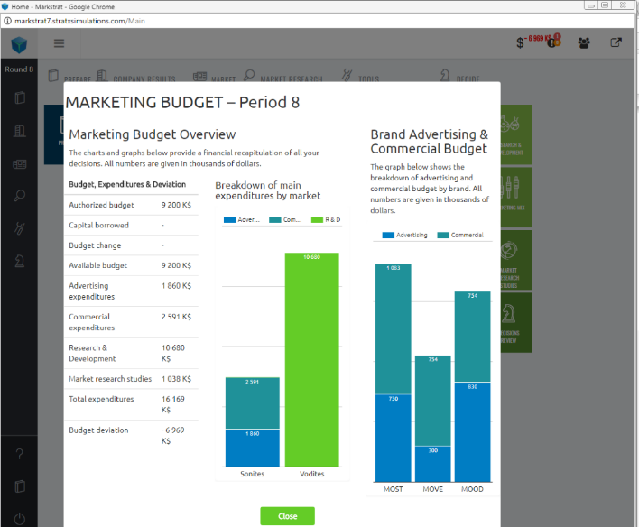
Spend entire budget
Click here to check your budget.
Budget will automatically update after you enter each of your decision (e.g., increasing advertising spend)

