Slide 1
Chapter 4 Channel Relationships

Slide 2
Agenda
Learning objectives
Introduction
Building Channel Commitment
Building Channel Trust
The Channel Relationship Lifecycle
Multi-Channel Versus Omni-Channel Relationships
Take- Aways

Slide 3
Learning Objectives
Describe the motivations for and importance of building channel relationships.
Distinguish upstream and downstream motivations for forming a relationship.
Recognize why multiple channels represent the norm and describe ways to build relationships therein.
Explain the role of relationship velocity.
Differentiate the five phases of a close marketing channel relationship.

Slide 4
Agenda
Learning objectives
Introduction
Building Channel Commitment
Building Channel Trust
The Channel Relationship Lifecycle
Multi-Channel Versus Omni-Channel Relationships
Take- Aways

Slide 5
Why Do Relationships Matter in Marketing Channels?
Channel management is about motivating and incentivizing interdependent yet independent entities to maximize the common good.
Becomes more challenging in an omni-channel environment
Strong channel relationships is a genuine commitment and willingness to engage in give-and-take interactions to achieve and reflect the objectives of a partnerships.
Commitment exists when one organization wants the relationship to continue indefinitely.
Organizations must also be willing to sacrifice to maintain and grow the relationship.

Slide 6
Example: sears (usa)
Sears was one of the first brick-and-mortar companies to move online. It sold everything from insurance products, to appliances, to clothing. But in recent years, it has lost more than $10 billion since the start of the 2010s. Sales fell to $22.14 billion from $41.57 billion, leading to stores closing. This caused issues for the suppliers, such as whirlpool. In the 1920s, sears came to the rescue and put whirlpool and their stores. When sales declined, whirlpool sent less inventory to sears, at higher prices. Insurers and bans were also concerned about sears being able to pay their vendors. Thus LG demands cash upfront, before it will supply sears; united national consumer suppliers allows it one month to make a payment, but that is far less than the two month grace period it provides sears’ competitors.

Slide 7
Upstream Motive for Building a Strong Channel Relationship
Channel relationships begin with the manufacturer’s recognition that it potentially can profit from the many advantages a downstream channel member can offer.
Some manufacturer’s use the “do it in-house technical” culture, which prevents them from understanding, respecting, and trusting intermediaries to any degree.
When appreciation of downstream organization exists, manufacturers seek relationships to motivate channel members to represent them better, in their current markets, in new markets, or with new products.

Slide 8
Upstream Motive for Building a Strong Channel Relationship
Manufacturers also may seek a relationship to coordinate its marketing efforts with distributors more tightly, which would enable it to reach end-users better.
Distributors may withhold market information to prevent the manufacturer from using the information against them in negotiations.
They are more willing to share information with their suppliers if those suppliers depend more on them than the other way around.

Slide 9
Downstream Motives for Building a Strong Channel Relationship
To build strong relationships that revolve around having an assured and stable supply of desirable products.
Consolidation is a motive because:
As mergers and acquisitions concentrate market share among a few manufacturers in many industries, downstream channel members commit to the survivors to maintain product supply.
Distributors build strong relationships with suppliers to differentiate themselves from other distributors.
Based on strategy of offering value-added services, such as preventive or corrective maintenance, application assistance, onsite product training, etc.
Upstream and downstream channels pursue relationships for the same reason: To attain an enduring competitive advantage that leads to profit.

Slide 11
Agenda
Learning objectives
Introduction
Building Channel Commitment
Building Channel Trust
The Channel Relationship Lifecycle
Multi-Channel Versus Omni-Channel Relationships
Take- Aways

Slide 12
Need for Expectations of Continuity
Channel members that want to build commitment should start by building the expectation that prospective partners will be doing business for a long time.
Channel members know they will be replaced if their performance fails to satisfy.
Continuity expectations increase in the presence of:
Trust, two-way communication, a reputation for fair dealing, a long-standing, stable relationship, balance power, and combined stakes.

Slide 14
Need for Reciprocation: Mutual Commitment
Strong relationships require strong commitment. Asymmetric commitment is rare.
Channel members that doubt the commitment of another organization may proclaim themselves partners, in the interest of preserving appearances, but they do not believe in, nor do they practice, commitment.

Slide 15
Strategies for Building Commitment
To build commitment, focus on two critical questions:
Have you had an acrimonious, conflict-laden past with this supplier?
What actions do you anticipate the supplier taking, to tie itself to your business?
Must take two forms of action: selectivity and specialized investments.
Selectivity by the supplier gives you some degree of protection from competitors that might sell the same brand.
Suppliers might seek to build assets that are dedicated to your relationship and that cannot be redeployed in connection with another distributor.

Slide 16
Strategies for Building Commitment
Some notable, difficult-to-redeploy investments include:
Supplier personnel and facilities dedicated to a single distributor.
A supplier’s stock of learning about you- such as your methods, your people, your strengths, and weaknesses.
Compatible reporting systems, geared to the peculiarities of your system.
Investments designed to identify your business and its business, in the minds of customers.
Investments in general training programs and other resources that help you run your business better.

Slide 17
Strategies for Building Commitment
Looking from the other side of the relationship, distributors invest in you by:
Dedicating people and facilities to your line.
Invests in upgrading and training the personnel serving your line.
Seeks to learn about you and build relations with your people.
Trains its customers in the use of your line.
Attempts to ally its name and yours in a customers’ minds.
Invests in a reporting system that is particularly compatible with yours.
Locates its facilities near you and far from your competitors.

Slide 18
How Downstream Channel Members Commit
A distributor enters relationships if it believes the payoffs with justify the costs.
To achieve results, the distributor dedicates resources to the supplier, including dedicated personnel, joint marketing, and so forth.
Two-way communication, close participation in the suppliers marketing efforts, allowing suppliers to see its weaknesses and strengths, and giving advice to the supplier can enhance commitment.

Slide 19
How Upstream Channel Members Commit
Before making any investments, many rigorously verify the downstream channel member’s ability and motivation.
Two-way communication also plays a big role because it enables the manufacturer to look over the wall and see the market and the distributor serves.
Firms can create a close, committed relationship without creating a successful channel.
Two firms work together in a closely coordinated way does not ensure their success or the success of the channel.

Slide 20
Agenda
Learning objectives
Introduction
Building Channel Commitment
Building Channel Trust
The Channel Relationship Lifecycle
Multi-Channel Versus Omni-Channel Relationships
Take- Aways

Slide 21
Building Channel Trust
Trust is essential to strong relationships.
To trust a channel member is to believe in its integrity and concern for mutual well-being.
A reasonable level of trust is necessary for any channel relationship to function and for the maintenance and management of business relationships.

Slide 22
Need for Economic Satisfaction
Economic satisfaction is a positive, affective response to the economic rewards generated by a channel relationship.
Economic rewards are typically financial.
Is very important that many firms agree to make risky, generic investments in channel members. These investments create vulnerability, because they empower the recipient to use the invested asset in the service of competitors.
Organizations build strong channel relationships to produce outcomes and increase economic satisfaction. Economic satisfaction increases trust and therefore builds relationships.

Slide 23
Strategies for Building Channel Partners’ Trust
Role of noneconomic factors: Many noneconomic drivers of trust appear purely interpersonal, but they also apply to the inter-organizational level, such that they get reproduced over and over, through daily interactions among people working for channel organizations.
Two drivers of economic satisfaction:
The absence of dysfunctional conflict
The absence of coercion by the other side.

Slide 24
Strategies for Building Channel Partners’ Trust
Decision-making processes: Takes place within a marketing channel that is closely structured.
Centralization hurts trust.
Centralization offers a way for an organization to marshal its own resources to get things done.
Formalization is also part of the decision making process.
Relies on rules and explicit procedures.
Can enhance positive attitudes and trust if it helps clarify how to perform tasks and who is responsible for them.

Slide 25
Strategies for Building Channel Partners’ Trust
Overcoming channel distrust: All top management can do is attempt to create a structure that is conductive to building trust and hope that employees will adjust their everyday behavior accordingly.
The structures and policies that are instituted to implement trust only create a foundation for it.
Slow, and expensive, as well as an uncertain process.

Slide 26
Strategies for Building Channel Partners’ Trust
Preventing perceptions of unfairness: Relationships can be easily damaged by the unresolved perceptions of unfairness.
Unfairness not only directly undermines channel partners’ trust and commitment but also aggravates the negative effects of any unresolved conflict or perceived opportunism.

Slide 27
Strategies for Building Channel Partners’ Trust
To prevent unfairness, both parties need to compare the benefits they derive from the relationship against 4 baselines:
Their own inputs
The benefits derived by comparable dealers
The benefits available from the next best alternative
The other party’s inputs
Low rewards are given to those that invest little, gain little, when the dealer has no better use for its resources, and the manufacturer invests heavily in the relationship.

Slide 28
Strategies for Building Channel Partners’ Trust
Even very high absolute rewards may seem unfair if:
The dealer invest heavily
Other dealers are very profitable
Other opportunities are appealing
The manufacturer invest little.

Slide 29
Agenda
Learning objectives
Introduction
Building Channel Commitment
Building Channel Trust
The Channel Relationship Lifecycle
Multi-Channel Versus Omni-Channel Relationships
Take- Aways

Slide 30
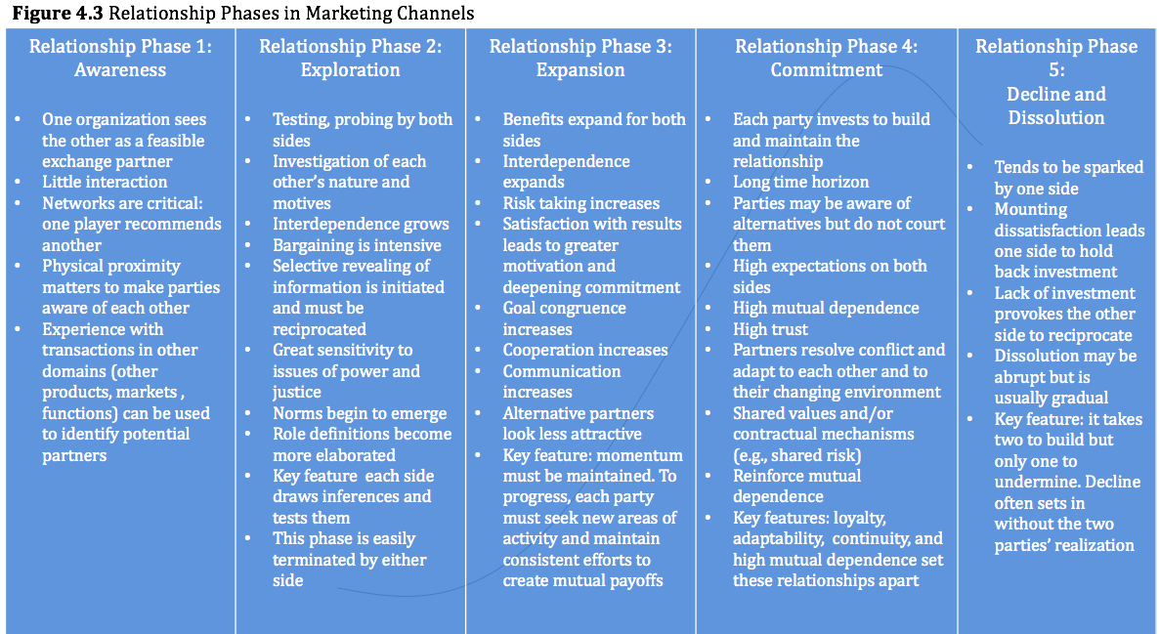

Slide 31
The Five Stages of a Channel Relationship
Stage 1: Awareness
Stage 2: Exploration
Stage 3: Expansion
Stage 4: Commitment
Stage 5: Decline to dissolution

Slide 32
Managing the Stages
Development takes time, particularly if the targeted partners do not currently do business together.
Relationships development rarely is as linear, orderly, and sequential as the 5 stages imply.
Relationship velocity offers a stronger predictor of performance than relationship level due to people’s propensity to use trend extrapolation as a decision heuristic.

Slide 33
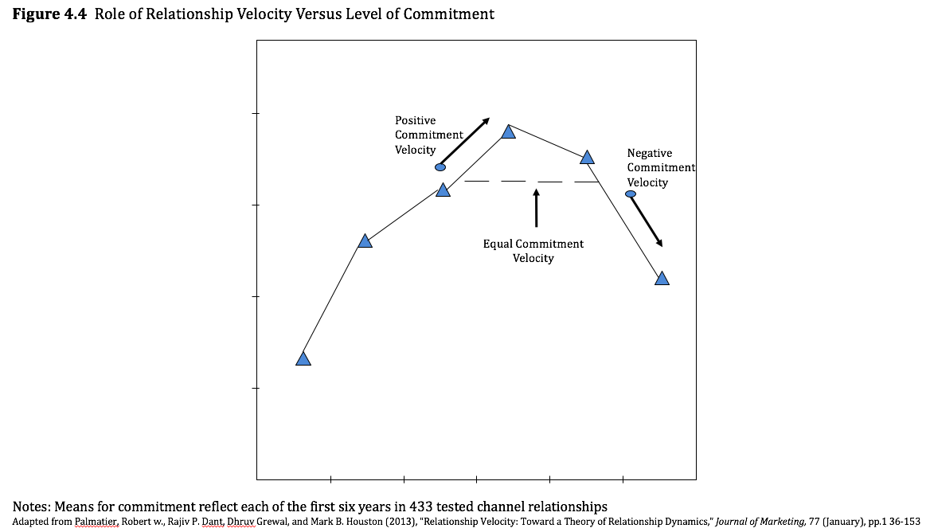

Slide 34
Managing Troubled Relationships
Relationships require maintenance.
In a common scenario, one partner might begin to suspect that the other partner is taking advantage of the spirit of their understanding and failing to live up to its promises.
In result: the relationship spirals downward, and performance declines.
Mutual idiosyncratic investments continue to perform or even increase, as well as relationships with congruent goals.

Slide 35
Relationship Portfolios
Manufacturers need a portfolio of downstream relationships to cover the market and meet multiple service output demands.
Downstream channel members need a portfolio of suppliers and brands to cover the assorted needs of their customers and prospects.

Slide 36
Relationship Quality
Relationship quality encompasses a range of variables that reflect the overall status of a relationship.
Relationship quality entails a combination of commitment, trust and satisfaction.
Increased presence and level of certain variables- such as commitment, satisfaction, and trust indicates that a relationship is on a strong footing.

Slide 37
Agenda
Learning objectives
Introduction
Building Channel Commitment
Building Channel Trust
The Channel Relationship Lifecycle
Multi-Channel Versus Omni-Channel Relationships
Take- Aways

Slide 38
Multi-Channel Versus Omni-Channel Relationships
Demands for seamless integration require the parties to commit at a deeper level, which may include relationship-specific investments.
We expect that in an omni-channel context, interdependence and commitment are greater than they would be in a multi-channel context.
Omni-channels serve different customer segments through different channels.
The consumer experience is heightened in omni-channels, and trust and commitment needs to be seamless.

Slide 39
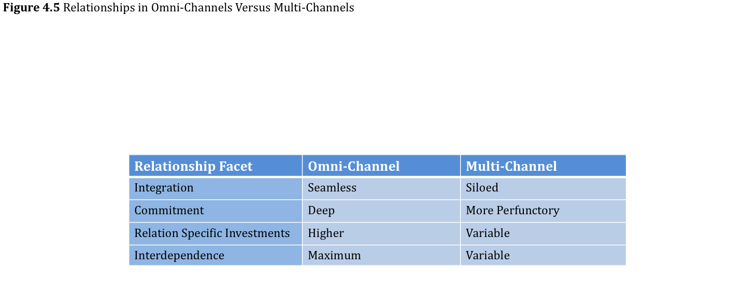

Slide 40
Agenda
Learning objectives
Introduction
Building Channel Commitment
Building Channel Trust
The Channel Relationship Lifecycle
Multi-Channel Versus Omni-Channel Relationships
Take- Aways

Slide 41
Take- Aways
A relationship channel partnership exists when two or more organizations have enduring, substantial connections that cause them to function according to their perceived single, shared interest.
Relationships serve both upstream and downstream needs to create enduring competitive advantages, leading to profits.
Relationships require an expectation of continuity, which grows with mutual communication, balanced power, and higher combined stakes of both parties.

Slide 42
Take- Aways
The foundation of a strong relationship is trust
Trust flourishes in response to satisfaction with noneconomic outcomes
Perceptions of procedural and distributive fairness supports trust, both directly and by enhancing non-economic satisfaction.
Economic satisfaction drives and results from relationships.
The move to omni-channel necessitates deeper relationships with greater trust and commitment amongst the parties.

