Slide 1
Chapter 1:
The Omni-Channel Ecosystem

Slide 2
Agenda
Learning Objectives
Introduction
Marketing Channel
Multi-Channel to Omni-Channel World
Trends Driving the Shift
Channel Strategy Framework
Take-aways

Slide 3
Learning Objectives
Define a go-to-market strategy.
Appreciate the importance of marketing channel management to a firm’s success.
Define an omni-channel strategy.
Articulate the differences between an omni-channel and a multi-channel strategy.
Identify and describe drivers and trends shaping the move to omni-channel strategies.
Outline the elements of a framework for omni-marketing channel design and implementation.

Slide 4
Agenda
Learning Objectives
Introduction
Marketing Channel
Multi-Channel to Omni-Channel World
Trends Driving the Shift
Channel Strategy Framework
Take-aways

Slide 5
Introduction
This book examines ways to design, modify, and maintain effective channel strategies and structures, in consumer goods markets and business-to-business markets, for both physical products and services, within nations and across country borders.
Focus on the 4P’s-
  Product
  Price
  Promotion
  Channel (Place)

Slide 6
Introduction
Marketers devote attention and energy to decisions on:
  Development
  Branding
  Promotion
  Prices
  Ability to make products/services
  When/where they want products

Slide 7
Introduction
Marketing Channel System- Compromised of inter- and independent organizations that work to go to market with a product or service, so that it is available for use or consumption.

Slide 8
Go-to-Market Strategy
Go-to-Market Strategy- The blueprint used to deliver the firm’s offerings to end-users in a manner that conforms to their preferred mode and method of buying.
Must know consumers buying preferences
  Information/Education before making purchasing decisions
  Services and after support they seek
  Expectations
  Willingness to pay for extras
  Delivery preferences
  Financing needs
  Mode of ordering they like best

Slide 9
Go-to-Market Strategy
There are 3 main steps to developing Go-to-Market Strategy
The firm can develop policies and procedures to incentivize and alter channel partners’ behaviors to motivate their efficient execution of channel tasks.
Firm must perform analysis of industry channel practices to isolate critical successful factors
Channel managers should identify areas of improvement in their practices

Slide 10
Go-to-Market Strategy Example
McDonalds
Chooses to franchise their restaurants.
82% of 36,000 outlets are franchised
Starbucks
Avoids franchising to have control over brand and customer in-store experience
Has branched out into college campuses, and airports as franchises as a go-to-market strategy in European markets.

Slide 11
EXAMPLE: FULFILLMENT BY AMAZON
Amazon offers a SErVICE for business clients called fulfillment by amazon (FBA).
Businesses can bulk ship their products to amazon who will store their product and then fulfill individual orders as they come in and provide customer support.
Businesses get access to amazon’s huge customer base and outsources many channel functions to amazon.

Slide 12
Agenda
Learning Objectives
Introduction
Marketing Channel
Multi-Channel to Omni-Channel World
Trends Driving the Shift
Channel Strategy Framework
Take-aways

Slide 13
What Is a Marketing Channel?
A Marketing Channel is defined as:
“The set of interdependent but in many cases independent organizations involved in the process of taking a product or services to market and making it available for use or consumption.”
Distributors, wholesalers, brokers, franchisees, and retailers all comprise a marketing channel system.

Slide 14
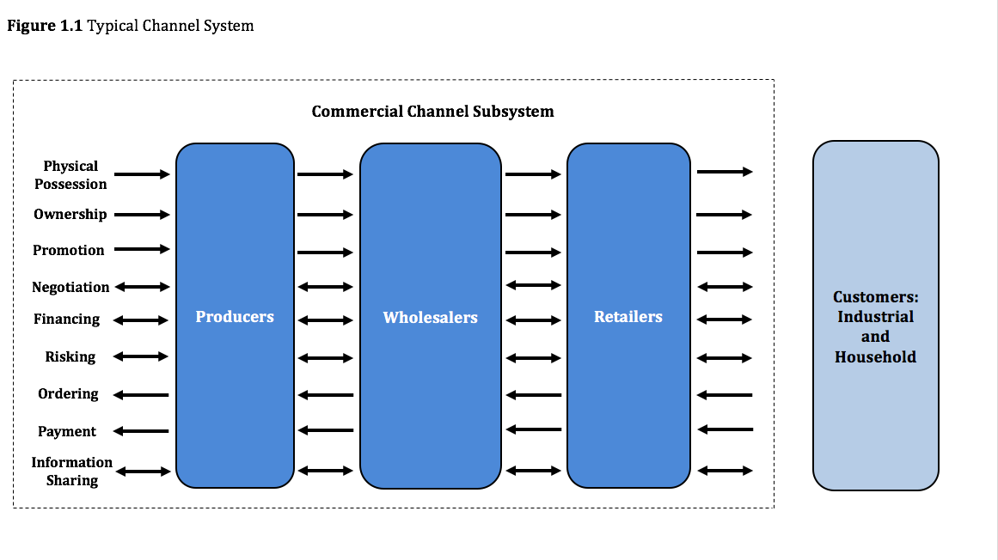
What Is a Marketing Channel?

Slide 15
Marketing Channel System
The end goal of any channel system is to make products and services available and easy for users to buy, in accordance with their preferences.
If firms fail to have a successful channel system, attractiveness to buyers will be limited, with negative effects on firms sales.

Slide 16
The Changing Channel Landscape
Technology advances significantly affect channel landscapes, manufacturers and retailers face new issues trying to keep up.
E-commerce, smartphones, and mobile technology has changed how consumers buy, and retailers like Sears, Macy’s, and JCPenney have suffered.

Slide 17
The Changing Channel Landscape
There are several reasons managers are vexed by altered channel landscapes
  Building or modifying a channel system involved costly, hard-to-reverse investments
  Modifying channels means confronting entrenched interests and the way things have always been done.
  To devote the considerable financial investments required and how to adjust the roles and compensation of different channel members.

Slide 18
Example: Best Buy’s Response to Online Threats (US)
BEST BUY IS FACED WITH THE THREAT OF BECOMING A SHOWROOM FOR ONLINE RETAILERS SUCH AS AMAZON. KEY ELEMENTS OF ITS STRATEGY INCLUDE CHARGING PRICES COMPARABLE TO THOSE OFFERED BY ONLINE VENDORS, TO MINIMIZE SHOWROOMING TENDENCIES.
  Best Buy partners with key vendors, such as Samsung that drive consumers to the store, because of brand loyalty.
  They invest heavily on training and knowledge on products, to create an omni-channel experience.

Slide 19
Marketing Channel Actors
3 key entities involved in every marketing channel
  Manufacturers, intermediaries (wholesale, retail, specialized), and end-users (business customers or customers).

Slide 20
1. The Manufacturer
The producer or originator of the product or service being sold
They can produce brand-name products.
  Ex: Coca-Cola, Mercedes-Benz, Sony
Or they can create private-label products
  Manufacturers make products but do not invest in a branded name for them.
  Ex: Multibar Foods Inc. is a private label and distributes their products to Dr. Atkins’ Nutritionals and Quaker Oats Co.
Is typically the “channel captain.”
  Takes most interest in the making of the channel for the product or service.

Slide 21
2. Wholesalers
Wholesalers sell to other channel intermediaries, such as retailers or to business end-users, not to individual consumer end-users.
They earn profits by buying at wholesale price and selling at a marked-up price to downstream customers, and pocket the difference.
Merchant wholesalers take title to and physical possession of:
  Inventory
  Store inventory
  Promote products in their line
  Arrange for financing, ordering, payment by customers

Slide 22
3. Retail intermediaries
Come in many forms:
  department stores
  mass merchandisers
  hypermarkets
  specialty stores
  category killers
  convenience stores
  franchises
  buying clubs
  warehouse clubs
  direct retailers, etc.
Can be B2C or B2B

Slide 23
4. Specialized Intermediaries
Enter the channel to perform a specific function
They are not typically heavily involved in the core business represented by the products being sold.

Slide 24
Specialized Intermediaries- Example
Mtime is China’s answer to Fandango, Rotten Tomatoes, and IMDb. China is predicted to overtake the United States as the world’s largest movie market, measured by box office revenues, relatively soon.
  Portals like Mtime are a primary source of news about Hollywood and celebrities. Mtime partnered with Dalian Wanda group to sell movie-themed merchandise in theaters. Mtime licenses products from Hasbro and Mattel, to sell through pop-up stores and its own online portal. There are 160 million visitors a month, and has been acquired by its partner, the Dalian Group for $350 million.

Slide 25
Online Channels
Known as e-commerce, e-tailing, online retailing, and internet channels.
Offer a form of direct retailing, such that the consumer uses an Internet-enabled device to order products or services through the internet and have them delivered.
Gives consumers the ability to shop where they want, when they want.
In 2016, online sales accounted for 8.1% of all retail sales, and is expected to grow at double-digit rates in the COMING years.

Slide 26
Example: Hollar- Taking the Dollar Store Online
Hollar is an online dollar store, created in 2015. The founders saw there was no online Dollar Store, so they created one.
80% of its traffic comes from customers using their mobile devices to find items commonly found in drug stores, at much lower prices. Many items cost $1, though the median price on Hollar is $5. The company has 2 million + active users.

Slide 27
Agenda
Learning Objectives
Introduction
Marketing Channel
Multi-Channel to Omni-Channel World
Trends Driving the Shift
Channel Strategy Framework
Take-aways

Slide 28
Multi-Channel to Omni-Channel World
Multi-Channel
Entails leveraging multiple channels that operate relatively independently
Operate as clearly separate entities
Consumers engage in cross-channel shopping by switching among online, mobile, and physical platforms during a transaction.
Omni-Channel
Harmoniously integrates functions that allow customers to shop- research, purchase, communicate, engage with, and consume the brand- across online, mobile, social and offline physical channels.
Channel arrangements help customers move seamlessly and however they choose, across multiple channels during a transaction.
Key difference: “consumer engagement” is central to omni-channel approaches; they explicitly seek customer experience through efforts that rely on social media, email, web links, mobile platforms, store visits, promotional efforts, etc.
What makes them different?

Slide 29
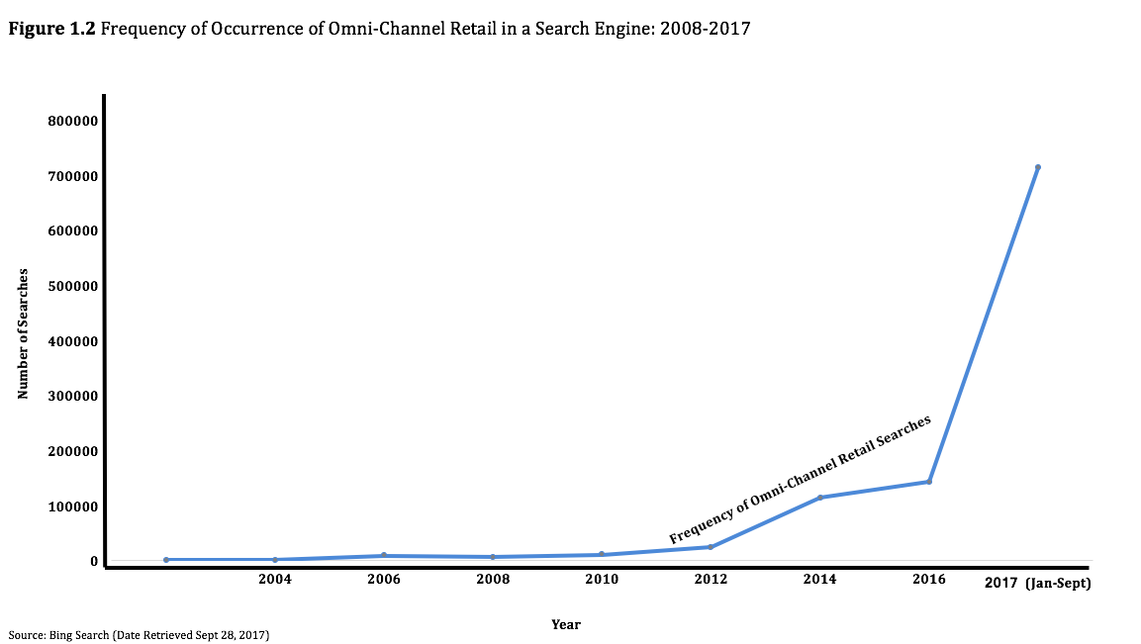
Multi-Channel to Omni-Channel World

Slide 30
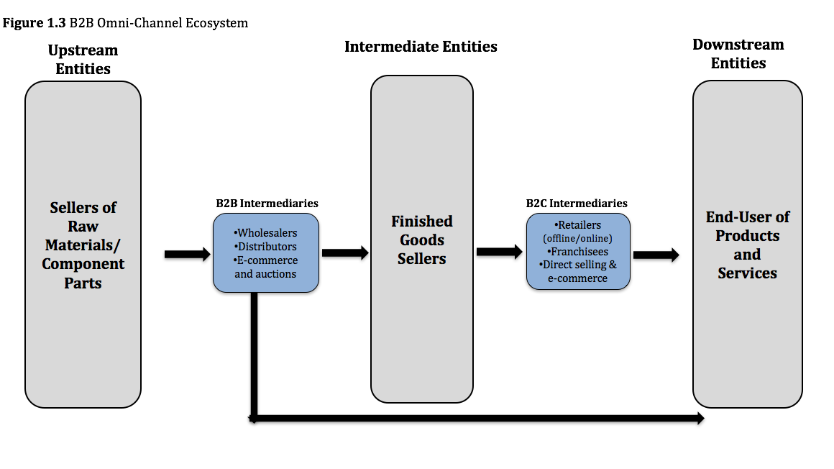
Multi-Channel to Omni-Channel World

Slide 31
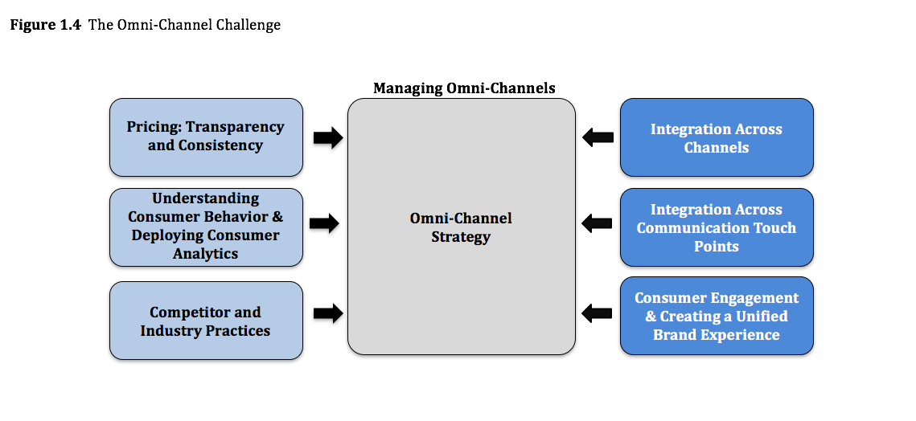
Multi-Channel to Omni-Channel World

Slide 32
Agenda
Learning Objectives
Introduction
Marketing Channel
Multi-Channel to Omni-Channel World
Trends Driving the Shift
Channel Strategy Framework
Take-aways

Slide 33
Trend 1: Channel Participants Operate in a Connected World
The Internet has vastly influenced people’s shopping behaviors.
  90% of Americans are online, 75% own a smartphone, and 75% have Internet access at home.
52% of U.S. consumers research home furnishings online prior to purchase. –Google Consumer Barometer report
A high level of interconnectivity means that consumers freely move across different channels, depending on their preferences at the time.

Slide 34
Trend 2: Cross-Channel Shopping
Consumers use their mobile phones in store to check and compare prices, brands, or products and might read reviews for advice.
  This showrooming phenomenon means that consumers visit physical stores to inspect products, but order online.
  This can lead to conflicts among upstream channel members because one firm is paying to get someone’s attention, but another firm will get the sale if it is for a better price.
The most common type of cross-channel is “webrooming.”
  Consumers research products online before purchasing them offline.

Slide 35
Trend 3: Altered Shopping Norms
The physical storefront continues to evolve and some retail futurists predict that stores may simply become showrooms with the ability to order the product they want, in store or online.
Marketers cannot control what consumers say, yet they can harness the power of social media as a platform for co-creating experiences and engaging with consumers.
A true omni-channel strategy integrates channels of communication as a key part of the channel system.

Slide 36
Trend 4: Move to Services
The intangible nature of services creates challenges for marketing channels
  Online channels have made it tough for industries such as travel and financial services.
  Disintermediation- the ability to remove or circumvent well-entrenched intermediaries from the marketing channel and its value chain.
The focus for service channels is to create customer engagement and customer value.
  Customization, co-creation

Slide 37
Trend 4: Move to Services
Example:
  Tesla Motors’ direct distribution model excludes traditional dealerships, because the company seeks to create a specific customer experience that goes beyond its product offer. The approach has prompted intense lobbying and legal action from advocacy groups and automobile associations though, which are seeking to avoid the fate of intermediaries like travel agents.

Slide 38
Trend 5: Targeted Promotions & Customer Insights
Targeted promotions delivered via email, online couponing, price matching, and social media advertising are all tools that leverage new mass communication promotional channels.
  Effectively harness customer relationship marketing to facilitate an omni-channel strategy
Ex: Walgreens and Foursquare partnering up on a social networking site that provides electric coupons to customers.

Slide 39
Trend 5: Targeted Promotions & Customer Insights
Many retailers have not fully developed their web pages, or e-stores to ensure optimal presentation on mobile and online devices.
  Sometimes mobile and online channels compete with each other.
Instead, omni-channel strategy requires that upstream and downstream channel members integrate their promotion, pricing, and brand positioning across all channels.

Slide 40
Agenda
Learning Objectives
Introduction
Marketing Channel
Multi-Channel to Omni-Channel World
Trends Driving the Shift
Channel Strategy Framework
Take-aways

Slide 41
Channel Strategy Framework
An ecosystem is an apt term to describe a firm’s go-to-market strategies and associated sales channels.
  Involves an all-encompassing, interconnected, complex network.
In a multi-channel world, firms rely on multiple routes to market.
In an omni-channel world, they must go further to develop framework that captures the flows of:
  Material, information, ownership, financing, promotion, and supporting services across the channels.
  Delivers a more curated and interactive brand experience.

Slide 42
Channel Strategy Framework
Omni-channel ecosystem- integrates domains that are often analyzed separately, namely, business-to-business (B2B) and channel intermediary domains.
  Applicable in both consumer and business markets.

Slide 43
Chapter Reviews
Chapters 2- how channels create value and provide solutions in an onmi-channel world
Chapter 3- Focuses on channel power and the ability to understand the sources of each channel.
Chapter 4- Further into ways to manage channel relationships
Chapter 5- The nature and types of channel conflict and how to measure it in channel relationships.
Chapter 6- Retailing
Chapter 7- Wholesaling

Slide 44
Chapter Reviews
Chapter 8- Franchising
Chapter 9- International Channels
Chapter 10- Focuses on end-user, similarities and differences
Chapter 11- Four pillars of an omni-channel strategy- harnessing customer knowledge, leveraging technology, managing channel relationships, assessing channel performance.

Slide 45
Channel Strategy Framework
Primary drivers to determine suitability of a given channel:
  Size of the customer and its buying preference.
  The sellers willingness and ability to interact through a certain channel
To earn business with larger customers, suppliers might deploy and in-house direct sales force, reflecting the size of their order and demand.
Although firms can go through wholesalers, e-commerce, agents, and brokers to get supplies, most omni-channel research tends to focus on business-to-consumer contexts.
Omni-channel demands pricing transparency and consistent pricing across channels or even globally.

Slide 46
Agenda
Learning Objectives
Introduction
Marketing Channel
Multi-Channel to Omni-Channel World
Trends Driving the Shift
Channel Strategy Framework
Take-Aways

Slide 47
Take-Aways
Marketing channels are a set of interdependent organizations involved in the process of making a product or service available for use of consumption
Firms have to come up with blueprints to deliver the firms offerings to the end-user in a manner tat conforms to their preferred mode and method of buying and is efficient, cost-effective, and has competitive advantage.
9 key channel functions: physically possession, ownership, promotion, negotiation, financing, risking, ordering, payment, and information sharing.
Technology advances are changing the channel landscape and altering how end-users buy.

Slide 48
Take-Aways
The focus is moving from multi-channel to omni-channel strategy
Key players in a channel system include: manufacturers’ who are upstream channel members, intermediaries like wholesalers, retailers, end-users who are the downstream channel members.
Key distinction of multi vs. omni-channel is that omni captures the notion of customer engagement in its DNA.
Trends driving migration of omni-channels are that consumers live in a connected world where they engage in cross-channel shopping.

Slide 49
Take-Aways
We view channel strategy as operating in an ecosystem.
Key to an omni-channel strategy is to integrate across channels and consumer touchpoints to create a transparent, seamless, and unified brand experience for the end-user.

