Slide 1
The Intelligent Marketer’s Guide to Data Privacy
The Impact of Big Data on Customer Trust
ROBERT W. PALMATIER
& KELLY D. MARTIN

Slide 2
Classroom uses for this book
In its entirety….
As a standalone lecture…
To accompany a data analytics class throughout the term
Incorporate discussion of ethics and privacy as ongoing supplement to the course
Book’s practical strategies and constraints can augment tools learned in class
In a marketing principles, marketing strategy, or other marketing survey course
In a digital marketing, marketing and society, or marketing and public policy course
In an IT applications course to bring in themes of privacy and a marketing-customer perspective

Slide 3
Why this book?
Marketing faces unprecedented tensions from “big data”
Reliance on data applications to glean customer insights, personalize customer experience, provide customized offerings
Harnessing data’s insights in a way that respects customer privacy, cautions against customer data as an unwitting profit source
New marketing tools (data and analytics) for reaching customers can have unintended customer consequences
Privacy is not just an IT issue or a legal issue
Customers and customer relationships are affected
Yet, few comprehensive accounts investigate data privacy from the customer’s perspective

Slide 4
Data Privacy: Why Does it Matter?
Research finds customers want better data privacy protections
Polling data shows data privacy is a significant source of worry
One of the only issues Democrats (66%) and Republicans (68%) agree on: People want more control of their personal information
Current marketing practices and data uses make people feel vulnerable
Privacy paradox is no excuse. Evidence shows people do not understand how to adequately protect themselves online
Pressure is increasing for companies to do more

Slide 5
Example: A Company Doing More
Principles of notice and consent are bare minimum
Walmart embodies a customer-focused data privacy culture
Technology outpaces regulations; Therefore Walmart is proactive in anticipating threats to customer privacy
Walmart monitors the technological landscape
Questions how new applications fit with the company’s guiding value of respect for individuals
All practices viewed against goal of being most trusted retailer
Walmart practices privacy-by-design, or embedding privacy into applications and practices as they are created
Source: Best of MSI Webinar Series (2018), Jonathan Avila, Vice President and Chief Privacy Officer, Walmart

Slide 6
Psychology of Privacy
Public opinion research shows people overwhelming want greater privacy protections
People feel more vulnerable regarding personal information than ever before
Sense of privacy is considered fundamental to the human psyche; Ability to attain privacy enables a sense of balance and harmony
Most models to investigate the psychology consumer privacy are highly rational, to the detriment of understanding how people really behave

Slide 7
Example: Helsinki Privacy Experiment
Study designed to understand psychological effects of ubiquitous surveillance
Researchers equipped 10 volunteers’ households with cameras, including video and audio, device tracking, smart sensors, and keystroke capturing technologies
Initial strong negative reactions, psychological distress by participants; However, these subsided after two weeks
Although seven participants reported seeking privacy and altering behavior, three reported no privacy seeking and that ubiquitous surveillance became a normal part of life
Source: Oulasvirta et al. (2012), “Long-term Effects of Ubiquitous Surveillance in the Home,” UbuComp’ 12, 41-50.

Slide 8
Psychology of Privacy
People dislike feeling vulnerable; This is a better way to understand customer thinking than ideas about privacy
Vulnerability can occur in several ways:
Data Access Vulnerability: Company has customer’s personal information
Data Breach Vulnerability: A company the customer uses experiences a data breach
Spillover Vulnerability: A close competitor of a company a customer uses experiences a data breach, making vulnerability salient
Data Manifest Vulnerability: Customer data are actually misused, causing personal harm (e.g., identity theft, fraudulent transactions or accounts)
Being transparent about information being collected and giving customers some control are effective ways to reduce vulnerability

Slide 9
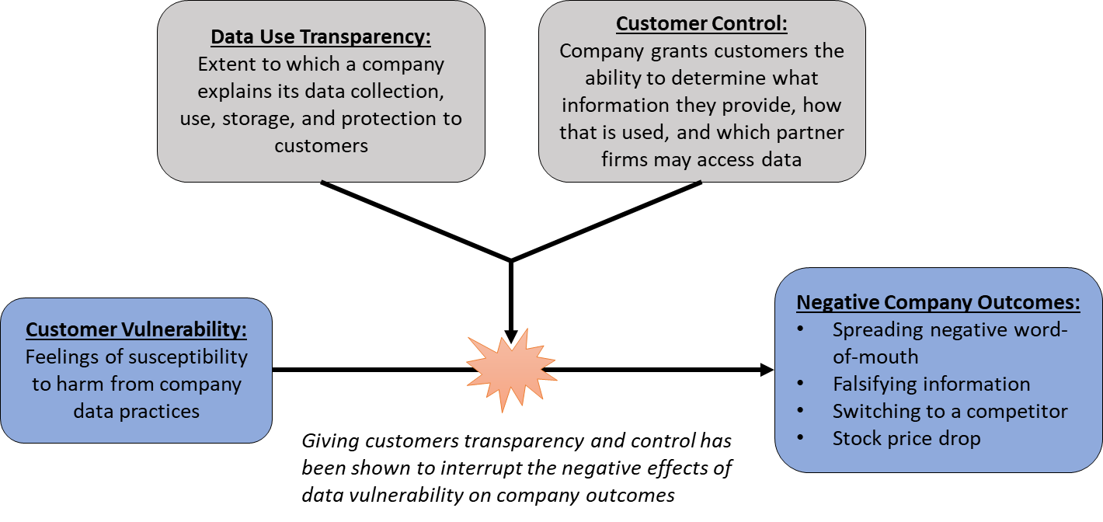
Interrupting Customer Vulnerability
Source: Martin, Borah, and Palmatier (2017), “Data Privacy: Effects on Customer and Firm Performance,” Journal of Marketing, 81 (1), 36-58.

Slide 10
The Changing Privacy Legal Landscape
U.S. privacy laws relies on principles of notice and choice
For example, on a website it is assumed the first thing a visitor does is read the company privacy policy (notice) and then choose whether it adequately protects personal data (choice).
Formal U.S. privacy laws resemble a patchwork of regulations that apply in specific contexts (e.g., healthcare) or to specific populations (e.g., children)
EU regulation in the form of GDPR (enacted May 2018) prevents companies from processing an EU resident’s information without a legal basis
Has implications for ANY company doing business in the EU, and thus has affected the U.S. privacy landscape

Slide 11
Example: Whats App Regulatory Troubles
Acquired by Facebook in 2014 for $19 billion
Facebook promises no automated machine matching between user accounts; Whats App personal data to remain private
Whats App promises users nothing will change; “No ads! No games! No gimmicks!”
In 2016, Whats App changed privacy policy and gave users a choice: Agree to share personal data with Facebook or stop using the app
UK Information Commission halts data sharing agreement; Mandates Facebook wait until GDPR takes effect (May 2018) and fully comply before any sharing is allowed

Slide 12
Understanding Big Data’s Benefits…
Seamless customer experience that enhances personalization and reduces effort
Capacity for unprecedented value co-creation between companies and customers that can spur radical innovation
Solving significant global challenges in new, interconnected ways
Enhanced productivity and cost reduction to benefit companies and customers

Slide 13
…as Well as Big Data’s Challenges
Drawbacks of customization that gets too personal; Micro-targeting can induce customer feelings of creepiness
Self-reinforcing cycle from micro-targeting can prevent customers from being exposed to new products, services, and ideas
Customer alienation risks (e.g., poor performing customers excluded from options or funneled to less-desirable services)
Growing backlash against data monetization puts companies that are dependent on it as revenue stream at risk

Slide 14
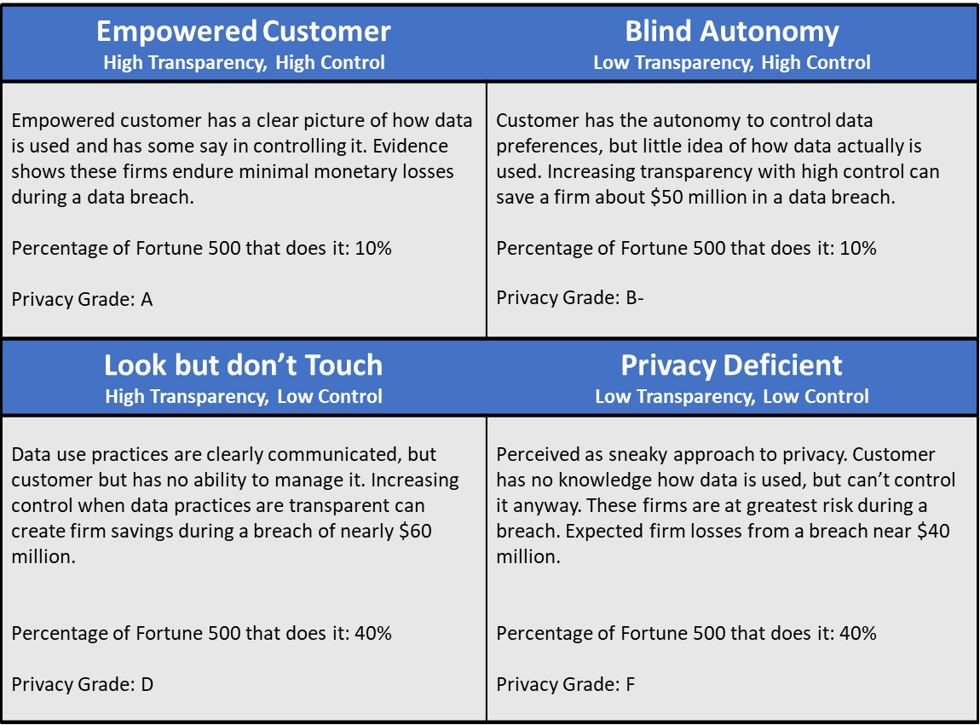
Privacy Scorecard: Who is Best Protected?

Slide 15
Inoculating Against Customer Vulnerability
Data breaches have become commonplace among U.S. business—no company is safe
Companies can experience significant harm when a close competitor is breached…even if the focal firm is not
For these reasons, companies should:
Practice data minimization, using only customer data absolutely necessary to deliver superior products, services, and experience
Embrace a customer-learning culture in favor of a data-driven culture
Empower customers with transparency and control

Slide 16
Privacy Failures Happen…So What?
Data breaches are another form of an organizational crisis
Managers should have a recovery plan in place to quickly respond to a data breach
First do no harm…the company should adopt a customer benevolence approach in everything it does
Learning from the medical field in how to best convey a negative, and uncertain diagnosis offers most relevant insights to data breach
Recovery strategy can implicitly convey breach severity

Slide 17
Effective Data Breach Recovery
Consider the context; Breaches at financial service firms and healthcare providers make people feel most vulnerable
Companies should tell customers quickly and directly; Learning about a breach via news media heightens vulnerability and anger
Having the CEO or other high-level authority figures convey the news can unnecessarily increase customer worry
When companies apologize for the breach and offer some form of protective compensation (i.e., credit monitoring service) it reduces harm and minimizes customer defection

Slide 18
How Bad is It? Sources of Data Breach Severity

Slide 19
Understanding and Valuing Customer Data
Firms extract value from data in the following ways:
Enhance product and service offerings
More precisely target advertising
Monetize by selling to a third-party
Primary sources of data include:
Customer information from loyalty program membership
Customer account formation (not necessarily for loyalty purpose)
Other public sources of data
Because companies glean value from their customers’ data, a framework for sharing value and fairly compensating customers is critical

Slide 20
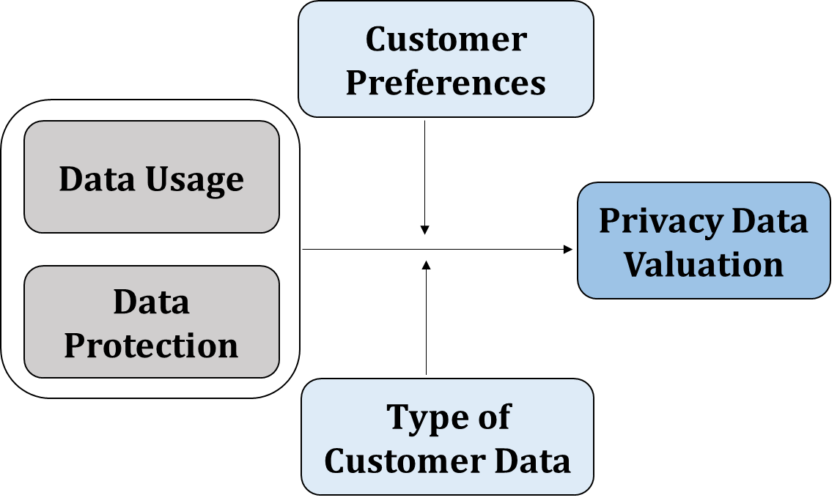
Customer Privacy Valuation Framework

Slide 21
Data Privacy Marketing Audit
Companies should use rigorous, systematic approach to understand how they manage their customers’ data privacy
A Data Privacy Marketing Audit uses six key steps to deeply appreciate the company’s strengths and weaknesses related to their data privacy practices
Metrics derived from an audit should be used to continually track progress and monitor the company’s practices to guard against threats

Slide 22
Data Privacy Marketing Audit
1. Benchmark Privacy Marketing Practices
Company performance compared to competitors, industry leaders, and other exemplars
Examine data collection, use, storage
Compliance with regulations
Evaluate privacy policy as well as use of customer transparency and control
Consider data breach recover plan
Performed in conjunction with (yet still separate from) IT and legal privacy audits

Slide 23
Data Privacy Marketing Audit
2. Gauge Customer Perspectives
Different techniques and approaches will be required
Qualitative interviews and focus groups with current and potential customers
Analyze internal customer information via complaints, lost customer analysis, social media activity
Large-scale online customer survey created from insights gleaned in qualitative and internal customer analyses

Slide 24
Data Privacy Marketing Audit
3. Regulatory and Legal Perspectives
Understand basic legal requirements to exceed such practices
Focus on law as baseline for building strong customer relationships and facilitating loyalty by going above and beyond
4. Gauge the Employee Perspective
Employees are on the front lines of managing privacy practices and fielding customer concerns
Qualitative interviews and focus groups start the process
Analyze internal company data, large employee surveys
Seek employee input for best practices

Slide 25
Data Privacy Marketing Audit
5. Data Privacy Marketing SWOT
Each element evaluated using a customer-centric approach
Unbiased perspective to identify best practices and gaps
Anticipate trends
Guidelines for allocating resources
6. Formulate Objectives, Strategies, and Action Plans
SWOT informs creation of specific goals and strategies
Stipulates how company will achieve customer-centric privacy objectives
Dynamic to account for regulatory, customer, or competitor changes
Specify clear success metrics

Slide 26
Data Privacy Metrics
Social Media Sentiment
Customer Data Incidents
Privacy Policy Violations
Lost Customers
Customer Trust
Financial Impact
Customer Privacy-Related Complaints
Customer Data Vulnerability
Customer Willingness to Share Data
Time to Initiate Response
Percentage of Staff Receiving Privacy Training

Slide 27
Tenets for Effective Privacy Marketing
Tenet #1: Avoid Customer Data Vulnerability | Tenet #4: Preempt Privacy Regulations
Practice Data Minimization | Anticipate Global Consumer & Legislative Trends
Empowerment with Transparency & Control | Develop Simple & Customer-Centric Policies
Tenet #2: Balance Big Data and Privacy | Tenet #5: Recover from Data Breaches
Keep Targeting from Appearing Creepy | Apology
Build Trust and Strengthen Relationships | Protective Compensation
Tenet #3: Share Data Value | Tenet #6: Audit for Knowledge
Fairness is Key | Create a Privacy Scorecard
Guarding Data Helps | Identify and Track Privacy Metrics

Slide 28
…and find us on Amazon The Intelligent Marketer’s Guide to Data Privacy
Questions? Contact us:
Robert W. Palmatier
Kelly D. Martin

